Slide 1
Machine Learning HW5
BERT - Ǫuestion Answering

Slide 2
Colab Link:
[Link]
Outline
Task Introduction
Grading
Tutorial
Hints
Regulations
Kaggle Link:
https://www.kaggle.com/t/5d1e5f86f3f848788479177ce9e4cfb3
Deadline:
Kaggle:
Code and Report: No Late Submission!
2023/5/18 23:59
2023/5/21 23:59

Slide 3
1. Task Introduction

Slide 4

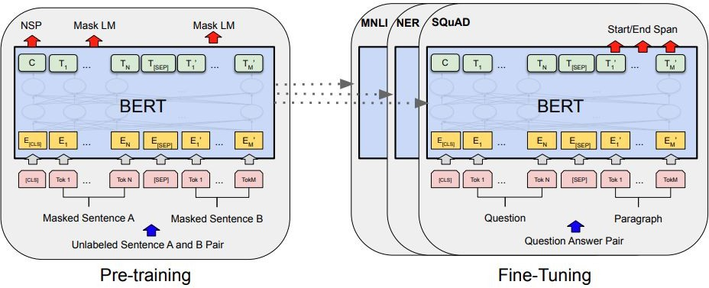
BERT
https://arxiv.org/abs/1810.04805

Slide 5
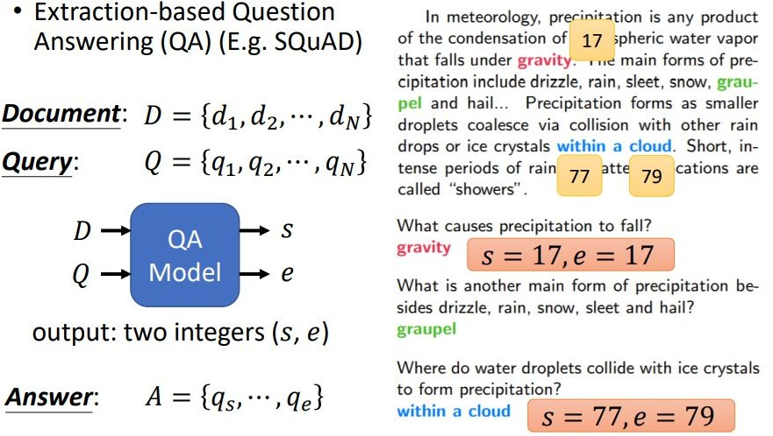
Task: Extractive Ǫuestion Answering

Slide 6
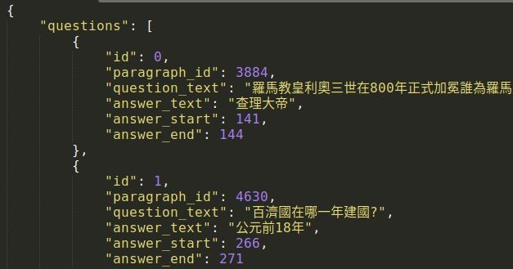
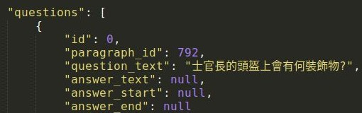
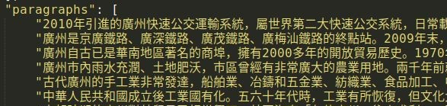
Dataset: Chinese Reading Comprehension
Testing:
No answer!

Slide 7
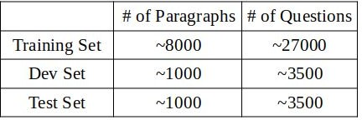
Dataset: Chinese Reading Comprehension
Paragraph
新加坡、馬來西亞的華文學術界在 1970年代後開始統一使用簡體中文；然而 繁體字在媒體中普遍存在著，例 如華人商店的招牌、舊告示及許多非學術類中文書籍，香港和臺灣所出版的書籍也有在市場上流動。當地許 多中文報章都會使用「標題繁體字， 內容簡化字」的方式讓簡繁中文並存。除此之外，馬來西亞所有本地中文 報章之官方網站都是以繁體中文為主要文字。
Question: 新加坡的華文學術界在哪個年代後開始使用簡體中文 ?
Answer:
1970
Question:
Answer:
馬來西亞的華人商店招牌主要使用什麼文字 ?
繁體字

Slide 8
2. Grading

Slide 9
Grading
Upload Code to 數位學苑 | +4pts
Simple Baseline (Public) | +1pt
Simple Baseline (Private) | +1pt
Medium Baseline (Public) | +1pt
Medium Baseline (Private) | +1pt
Strong Baseline (Public) | +0.5pt
Strong Baseline (Private) | +0.5pt
Boss Baseline (Public) | +0.5pt
Boss Baseline (Private) | +0.5pt
Report Bonus | +0.5pt

Slide 10
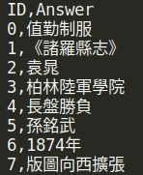
Kaggle Link:
https://www.kaggle.com/t/5d1e5f86f3f848788479177ce9e4cfb3
Kaggle (6pts)
Deadline: Displayed name: Testing Set: Evaluation Metric:
5/18 23:59
<student ID>_<科系英文縮寫>_<anything>
3493 Questions (~50% public set, ~50% private set)
Accuracy (Exact Match) Submission Format: (csv)
Baselines | Public Score
Simple (1pt + 1pt) | 0.45000
Medium (1pt + 1pt) | 0.67600
Strong (0.5pt + 0.5pt) | 0.76200
Boss (0.5pt + 0.5pt) | 0.78600

Slide 11

Code Submission (4pts)
數位學苑
Deadline: 5/21 23:59
Compress your code and report into
We can only see your last submission.
<student ID>_hw5.zip（e.g. 711183116_hw5.zip）
Do not submit your model or dataset.
If your code is not reasonable, your semester grade x 0.9.
Your .zip ﬁle should include only
Code: either .py or .ipynb
Report: .pdf (only for those who got 10 points)
Report template
hw7.ipynb

Slide 12
3. Tutorial

Slide 13
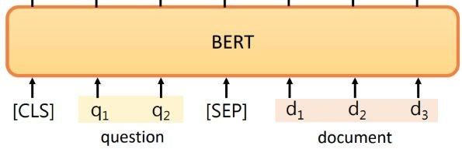
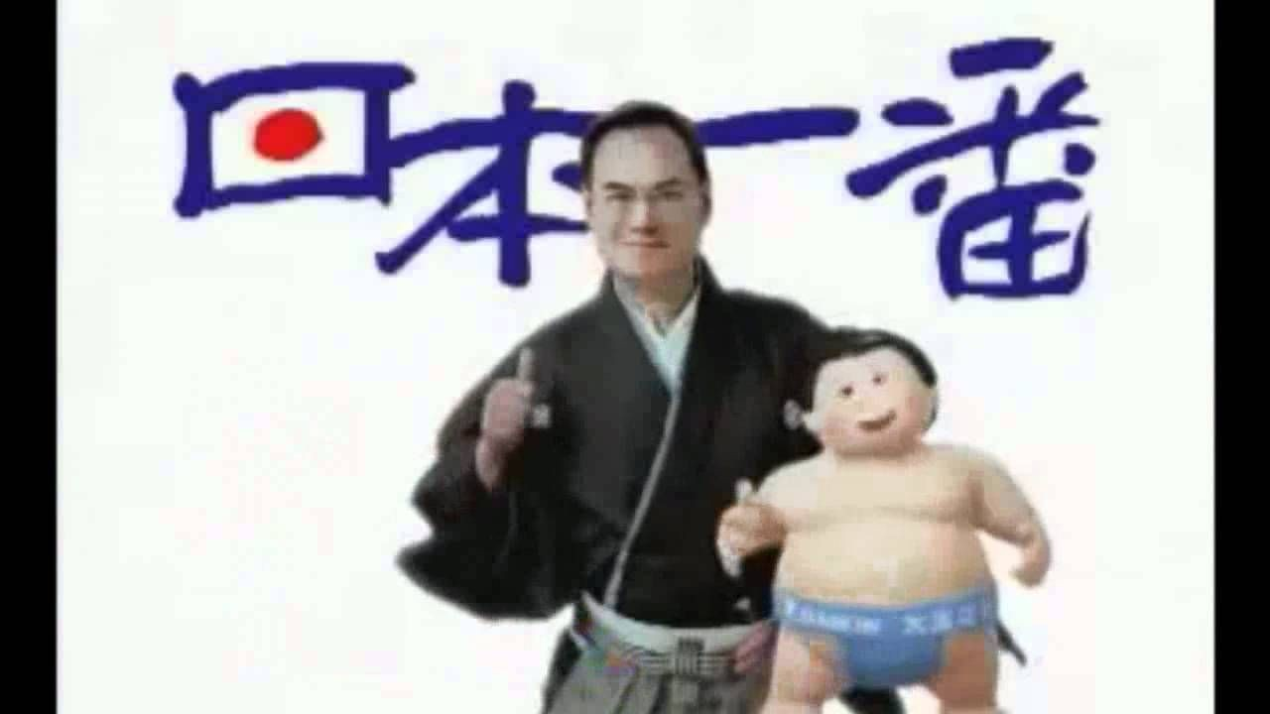
A toy example
[Link to Demo]
Toy Example
文章： 李宏毅幾班大金。 題目： 李宏毅幾班？
答案： 大金
Paragraph: Question: Answer:
Jeanie likes Tom because Tom is good at deep learning. Why does Jeanie like Tom?
Tom is good at deep learning

Slide 14
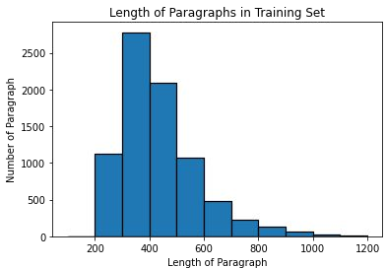
Why Long Paragraph is an Issue?
Total sequence length = question length + paragraph length + 3 (special tokens)
Maximum input sequence length of BERT is restricted to 512, why?
Self-Attention in transformer has complexity
Therefore, we may not be able to process the whole paragraph. What can we do?

Slide 15
Training
We know where the answer is in training!
Assumption:
Simple solution:
Info needed to answer the question can be found near the answer!
Just draw a window (as large as possible) around the answer!
e.g. window size = max_paragraph_len = 32
新加坡、馬來西亞的華文學術界在 1970年代後開始統一使用簡體中文；然而 繁體字在媒體中普遍存在著，例如 華人商店的招牌、舊告示及許多非學術類中文書籍，香港和臺灣所出版的書籍也有在市場上流動 ...
Q: 新加坡的華文學術界在哪個年代後開始使用簡體中文 ? A: Q: 馬來西亞的華人商店招牌主要使用什麼文字 ? A:
1970
繁體字

Slide 16
Testing
We do not know where the answer is in testing
e.g. window size = max_paragraph_len = 32
split into windows!
新加坡、馬來西亞的華文學術界在 1970年代後開始統一使用簡體中文；然而 繁體字在媒體中普遍存在著，例 如華人商店的招牌、舊告示及許多非學術類中文書籍 ......
Q: 新加坡的華文學術界在哪個年代後開始使用簡體中文 ? A: Q: 馬來西亞的華人商店招牌主要使用什麼文字 ? A:
1970
繁體字
For each window, model predicts a start score and an end score
take the maximum to be answer!
 | start score | start position | end score | end position | total score
window 1 | 0.5 | 23 | 0.4 | 26 | 0.9
window 2 | 0.3 | 35 | 0.7 | 37 | 1.0
Answer:
position 35 to 37

Slide 17
4. Hints

Slide 18
Hints for beating baselines
Estimated training time
Simple:
Sample code
Medium:
Apply linear learning rate decay
Change value of “doc_stride”
Strong:
Improve preprocessing
Try other pretrained models
Boss:
Improve postprocessing
Further improve the above hints
 | K80 | T4 | T4 (FP16) | V100
Simple | 40m | 20m | 8m | 7m
Medium | 40m | 20m | 8m | 7m
Strong | 2h | 1h | 25m | 20m
Boss | 10h | 5h | 2h | 1h30m
Training Tips (Optional):
Automatic mixed precision (fp16)
Gradient accumulation
Ensemble

Slide 19
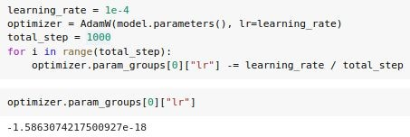
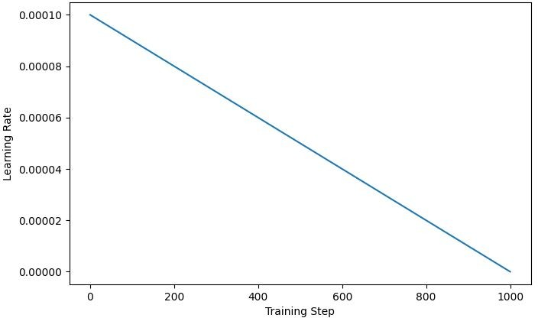
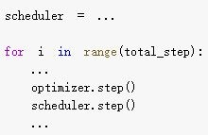
Linear Learning rate decay
Method 1: Adjust learning rate manually
Decrement optimizer.param_groups[0][“lr”] by learning_rate / total training step per step
Decrement learning rate to zero linearly
This block is only an example! You only need to add 1 or 2 lines
Check whether learning rate after training is very close to zero
Adjust learning rate automatically by scheduler
Method 2:
huggingface (Recommended)
pytorch
Link Link
You may also try other learning rate schedules (e.g. warmup)!
You only need to add 3 or 4 lines

Slide 20

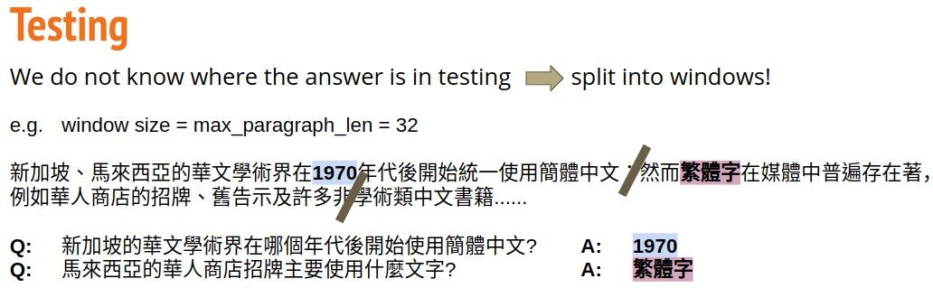
Doc stride
start position of 2nd window
doc_stride = distance between the start position of two consecutive windows
start position of 1st window
doc_stride is set to “max_paragraph_len” in sample code (i.e. no overlap) What if answer is near the boundary of windows or across windows?
Hint: Overlapping windows
註：影片中「翻倍」有機會為口誤

Slide 21
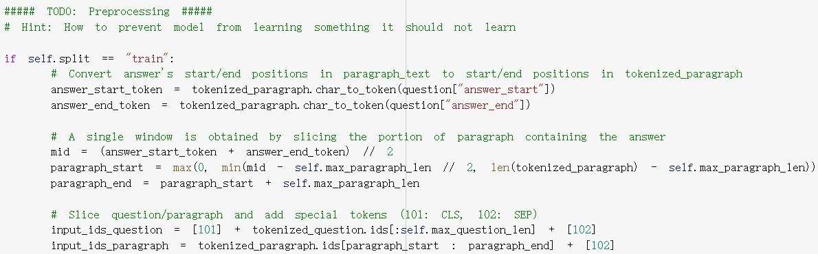
Preprocessing
Hint:
How to prevent model from learning something it should not learn during training? (i.e. answers are not always near the middle of window)

Slide 22

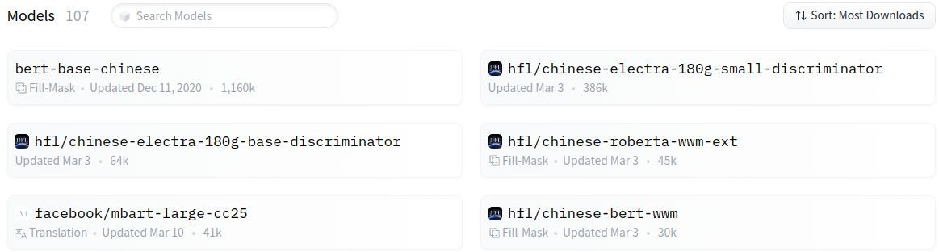
Other pretrained models
You can choose any model you like! [Link to pretrained models in huggingface]
Note 1:
You are NOT allowed to use pretrained models outside huggingface! (Violation = cheating = ﬁnal grade x 0.9)
Some models have describing details of the model
Changing models may lead to error message, try it solve it yourself
Note 2:
Note 3:

Slide 23
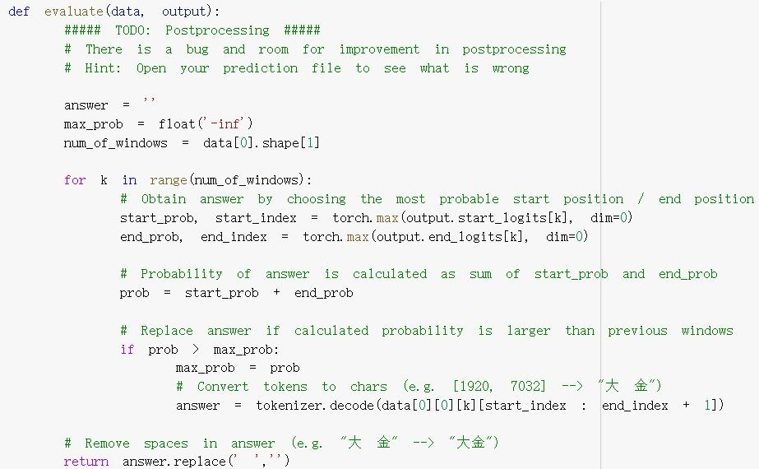
Postprocessing
Hint:
Open your prediction ﬁle to see what is wrong
(e.g. what if predicted end_index < predicted start_index?)

Slide 24
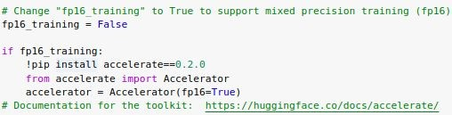

Training Tip: Automatic mixed precision
PyTorch trains with 32-bit ﬂoating point (FP32) arithmetic by default
Automatic Mixed Precision (AMP) enables automatic conversion of certain GPU operations from FP32 precision to half-precision (FP16)
Oﬀer about 1.5-3.0x speed up while maintaining accuracy
Estimated training time
 | T4 | T4 (FP16)
Simple | 20m | 8m
Medium | 20m | 8m
Strong | 1h | 25m
Boss | 5h | 2h
Warning: only work on some gpu (e.g. T4, V100)
accelerate documentation
Intro to native pytorch automatic mixed precision
Reference:

Slide 25
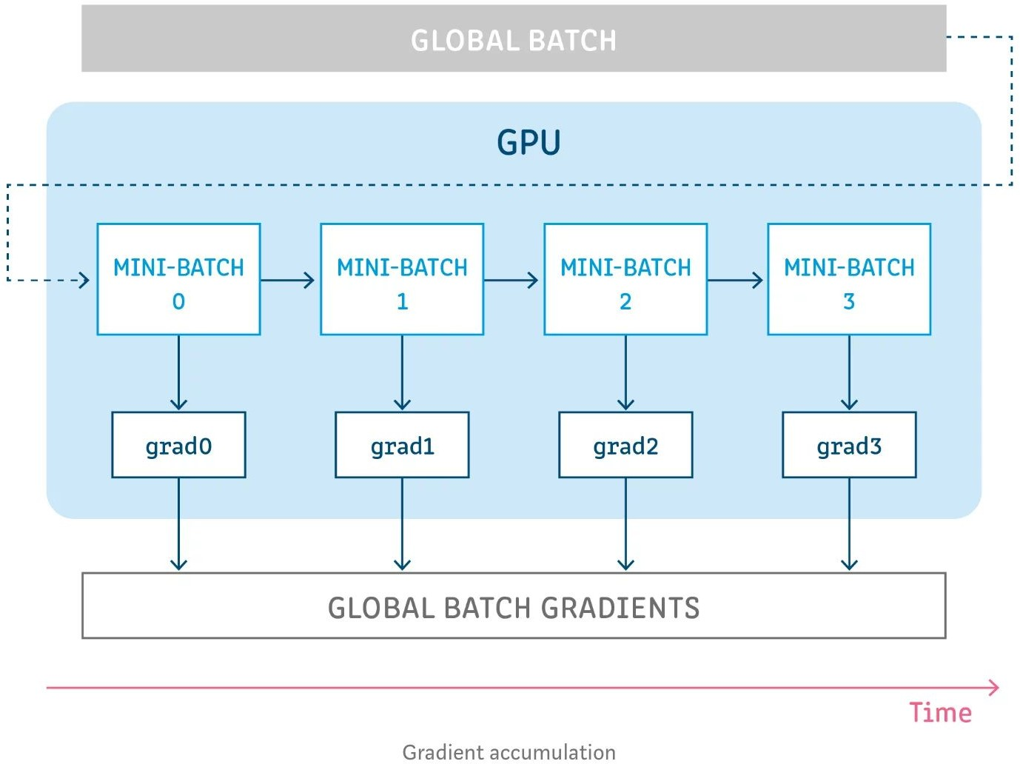

Training Tip: Gradient accumulation
Use it when gpu memory is not enough but you want to use larger batch size
Split global batch into smaller mini-batches
For each mini-batch: Accumulate gradient without updating model parameters
Update model parameters
Reference:
Gradient Accumulation in PyTorch

Slide 26
5. Regulations

Slide 27
Regulations
You should NOT plagiarize, if you use any other resource, you should cite it in the reference. (＊)
You should NOT modify your prediction ﬁles manually.
Do NOT share codes or prediction ﬁles with any living creatures.
Do NOT use any approaches to submit your results more than 5 times a day.
Do NOT search or use additional data.
Do NOT use any pre-trained models outside huggingface.
Your ﬁnal grade x 0.9 if you violate any of the above rules.
Prof. Lee & TAs preserve the rights to change the rules & grades.
(＊) Academic Ethics Guidelines for Researchers by the Ministry of Science and Technology

Slide 28
If any questions, you can ask us via...
Email
kafuchino0410@gmail.com
The title must begin with “[ml_hw5]”

