Slide 1
Machine Learning Homework 6 Anomaly Detection

Slide 2
Goal
Unsupervised anomaly detection in computer vision: Whether a machine learning model is able to tell a testing image is of the same class (distribution) as the training images

Slide 3


Goal
Unsupervised anomaly detection in computer vision: Whether a machine learning model is able to tell a testing image is of the same class (distribution) as the training images
Training
Model

Slide 4


Goal
Unsupervised anomaly detection in computer vision: Whether a machine learning model is able to tell a testing image is of the same class (distribution) as the training images
Training
Testing
Model
Seen
Normal
Model

Slide 5


Goal
Unsupervised anomaly detection in computer vision: Whether a machine learning model is able to tell a testing image is of the same class (distribution) as the training images
Training
Testing
Model
Seen
Normal
Model
Unseen Anomaly
Model

Slide 6
Data
Trainingset: About 140k human faces (size 64*64*3)
Testingset: Another 10k data from the same distributions as the trainingset (normal data, of class label 0) along with 10k human face images from the other distributions (anomalies, of class label 1)
Notice: Additional training data and pretrained models are prohibited
Data format: tar zxvf data-bin.tar.gz
data-bin/
trainingset.npy
testingset.npy

Slide 7
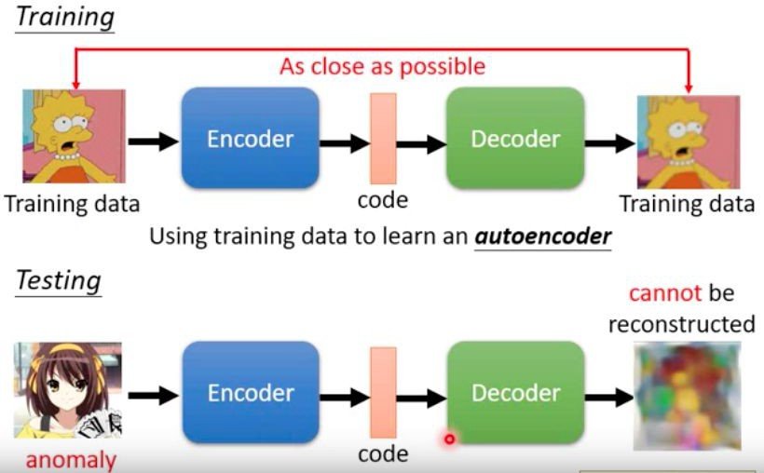
Method - Autoencoder

Slide 8
Autoencoder
When to stop training? Training should stop when the mse loss converges
During inference, we calculate the reconstruction error between the input image and the reconstructed one
The reconstruction error will be referred to as abnormality (anomaly score)
The abnormality of an image can be a metric of the possibility that it’s distribution is unseen during training
Therefore we use the abnormality as our predicted values

Slide 9
Accuracy score
Usually we compute accuracy scores for classiﬁcation tasks
Here, our model functions as a sensor (or a detector) rather than a classiﬁer
Thus, we need a threshold with respect to abnormality (usually the reconstruction error) to determine whether a piece of data is an anomaly
If we used accuracy score for this assignment, you would have to try every possible threshold for one single model to get a satisfactory score
However, what we want is a sensor that gets the highest accuracy on the average of every possible threshold

Slide 10
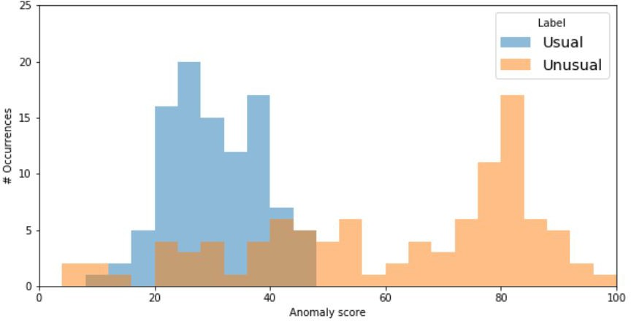
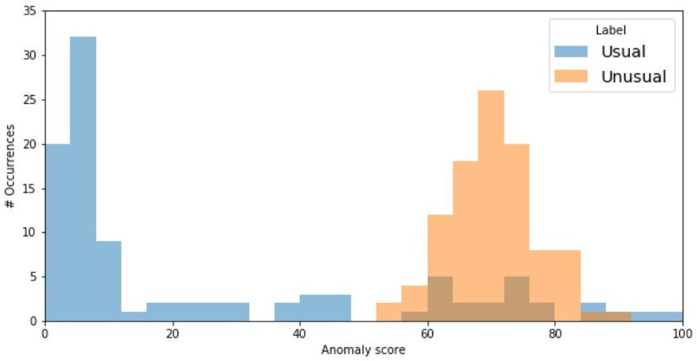
Which sensor is better?

Slide 11
Metric - ROC_AUC score
A good sensor should
Give high anomaly scores to the anomalies and low scores to the normal data
Exhibit a large gap between the scores of 2 groups
An ROC is suitable for our task
Each point on the ROC curve stands for true positive rate and false positive rate at certain threshold
The Area Under the ROC curve is calculated to measure the general ability of the model

Slide 12
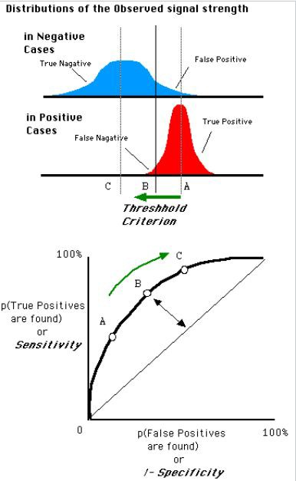
ROC_AUC score
https://en.wikipedia.org/wiki/Receiver_operating_characteristic

Slide 13
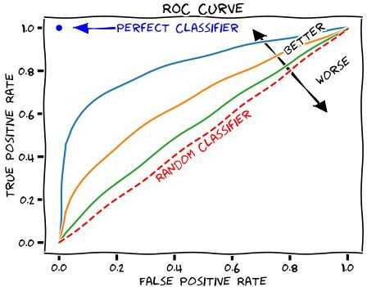
ROC_AUC score
https://en.wikipedia.org/wiki/Receiver_operating_characteristic

Slide 14
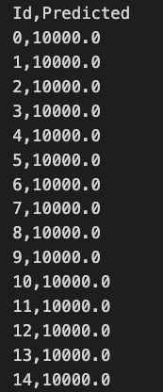
Kaggle
Metric: ROC_AUC score Sample output:

Slide 15
How ROC AUC is calculated
ID | Anomaly score | Label
0 | 11383 | 0
1 | 256676 | 1
2 | 862365 | 1
3 | 152435 | 0
4 | 848171 | 0
Sort by score
ID | Anomaly score | Label
2 | 862365 | 1
4 | 848171 | 0
1 | 256676 | 1
3 | 152435 | 0
0 | 11383 | 0
https://towardsdatascience.com/how-to-calculate-use-the-auc-score-1fc85c9a8430

Slide 16
How ROC AUC is calculated
ID | Anomaly score | Label | fp before normalization | tp before normalization
2 | 862365 | 1 | 0 | 1
4 | 848171 | 0 | 1 | 1
1 | 256676 | 1 | 1 | 2
3 | 152435 | 0 | 2 | 2
0 | 11383 | 0 | 3 | 2

Slide 17
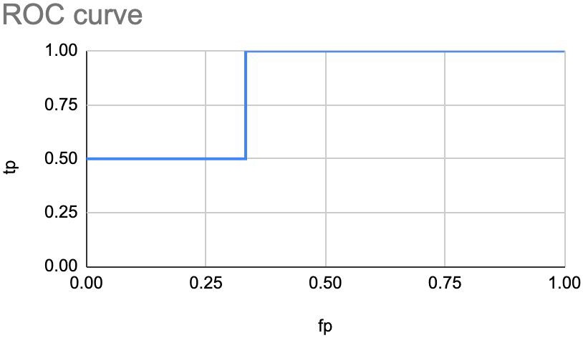
How ROC AUC is calculated
ID | Anomaly score | Label | fp | tp
0 | 11383 | 0 | 0 | 0.5
3 | 152435 | 0 | 0.333333 | 0.5
1 | 256676 | 1 | 0.333333 | 1
4 | 848171 | 0 | 0.666667 | 1
2 | 862365 | 1 | 1 | 1
Area Under Curve: 0.5*⅓ + ⅔ = 0.8333

Slide 18
Scoring
Code submission: 4 pt
Baselines 6 pt (3 pt for the public ones and the other 3 pt for the private ones)
Simple public: 1 pt
Medium public: 1 pt
(public score: 0.40463)
(public score: 0.88406)
(public score: 0.94808)
Strong public: 1 pt
Simple private: 1 pt
Medium private: 1 pt
Strong private: 1 pt
Bonus for submitting report: 0.5 pt

Slide 19
Bonus
If you succeed in beating both boss baselines, you can get extra 0.5 pt by submitting a brief report to explain your methods (in less than 100 English words), which will be made public to the whole class
Report Template

Slide 20
Baseline guides
Simple
FCN autoencoder
Medium
CNN autoencoder
Try smaller models (less layers)
Smaller batch size
Strong
Add BatchNorm
Train for longer

Slide 21
Code Submission
Zip your code and name the compressed file <student_id>_hw6.zip
And it should contain
Your codes
report.pdf (only for those beating both boss baselines)
Submit <student_id>_hw6.zip （e.g. 711083101_hw6.zip）

Slide 22
Code Submission
DO
Specify the source of your code. (You may refer to Academic Ethics Guidelines)
Organize your code and make it easy to read (not necessary)
DO NOT
Submit empty or garbage ﬁles
Submit the dataset or model
Compress your codes into other formats like .rar or .7z and simply rename it to .zip
Note
We can only see your last submission
Do not submit your model or dataset
If your code is not reasonable, your semester grade x 0.9

Slide 23
Regulations
Plagiarism is not allowed
Do not modify your prediction ﬁle
Do not share your prediction ﬁle with anyone
Do not submit your prediction ﬁle more than 5 times to Kaggle in any way
Do NOT search or use additional data or pre-trained models.
Violators are subject to x 0.9 of their semester grades
Prof. Lee & TAs preserve the rights to change the rules & grades

Slide 24
Deadline
Kaggle: 2023/05/30 23:59 (UTC+8)
數位學院: 2023/05/31 23:59 (UTC+8)

Slide 25
Links
Kaggle: https://www.kaggle.com/t/77d6740012674b6185c77f79def71d63
Colab:https://colab.research.google.com/drive/1NwoY5FJAxvlRjGh3v9FIm2Lbzi7WU21w?usp=share_link

Slide 26
Contact TAs
Email:
maypp555@gmail.com
The title should begin with [hw6]

