Slide 1
Machine Learning HW7

Slide 2
Outline
Links
Kaggle
Data
colab tutorial
Due
Kaggle: 2023/06/09 23:59:59
Code & Report: 2023/06/12 23:59:59
No Late Submission!!!
Task Description
Dataset
Data & Submission Format
Grading Policy
Baseline Guides
Regulations

Slide 3
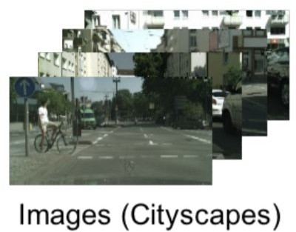
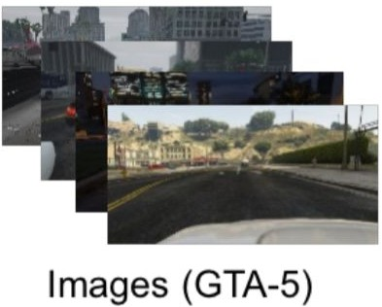
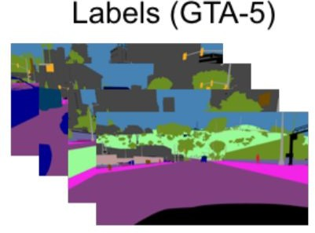
Task Description - Domain Adaptation
Image Reference: https://arxiv.org/pdf/1810.07911.pdf
Imagine you want to do tasks related to the 3D environment, and then discover that…
3D images are diﬃcult to mark and therefore expensive.
Simulated images (such as simulated scene on GTA-5) are easy to label. Why not just train on simulated images?

Slide 4
Task Description - Domain Adaptation
Image Reference: https://arxiv.org/pdf/1810.07911.pdf
For Net, the input is “abnormal”, which makes Net doesn’t work properly.
Train
Net (U)
Net (D)
Feat A
Output
Test
???
???
????
????

Slide 5
Task Description - Domain Adaptation
Image Reference: https://arxiv.org/pdf/1810.07911.pdf
Therefore, one simple way to solve this problem is to
make the distributions of and
Train
similar.
FeatA
FeatB
Net (U)
Net (D)
Feat A
Output
Test
similar
???
Feat B
Output

Slide 6
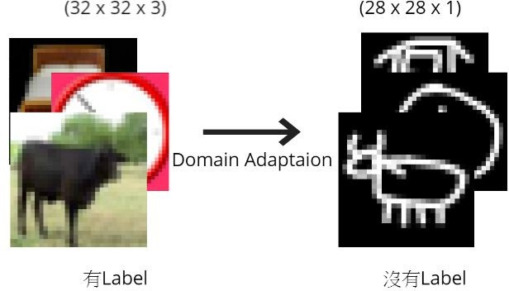
Task Description - Domain Adaptation
Our task: Given real images (with labels) and drawing images (without labels), please use domain adaptation technique to make your network predict the drawing images correctly.

Slide 7
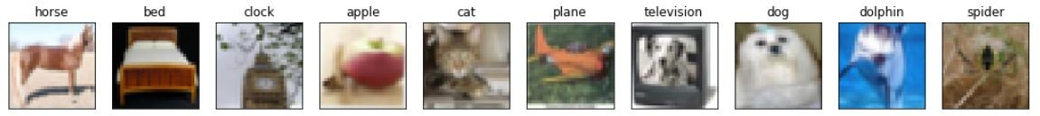
Dataset
Label: 10 classes (numbered from 0 to 9), as following pictures discribed.
Training : 5000 (32, 32) RGB real images (with label).
Testing : 100000 (28, 28) gray scale drawing images.

Slide 8
Data Format
Unzip real_or_drawing.zip, the data format is as below:
real_or_drawing/
train_data/
0/
0.bmp, 1.bmp … 499.bmp
1/
500.bmp, 501.bmp … 999.bmp
… 9/
test_data/
0/
00000.bmp
00001.bmp
… 99999.bmp

Slide 9
Data Format
You can simply use the following code to get dataloader after extracting the zip. (You can apply your own source/target transform function.)
source_dataset = ImageFolder('real_or_drawing/train_data', transform=source_transform) target_dataset = ImageFolder('real_or_drawing/test_data', transform=target_transform)
source_dataloader = DataLoader(source_dataset, batch_size=32, shuffle=True) target_dataloader = DataLoader(target_dataset, batch_size=32, shuffle=True) test_dataloader = DataLoader(target_dataset, batch_size=128, shuffle=False)

Slide 10
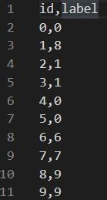
Submission Format
First line should be “id, label”.
Next 100, 000 lines are your predicted labels of test images.
Evaluate Metrics = Accuracy.

Slide 11
Grades
+4pt : code submission
+1pt : Simple public baseline (0.47348)
+1pt : Simple private baseline
● +1 : Medium public baseline (0.59980)
● +1 : Medium private baseline
+1 : Strong public baseline (0.70624)
+1 : Strong private baseline

Slide 12
Baseline Guides
Simple Basline (2pts, acc≥0.47348, < 1hour)
Just run the code and submit answer.
Medium Baseline (2 pts, acc≥0.59980, 2~4 hours)
Set proper λ in DaNN algorithm.
Luck, Training more epochs.
Strong Baseline (2 pts, acc≥0.70624, 5~6 hours)
The Test data is label-balanced, can you make use of this additional information?
Luck, Trail & Error :)

Slide 13
Baseline Guides
Boss Baseline
原本台大有boss baseline，但是考慮到期末同學會比較忙，所以刪除，但還是提供下面方法來讓各位提升模型performance。
All the techniques you’ve learned in CNN.
Change optimizer, learning rate, set lr_scheduler, etc…
Ensemble the model or output you tried.
Implement other advanced adversarial training.
For example, MCD MSDA DIRT-T
Huh, semi-supervised learning may help, isn’t it?
What about unsupervised learning? (like Universal Domain Adaptation?)
請把”助教是神”打在Kaggle上

Slide 14
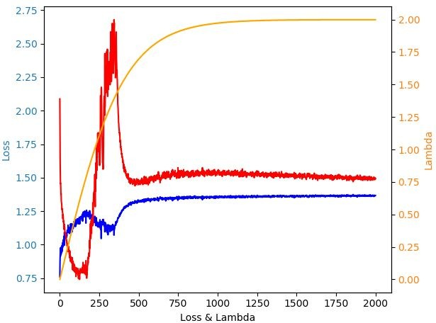
Learning Curve (Loss)
This image is for reference only.

Slide 15
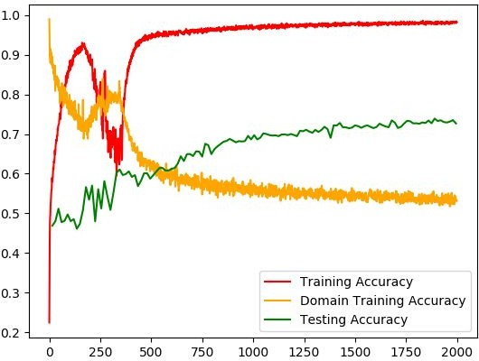
Learning Curve (Accuracy)
This image is for reference only.
Note that you cannot access testing accuracy.
However, this plot tells you that even though the model overﬁts the training data, the testing accuracy is still improving.

Slide 16
Kaggle Submission
Deadline: 6/9 23:59
Displayed Name: <student ID>_<系所縮寫>_<隨便你打>
Evaluation Metric: Accuracy (Exact Match)

Slide 17
Code Submission – 數位學苑
數位學苑
Deadline: 6/12 23:59
Compress your code and report into <student_ID>_hw7.zip（e.g. 711183116_hw7.zip）
We can only see your last submission.
DO NOT submit your model or dataset.
If your code is not reasonable, your semester grade x 0.9.
Your .zip ﬁle should include only
Code: either .py or .ipynb
Report: .pdf (only for those who got 10 points)
Report template

Slide 18
Regulations
You should NOT plagiarize, if you use any other resource, you should cite it in the reference. (＊)
Do NOT share codes or prediction ﬁles with any living creatures.
Do NOT use any approaches to submit your results more than 5 times a day.
Do NOT search or use additional data.
Do NOT search the label or dataset on the Internet.
Do NOT use pre-trained models on any image datasets.
Your ﬁnal grade x 0.9 if you violate any of the above rules.
Prof. Wu & TAs preserve the rights to change the rules & grades.

Slide 19
If any questions, you can ask us via...
Email(recommended)
kafuchino0410@gmail.com

Slide 20
Hidden Guideline - DaNN (1/3)
這裡我們介紹最基礎的 DaNN (Domain-Adversarial Training of NNs)。
如果一個模型在測試時吃到不是與訓練集同個 distribution 的輸入，那麼輸出 往往會爆走，如下圖。
而為什麼不能讓圖中的 CNN 在輸入 B dataset 輸出正常的 output？因為你並 沒有 B dataset 的 label 使模型學習。
A dataset (∈ Training)
CNN
Normal Output
B dataset (∉ Training)
Abnormal Output

Slide 21




Hidden Guideline - DaNN (2/3)
為了因應這樣的情況，DaNN就將 CNN 先拆成兩個部分，並且想辦法讓前半的 CNN 在吃入兩個 A dataset & B dataset 後得到的 distribution 是相近的，那麼 後半就會因為輸入是正常的 output，而發揮正常的功用。
A dataset (∈ Training)
前半 CNN / Feature Extrator
Normal Output
努力變成 Normal Output
後半 CNN / Label Predictor
Normal Output
Normal Output
B dataset (∉ Training)

Slide 22




Hidden Guideline - DaNN (3/3)
而如何讓前半段的模型輸入兩種不同分布的資料，輸出卻是同個分布呢？最簡 單的方法就是像 GAN 一樣導入一個 discriminator 來分辨輸入是哪個 dataset，並讓 feature extractor 來騙過 discriminator 即可。
努力變成 B’s normal Output
A dataset (∈ Training)
前半 CNN / Feature Extrator
Discriminator / Domain Classifier
是 A dataset
B dataset (∉ Training)
努力變成
A’s Normal
是 B dataset
Output
，以騙過 discriminator

