Slide 1
Tech Company
Cash Flow & Runway Analysis
24-Month Forecast · Series A SaaS · Python-Powered
Prepared by William McPhaul

Slide 2
Executive Summary
A 24-month cash flow and runway forecast for a Series A B2B SaaS company that recently raised $12M. The company is growing fast but burning cash aggressively — this analysis answers the question that matters most to the founders and board:
“How long will our money last?”
24-Month Forecast
Runway Analysis
Scenario Insight
Monthly revenue, costs, and cash projection
Months remaining and projected cash-out date
Impact of hiring pace on runway
LumaFlow · Cash Flow & Runway Analysis
2

Slide 3
Key Metrics
$11.5M
~$580K
~14 mo
Mar 2027
Starting Cash
Monthly Net Burn
Runway Remaining
Projected Cash-Out
At the current burn rate, the company has roughly 14 months of runway — cash turns negative in March 2027.
LumaFlow · Cash Flow & Runway Analysis
3

Slide 4
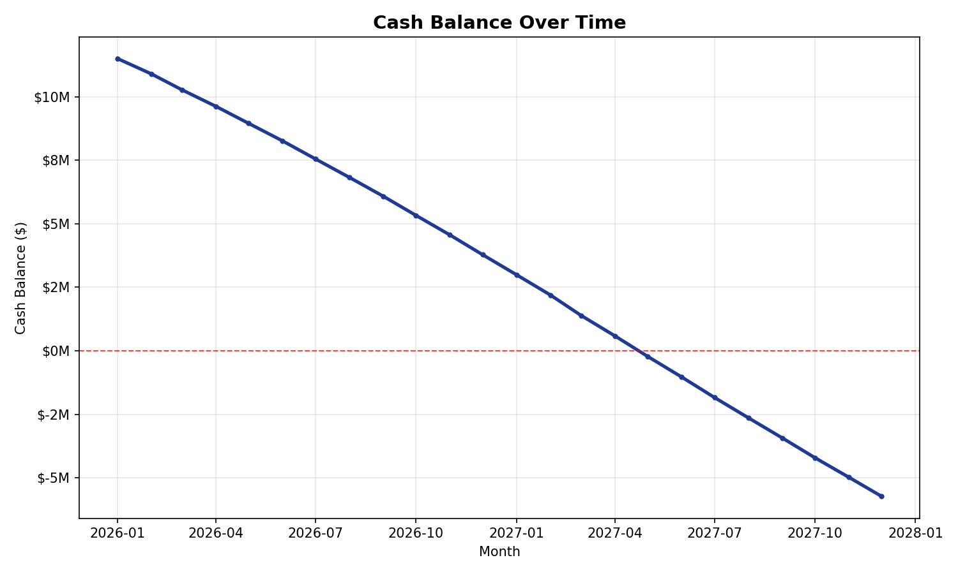
Cash Runway
Cash balance over the 24-month forecast
INSIGHT
Cash declines steadily and crosses zero in March 2027 (Month 14). The red line marks the cash-out threshold.
LumaFlow · Cash Flow & Runway Analysis
4

Slide 5
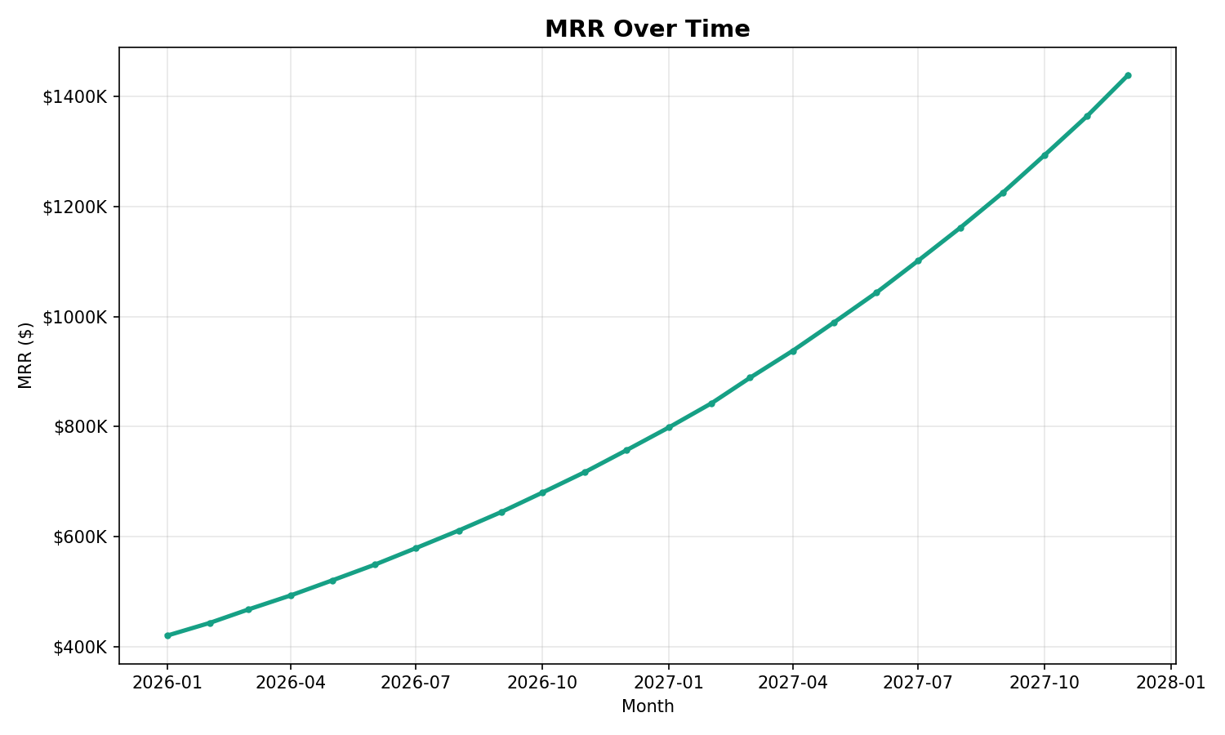
Growth Story
Monthly Recurring Revenue (MRR) over time
INSIGHT
MRR grows from $420K to roughly $1.4M over 24 months — strong, accelerating top-line growth.
LumaFlow · Cash Flow & Runway Analysis
5

Slide 6
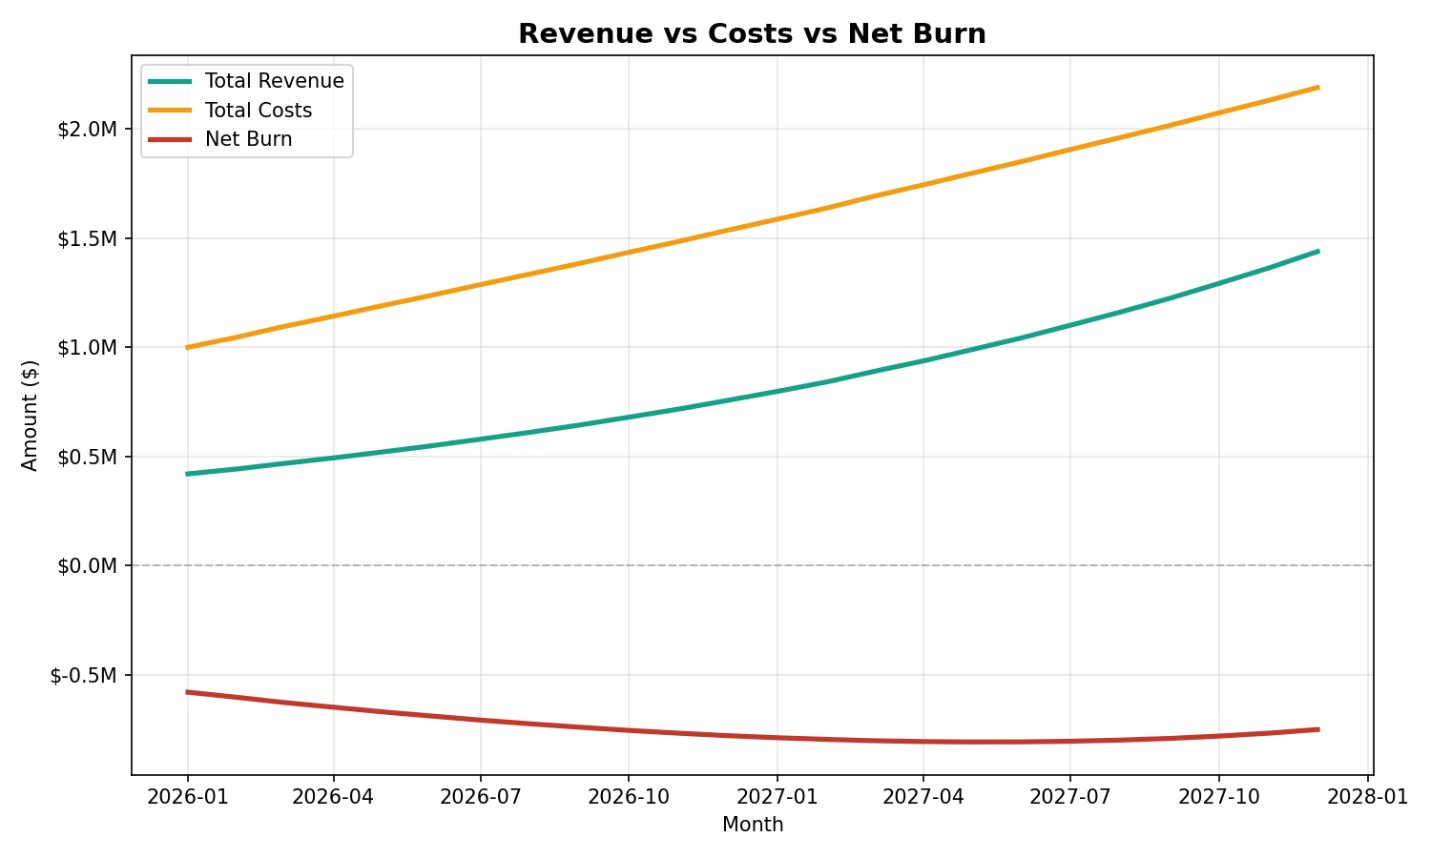
Why the Burn Accelerates
Revenue vs. costs vs. net burn
INSIGHT
Costs outpace revenue as headcount scales. Net burn widens from $580K to $780K per month, draining cash faster over time.
LumaFlow · Cash Flow & Runway Analysis
6

Slide 7
Key Findings
1
Cash reserves deplete to zero by Month 14 (March 2027).
2
Monthly net burn accelerates from $580K to $780K as headcount scales.
3
The simple “cash ÷ average burn” rule overstates runway by ~3 months versus the dynamic model — because burn is not constant, it grows.
LumaFlow · Cash Flow & Runway Analysis
7

Slide 8
Recommendations
Start fundraising by Month 8
Due diligence now takes 6–8 weeks. Begin the raise well before cash runs critically low.
Model a hiring freeze scenario
Slowing headcount growth extends runway by several months and buys negotiating room.
Target the next round or break-even before Q1 2027
Align the fundraising timeline with the projected cash-out date to avoid a forced raise.
LumaFlow · Cash Flow & Runway Analysis
8

