Slide 1
Financial Performance and Metrics

Slide 2
Executive Summary
Overview of financial performance, metrics, and trends for a company based on historical data (2021–2023) and projected estimates for 2024. This presentation provides a comprehensive financial assessment of the company, including:
• Full financial statements (income statement, balance sheet, and cash flow)
• Key financial ratios (profitability, efficiency, liquidity, leverage)
• Year-over-year analysis and compound growth rates
• Visual dashboard with KPIs and insights
Notes:
The analysis is based on projected 2024 estimates and highlights key trends in revenue growth, margin stability, asset utilization, and capital structure.
Use this workbook to gain a clear snapshot of company performance and guide strategic decision-making.

Slide 3
Key Financial Ratios

Slide 4
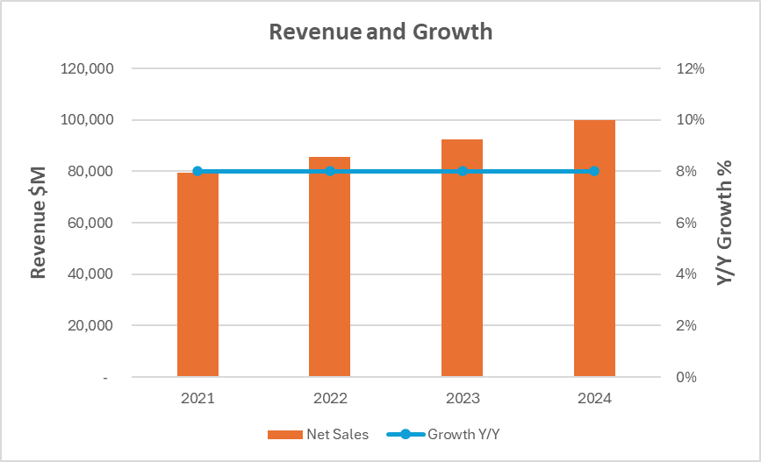
Revenue Performance & YoY Growth

Slide 5
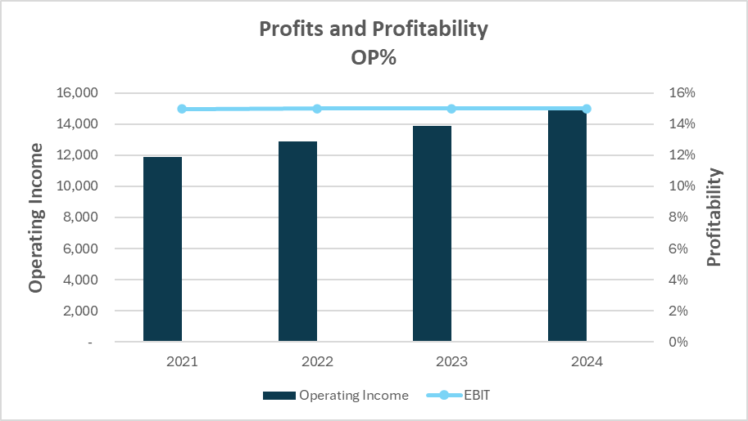
Operating Profitability & EBIT Margin

Slide 6
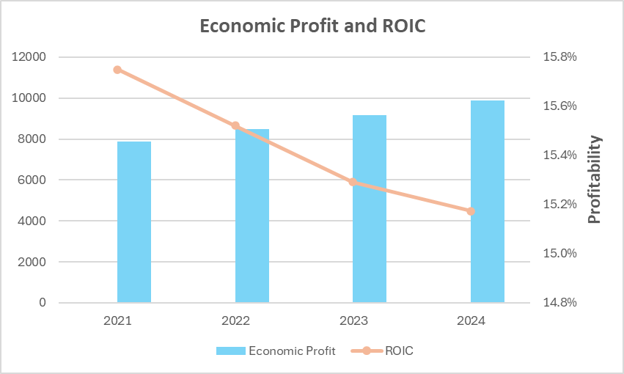
Economic Profit & Return on Invested Capital (ROIC)

Slide 7
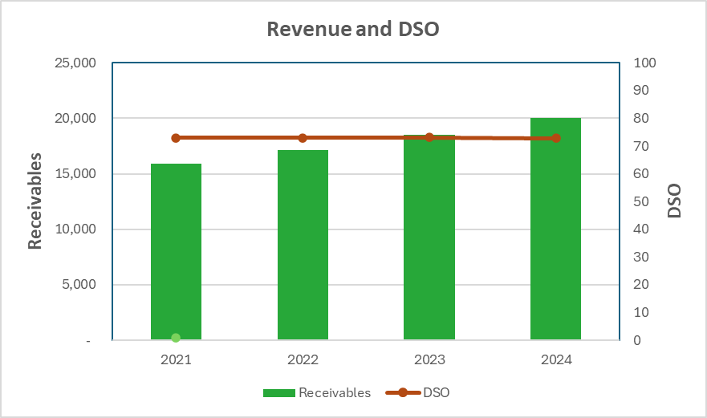
Accounts Receivable & Days Sales Outstanding (DSO)

Slide 8
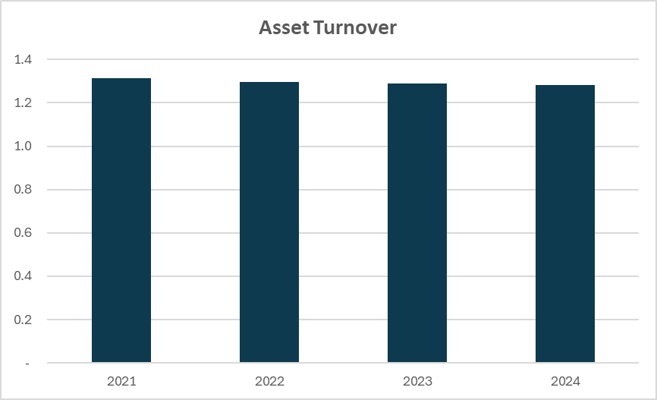
Asset Turnover Trend

Slide 9
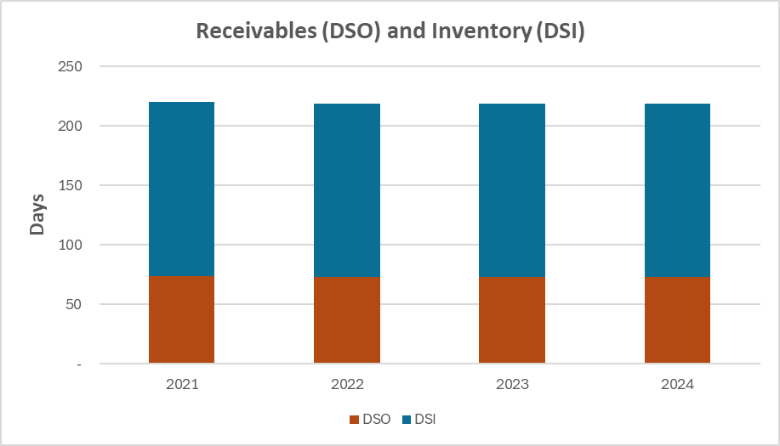
Working Capital Efficiency – DSO & DSI

Slide 10
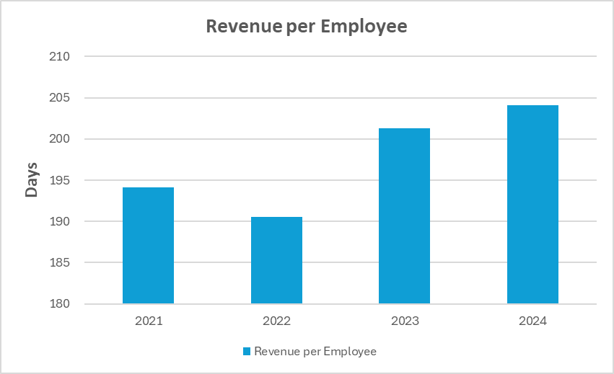
Revenue per Employee – Productivity Trend

Slide 11
Key Takeaways
Revenue shows consistent 8% YoY growth
Operating margin remains stable despite rising COGS
ROIC slightly declines while economic profit improves
Receivables and DSO remain constant, not affecting cash efficiency

