Slide 1
Product Performance and Growth Analysis

Slide 2
Executive Summary
Title: Executive Summary – Product Performance & Growth Dashboard
Project Context: Historical Excel dashboard (2016–2022) analyzing product-level sales, margins, and revenue to support business decisions.
Objective: Identify trends in product performance and growth for strategic planning
Method Used: Excel dashboards using stacked columns, dual-axis charts, and trend analysis
Key Insight: Margins improved by 8%; new products outpaced legacy SKUs; growth shows rebound post-2020 dip.
Tools Used: Microsoft Excel, conditional formatting, combo charts
Next Steps: Phase out low-performing SKUs and scale investment in top-margin product families

Slide 3
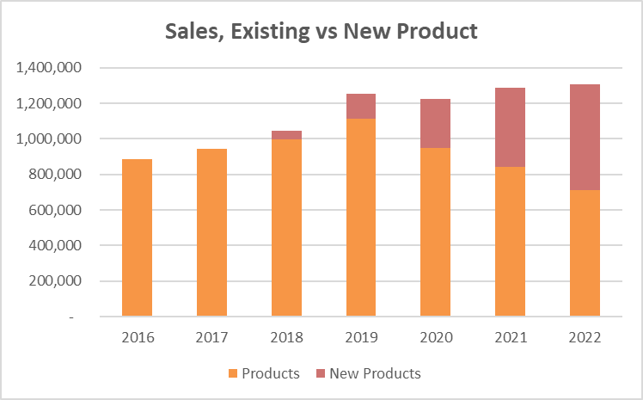
Sales Mix – Existing vs New Products

Slide 4
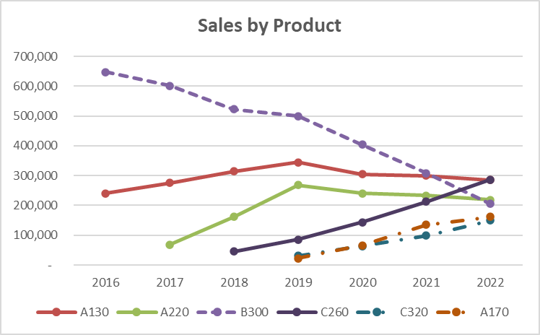
Sales by Product – SKU-Level Performance

Slide 5
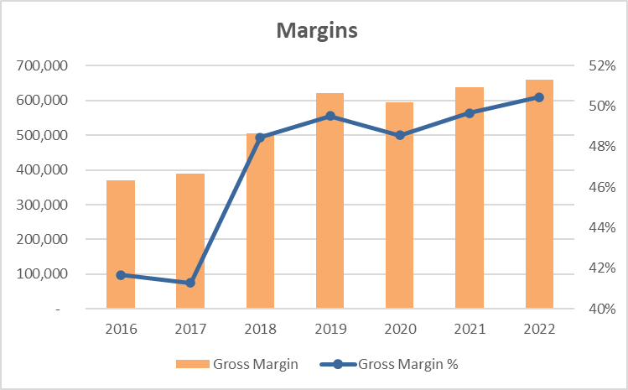
Gross Margin – Dollar & % Trend

Slide 6
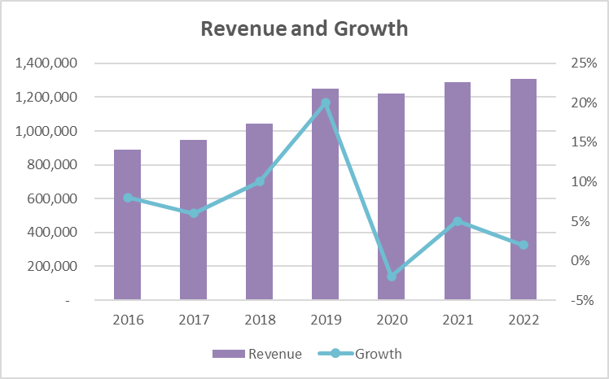
Revenue Trajectory & Annual Growth Rate

Slide 7
Insights
Insight: Despite stable total revenue since 2019, the business is shifting from legacy products to newer offerings. Margins improved by 8% since 2017, driven by newer high-margin products. Strategic focus on phasing out older SKUs and promoting growth lines is already showing results.

