Slide 1
Analyzing Stock Performance and Volatility

Slide 2
Executive Summary
• Short-term: Daily stock returns fluctuate randomly, showing no predictable pattern.
• Long-term: Stock prices tend to follow a random walk with an upward drift, reflecting sustained growth
• Implication: Forecasting is uncertain in the short term, but long-term trends can still be captured.
Notes:
The analysis is based on projected 2024 estimates and highlights key trends in revenue growth, margin stability, asset utilization, and capital structure.
Use this workbook to gain a clear snapshot of company performance and guide strategic decision-making.

Slide 3
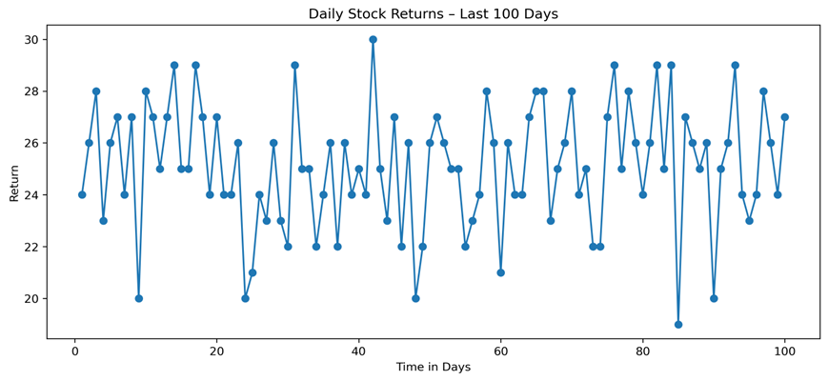
Randomness in Stock Returns
This chart illustrates how daily stock returns often resemble white noise: random fluctuations around zero with no predictable pattern.

Slide 4
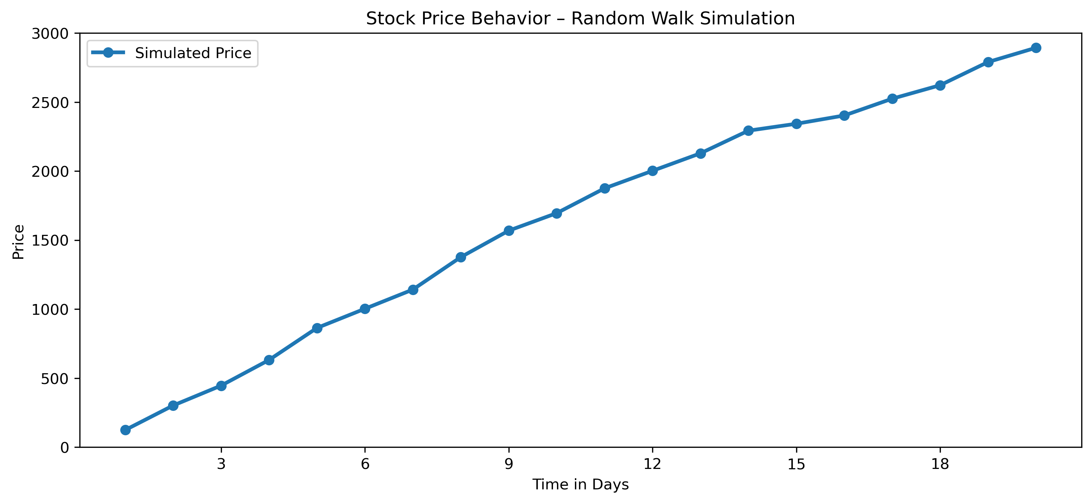
Modeling Stock Price Behavior
This chart illustrates how stock prices can be modeled as a random walk with an upward drift. Each day, the price follows the previous value plus a random shock. Over time, this generates a trend with unpredictable short-term fluctuations.

Slide 5
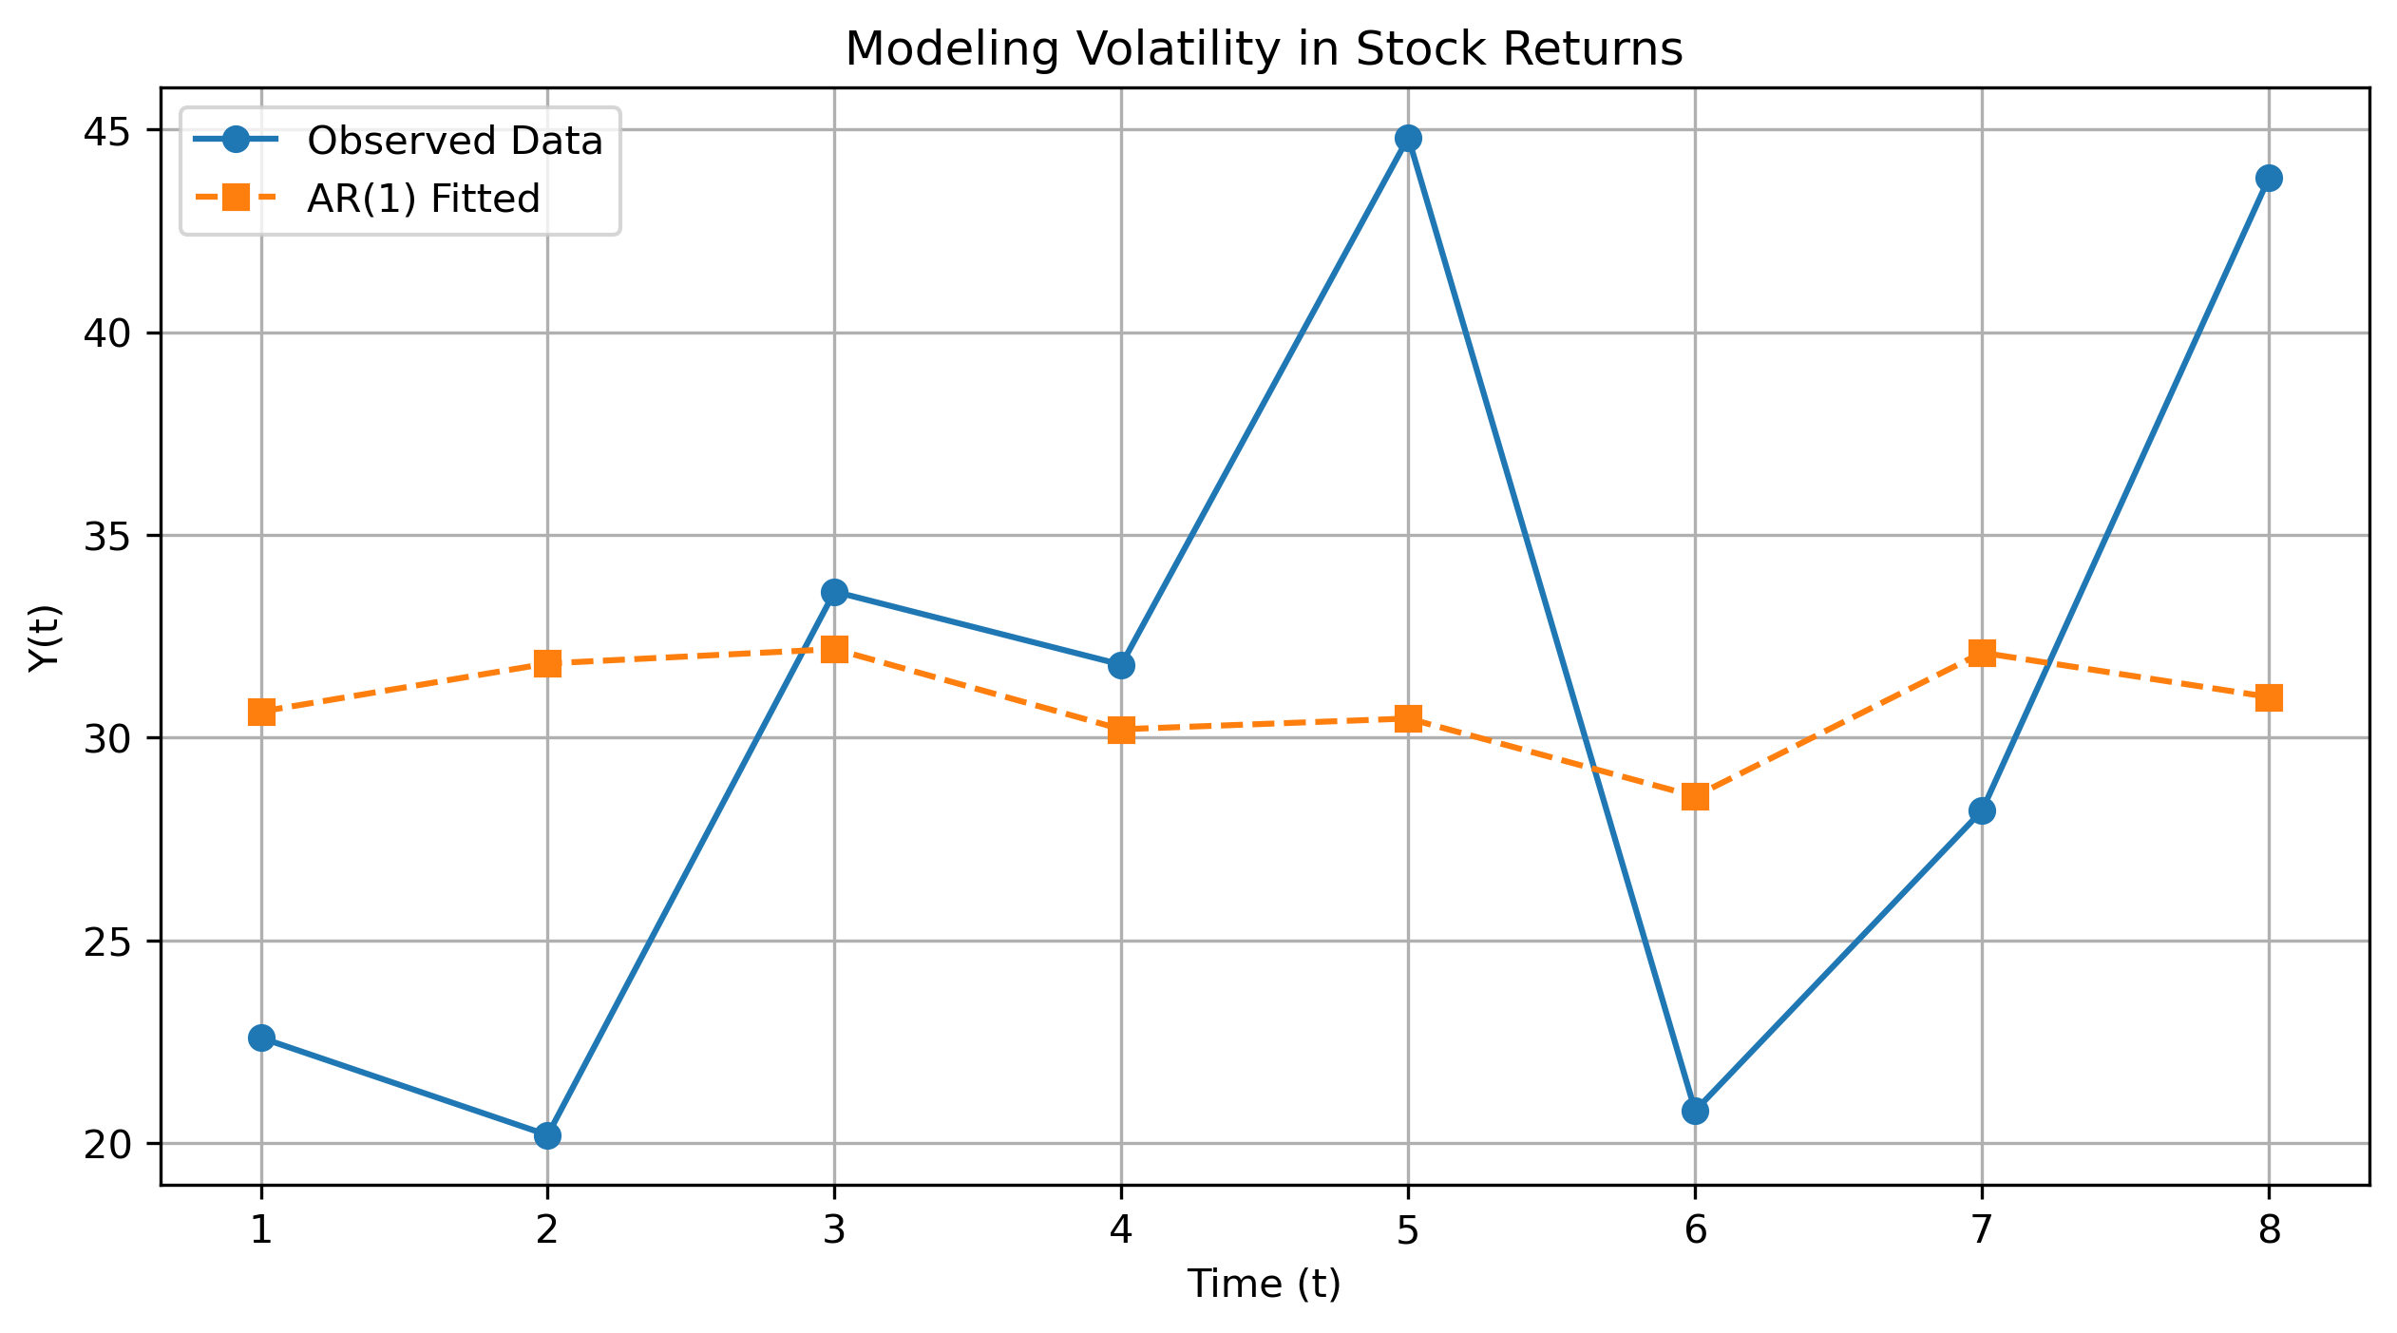
Testing for Dependence in Stock Returns
Low autocorrelation in returns implies short-term unpredictability.
AR(1) results show minimal persistence, meaning past values have little influence on future returns.
AR(1) estimate close to zero, indicating low persistence in returns

Slide 6
Key Takeaways
Short-term unpredictability: Daily stock returns show very low autocorrelation, meaning past values provide little guidance for forecasting the next period.
Long-term growth: Despite daily randomness, stock prices can follow a random walk with upward drift, capturing long-term appreciation.
Volatility dynamics: AR(1) models help test short-term dependence in return volatility, even if in this case persistence is minimal.
Practical implication: Focus should be on long-term trends and volatility management rather than short-term return prediction.

