Slide 1
Picture PPT

Slide 2



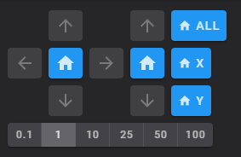


Slide 3
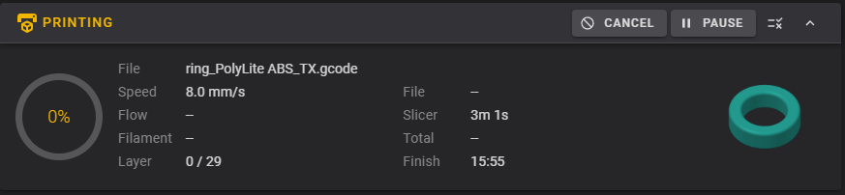
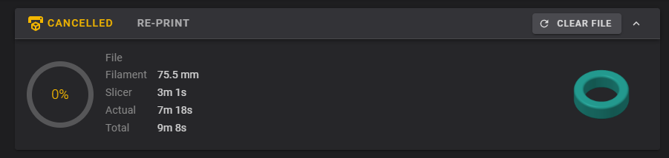
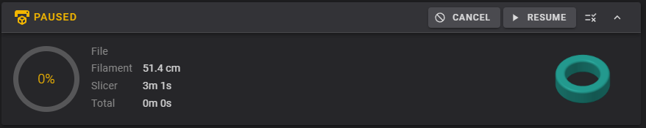

Slide 4
Z

Slide 5
X.pos
Y.pos
Z.pos
SCREWS_TILT
ALL
PROBE_CALI
X
Z_TILT
MOTOR_OFF
Y
LOAD
0.1
1
10
25
50
UNLOAD

Slide 6
X.pos
Y.pos
Z.pos
PLA
ABS
PETG
TPU
Z.pos
0.01
0.025
0.05
0.1
1

Slide 7
Accept
Abort
Z.pos
0.01
0.025
0.05
0.1
1

Slide 8
FIRMWARE_RESTART
ABS
PETG
TPU

