Slide 1
Title: Data Analysis and Prediction of Housing Prices
Author: Willy Bernal Heredia

Slide 2
Introduction
This projects analyzes and predicts housing prices from housing data. For this project, we followed the following procedure:
Read/Parse housing prices data file
Clean the data
Analyze the data and identify the most relevant characteristics/features
Train a model
Predict housing prices for data outside the training data
Verify predictive capabilities with unseen data
*Please add slides as required.

Slide 3
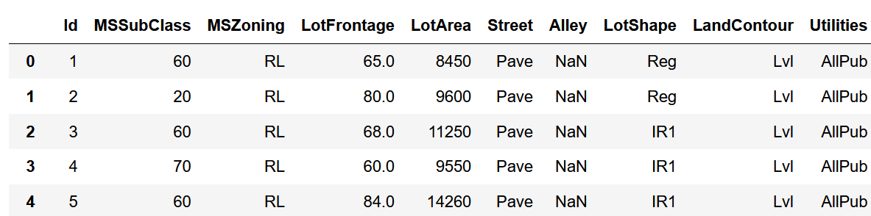
The Data
The data contains 100 observations (rows) and includes 80 features (columns)
You can find the sale price of the houses among those. It also includes features like “Overall Quality” or “Garage Area”
It is a combination of categorical and numerical values. The data does not contain values for all entries: some of them are NaN
Below are included the first 5 rows and a subset of columns
*Please add slides as required.

Slide 4
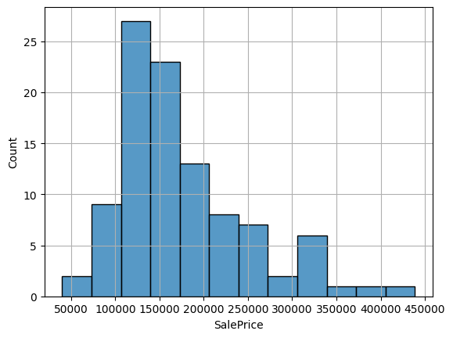
The Data
Below is the histogram for the sales prices.
The sales price does not follow a normal distribution. The mean is $173’820 and the standard deviation is $72’236
*Please add slides as required.

Slide 5
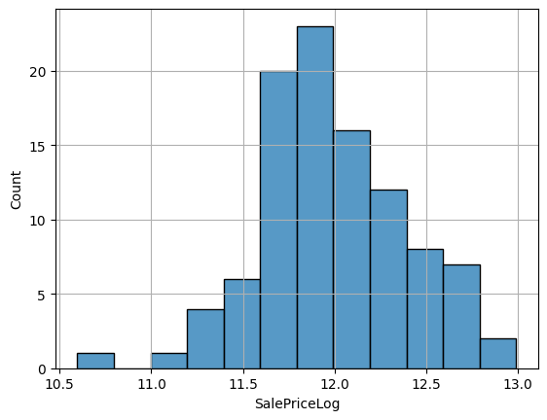
The Data
Below is the histogram for the log(sales prices).
This shows much smaller skewness (-0.1) vs. the regular sale price (1.18).
“Skewness is a measure of the asymmetry of the probability distribution of a real-valued random variable about its mean.”¹
¹ https://www.geeksforgeeks.org/python-pandas-dataframe-skew/

Slide 6
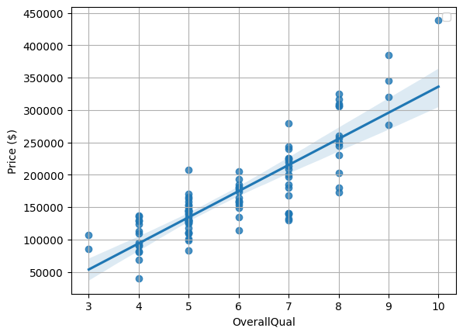
Data Exploration
The following graphs show the relationship between the Overall Quality and the Ground Living Area with respect to the Sales Price.
The overall quality feature provides a good predictor for the house price as seen in the graph below. It is a positive correlation
*Please add slides as required.

Slide 7
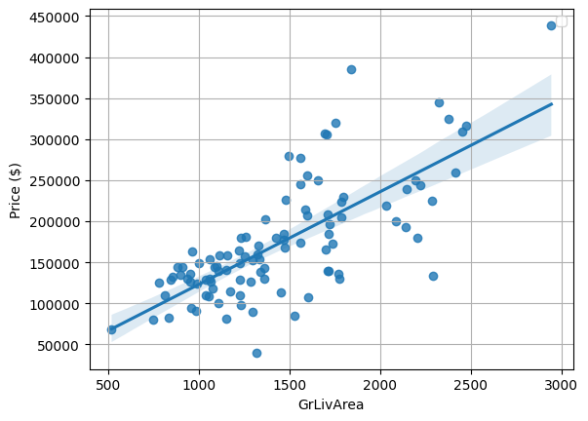
Data Exploration
Ground Living area has a positive correlation and will be useful for predicting house prices
Seaborn.regplot provides a linear regression model fit

Slide 8
Data Preparation
The following steps were followed to clean and reshape the data:
Select only numerical values.
We will not be using categorial data for now
Identify the amount of NaN or missing data in the database
Remove all NaN in the Sales Price column
As we are predicting prices, we can’t use any rows without pricing data
Imputation of data with more reasonable values
We can replace NaN or Null values with more relevant ones (e.g., mean)
Select the features with the highest correlation with pricing
*Please add slides as required.

Slide 9
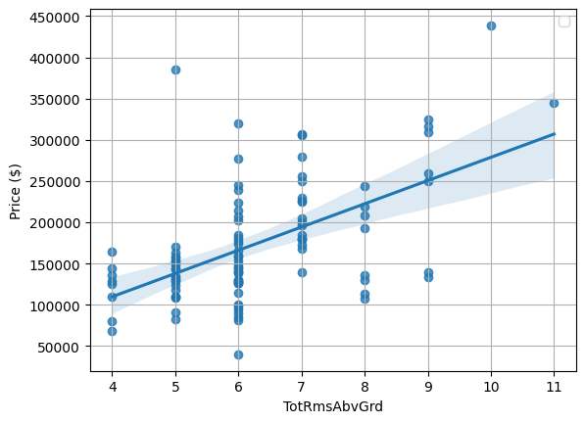
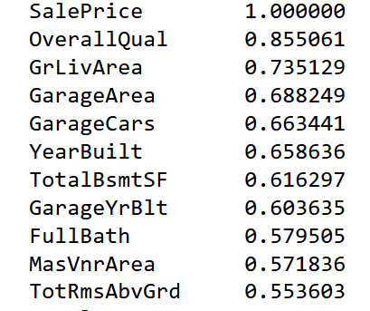
Correlation
The correlation shows the level of dependency between two variables.
Correlation coefficient were calculated for all numerical variables and ordered by descending order. Shown below
We selected the first 10 variables as they were above 0.5
Total Rooms above grade shows a positive correlation in the graph below (0.55)

Slide 10

Project Description
The multiple linear regression model was used.
Multiple features had a strong correlation with the price.
The relationship to the Sales price for those features was approximately linear.
Linear regression is a straightforward technique to implement and can provide good predictive capabilities for the existing data.
The Skitlearn module was used. Specifically, the LinearRegression() object.
The multiple linear regression model can be represented with the equation:
Where:
y is the target (dependent variable). E.g., Sales Price
X_{i} denotes the predictors (independent variables). E.g, Overall Quality
Beta₀ represents the intercept or bias
Beta_{i} represent the estimated parameters (slope or weight) for each independent variable
The linear regression estimates the model parameters by minimizing the sum of the square values of the error
*Please add slides as required.

Slide 11
Analysis and Results
The pandas.corr() function was used to calculate the correlation coefficient for all numerical features with respect to the Sales Price
The correlation provides a measure of dependency of two variables.
The value can go from -1 to 1
-1 means that as one variable increases, the other one decreases
+1 means that both variables change in the same direction
0 means there is not dependency
The top features were chosen: the coefficient was greater than 0.5 (or smaller than -0.5). No negative correlation was lower than -0.5
The fit improve as more features were added. Starting with two features provided acceptable predictions
*Please add slides as required.

Slide 12
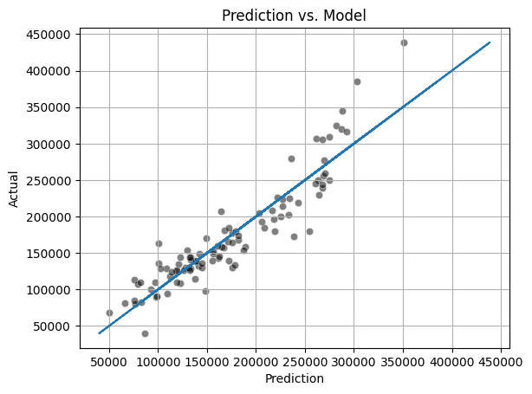
Verification
The model shown below uses the top 10 most correlated features and produces a R²: 0.85 .
For our purposes, this was an acceptable estimate. The graph below shows the actual vs the predicted values (by our model).
The linear approximation is acceptable
The linearity starts to break for higher prices. It tends to underestimate higher prices.
*Please add slides as required.

Slide 13
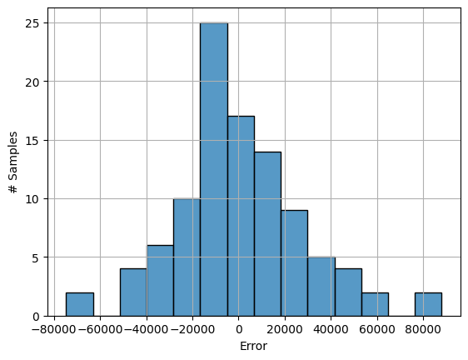
Error Analysis
The following a is a histogram of the error for our model. The error approximates a normal distribution.

Slide 14
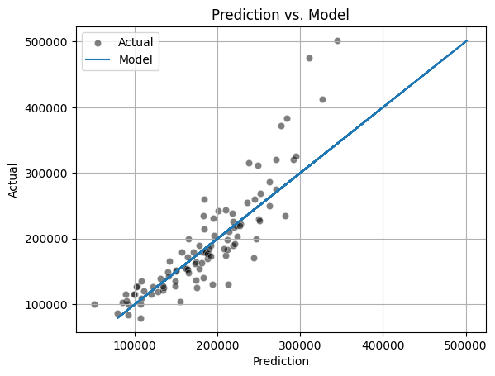
Verification – New Data
For the never seen data (jtest.csv), the model produces a R²: 0.75.
The linear approximation is acceptable
The linearity starts to break for higher prices. It tends to underestimate higher prices.
*Please add slides as required.

Slide 15
Conclusion
The data provided could be cleaned and treated for missing values.
The most correlated features were used to train our model and produce the best results
A multiple linear regression was used due to its simplicity and predictive power
The model performed very well to predict data: R² =0.85 for the same data and R² = 0.75 for never seen data
Next Steps:
Model can be improved to account for higher prices
A polynomial fit (order=2) might provide a better fit
*Please add slides as required.

Slide 16
References
API Reference. “pandas.DataFrame.dropna.” Accessed Nov-28-2022. https://pandas.pydata.org/docs/reference/api/pandas.DataFrame.dropna.html
API Reference. “sklearn.linear_model.LinearRegression.” Accessed Nov-28-2022. https://scikit-learn.org/stable/modules/generated/sklearn.linear_model.LinearRegression.html
API Reference. “Python | Pandas dataframe.skew().” Accessed Nov-28-2022. https://www.geeksforgeeks.org/python-pandas-dataframe-skew/
*Please add slides as required.

