Slide 1
Lab 0

Slide 2
What You will Learn

Slide 3
Familiar with a simple WebGL program
Run a WebGL program
Know the basic WebGL programming environment
Modify the code by instructions
Submit the code

Slide 4
What You Should Do Step by Step

Slide 5

1. Download and Run
Download the zip file which contains “index.html” and “WebGL.js” from Moodle (unzip the zip file)

Slide 6
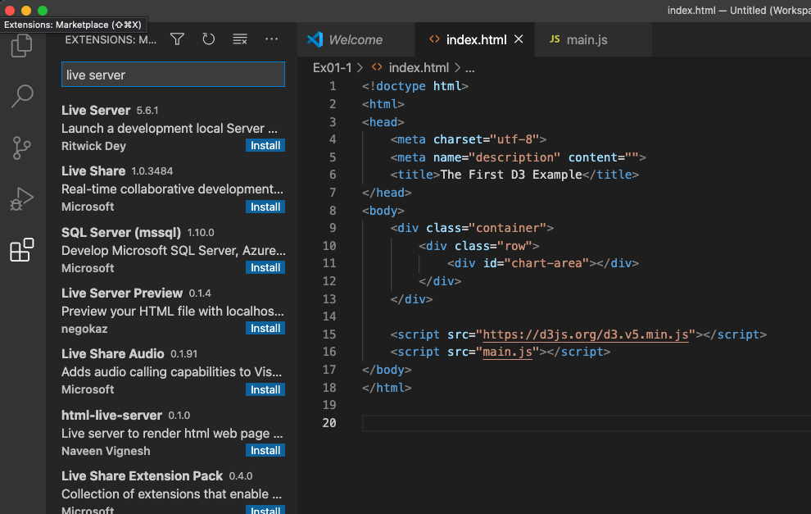
How to Run it?
Open “VSCode”
Install “Live Server” extension
2. Search ”live server”
3. Click “install”
1. Click

Slide 7
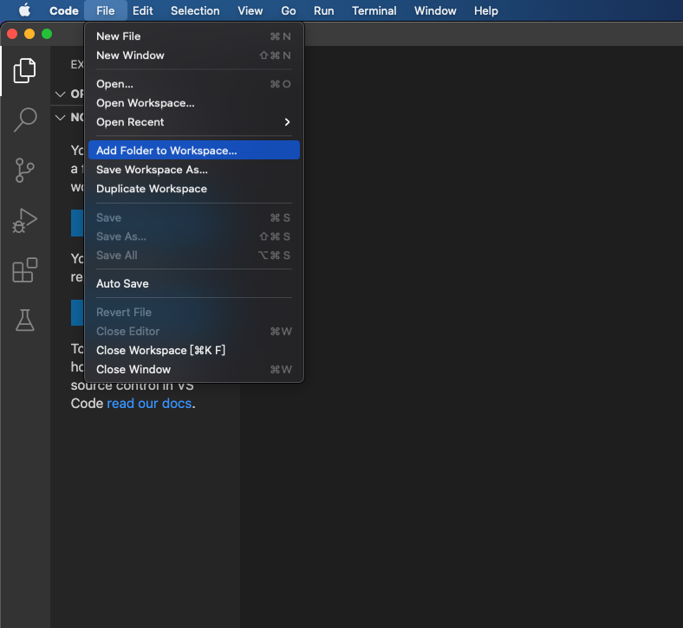
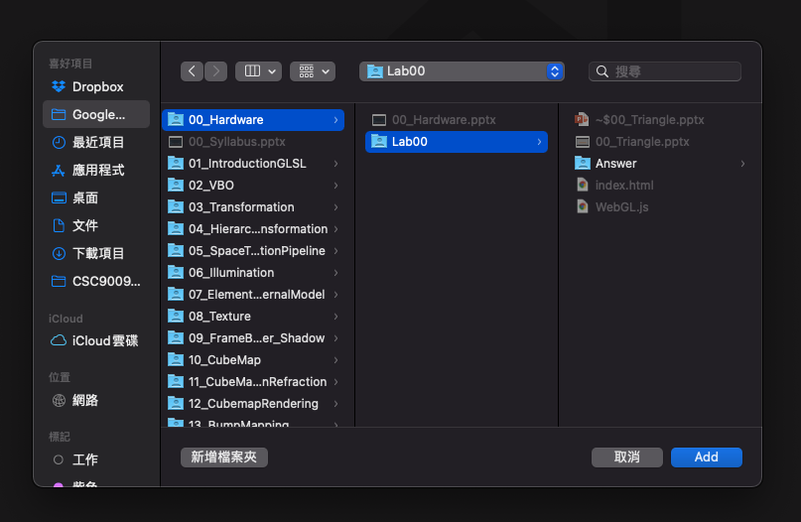
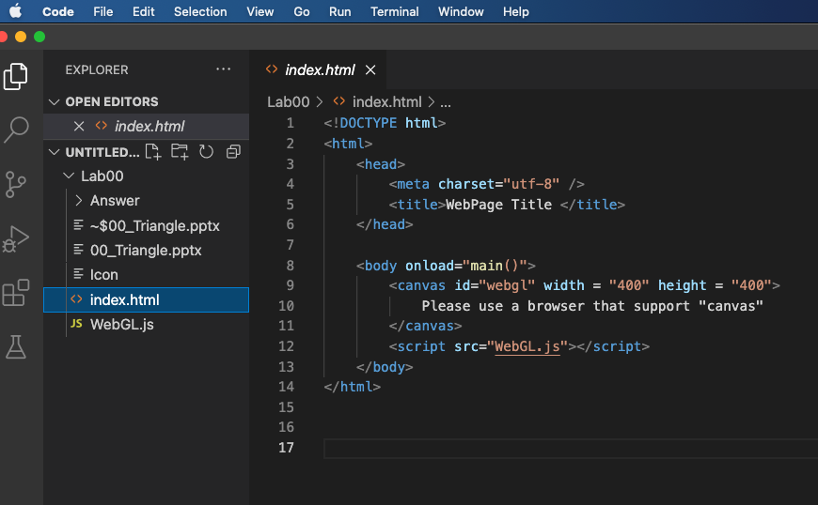
How to Run it?
You have to add the folder into “workspace” to run it by Live Server
1.
3. Select the folder
2.
4.
The folder added to VSCode workspace

Slide 8
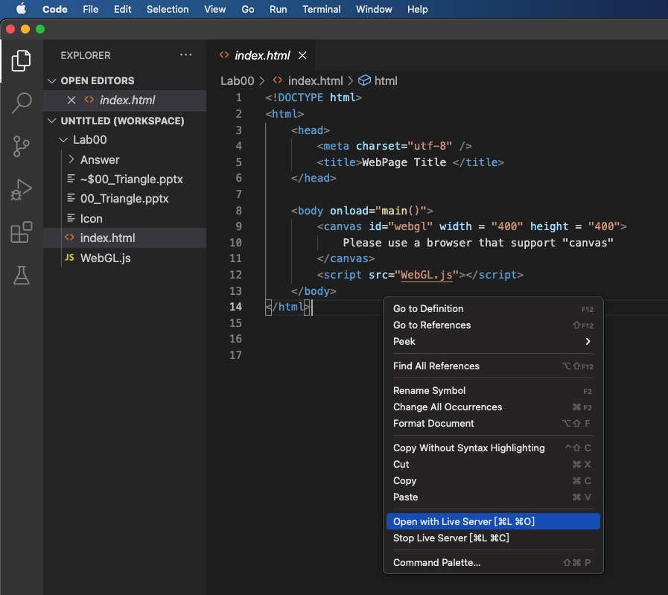
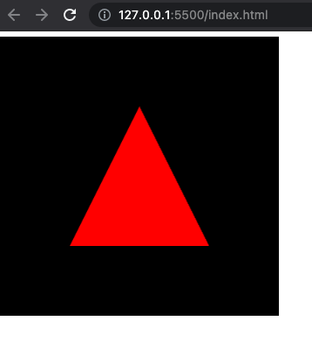
How to Run it?
Run it by right-clicking on “index.html”
3. “live server” can create a http server and run “index.html” on your browser
1. Right-click on “index.html”
2. Click “open with liver server”

Slide 9
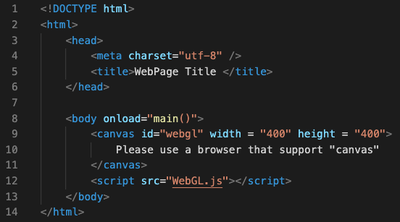
2. Index.html
In “index.html”, we have a canvas (for WebGL to draw and set its size (Line 9)

Slide 10
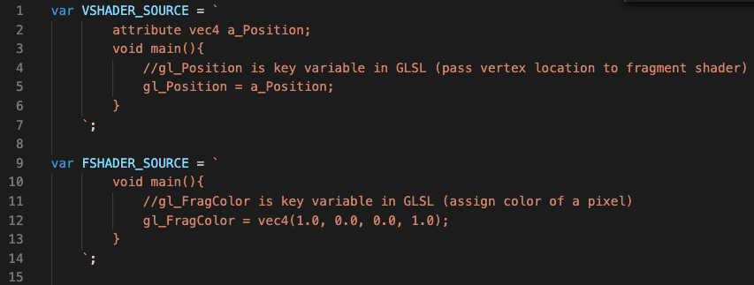
3. WebGL.js (Shaders)
Open the files (index.html and WebGL.js) to edit
You should choose an editor you prefer (e.g. Visual Studio Code, Subline Text…)
“Read and understand” the code, and map this code to the rendering pipeline we just learned
Line1 ~ Line7 is the Vertex processing in the pipeline (Vertex shader)
Line9 ~ Line14 is the pixel processing in the pipeline (Fragment shader)
They are so-called GLSL (C-like language)
The main code segment to render images (run in graphics card to speed up the rendering)
Host interface
Vertex processing
Triangle setup
Pixel processing
Memory interface

Slide 11
4. WebGL.js
Trace the main function in WebGL.js and read the comments in code
Step 1 and 2: get the canvas for WebGL to draw later
Step 3: “Compile” the shader programs (vertex and fragment shaders)
You do not have to understand the details of the two functions, “createProgram” and “compileShader”, so far.
Step 4: tell WebGL which shader program you want to use (you may have multiple shader programs later)
Step 5: array of triangle vertices and number of vertices
Line93~Line107: pass the triangle vertices to shader programs
You do not need to know the details so far
Step 6: assign the background color and clear screen by the color
Step7: “draw” the triangle

Slide 12
What You Should Do for “Submission”

Slide 13

Modify the code to draw
an “up-side down” “blue” triangle
on a “green” background

Slide 14
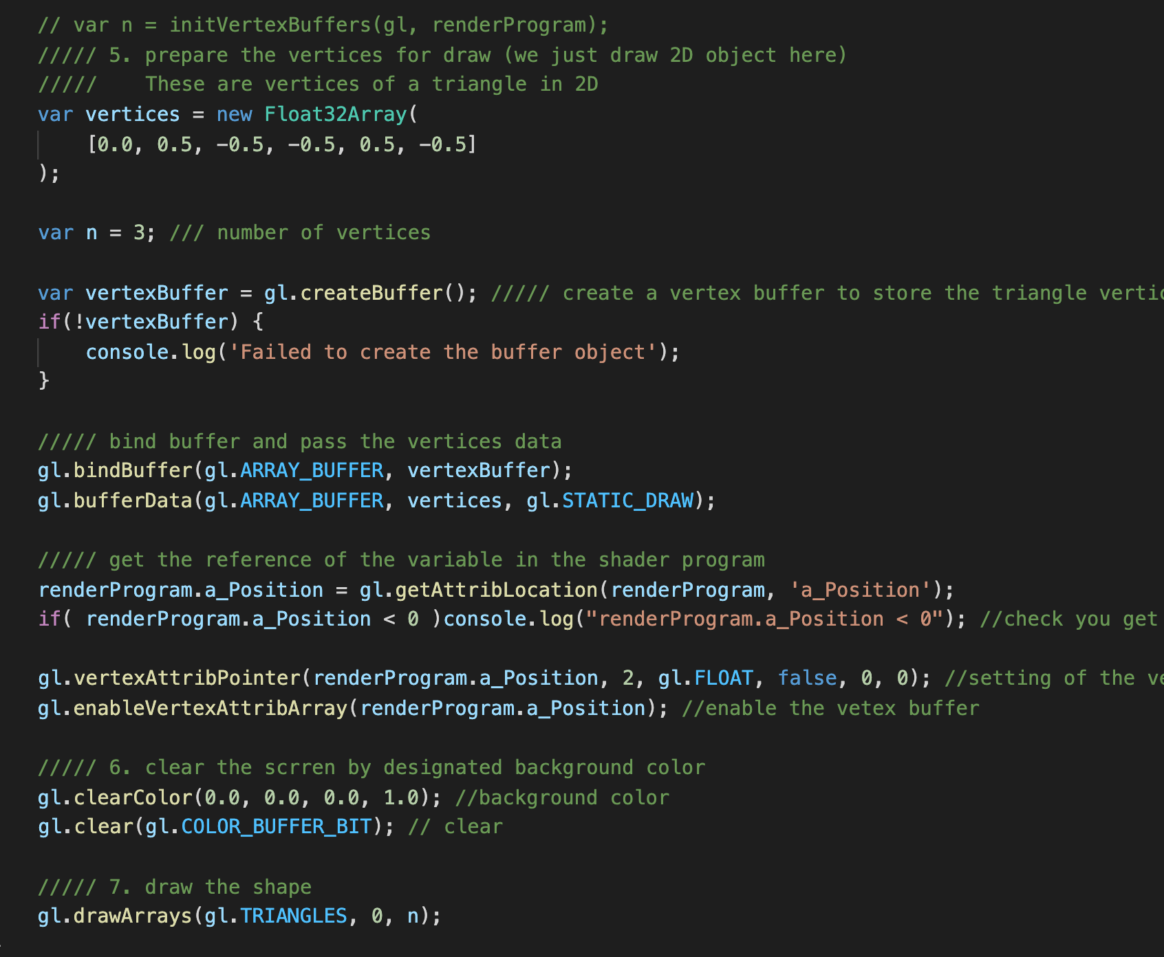
Where to modify
WebGL.js

Slide 15
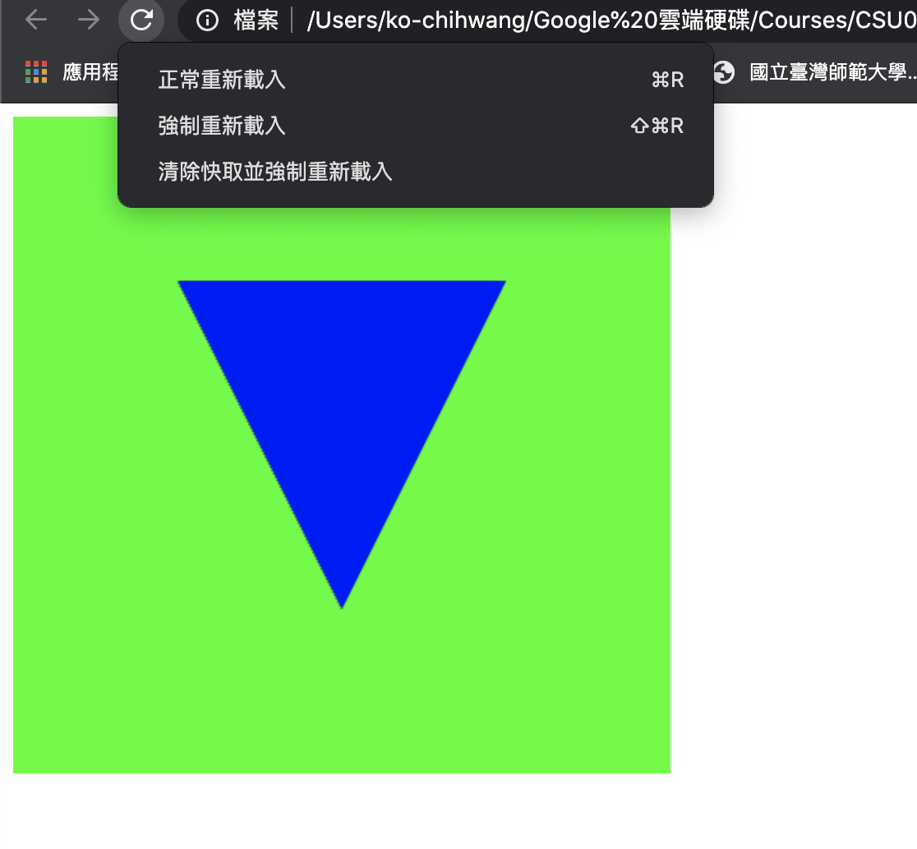
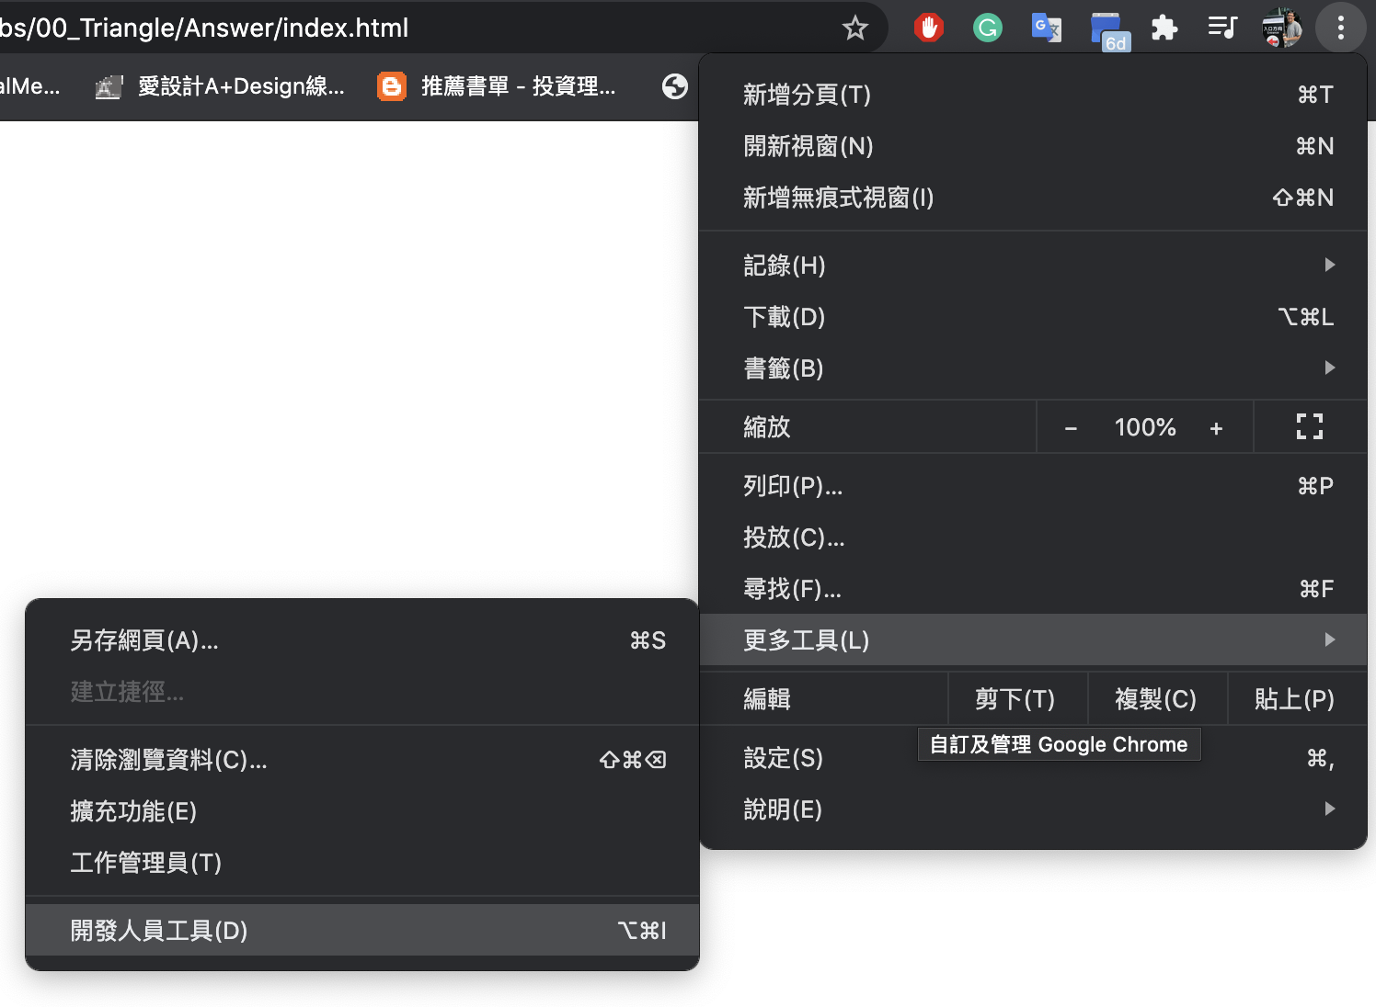
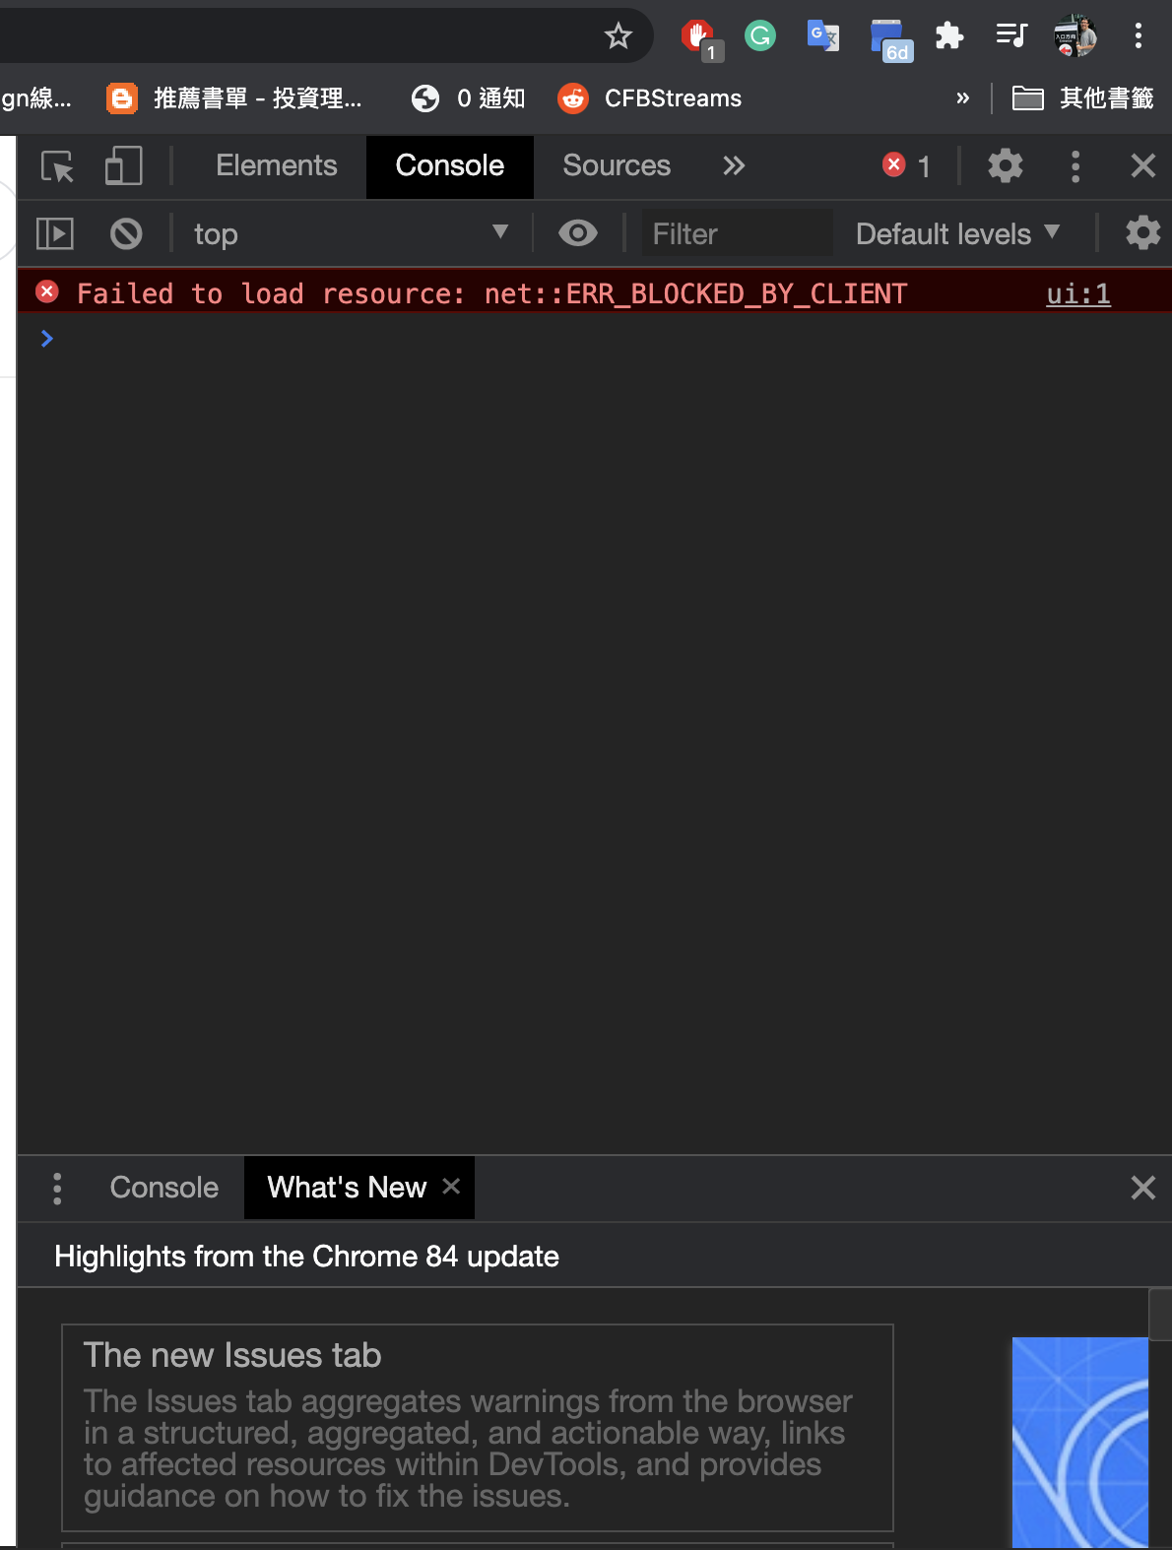
What if the browser does not load you new code
You can force the browser to refresh its cache
Here is an example for Chrome
Open the developer tool
Long press on the refresh button, then select “hard reload”

Slide 16
Submission Instruction
Create a folder
Put the html and js files in the folder
Zip the folder
Rename the zip file to your student ID
For example, if your student ID is “40312345s”, rename the zip file to “40312345s.zip”
Submit the renamed zip file to Moodle
Make sure
you put all files in the folder to zip
You submit the zip file with correct name
You won’t get any point if
the submitted file does not follow the naming rule,
TA cannot run your code,
or cannot unzip your zip file.

