Slide 1

Lab 7

Slide 2
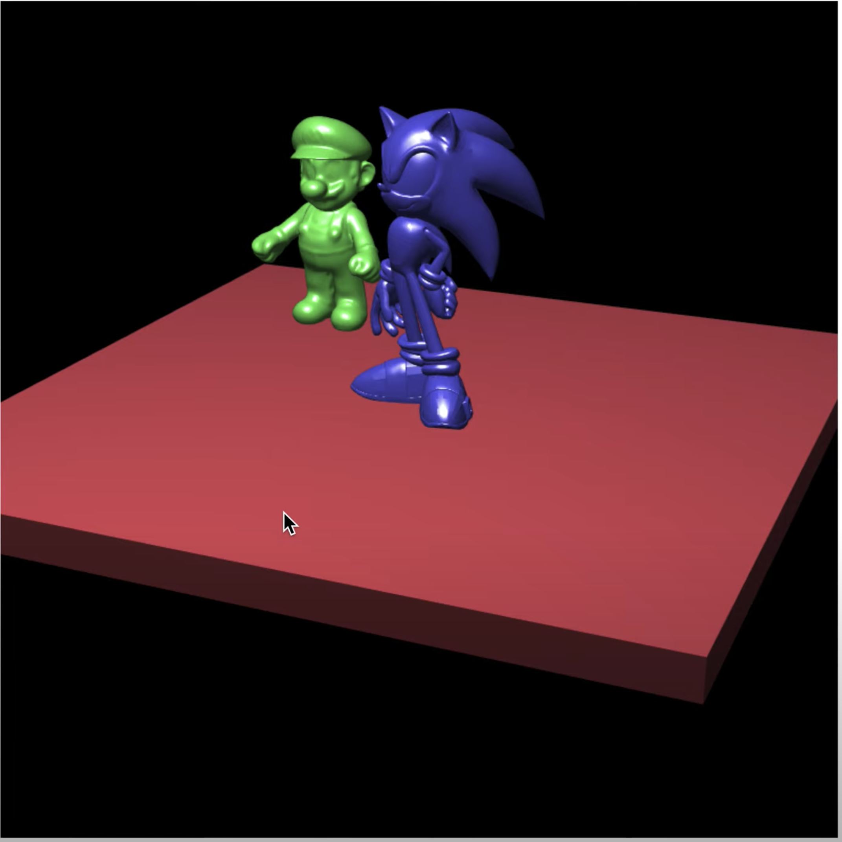
Download the lab7 template
You will load the mario and sonic model and create a cube to render the scene
You should use scale() to make the cube look like a ground
Mario and sonic should stand right on the ground
Maio and sonic should be rescaled to the proper size
Mario is static
User can use sliders to move and rotate the sonic
Nice illumination on all objects
Please check this video, this is the result you should have
https://www.youtube.com/watch?v=oIb1jCNwDGE&list=PLsId7efYPyAah0Z64j9DpedSVAcvzOSKb&index=8

Slide 3
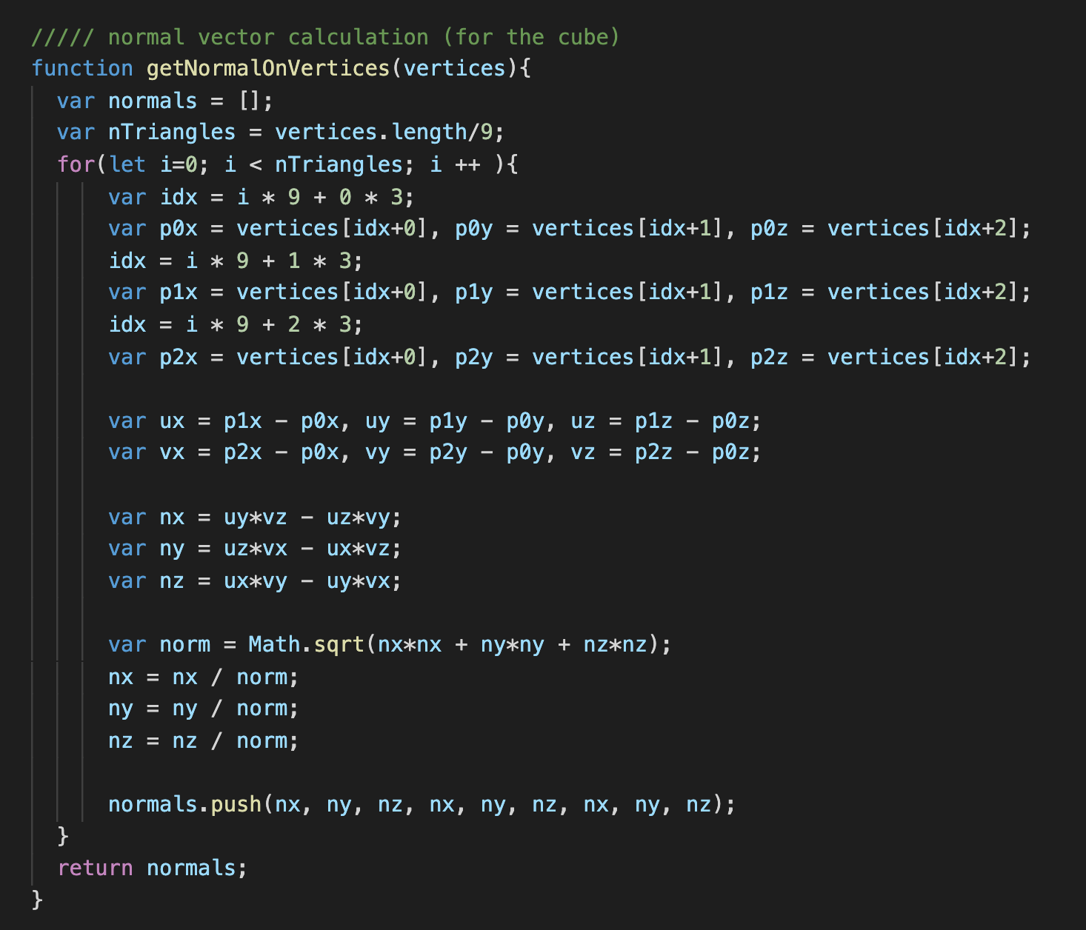
Normal Vector Calculation
I have provided the normal vector calculation function for you.
You can pass all vertices of an object to it and it will return normal vectors on each vertex to you.
Input vertices: an array. All vertices of all triangles of the object are separated (e.g. a cube: 36 input vertices)

Slide 4
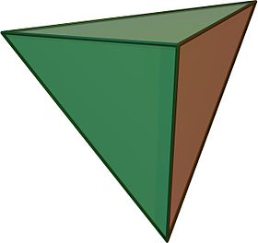
Normal Vector Calculation
Normal vector can be calculated by ”cross product” of two vectors which come from two edge of the triangle
https://en.wikipedia.org/wiki/Cross_product
Key to correctly calculate normal vector (let‘s focus on the green triangle)
We can get normal vector which point to outside of the object of inside of the object
What we want is the normal vector which points to outside of the object
u
u
n’: Point to inside
n: Point to inside
v
v
n = u x v
n’ = v x u

Slide 5

Normal Vector Calculation
By the normal vector calculation function I provide
You should give the vertices of a triangles in counter clock wise order (when you look at the triangle from outside)
n = u x x
$n_{x}=u_{y}∗v_{z}−u_{z}∗v_{y}$
$n_{y}=u_{z}∗v_{x}−u_{x}∗v_{z}$
$n_{z}=u_{x}∗v_{y}−u_{y}∗v_{x}$
1
u
0
n: Point to inside
v
n = u x v
2

Slide 6
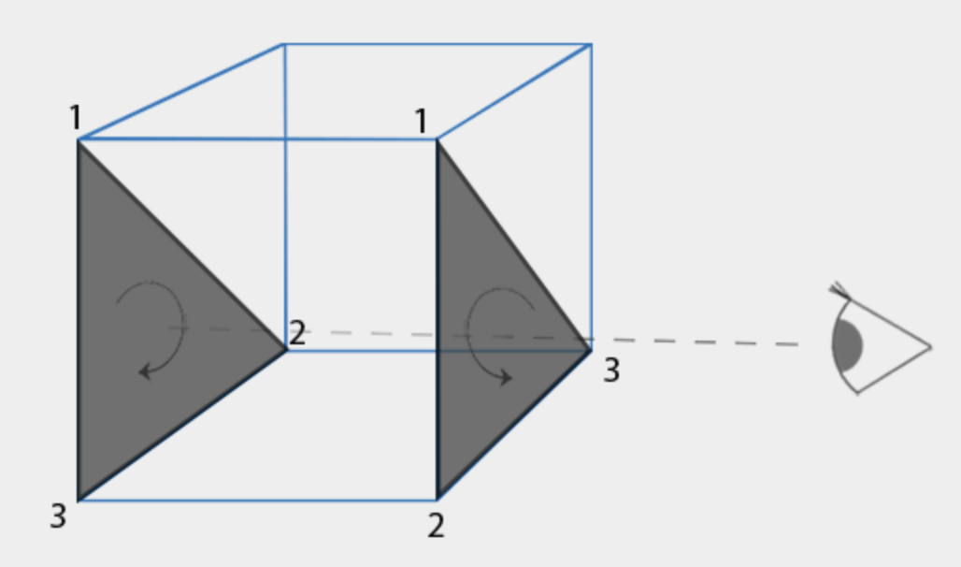
Why the Order of Vertices is Important?
(You do NOT need to know this page to complete this practice. I just would like to say why the order of vertices matters in regular webgl rendering pipeline)
https://learnopengl.com/Advanced-OpenGL/Face-culling
Reading for face culling
To help GL to save computational time
Determine a face a front or back face
Ignore the back face for the fragment shader

Slide 7
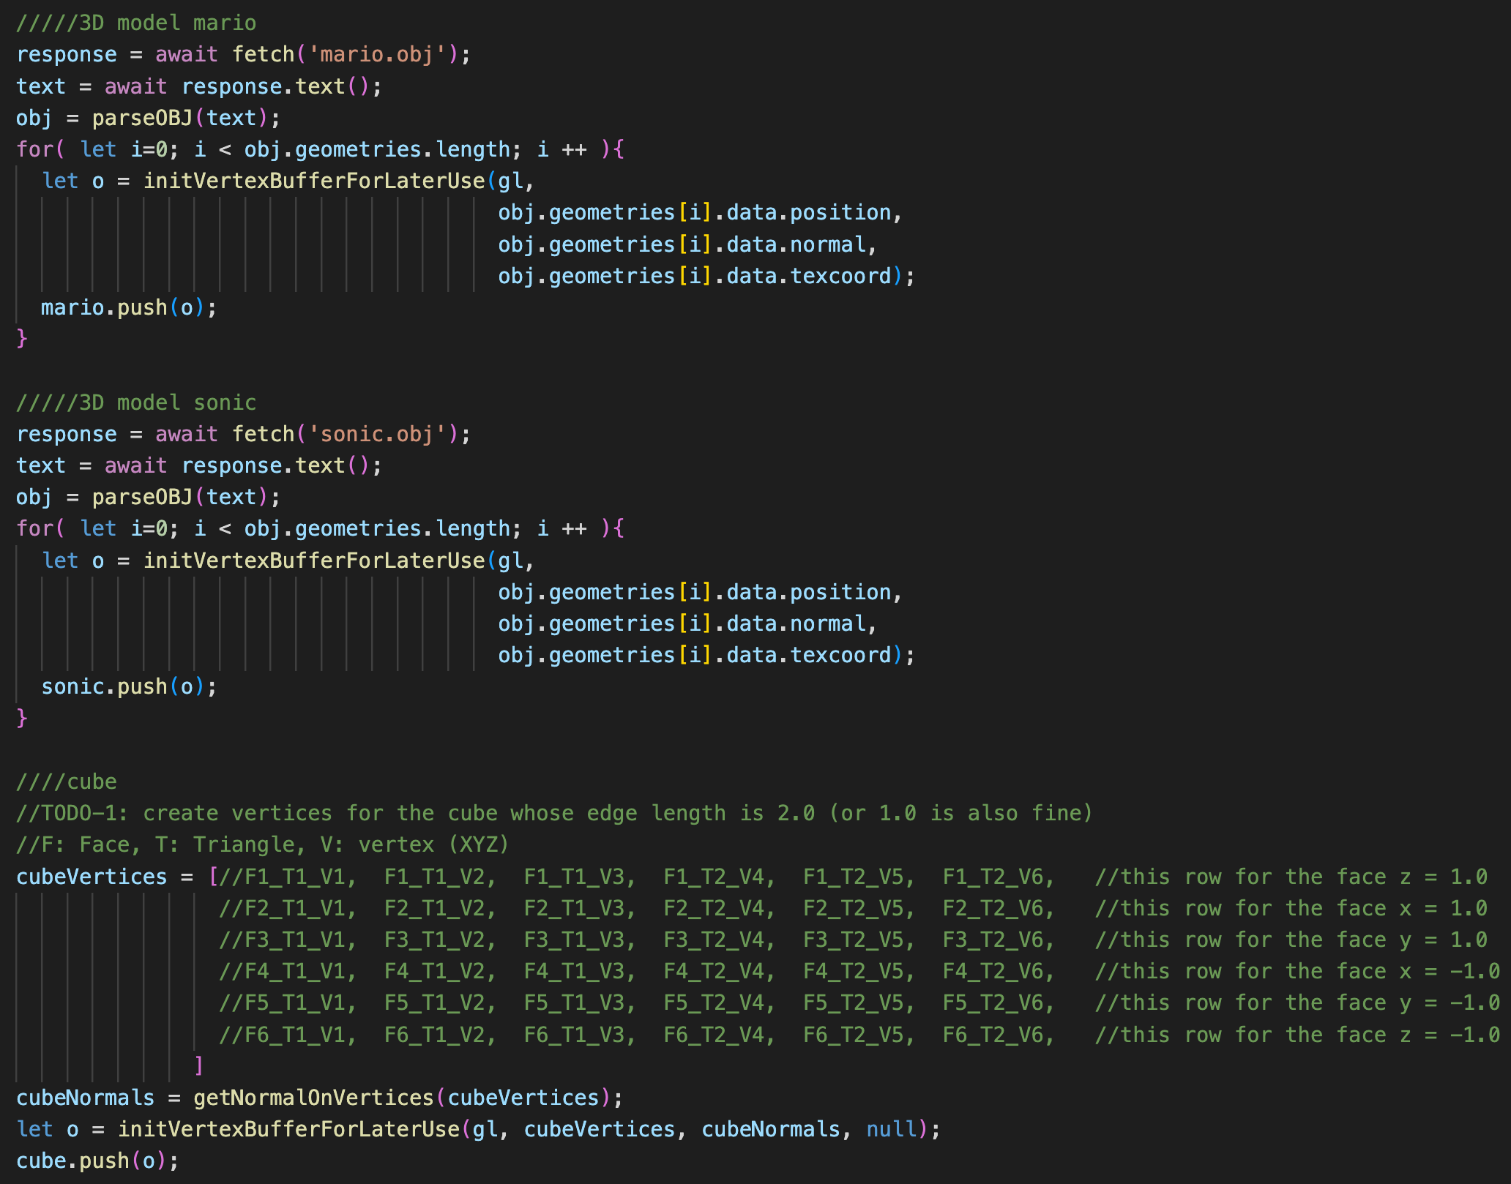
Check ”TODO”s
In main(), fill the vertices xyz of the cube in “cubeVertices”
Let getNormalVertices() calculates the correct normal vectors for you
We have loaded and setup two external 3D models for you

Slide 8
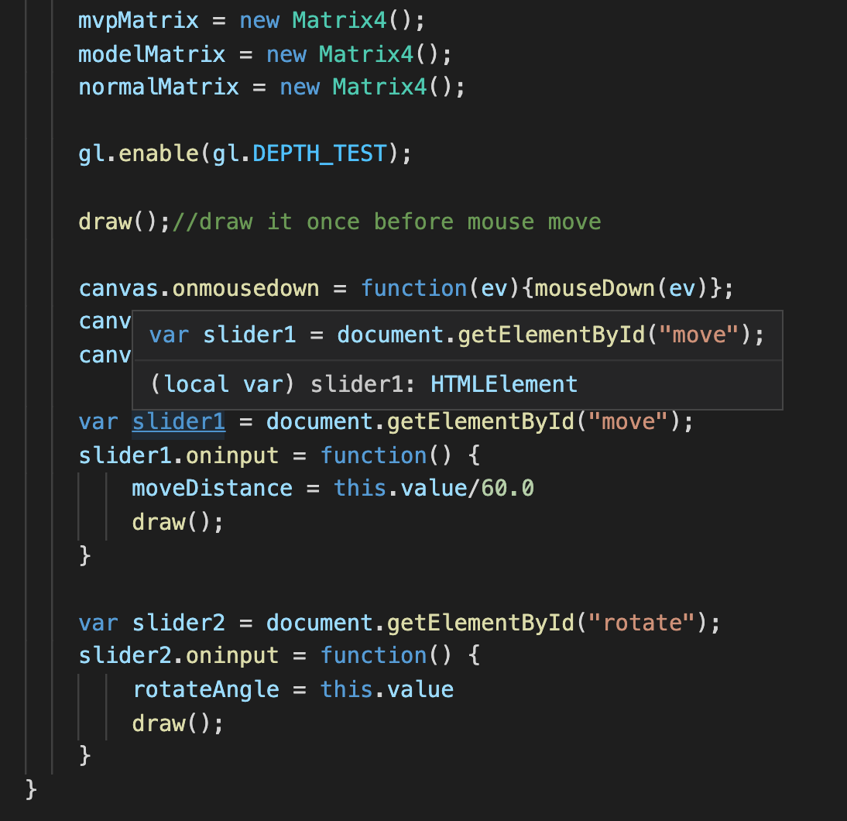
TODO-2 -3 -4
At the end of main(), we have registered the sliders and mouse events
When the slides are dragged, we will get the reading and store values into “moveDistance” and “rotateAngle”, then redraw the scene.

Slide 9
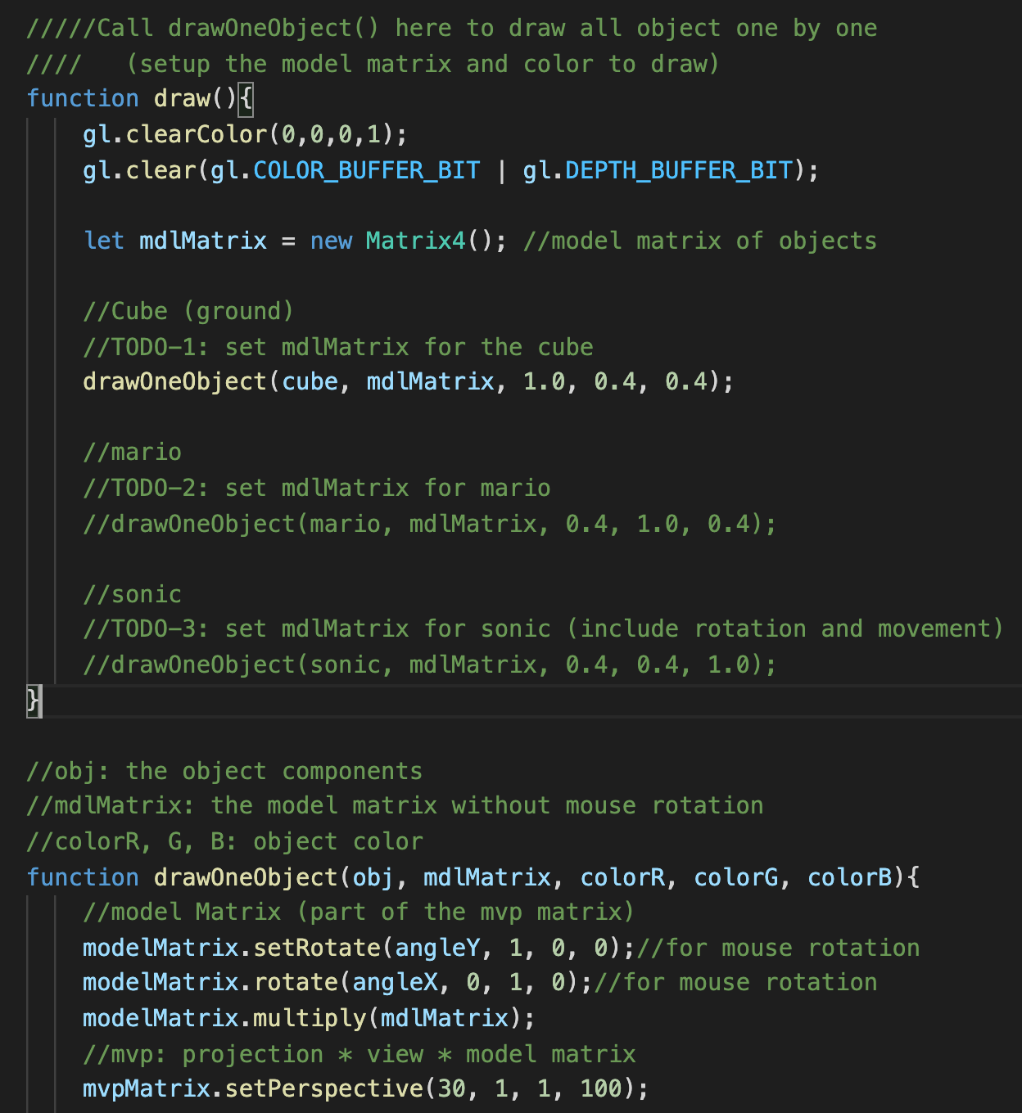
TODO-2 -3 -4
In draw(), we should set up the model matrix (without considering the mouse(view) rotation) into mdlMatrix and call drawOneObject() to draw an object
Cube(ground)
Mario
Sonic

Slide 10
What You Should Do for “Submission”

Slide 11
Submission Instruction
Create a folder
Put the html and js files in the folder
Zip the folder
Rename the zip file to your student ID
For example, if your student ID is “40312345s”, rename the zip file to “40312345s.zip”
Submit the renamed zip file to Moodle
Make sure
you put all files in the folder to zip
You submit the zip file with correct name
You won’t get any point if
the submitted file does not follow the naming rule,
TA cannot run your code,
or cannot unzip your zip file.

