Slide 1

Lab 9

Slide 2
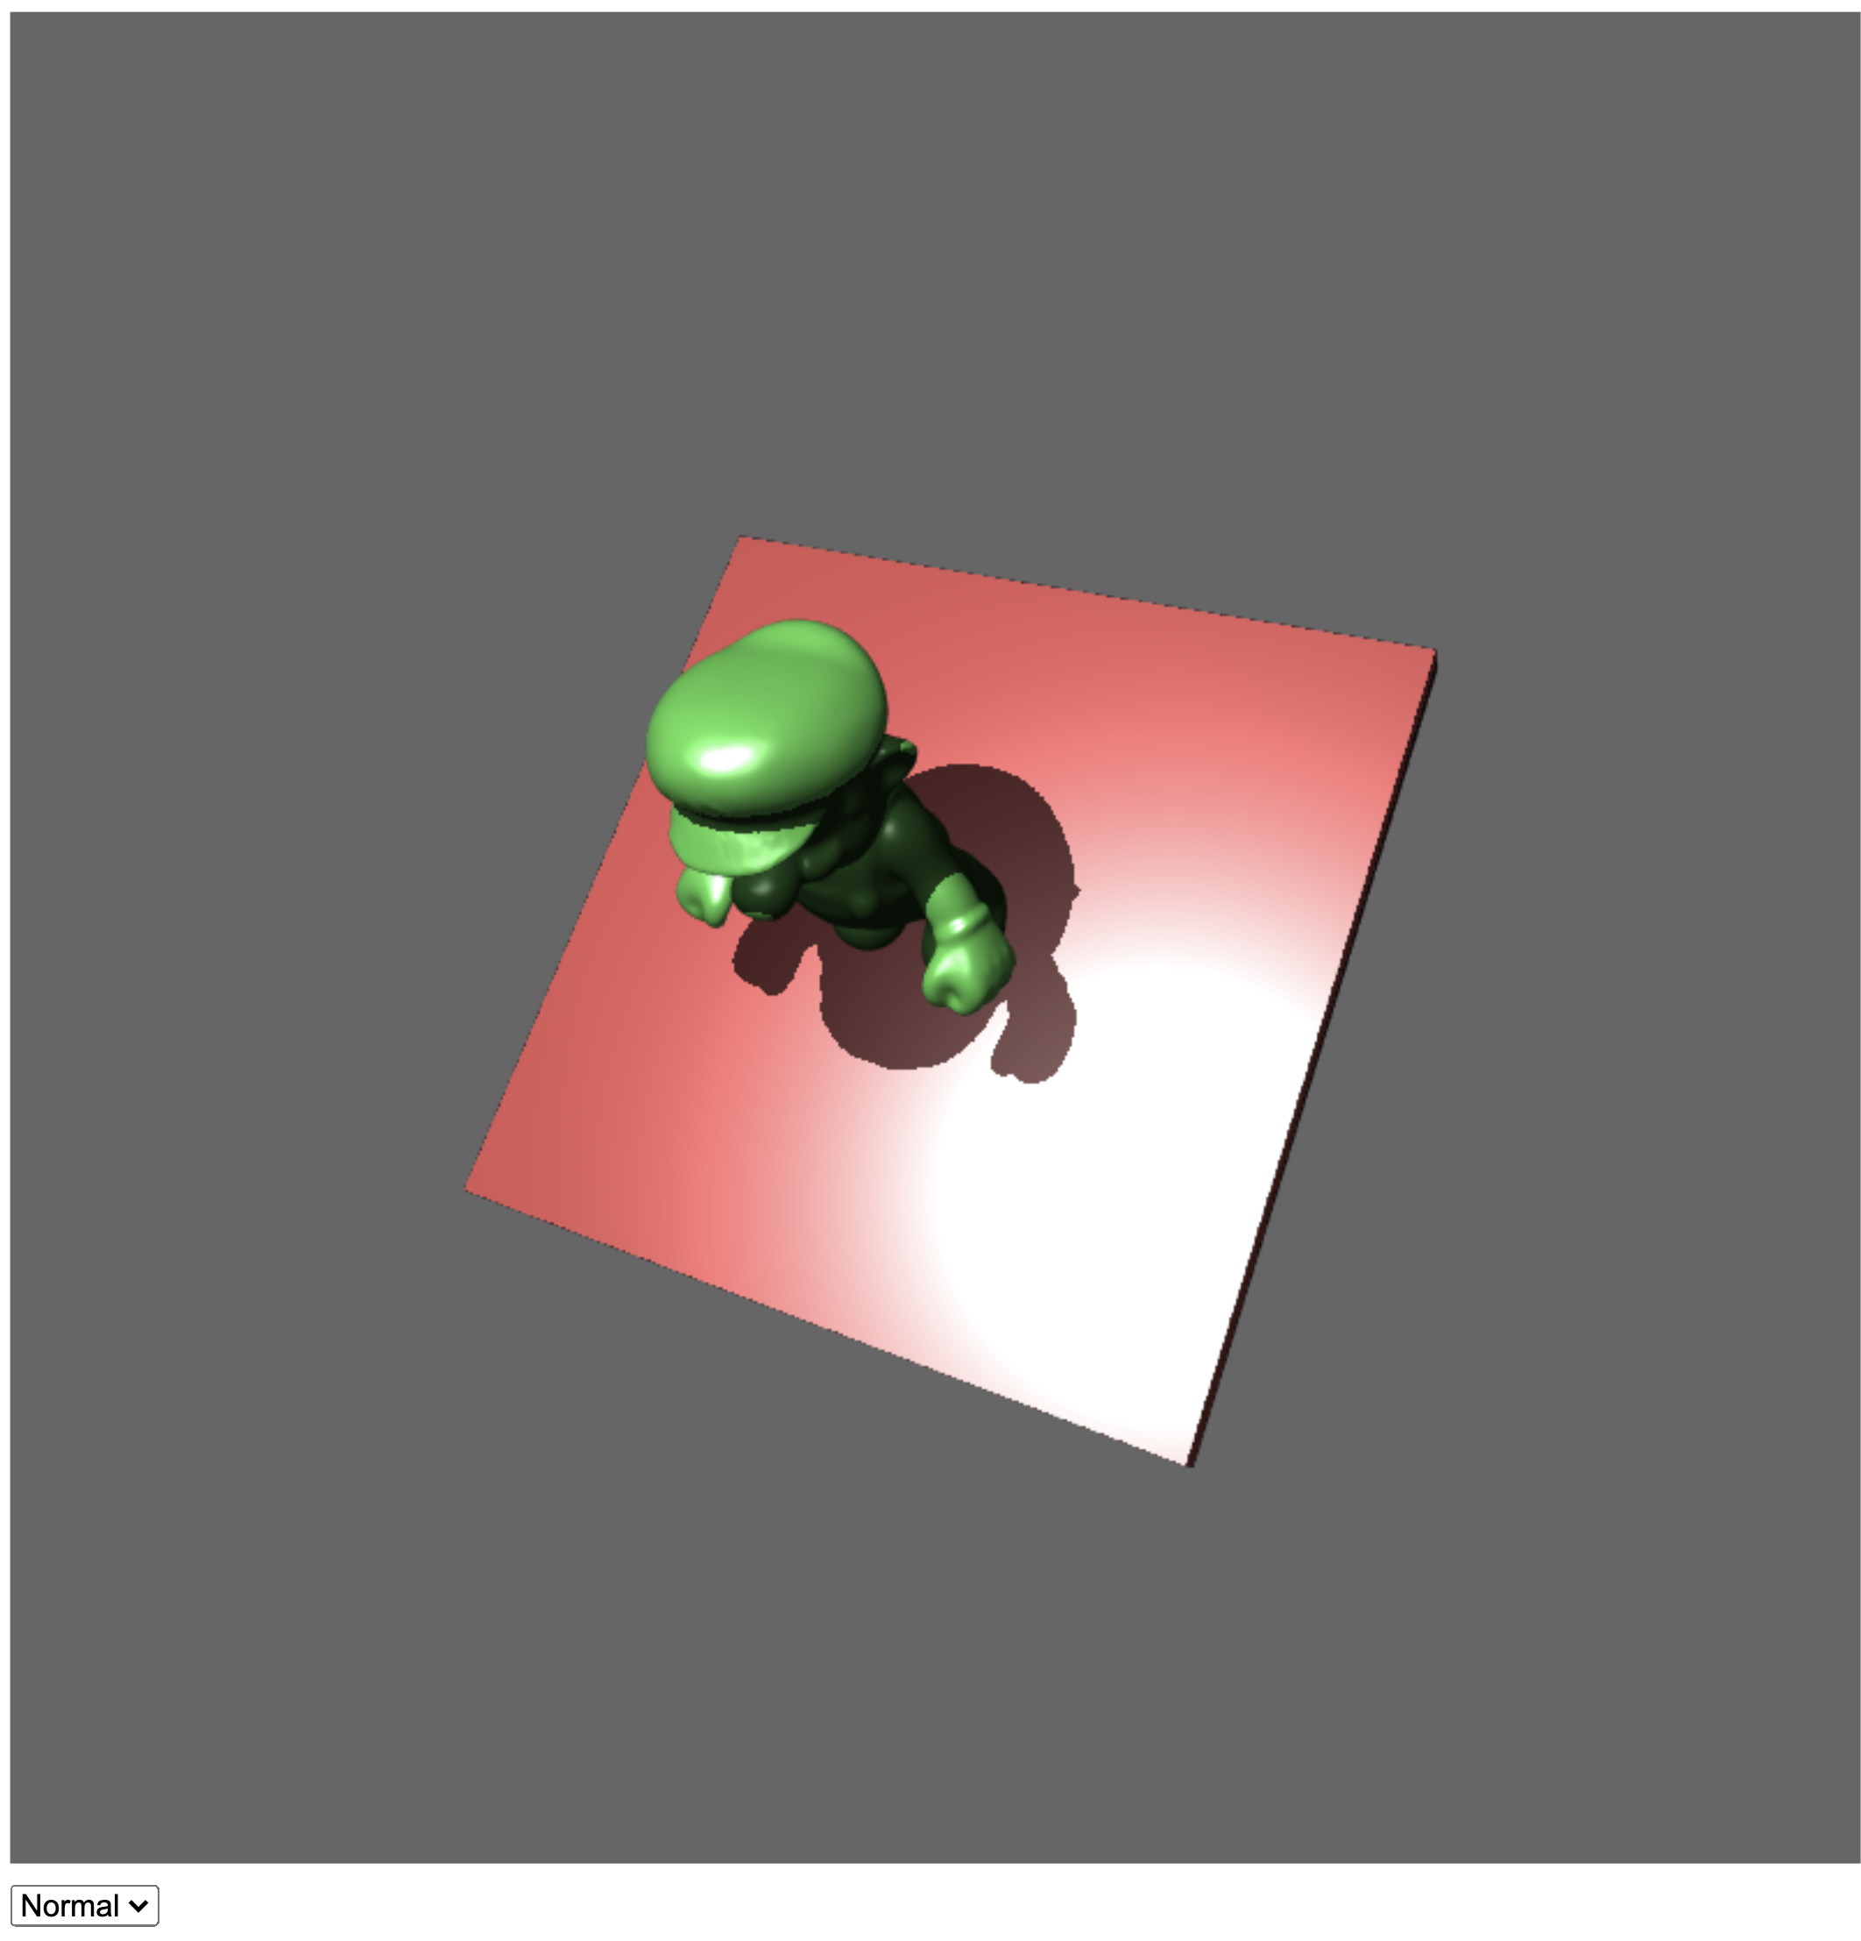
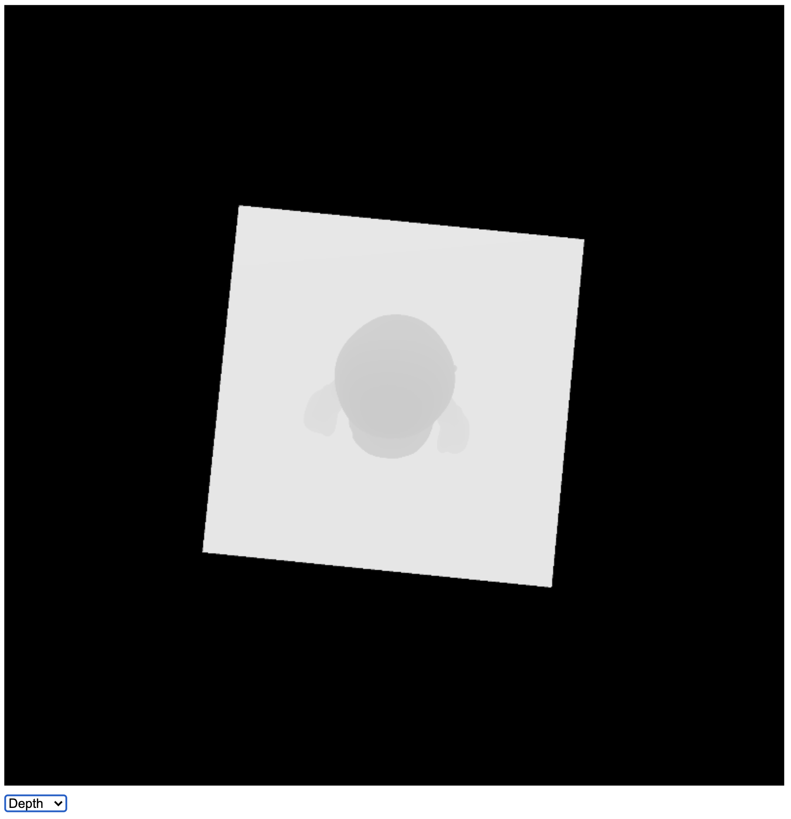
Download the lab9 template
Use the dropdown menu to show what the “light” sees
https://www.youtube.com/watch?v=tObYAhA2iGo&ab_channel=Ko-ChihWang

Slide 3
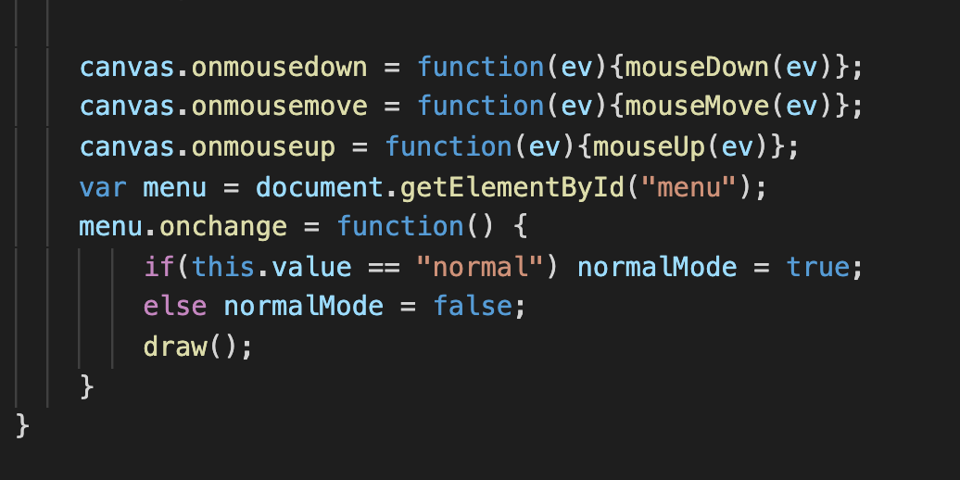
Bottom of the main() function
If users switch the drop-down menu, the value of ”normalMode” is modified to indicate what should be shown on the canvas now.

Slide 4
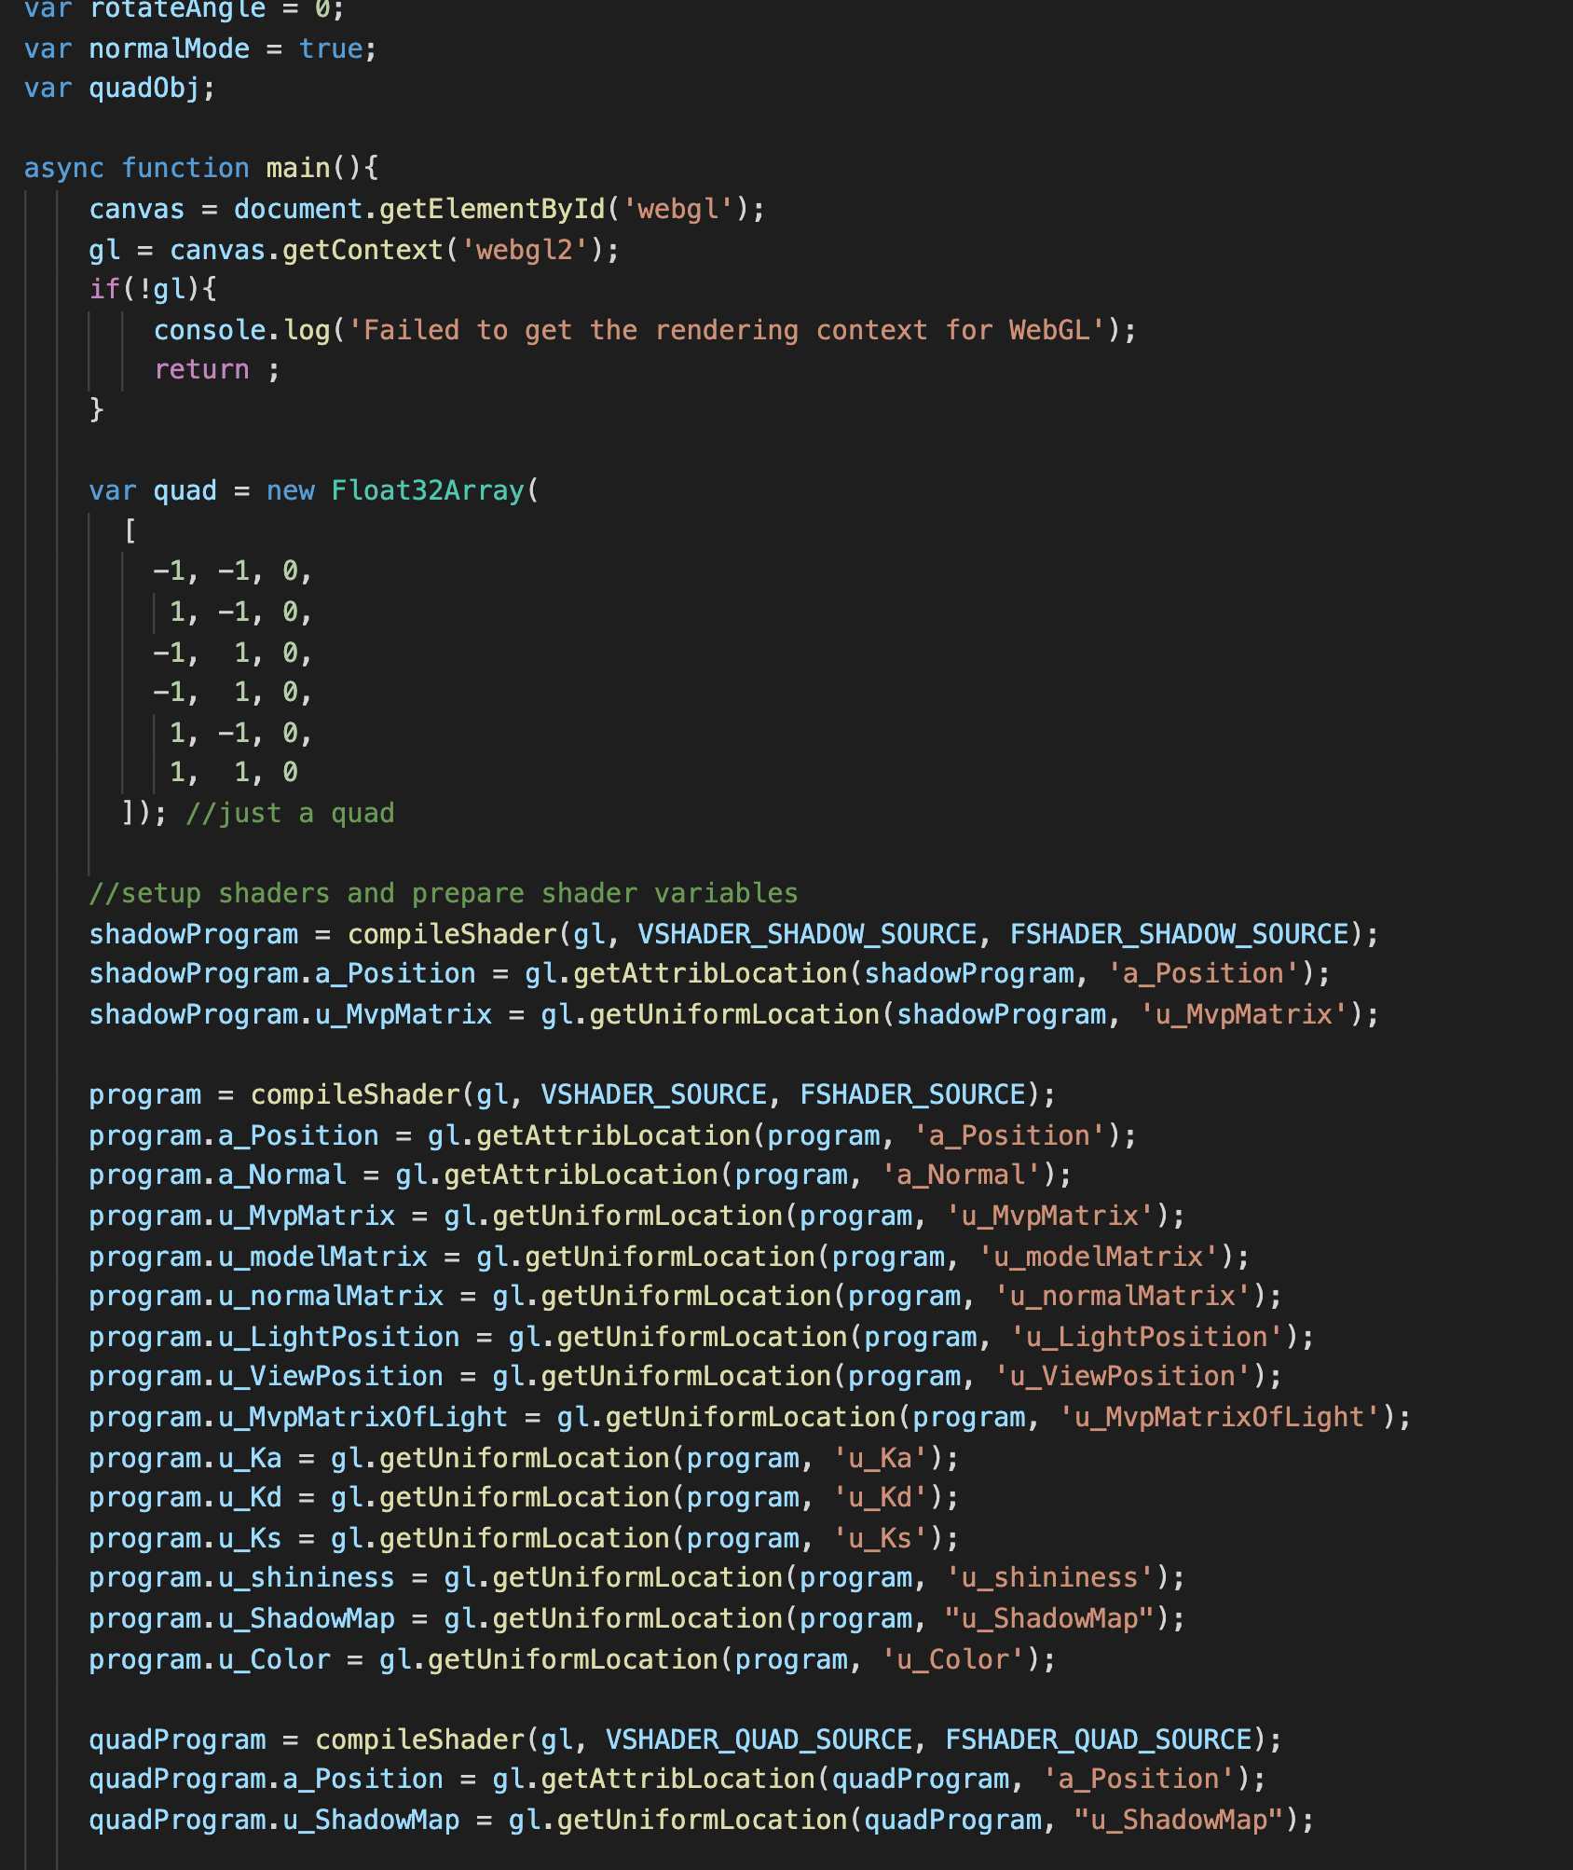
The idea of show a texture on canvas
Just draw a quad to cover whole canvas
Trick: set the quad coordinate to ([-1, +1], [-1, +1]) match the x-y range of coordinate of clip space
Directly set the quad coordinate to gl_Position in vertex shader
Look up the texture to color the quad in the fragment shader
(1,1)
Btw, we compile the quadProgram here
(-1,-1)

Slide 5
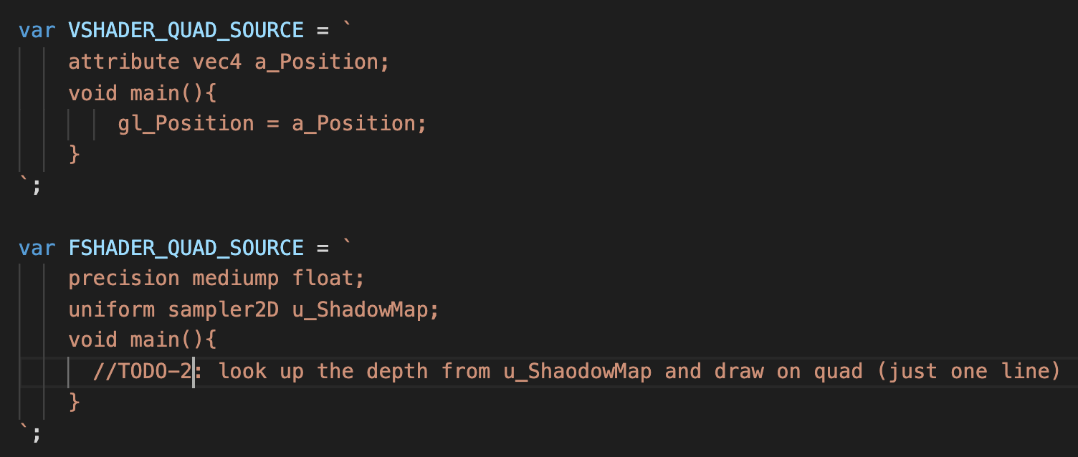
The idea of show a texture on canvas
Just draw a quad to cover whole canvas
Trick: set the quad coordinate to ([-1, +1], [-1, +1]) match the x-y range of coordinate of clip space
Directly set the quad coordinate to gl_Position in vertex shader
Look up the texture to color the quad in the fragment shader (this is your TODO-2)
(1,1)
(-1,-1)

Slide 6
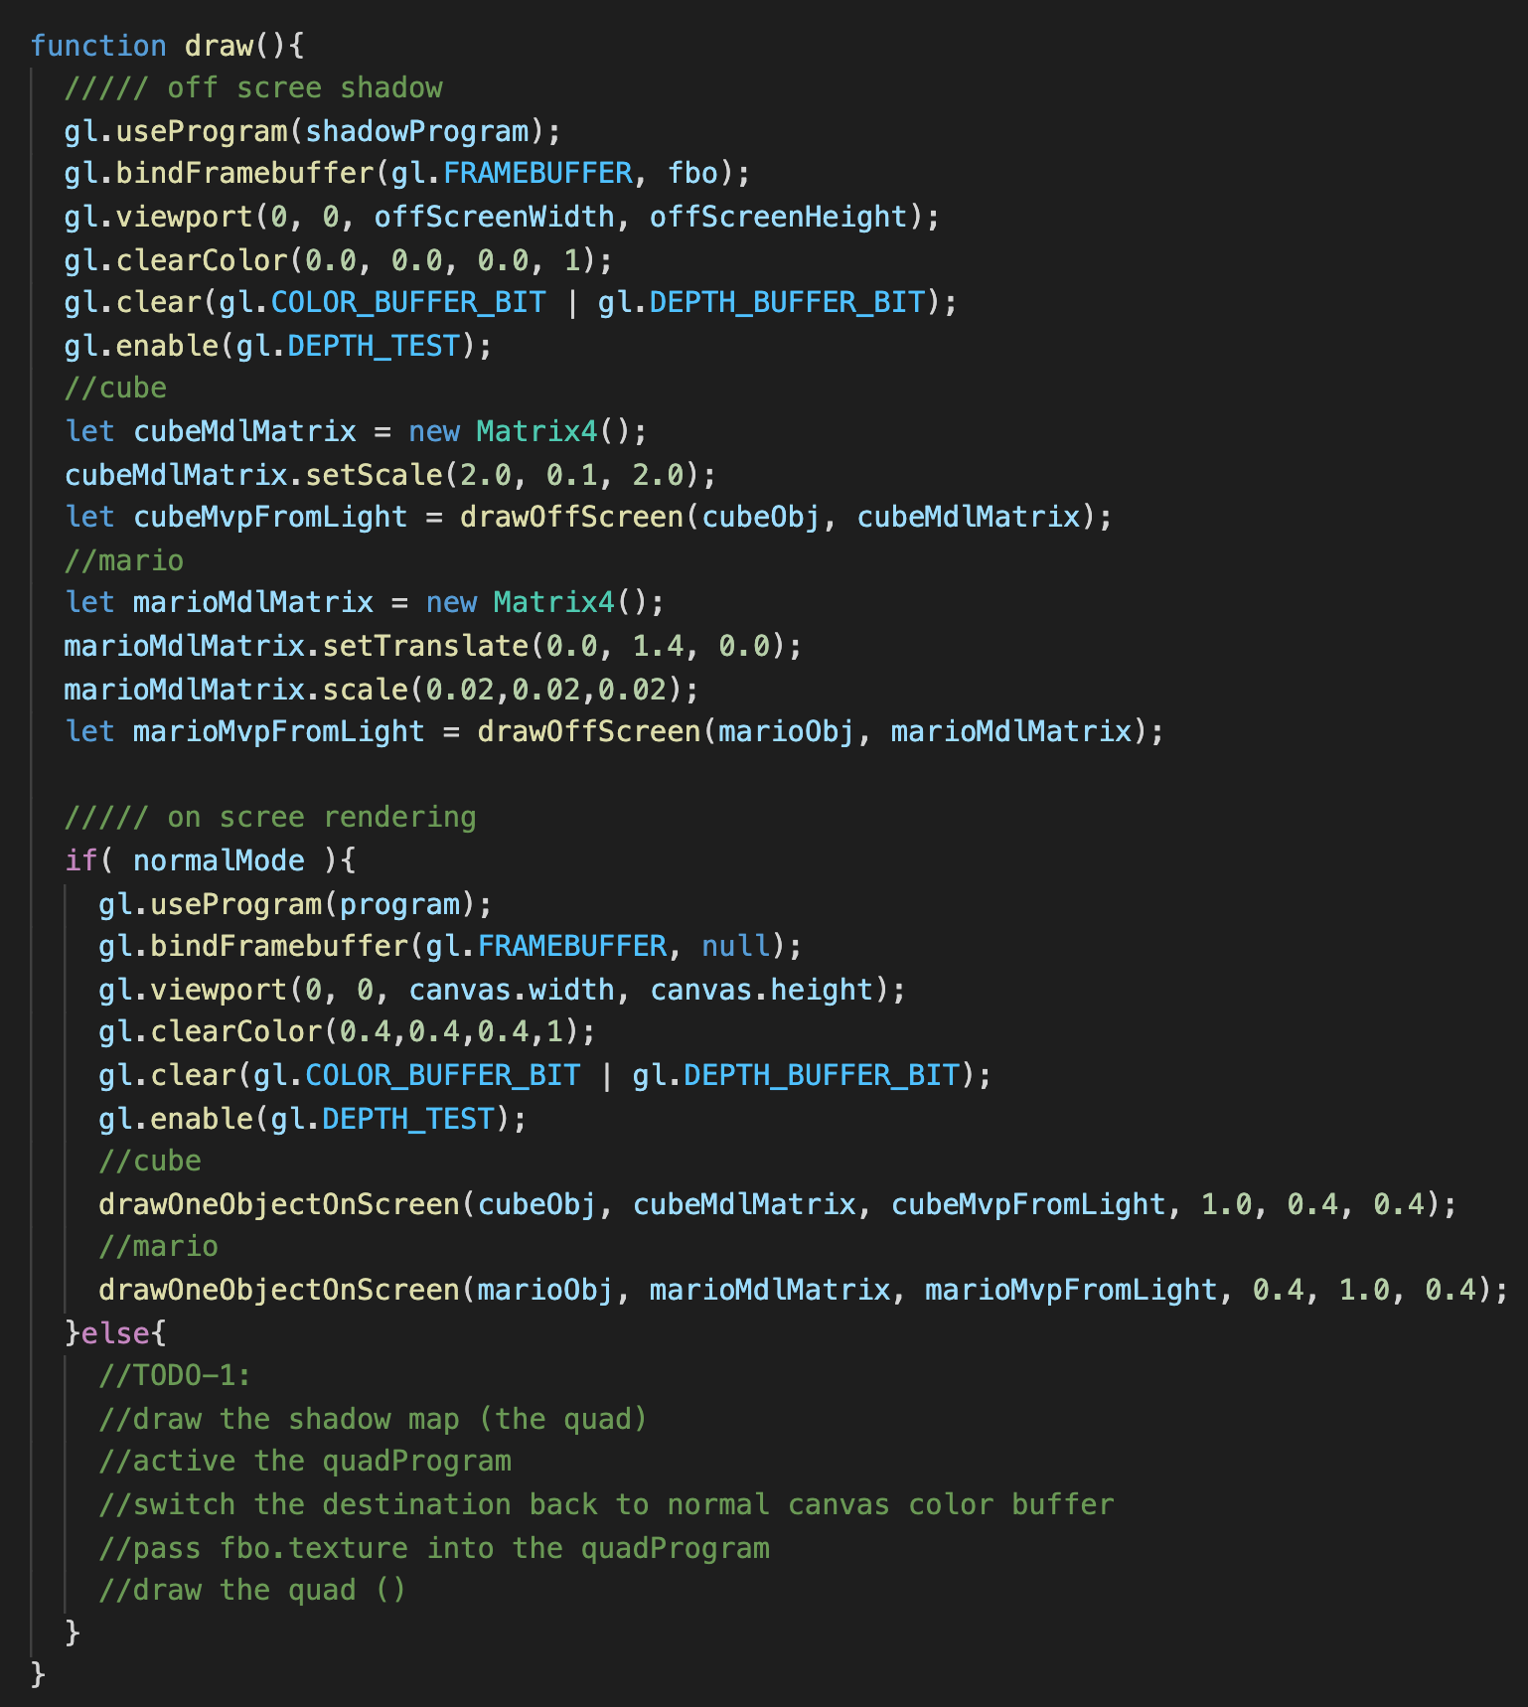
If the mode is not normal Mode (normalMode == false)
In order to show what the “light” sees, you should use ”quadProgram”(shader) to draw a quad, pass the fbo.texture to the shader to color the quad
This is your TODO-1

Slide 7
What You Should Do for “Submission”

Slide 8
Submission Instruction
Create a folder
Put the html and js files in the folder
Zip the folder
Rename the zip file to your student ID
For example, if your student ID is “40312345s”, rename the zip file to “40312345s.zip”
Submit the renamed zip file to Moodle
Make sure
you put all files in the folder to zip
You submit the zip file with correct name
You won’t get any point if
the submitted file does not follow the naming rule,
TA cannot run your code,
or cannot unzip your zip file.

