Slide 1
Computer Programming
Simple and Compound Statements

Slide 2

Agenda
Lecture Goal(s)
Variables and Scope
Simple Statements
Conditional Statements
Loop Statements
Branching Statements
Conclusions

Slide 3
Lecture Goal(s)

Slide 4
Lectures Overview
1: Introduction
2: Basic data structures & Statements
3: Object-oriented programming I
4: Object-oriented programming II
5: Object-oriented programming III
6: Complex data structures
7: Threads & Exception handling
Fundamental Concepts
L
E
C
T
U
R
E
G
O
A
L
S

Slide 5

Today's Goal
To provide programming
knowledge about statements
L
E
C
T
U
R
E
G
O
A
L
S

Slide 6
Variable and Scope

Slide 7
Variable Definition
A variable is an item of data named by an identifier
V
A
R
I
A
B
L
E
S
&
S
C
O
P
E

Slide 8

Java Identifiers
Unlimited-length sequence of
  Java letters A-Z, a-z, _, $
  Java digits 0-9
First a letter
Caution!
  keywords
  literals true or false
  null null
V
A
R
I
A
B
L
E
S
&
S
C
O
P
E

Slide 9

Java Keywords
abstract double int strictfp
boolean else interface super
break extends long switch
byte final native synchronized
case finally new this
catch float package throw
char for private throws
class goto protected transient
const if public try
continue implements return void
default import short volatile
do instanceof static while
V
A
R
I
A
B
L
E
S
&
S
C
O
P
E

Slide 10
Java Identifier Examples
Correct
  myVariable
  my2ndVariable (better: mySecondVariable)
  _internalVariable
  _i_love_underscores
  $legacyVariable
Incorrect
  1stVariable
  vice-versa
V
A
R
I
A
B
L
E
S
&
S
C
O
P
E

Slide 11

Variable Definition in Java
With initialization
  type name = value;
    int counter = 0;
With late initialization
  type name;
  name = value;
    int counter;
    counter = 0;
V
A
R
I
A
B
L
E
S
&
S
C
O
P
E

Slide 12
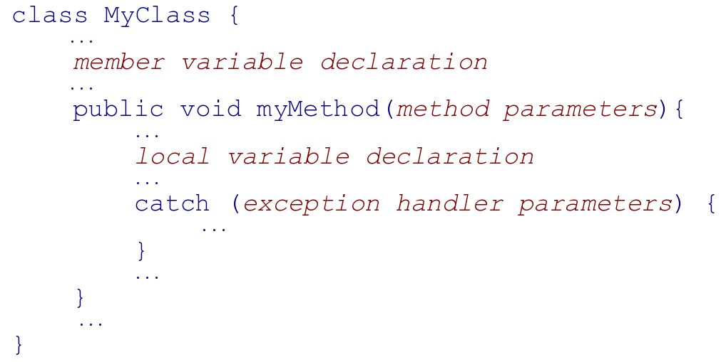
Variable Classification in Java
Four categories
  member variable
  local variable
  method parameter
  exception-handler parameter
V
A
R
I
A
B
L
E
S
&
S
C
O
P
E

Slide 13
Example
package pl.poznan.ae.compProg;
import java.util.*;
public class Sorter {
private List _words;
public void sort(String[] words){
_words = Arrays.asList(words);
Collections.sort(_words);
}
public String getSortedWords(){
String sortedString = "";
for (int i = 0; i< _words.size(); i++){
sortedString += _words.get(i);
}
return sortedString;
}
public static void main(String[] args){
Sorter sorter = new Sorter();
sorter.sort(args);
System.out.println(sorter.getSortedWords());
}
}
Member variable
Local variable
V
A
R
I
A
B
L
E
S
&
S
C
O
P
E
Method parameter

Slide 14
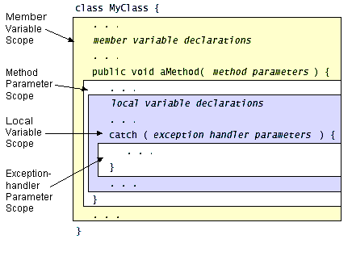
Scope
Where a variable can be referred
Scope ≠ visibility
V
A
R
I
A
B
L
E
S
&
S
C
O
P
E

Slide 15
Simple Statements

Slide 16
Statement Definition
A statement is
a complete unit
of execution
S
I
M
P
L
E
S
T
A
T
E
M
E
N
T
S

Slide 17
Empty Statement
Syntax: ;
Does nothing(!)
Always complete normally
S
I
M
P
L
E
S
T
A
T
E
M
E
N
T
S

Slide 18
Expression Definition
An expression is a series
of variables, operators, and method calls that evaluates
to a single value
S
I
M
P
L
E
S
T
A
T
E
M
E
N
T
S

Slide 19

Expression Examples
counter = 0
counter++
reset(counter)
counter + minValue
S
I
M
P
L
E
S
T
A
T
E
M
E
N
T
S

Slide 20
Expression Statements
<expression> ; is a <statement>
Only some expressions
  Assignment expressions
  Any use of ++ or --
  Method calls
  Object creation expressions
S
I
M
P
L
E
S
T
A
T
E
M
E
N
T
S

Slide 21
Expression Statement Examples
counter = 0;
counter++;
reset(counter);
counter + minValue;
S
I
M
P
L
E
S
T
A
T
E
M
E
N
T
S

Slide 22
Block Definition
A block is a group of
zero or more statements
between balanced braces
S
I
M
P
L
E
S
T
A
T
E
M
E
N
T
S

Slide 23
Empty Block
Syntax: {}
Does nothing(!)
Always complete normally
S
I
M
P
L
E
S
T
A
T
E
M
E
N
T
S

Slide 24

Block Example
{
  counter = 0;
  counter++;
  {
    reset(counter);
    counter+minValue;
  }
}
S
I
M
P
L
E
S
T
A
T
E
M
E
N
T
S

Slide 25
Conditional Statements

Slide 26
Conditional Statement Definition
A conditional statement conditionally performs statements based on a criterion
C
O
N
D
I
T
I
O
N
A
L

Slide 27
Conditional Statements in Java
Two statements
  if-else
  switch-case
if-else
  an alternative
switch-case
  a n-choice
C
O
N
D
I
T
I
O
N
A
L

Slide 28

If-else Statement
Two forms
  if (expression) statement
  if (expression) statement1 else statement2
Criterion
  boolean expression
Statements
  simple
  compound
C
O
N
D
I
T
I
O
N
A
L

Slide 29
If-else Example
if ( (number % 2) == 0) {
  System.out.println(number+“ is an even number”);
} else {
  System.out.println(number+“ is an odd number”);
}
C
O
N
D
I
T
I
O
N
A
L

Slide 30
Switch-case Statement
One form
  switch (<expression>) {
  case value: statement;
  potentially default: statement;
  }
Criterion
  char, byte, short, or int expression
Statements
  simple
  compound
C
O
N
D
I
T
I
O
N
A
L

Slide 31


Switch-case Example
switch (number % 3) {
  case 0:
  System.out.println(number+“ can be divided by 3”);
  break;
case 1:
  System.out.println(“Number%3=1”);
  break;
  case 2:
  System.out.println(“Number%3=2”);
  break;
}
C
O
N
D
I
T
I
O
N
A
L

Slide 32
Let's Have a Break
switch (day) {
  case 1:
  case 2:
  case 3:
  case 4:
  case 5:
  System.out.println(“Working day”);
  break;
case 6:
  case 7:
  System.out.println(“Having a rest!”);
  break;
}
C
O
N
D
I
T
I
O
N
A
L

Slide 33
Default
switch (day) {
  case 1:
  case 2:
  case 3:
  case 4:
  case 5:
  System.out.println(“Working day”);
  break;
case 6:
  case 7:
  System.out.println(“Having a rest!”);
  break;
  default:
  System.out.println(“From which planet are you?”);
}
C
O
N
D
I
T
I
O
N
A
L

Slide 34
Loop Statements

Slide 35
Loop Statement Definition
A loop statement iteratively performs statements
L
O
O
P
S
T
A
T
E
M
E
N
T
S

Slide 36
Loop Statements in Java
Three statements
  while
  do-while
  for
L
O
O
P
S
T
A
T
E
M
E
N
T
S

Slide 37
While Statement
One form
  while (expression) statement
Criterion
  boolean expression
Statements
  simple
  compound
L
O
O
P
S
T
A
T
E
M
E
N
T
S

Slide 38
While Example
int counter = 0;
while (counter != 3) {
  System.out.println(“Run “+counter);
  counter++;
}
L
O
O
P
S
T
A
T
E
M
E
N
T
S

Slide 39
Do-while Statement
One form
  do statement while (expression);
Criterion
  boolean expression
Statements
  simple
  compound
L
O
O
P
S
T
A
T
E
M
E
N
T
S

Slide 40
Do-while Example
int counter = 0;
do {
  System.out.println(“Run ”+counter);
  counter++;
} while (counter !=3);
L
O
O
P
S
T
A
T
E
M
E
N
T
S

Slide 41
For Statement
One form
  for (init; condition; increment) statement
Optional expressions
  initialization
  condition
  increment
Statements
  simple
  compound
L
O
O
P
S
T
A
T
E
M
E
N
T
S

Slide 42
For Example
int myValue = 10;
for (int i = 0; i < myValue; i+=2){
  System.out.println(myValue+“ > ”+i);
}
L
O
O
P
S
T
A
T
E
M
E
N
T
S

Slide 43
Branching Statements

Slide 44
Branching Statement Definition
A branching statement alters the execution sequence
B
R
A
N
C
H
I
N
G

Slide 45
Branching Statements in Java
Three statements
  return
  break
  continue
B
R
A
N
C
H
I
N
G

Slide 46
Return Statement
Two forms
  return;
  return <value>;
Exits from the current method
B
R
A
N
C
H
I
N
G

Slide 47
Return Example
public int dividedByThree(int number) {
switch (number % 3) {
  case 0:
  System.out.println(number+“ can be divided by 3”);
  return number;
case 1:
  System.out.println(number+”%3=1”);
  break;
  case 2:
  System.out.println(number+”%3=2”);
  break;
  }
  return 0;
}
B
R
A
N
C
H
I
N
G

Slide 48
Break Statement
Two forms
  break;
  break <label>;
Terminates statements
  switch
  while
  do-while
  for
B
R
A
N
C
H
I
N
G

Slide 49
Break Example
switch (number % 3) {
  case 0:
  System.out.println(number+“ can be divided by 3”);
  break;
case 1:
  System.out.println(number+”%3=1”);
  break;
  case 2:
  System.out.println(number+”%3=2”);
  break;
}
B
R
A
N
C
H
I
N
G

Slide 50


Break Example with Label
int first, second;
compute:
  for (int i = 0; i<10 ; i++){
    for (int j = 0; j< i; i++) {
      int sum = i+j;
      if ( sum > 15 ){
        first = i;
        second = j;
        break compute;
      }
    }
  }
System.out.println(“Found 15=”+first+”+”+second);
B
R
A
N
C
H
I
N
G

Slide 51
Continue Statement
Two forms
  continue;
  continue <label>;
Go back to iteration expressions of statements
  while
  do-while
  for
B
R
A
N
C
H
I
N
G

Slide 52
Continue Example
for (int i = 0; i<100 ; i++){
    if ( (i % 7) != 0 )
      continue;
    System.out.println(i+“ may be divided by 7”);
}
B
R
A
N
C
H
I
N
G

Slide 53
Continue Example with Label
compute:
  for (int i = 0; i<10 ; i++){
    for (int j = 0; j< i; i++) {
      int sum = i+j;
      if ( sum > 15 ){
        System.out.println(“15=”+i+”+”+j);
        continue compute;
      }
    }
  }
B
R
A
N
C
H
I
N
G

Slide 54
Conclusions

Slide 55
Conclusions
Variables
Simple statements
  expressions
  blocks
Control flow statements
  conditional statements
  loop statements
  branching statements
C
O
N
C
L
U
S
I
O
N
S

Slide 56
Example
package pl.poznan.ae.compProg;
import java.util.*;
public class Sorter {
private List _words;
public void sort(String[] words){
_words = Arrays.asList(words);
Collections.sort(_words);
}
public String getSortedWords(){
String sortedString = "";
for (int i = 0; i< _words.size(); i++){
sortedString += _words.get(i);
}
return sortedString;
}
public static void main(String[] args){
Sorter sorter = new Sorter();
sorter.sort(args);
System.out.println(sorter.getSortedWords());
}
}
C
O
N
C
L
U
S
I
O
N
S

Slide 57
See you next week

