Slide 1
Computer Programming
Object-Oriented
Programming III
The Revenge

Slide 2

Agenda
Lecture Goal(s)
From Italy to Indonesia
Interfaces, Classes, and Objects
Attributes and Methods
Refreshments and Peanuts
Inheritance
Polymorphism
Encapsulation
Conclusions

Slide 3
Lecture Goal(s)

Slide 4
Lectures Overview
1: Introduction
2: Basic data structures & Statements
3: Object-oriented programming I
4: Object-oriented programming II
5: Object-oriented programming III
6: Complex data structures
7: Threads & Exception handling
Fundamental Concepts
L
E
C
T
U
R
E
G
O
A
L
S

Slide 5
Today's Goal
To provide programming
knowledge about
object-oriented (OO) programming
L
E
C
T
U
R
E
G
O
A
L
S

Slide 6
Refreshments and
Peanuts

Slide 7
Example of Interface
class IAnimal{
int getWeight();
String getName();
void shout();
void eat();
void eat(int FoodAmount);
}
R
E
F
R
E
S
H
M
E
N
T
S

Slide 8
Example of Class
class Cat implements IAnimal{
int _weight;
String _name;
Cat(int weight, String name){
_weight = weight;
_name = name;
}
...
}
Cat myCat = new Cat(1200, “Felix”);
R
E
F
R
E
S
H
M
E
N
T
S

Slide 9
Example of Class
class Cat implements IAnimal{
int _weight;
String _name;
int getWeight(){
return _weight;
}
String getName(){
return _name;
}
...
}
R
E
F
R
E
S
H
M
E
N
T
S

Slide 10
Example of Class
class Cat implements IAnimal{
...
void shout(){
System.out.println(“Miaow”);
}
void eat(){
_weight += 200;
}
void eat(int foodAmount){
_weight += foodAmount;
}
}
System.out.prinln(myCat.getName()+
” says “+ myCat.shout());
R
E
F
R
E
S
H
M
E
N
T
S

Slide 11

Java String
A String is
  An object
  A chain of characters
Example
String catName = new String(“Felix”);
String catName = “Felix”;
Useful “tricks”
  Adding strings: “My cat's name is “ + catName;
  Comparing: catName.equals(“Felix”);
P
E
A
N
U
T
S

Slide 12


The main() method
public class Cat{
public static void main(String[] args){...}
}
Run by java Cat
Arguments
  String[] args
  Number of arguments: args.length
Example
  java Cat “Felix” “1200”
  args[0] = “Felix”, args[1] = “1200”
P
E
A
N
U
T
S

Slide 13
Inheritance

Slide 14
Classes and Interfaces
A class which implements an interface must define all methods declared in the interface
I
N
H
E
R
I
T
A
N
C
E

Slide 15
Classes and Interfaces in Java
Syntax
class <className> implements <interfaceName>{
...
}
Example
class Cat implements IAnimal{
...
}
I
N
H
E
R
I
T
A
N
C
E

Slide 16
Classes and Subclasses
A subclass which extends a class inherits attributes and methods from the its superclass and all its ancestors
I
N
H
E
R
I
T
A
N
C
E

Slide 17
Classes and Subclasses in Java
Syntax
class <className> extends <parentClassName>{
...
}
Example
class PersianCat extends Cat{
...
}
I
N
H
E
R
I
T
A
N
C
E

Slide 18
Overriding Methods
Redefinition of a method in a subclass
  specialization
  possible code reuse
Identical method signature
Constructors
I
N
H
E
R
I
T
A
N
C
E

Slide 19
Overriding Methods in Java
class Cat {
void eat(){
_weight +=200;
}
}
class PersianCat extends Cat {
boolean _isSleeping = false;
void eat(){
super.eat();
takeANap();
}
void takeANap(){ _isSleeping = true;}
}
I
N
H
E
R
I
T
A
N
C
E

Slide 20
“this.” in Java
class PersianCat extends Cat {
int foodAmount;
void eat(int foodAmount){
this.foodAmount += foodAmount;
super.eat(foodAmount);
takeANap();
}
void eat(){
eat(200);
}
}
I
N
H
E
R
I
T
A
N
C
E

Slide 21
Overriding Constructors in Java
class Cat {
Cat(String name, int weight){
_name = name;
_weight = weight;
}
}
class PersianCat {
PersianCat(String name, int weight){
super(name, weight);
_foodAmount = 0;
_isSleeping = false;
}
}
I
N
H
E
R
I
T
A
N
C
E

Slide 22
“this()” in Java
class PersianCat {
PersianCat(String name, int weight,
int foodAmount,
boolean isSleeping){
super(name, weight);
_foodAmount = foodAmount;
_isSleeping = isSleeping;
}
PersianCat(String name, int weight){
this(name, weight, 0, false);
}
}
I
N
H
E
R
I
T
A
N
C
E

Slide 23

Multiple Inheritance
Interfaces
  may extends 0, 1 or many interfaces
  no implementation → no ambiguity
Classes
  may extends 0, 1 or many interfaces
  no implementation → no ambiguity
  may extends 0, 1 or many classes
  the “diamond” issue
I
N
H
E
R
I
T
A
N
C
E

Slide 24
The “Diamond” Issue
IAnimal
Cat
LazyAnimal
I
N
H
E
R
I
T
A
N
C
E
PersianCat

Slide 25
Polymorphism

Slide 26
Polymorphism Definition
Polymorphism is the ability of some objects to present/deal with various forms (various aspects)
P
O
L
Y
M
O
R
P
H
I
S
M

Slide 27
One Object, Various Forms
IAnimal
Cat
ILazyAnimal
P
O
L
Y
M
O
R
P
H
I
S
M
PersianCat

Slide 28

One Object,
Various Forms in Java
IAnimal
IAnimal cat = new IAnimal();
ILazyAnimal
Cat
IAnimal cat = new Cat();
IAnimal cat = new PersianCat();
IAnimal cat = new ILazyAnimal();
PersianCat
Cat cat = new Cat();
Cat cat = new PersianCat();
ILazyAnimal cat = new PersianCat();
PersianCat cat = new PersianCat();
P
O
L
Y
M
O
R
P
H
I
S
M

Slide 29
Casting Definition
Casting is the operation of changing the form of a given object
P
O
L
Y
M
O
R
P
H
I
S
M

Slide 30
Casting in Java
ICat cat1 = new PersianCat();
ILazyAnimal cat2 = new PersianCat();
cat1.takeANap() is incorrect
cat2.takeANap() is correct
ILazyAnimal cat3 =
(ILazyAnimal) cat1;
cat3.takeANap() is correct
P
O
L
Y
M
O
R
P
H
I
S
M

Slide 31
Dealing with Polymorphic Objects
Overloading methods
  in one class
  many methods
  one method name
  different parameters
Overridding methods
  in many interfaces, classes, subclasses
  the same method
  different implementations
P
O
L
Y
M
O
R
P
H
I
S
M

Slide 32
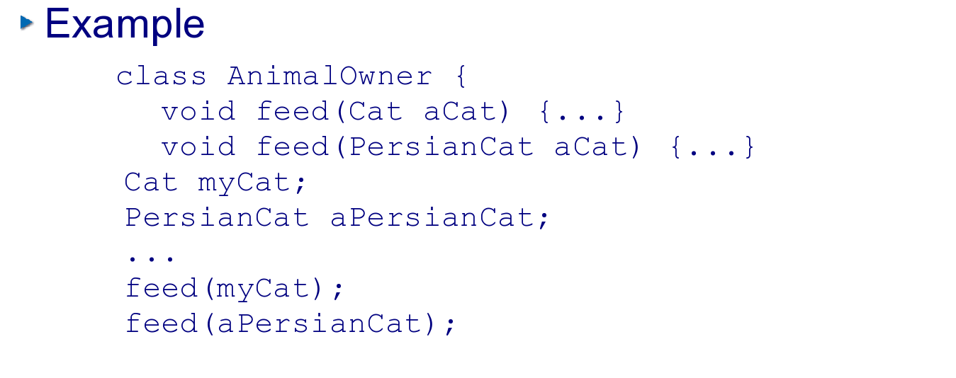
Overloading
Various methods with different arguments
Checked during compilation
P
O
L
Y
M
O
R
P
H
I
S
M

Slide 33
Overridding
One method
  with different implementations
  in various interfaces,
  classes and subclasses
Checked during run-time
A.k.a
  Late binding
  Dynamic binding
  Run-time binding
P
O
L
Y
M
O
R
P
H
I
S
M

Slide 34
Overriding in Java
class Cat {
void eat(){
_weight +=200;
}
}
class PersianCat extends Cat {
boolean _isSleeping = false;
void eat(){
super.eat();
takeANap();
}
void takeANap(){ _isSleeping = true;}
}
P
O
L
Y
M
O
R
P
H
I
S
M

Slide 35
Late Binding in Java
IAnimal
IAnimal myCat = new Cat();
IAnimal aPersianCat =
new PersianCat();
myCat.eat(){
_weight +=200;
}
aPersianCat.eat(){
super.eat();
takeANap();
}
ILazyAnimal
Cat
PersianCat
P
O
L
Y
M
O
R
P
H
I
S
M

Slide 36
Encapsulation

Slide 37

Packages in Java
Grouping classes
Package name
  Empty: default package
  (<identifier>.)* <identifier>
  e.g. java.lang
Declaration
  package <packageName>;
Use
  import <packageName>.*;
  import <packageName>.<className>;
E
N
C
A
P
S
U
L
A
T
I
O
N

Slide 38
Hiding Implementation Details
Rule 1
  No field is visible outside
  the class within it is define
Rule 2
  A method is visible iff it is used by another class
Rule 3
  Program again interfaces
E
N
C
A
P
S
U
L
A
T
I
O
N

Slide 39
Visibility in Java
A set of modifiers
  private
  protected
  public
Format
  <modifier> <field>
  e.g. private int _weight
E
N
C
A
P
S
U
L
A
T
I
O
N

Slide 40
Visibility Rules in Java
E
N
C
A
P
S
U
L
A
T
I
O
N

Slide 41
Conclusions

Slide 42
C Language vs. OOPLs
Coupling between classes, encapsulation
  procedures/functions
  data structures
Code reuse inheritance
Spread code classes, inheritance
Description vs. encapsulation
Definition
C
O
N
C
L
U
S
I
O
N
S

Slide 43
Golden Rules
Rule 1
  Use interfaces
Rule 2
  Use interfaces
Rule 3
  Use interfaces
C
O
N
C
L
U
S
I
O
N
S

Slide 44
Golden Rules
Rule 4
  Hide everything that should not be visible
Rule 5
  Decouple
Rule 6
  Give responsibility to your objects
C
O
N
C
L
U
S
I
O
N
S

Slide 45
Example
package pl.poznan.ae.compProg;
import java.util.*;
public class Sorter {
private List _words;
public void sort(String[] words){
_words = Arrays.asList(words);
Collections.sort(_words);
}
public String getSortedWords(){
String sortedString = "";
for (int i = 0; i< _words.size(); i++){
sortedString += _words.get(i);
}
return sortedString;
}
public static void main(String[] args){
Sorter sorter = new Sorter();
sorter.sort(args);
System.out.println(sorter.getSortedWords());
}
}
C
O
N
C
L
U
S
I
O
N
S

Slide 46
See you next week

