Slide 1
Computer Programming
Conclusion

Slide 2

Agenda
Lecture Goal(s)
Skills Summary
Three Editions of Java

Slide 3
Lecture Goal(s)

Slide 4
Lectures Overview
8: Summarizing Example
9: Standard library
10: GUI – AWT
11: GUI – Swing
12: IO programming
13: Network programming
14: Java archives and Reflection
15: Conclusion
Java
L
E
C
T
U
R
E
G
O
A
L
S

Slide 5
Today's Goal
To summarize earned skills
and present a broader spectrum of computer programming
L
E
C
T
U
R
E
G
O
A
L
S

Slide 6
Earned Skills and Knowledge

Slide 7

Computer Programming Culture
Notions
  Iteration
  Recursion
  Compilation
  Interpretation
Languages
  Assembler
  Basic
  Pascal
  C, C++
S
K
I
L
L
S
&
K
N
O
W
L
E
D
G
E

Slide 8
Tools
The JDK
Eclipse
  Java editor
  Auto-completion
  Debugger
  Refactoring
The Java Tutorial
The API Reference
S
K
I
L
L
S
&
K
N
O
W
L
E
D
G
E

Slide 9
The Java Language
Basic and complex types
Control flow
Collections
Exceptions
Threads
OO concepts
Java archives
S
K
I
L
L
S
&
K
N
O
W
L
E
D
G
E

Slide 10
Java APIs
java.lang
java.util
java.awt
javax.swing
java.io
java.net
java.lang.reflection
S
K
I
L
L
S
&
K
N
O
W
L
E
D
G
E

Slide 11
General Topics
Computer programming language
Continuous evolution of software
  Design
  Implementation
  Testing
  Debugging
  Redesign
Complexity of software design
S
K
I
L
L
S
&
K
N
O
W
L
E
D
G
E

Slide 12
Java: the Whole Picture

Slide 13
Three Editions of Java
J2ME (Micro Edition)
J2SE (Standard Edition)
J2EE (Enterprise Edition)
Java Card
T
H
E
W
H
O
L
E
P
I
C
T
U
R
E

Slide 14
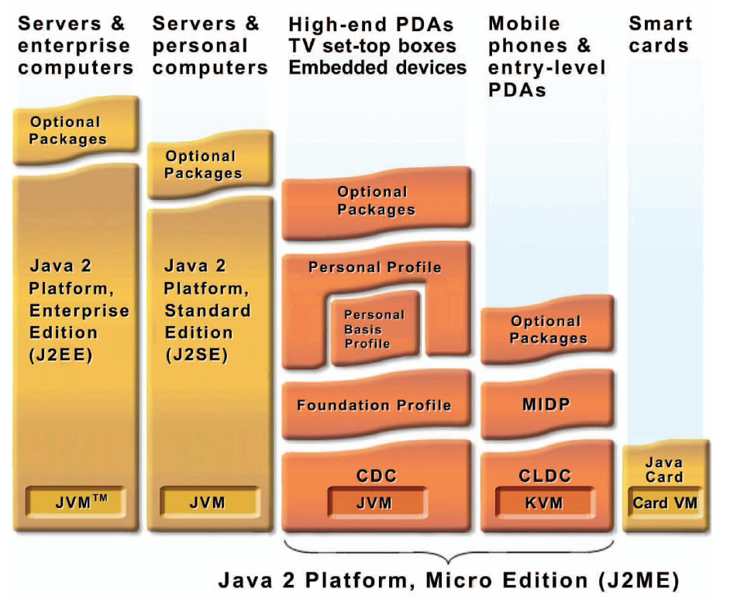
Java 2 Platform, Micro Edition
T
H
E
W
H
O
L
E
P
I
C
T
U
R
E

Slide 15
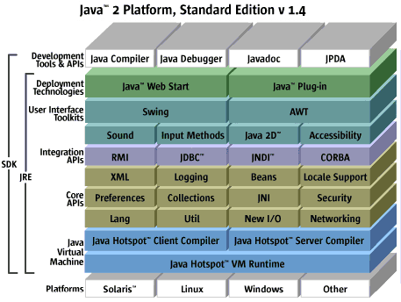
Java 2 Platform, Standard Edition
T
H
E
W
H
O
L
E
P
I
C
T
U
R
E

Slide 16
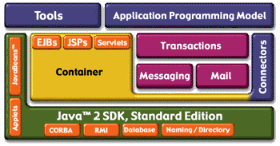
Java 2 Platform, Enterprise Edition
T
H
E
W
H
O
L
E
P
I
C
T
U
R
E

Slide 17
See you next semester

