Slide 2
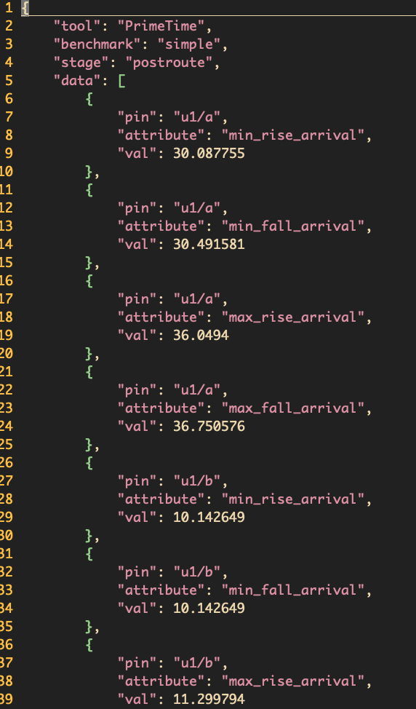
Json
Tool: PrimeTime, OpenTimer, OpenSTA
Benchmark: benchmark name
Stage: preroute, postroute
Start time, end time
Core
version
Data: list of testing results
Each entry: pin name, attribute, value

