Slide 1

Non - Invasive Glucose Monitoring System
CS 578 : Internet of Things

Slide 2

Motivation
Patients diagnosed with diabetes must monitor their blood glucose levels at least three times per day and, besides that, a laboratory test once or twice per month.
These standard methods pose difficulty for patients since they need to prick their finger in order to determine the glucose concentration, yielding discomfort and distress.
Solution: An Internet of Things (IoT)-based framework for non-invasive blood glucose monitoring.

Slide 3

Objectives
Development of non-invasive glucose fluctuation monitoring system.
To assist in diet control by providing nutritional recommendations for the individual with diabetes.

Slide 4
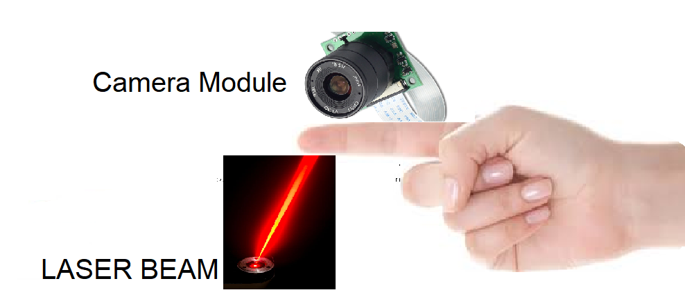
Setup

Slide 5
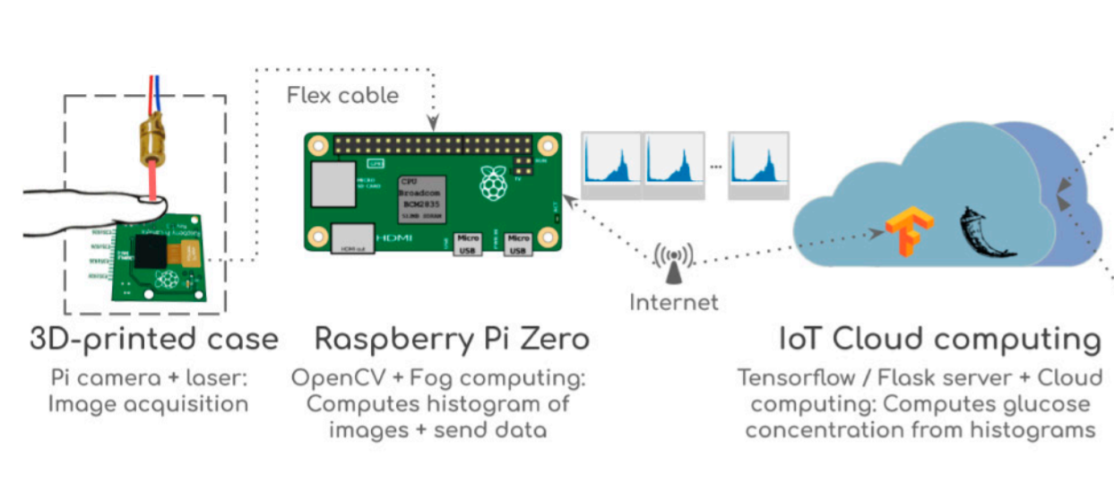
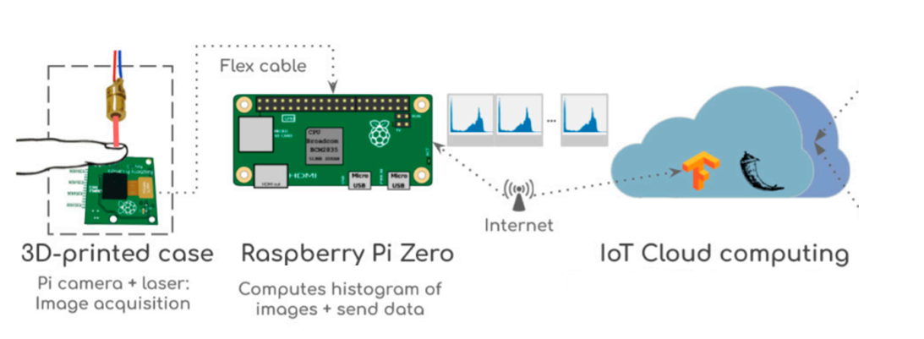
The System
The system is based on Raspberry Pi Zero (RPi) using –
i. A visible laser beam
ii. A Raspberry Pi Camera

Slide 6
Methodology
The Beer–Lambert law is an optic measure considering the relationship between the absorbance and the amount of a material.
It permits to compute the amount of a material in a sample by using its absorbance rate, so the light absorption of a material is proportional to the quantity of the same material.

Slide 7

This formulation was used as the main principle for measuring the glucose concentration in a blood sample by passing a laser-beam through the fingertip.
The laser-beam is fixed facing to the camera lens, with enough space in between for enclosing the fingertip of a person adequately.

Slide 8
Flow
A laser beam is bombarded on the fingertip.​
Parallelly the camera module takes the photo of the fingertip.​
Histogram is calculated for the captured image.​
This histogram is then used to measure glucose concentration of blood.

Slide 9
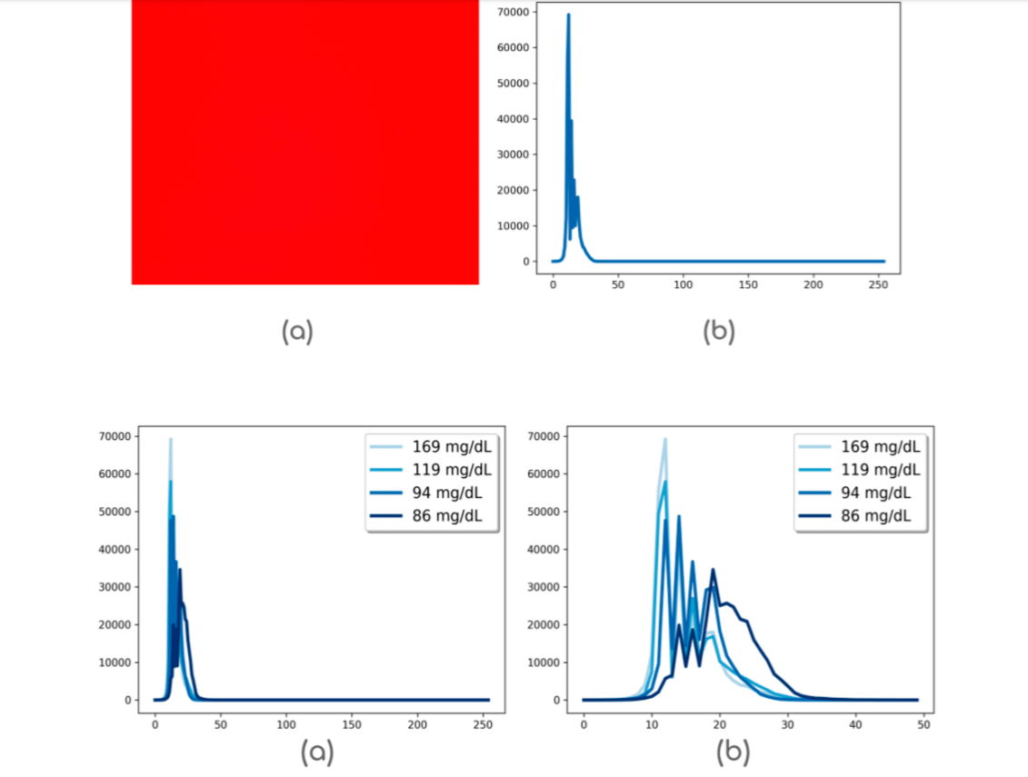
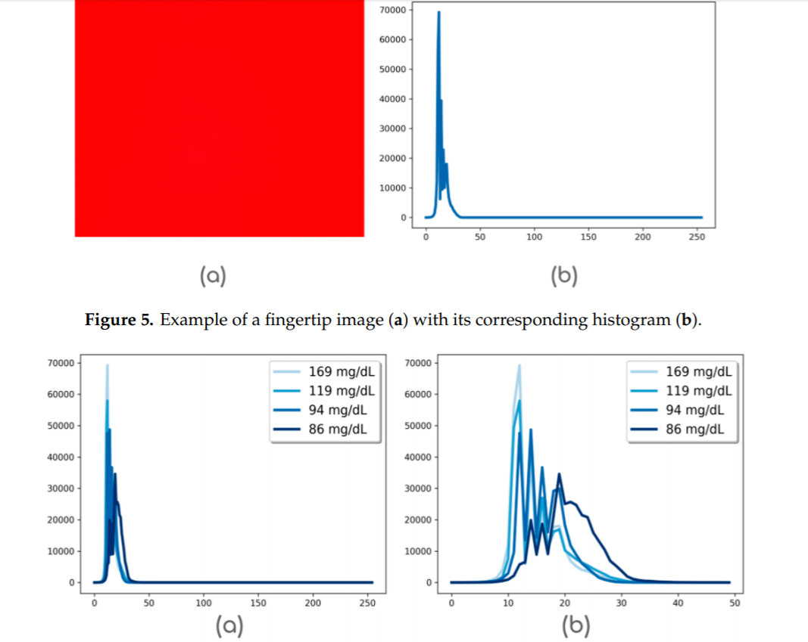

Slide 10
Nutrition Recommendation-Linear Regression
The Average absorption ratio from the peak values in the histogram are used for Glucose level detection using Linear Regression Model.
The glucose level in mg/dL is used to determine the food items a person may intake.

Slide 11
Conclusion
The fingertip images differ for different glucose concentrations.
Glucose levels change according to user, time of day and time since user has ate something.​
The results suggests that our approach is competitive with invasive methods.​
Improvements can be done by taking high quality images with better camera.​
Complex algorithms can be used to consider multiple factors while calculating glucose levels.

