Slide 1


Slide 4
SKETCHES

Slide 5
PROTOTYPES

Slide 6
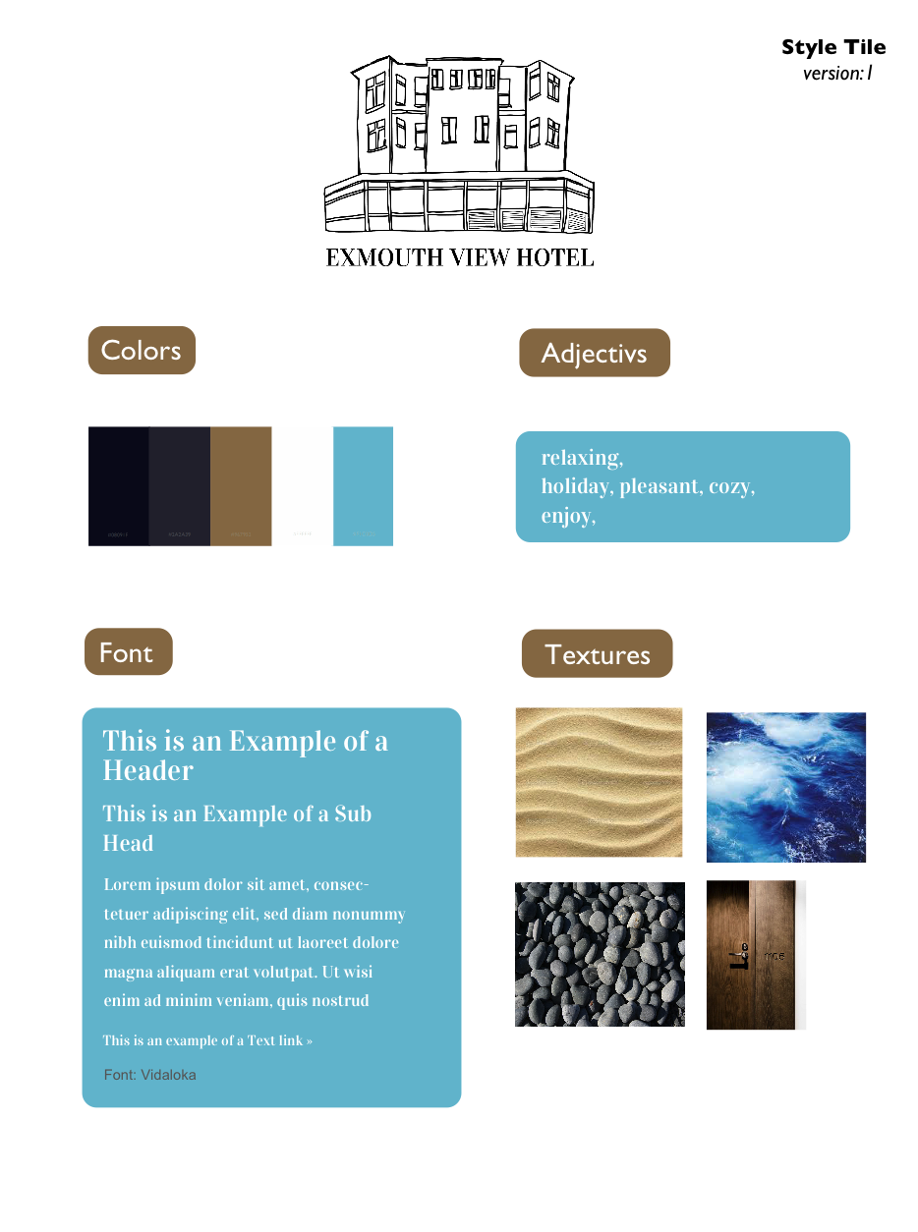
STYLE TILE

Slide 12
GROUP 12

