Slide 1
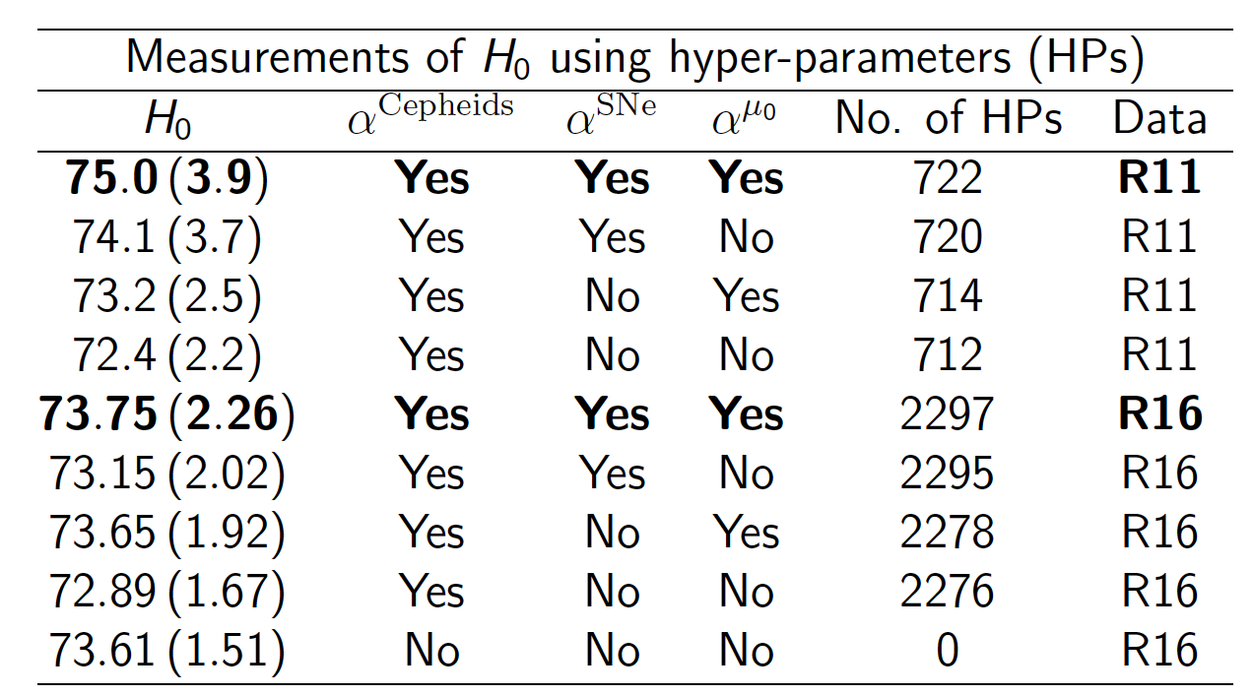
Cardona, Kunz, Pettorino 2016 (preliminary results)
Hyper Parameters
3 anchor distances (NGC4258, LMC, MW)
Weak prior on Cepheid metallicity for R16
No period cut
Cardona et al 2016 compatible with Riess et al
Probability of some HP peaks below 1
HP < 1 can be a symptom of tensions
Choice of anchors is important
Other choices have smaller impact
ASSUMPTIONS
RESULTS

