Slide 1
A Closed Form Solution to Natural Image Matting
Anat Levin, Dani Lischinski and Yair Weiss
School of CS&Eng
The Hebrew University of Jerusalem, Israel

Slide 2
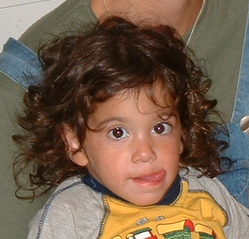
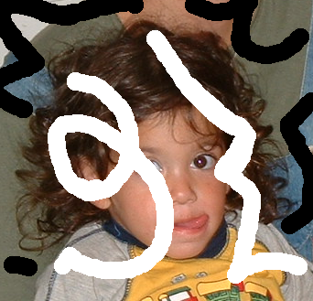
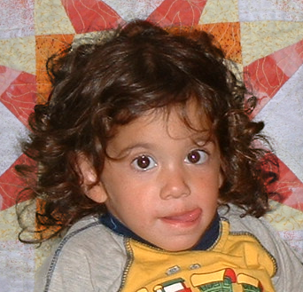
Matting and compositing
+

Slide 3
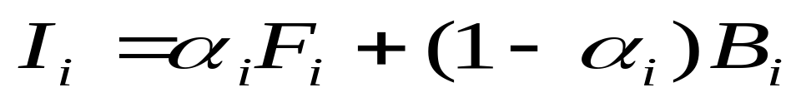
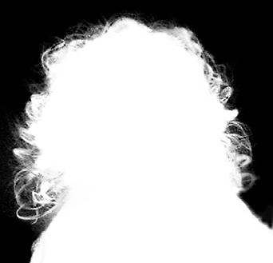
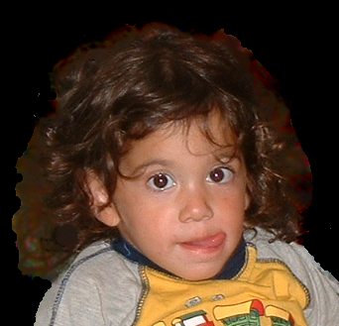
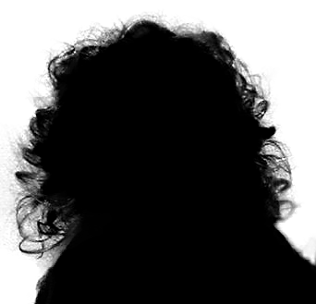
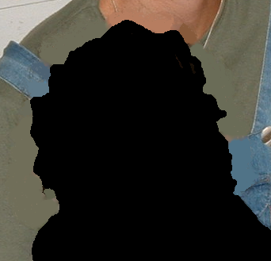
The matting equations
=
x
+
x

Slide 4

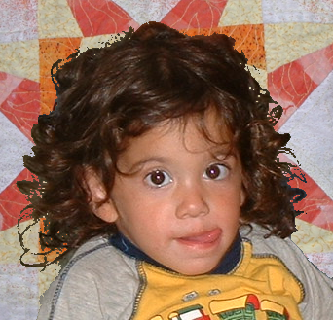
Why is matting hard?

Slide 5
Why is matting hard?

Slide 6
Why is matting hard?

Slide 7
Why is matting hard?
Matting is ill posed: 7 unknowns but 3 constraints per pixel

Slide 8




Previous approaches
The trimap interface:
Bayesian Matting (Chuang et al, CVPR01)
Poisson Matting (Sun et al SIGGRAPH 04)
Random Walk (Grady et al 05)
Scribbles interface:
Wang&Cohen ICCV05

Slide 9

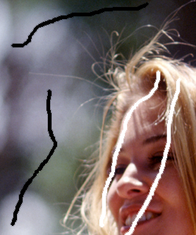
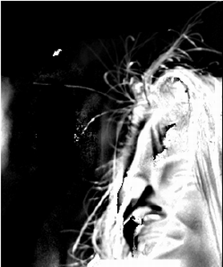
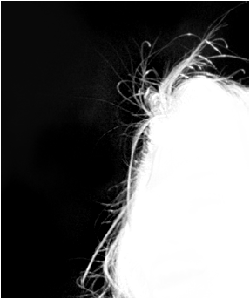
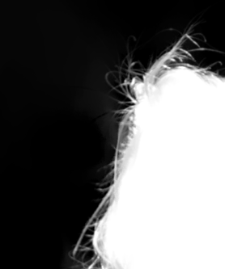
Problems with trimap based approaches
Iterate between solving for F,B and solving for
Accurate trimap required
Input Scribbles
Bayesian matting from scribbles
Good matting from scribbles
(Replotted from Wang&Cohen)

Slide 10
Wang&Cohen ICCV05- scribbles approach
Iterate between solving for F,B and solving for
Each iteration- complicated non linear optimization

Slide 11
Our approach
Analytically eliminate F,B. Obtain quadratic cost in
Provable correctness result
Quantitative evaluation of results

Slide 12
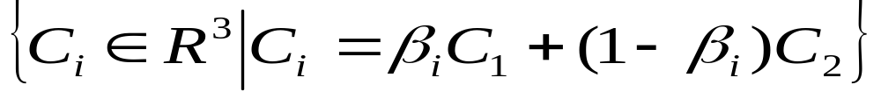


Color lines
Color Line:
(Omer&Werman 04)

Slide 13
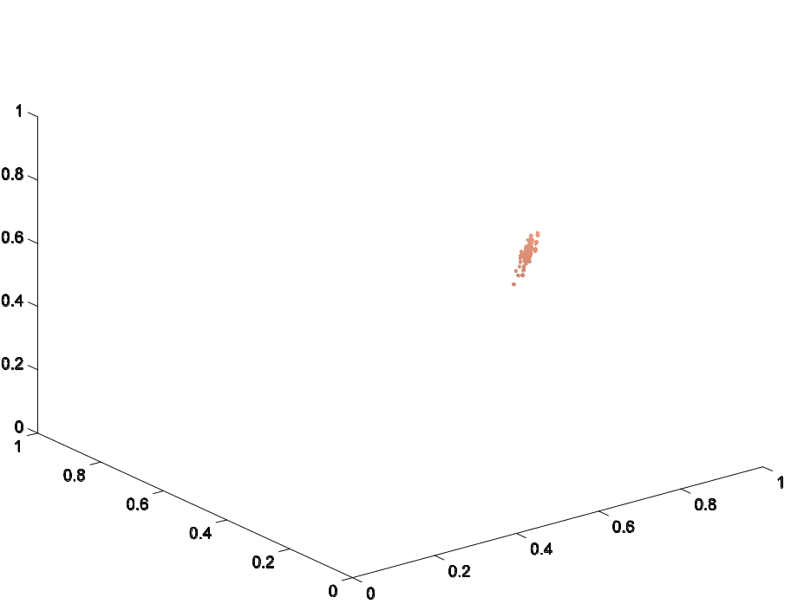
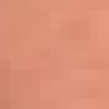
Color lines
Color Line:
B
R
G

Slide 14
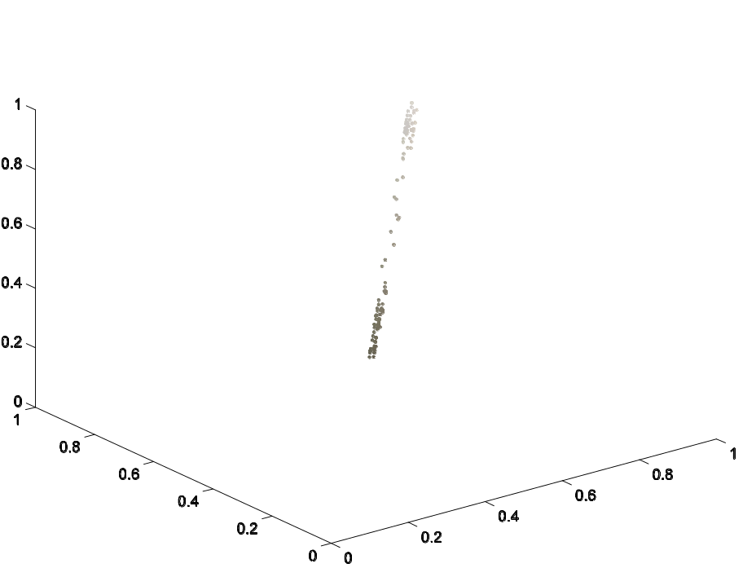
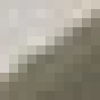
Color lines
Color Line:
B
R
G

Slide 15
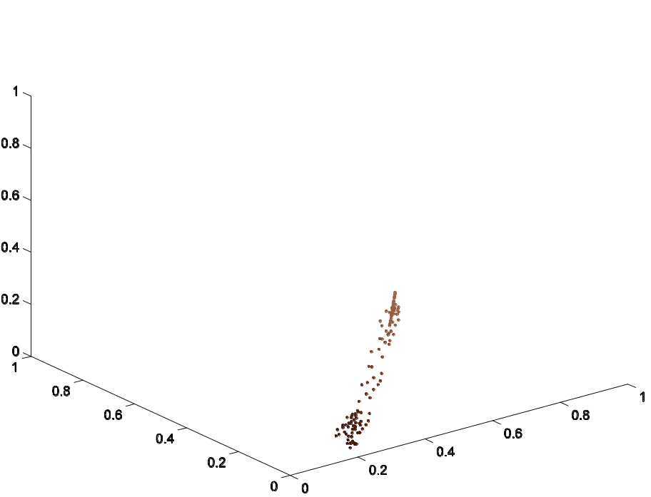
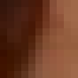
Color lines
Color Line:
B
R
G

Slide 16
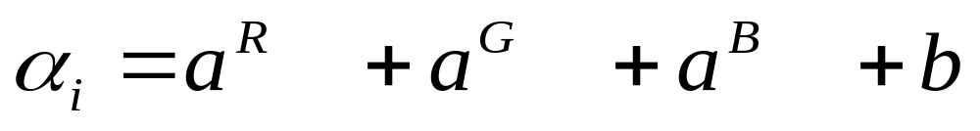
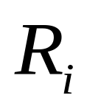
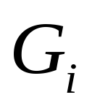
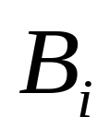
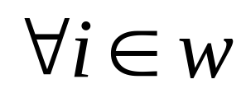
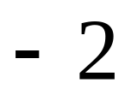
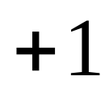
Linear model from color lines
Observation:
If the F,B colors in a local window lie on a color line, then
=
Result: F,B can be eliminated from the matting cost

Slide 17


Evaluating an -matte
?

Slide 18
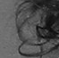
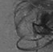
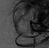
Evaluating an -matte
?
?

Slide 19
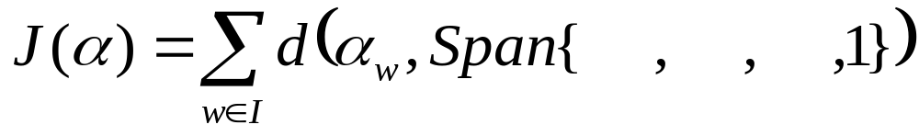
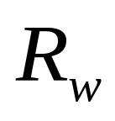
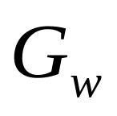
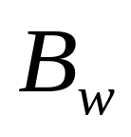
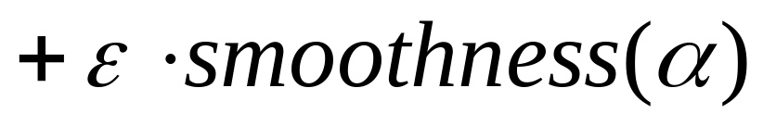
Evaluating an -matte
?
?

Slide 20
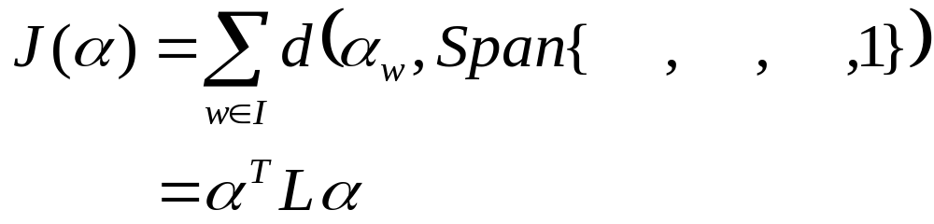

Theorem
F,B locally on color lines
Where local function of the image

Slide 21

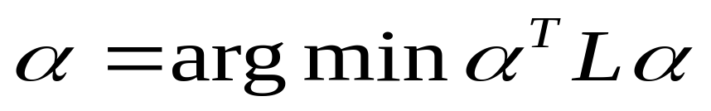
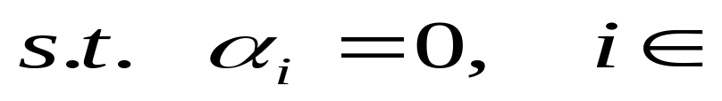

Solving for using linear algebra
Input:
Image+ user scribbles

Slide 22
Solving for using linear algebra
Input:
Image+ user scribbles
Advantages:
Quadratic cost- global optimum
Solve efficiently using linear algebra
Provable correctness
Insight from eigenvectors

Slide 23
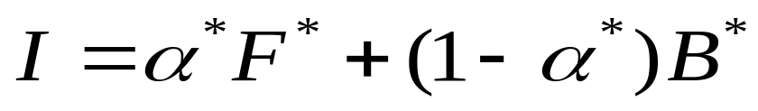
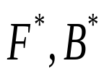
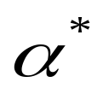
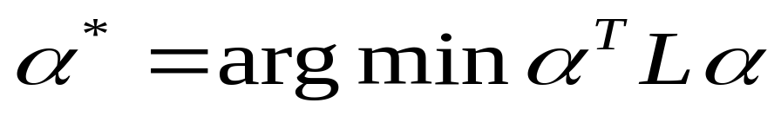
Cost minimization and the true solution
Theorem:
Given:
If:
Then:
locally on color lines
Constraints consistent with

Slide 24

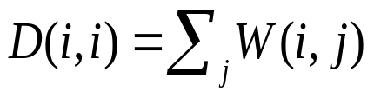
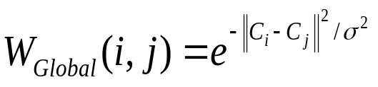
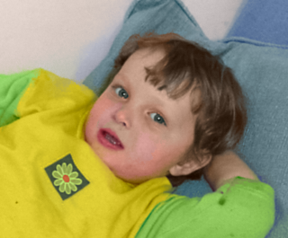
Matting and spectral segmentation
Spectral segmentation: Analyzing smallest eigenvectors of a graph Laplacian L (E.g. Normalized Cuts, Shi&Malik 97)

Slide 25

Matting and spectral segmentation
Spectral segmentation: Analyzing smallest eigenvectors of a graph Laplacian L (E.g. Normalized Cuts, Shi&Malik 97)

Slide 26



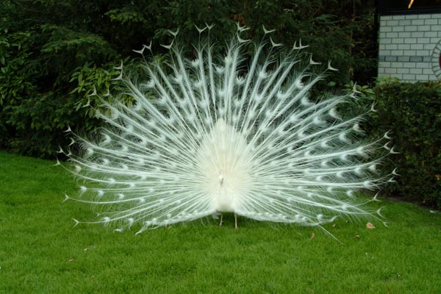
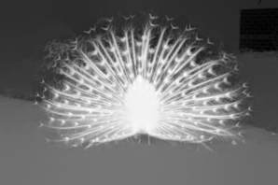
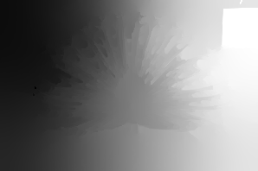

Comparing eigenvectors
Input image
Matting Eigenvectors
Global- Eigenvectors

Slide 27
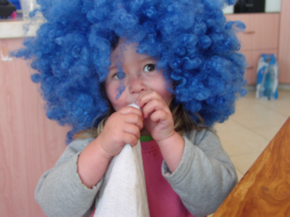
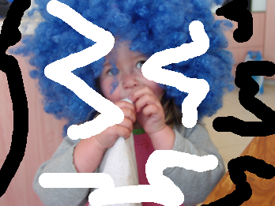


Matting results
+

Slide 28






Quantitative results
Experiment Setup:
Randomize 1000 windows from a real image
Create 2000 test images by compositing with a constant foreground using 2 different alpha mattes
Use a trimap to estimate mattes from the 2000 test images, using the different algorithms
Compare errors against ground truth

Slide 29


Quantitative results
Error
Error
Averaged gradient magnitude
Averaged gradient magnitude
Smoke Matte
Circle Matte

Slide 30

Conclusions
Analytically eliminate F,B and obtain quadratic cost .
Solve efficiently using linear algebra.
Provable correctness result.
Connection to spectral segmentation.
Quantitative evaluation.
Code available: http://www.cs.huji.ac.il/~alevin/matting.tar.gz

