Slide 1

Welcome!
presentation by JUSTIN

Slide 2
Object-Oriented
BEST PRACTICES
IN PHP
presentation by justin

Slide 3
1
2
Object-Oriented
BEST PRACTICES
IN PHP
3
4
5
6
7
presentation by justin

Slide 4
1
Be Modest
2
Object-Oriented
BEST PRACTICES
IN PHP
3
4
5
6
7
presentation by justin

Slide 5
1
Be Modest
2
Be A Good Neighbor
Object-Oriented
BEST PRACTICES
IN PHP
3
4
5
6
7
presentation by justin

Slide 6
1
Be Modest
2
Be A Good Neighbor
Object-Oriented
BEST PRACTICES
IN PHP
3
Avoid Looking At Medusa
4
5
6
7
presentation by justin

Slide 7
1
Be Modest
2
Be A Good Neighbor
Object-Oriented
BEST PRACTICES
IN PHP
3
Avoid Looking At Medusa
4
Embrace The Weakest Link
5
6
7
presentation by justin

Slide 8
1
Be Modest
2
Be A Good Neighbor
Object-Oriented
BEST PRACTICES
IN PHP
3
Avoid Looking At Medusa
4
Embrace The Weakest Link
5
You’re Rubber, I’m Glue
6
7
presentation by justin

Slide 9
1
Be Modest
2
Be A Good Neighbor
Object-Oriented
BEST PRACTICES
IN PHP
3
Avoid Looking At Medusa
4
Embrace The Weakest Link
5
You’re Rubber, I’m Glue
6
Keep It In The Family
7
presentation by justin

Slide 10
1
Be Modest
2
Be A Good Neighbor
Object-Oriented
BEST PRACTICES
IN PHP
3
Avoid Looking At Medusa
4
Embrace The Weakest Link
5
You’re Rubber, I’m Glue
6
Keep It In The Family
7
Think In Patterns
presentation by justin

Slide 11
presentation by Justin
Be Modest
Be Modest in Speech, but excel in action.
- The Chinese

Slide 12
presentation by Justin
Be A Good Neighbor
Being a good neighbor is an art which makes life richer
- Gladys Taber
You can be a good neighbor, only if you have good neighbors.
- Howard Koch
Like a good neighbor, State Farm is there.
- State Farm Insurance
Like a good neighbor, Stay over there.
- Grumpy Cat

Slide 13
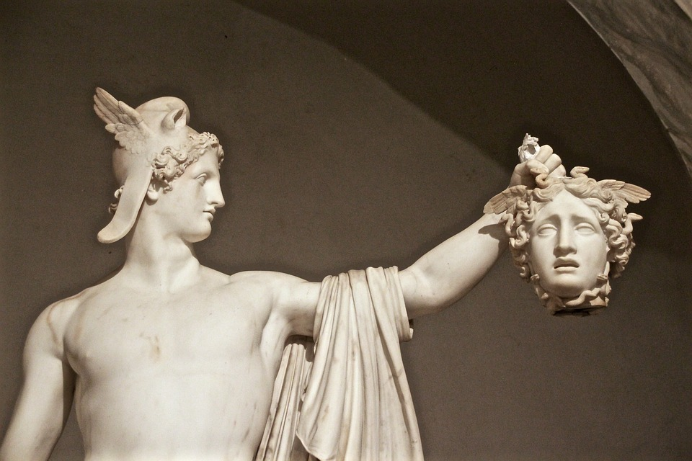
presentation by Justin
Avoid Looking At Medusa

Slide 14
presentation by Justin
Embrace The Weakest Link
Always code as if the person who ends up maintaining your code will be
a violent psychopath who knows where you live.
- Martin Golding

Slide 15
presentation by Justin
You’re Rubber, I’m Glue
You’re Rubber, I’m Glue
- Every child since the 50’s

Slide 16
presentation by Justin
Keep It In The Family

Slide 17
presentation by Justin
Think In Patterns

Slide 18
1
Be Modest
2
Be A Good Neighbor
Object-Oriented
BEST PRACTICES
IN PHP
3
Avoid Looking At Medusa
4
Embrace The Weakest Link
5
You’re Rubber, I’m Glue
6
Keep It In The Family
7
Think In Patterns
presentation by justin

