Slide 1
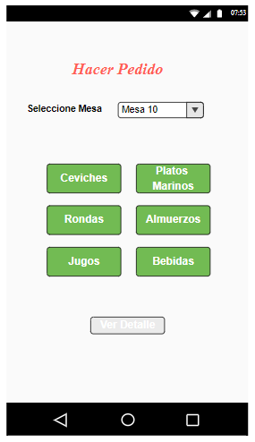
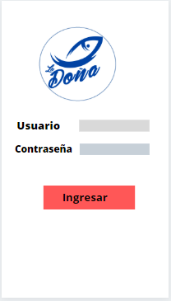
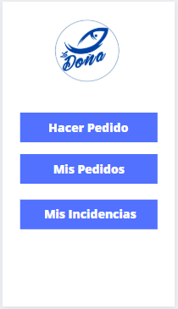
https://www.canva.com/design/DADtrYrrnFA/5B6eaZGHu_-EAklj7W4Hjw/edit?category=tADm6_4tiVs

Slide 2
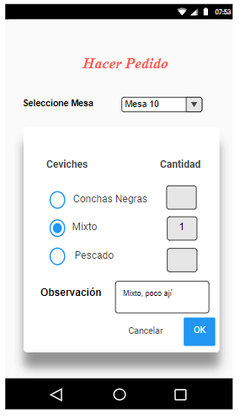
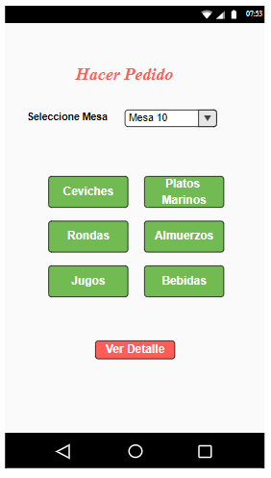
https://app.moqups.com/3TRGGWdye7/edit/page/aa9df7b72

Slide 3
