Slide 1
APP PEDIDOS

Slide 2
HACER PEDIDOS

Slide 3
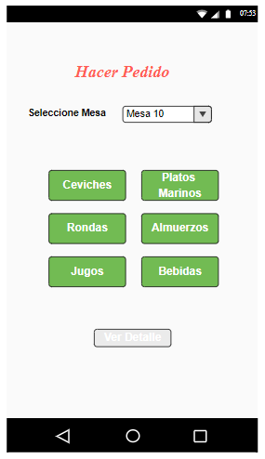
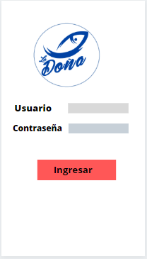
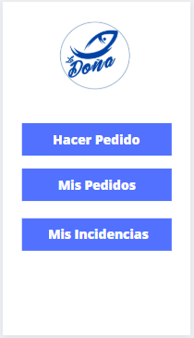
https://www.canva.com/design/DADtrYrrnFA/5B6eaZGHu_-EAklj7W4Hjw/edit?category=tADm6_4tiVs

Slide 4
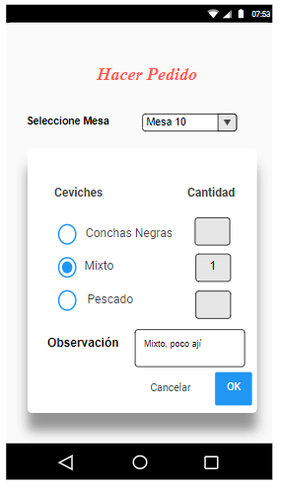
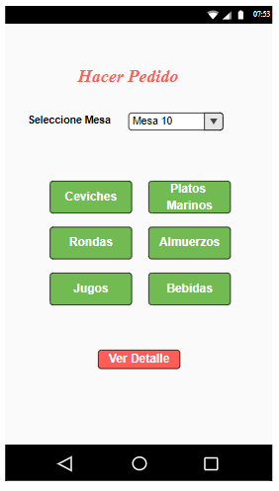
https://app.moqups.com/3TRGGWdye7/edit/page/aa9df7b72

Slide 5
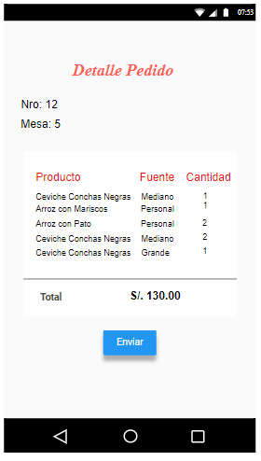
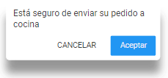

Slide 6
MIS PEDIDOS

