Slide 1
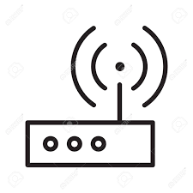
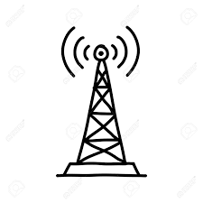

2.4 GHZ
Mesh-Network
Node
ATMega
Node
ATMega
Node
ATMega
Gateway/
ESP-Node
ESP8266
ESP32
Gateway
Linux
Hub
FHEM
DB
IP-Network
Webserver

Slide 2
Node
ATMega
Gateway/
ESP-Node
ESP8266
ESP32

