Slide 1
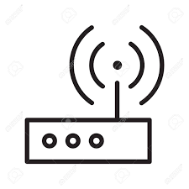
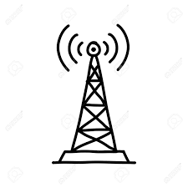

2.4 GHZ Network
Node
Node
Node
Gateway
Gateway
Hub
IP-Network

