Slide 1
Huffman Code for Image Compression
Wilson Pena
5/09/22

Slide 2
Huffman Code
The Huffman coding algorithm is a lossless data compression technique which encode/decodes input characters.
The lengths of the code given to the inputs characters is determined by the frequency of the related character
The smallest code is assigned to the most frequently occurring character, whereas e largest code is assigned to the least frequently occurring character.

Slide 3

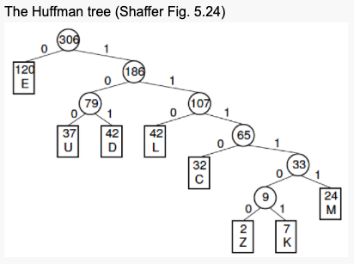
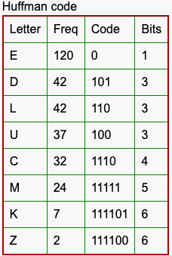
Huffman Tree

Slide 4
Program Implementation
Compression.cu
This is the main file that drive and execute the whole program.
Compress_Helper.h
This files contains all the functions needed to implement the Huffman Code using regular C++.
Compress_Helper_cu.h
This files contains all the functions needed to implement the Huffman Code using CUDA in C++.
Utilities.h
This files contains multiples functions for the devices and the host, which helps with the execution of the program.
MakeFile
It builds and compile the program. Also, it creates an executable.
Lena.bmp
This is the image used for compression.

Slide 5
Flow Diagram
Main
Load Image
Calculate Frequency
Build Tree
Assign Code

Slide 6
Performance
The Performance of my code is not looking as I expected.
Average Elapse time without using CUDA = 0.011 msec
Average Elapse time using CUDA = 2.8 msec
Not using CUDA was about 243 times faster.

Slide 7
Possible Reason for my Results
My setup is not optimized in CUDA
My CUDA implementation is not optimized

