Slide 1

Measuring the Power Efficiency of Subthreshold FPGAs for Implementing Portable Biomedical Applications
Shahin Lotfabadi

Slide 2
Agenda
Objectives
Auto-Regressive (AR) Modeling
Overview Of The FPGA Implementation of AR Burg Algorithm
Subthreshold Circuit Design
Conclusion
Future Work

Slide 3
Objective
Collecting and Processing biomedical signals
FPGA implementation of an Autoregressive model
targeted for portable devices
Optimizing design to lower the power consumption of the
device that is crucial for portable devices
Using subthreshold circuit design technique to lower static
power consumption of the FPGA

Slide 4
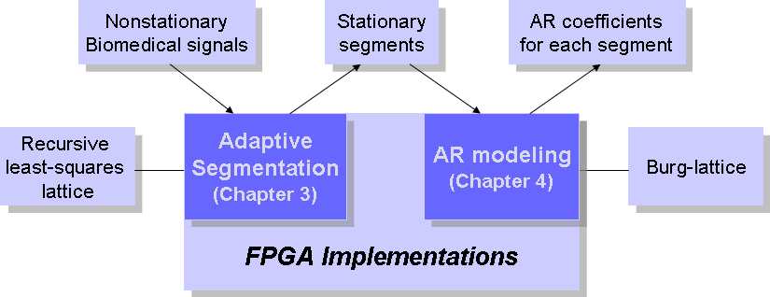
System Architecture Diagram
Adaptive Segmentation
AR Modeling

Slide 5
Biomedical Signals [2, 3]
The bandwidth of biomedical signals is limited to a few tens
to a few thousand Hertz
Biomedical signals are generated by human organisms that
carry significant information about human organisms.
Modeling of biomedical signals provides parameters which
could co-relate to the physiological sources of the signal

Slide 6

AR Modeling and BURG Algorithm
The autoregressive (AR) modeling result in higher resolution spectral
estimation in comparison with the Fast Fourier Transform (FFT)
method
In many biomedical signals, a hypothetical input is considered since
the input is actually unknown. Hence, a linear combination of past
values of the output can be used to predict the approximate value of
current output. The equation for approximate predicted output is:
The Burg algorithm is used to compute model coefficients (or poles)
The Burg algorithm is based on minimizing least squares of the forward
and backward prediction errors:
(1.1)
(1.2)

Slide 7

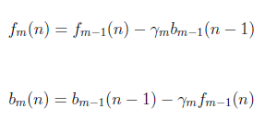

Calculation of Auto-Regression parameters
(1.2)
(1.3)
(1.4)
(1.5)

Slide 8

Calculation of Auto-Regression parameters
(1.6)
∑
+
+
∑
The lattice structure of the recursion equations for forward and backward prediction errors
based on reflection coefficient

Slide 9


The block diagram of the AR coefficients computation loop
Reg
X
∑
X
+
÷
x 2
Reg
X
+
∑
X
+
X

Slide 10
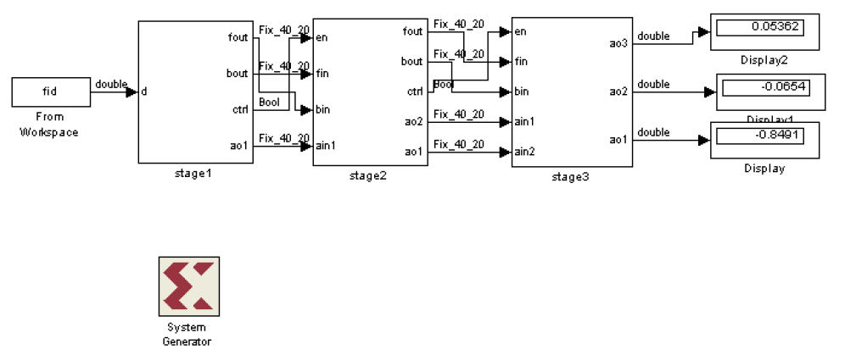
Block Diagram Of Burg Algorithm For 3 Stages

Slide 11
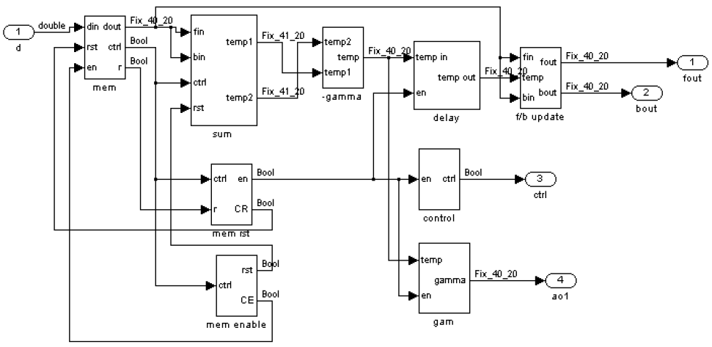
Block Diagram Of Stage1 For Burg Algorithm

Slide 12
Block Diagram Of AR Modeling Design
DataIn
Data
Capture
Multiplier
Muxes
Control Unit
Divider
Adder/Subtractor
MMU
FSM
DataOut
Output Buffer

Slide 13
A comparison of resource utilization between
two implementation methods
Resources Vs. Implementation Method | AR Order | Flip Flops | LUTs | Occupied Slices | Bounded IOBs | Block RAMs | 18x18 Multipliers
Previous Design using Simulink-to-FPGA | 3 | 18% | 20% | 25% | 11% | 20% | 32%
Current Design | 3 | 6% | 10% | 12% | 11% | 17% | 3%
Current Design | 32 | 6% | 10% | 12% | 11% | 17% | 3%
This design was implemented on a device of Virtex II Pro family of Xilinx FPGAs
(XC2VP1006FF1704)

Slide 14
Number of cycles required per frame for various model orders
Number of samples | 20 | 100 | 200 | 400 | 2000 | 8000
Number of Cycles for AR8 | 554 | 2474 | 4874 | 9674 | 48074 | 192074
Number of Cycles for AR16 | 1114 | 5014 | 9814 | 19414 | 98014 | 392014
Number of Cycles for AR32 | 2214 | 10014 | 19614 | 38814 | 196014 | 760414

Slide 15
Comparison of power estimation for 32-bit and 64-bit floating point
implementations
XPower Analyzer delivered with ISE® Design Suite was used for FPGA (XC5VLX110-3FF676C)

Slide 16
Routing Channel and Delay Path Model [4]
LB
LB
4X Buffer
4X Buffer
CW
CW
Isolation Buffer
LB
LB

Slide 17
Parameters used to determine interconnect capacitance [5, 6]
Metal Type | Cu
Width of the Trace | 0.064μm
Separation Between Traces | 0.064μm
Length of the Trace | 30μm
Thickness of the Trace | 0.14μm
Height From Ground | 0.14μm
Dielectric Constant | 2.2
The NMOS and PMOS transistors models (32 nm technology) were obtained from
Predictive Technology Model (PTM).
The information related to area of a tile was taken from
Intelligent FPGA Architecture Repository (IFAR) website
The wiring capacitance for a routing track of length of 30μm was found to be 4.63fF.

Slide 18
Subthreshold Circuit Design [1]
The transistors leak a small amount of current even
when the gate voltage is less than the threshold voltage.
In subthreshold region of operation, current drops
off exponentially as gate voltage falls below
(weak inversion).
This region can be used for low power circuit design at
the cost of reduced performance

Slide 19
Body Effect [1]
The transistor is a four-terminal device with gate, source, drain, and body as an implicit terminal. Applying a voltage between the source and body increases the amount of charge required to invert the channel and hence increases the threshold voltage .
For a small voltage applied to the source and body, the relationship between the threshold voltage and can be simplified to (12):
where depends on the body effect coefficient and the surface potential
(1.7)
(1.8)
There are two options for body bias :
Reverse bias to increase and reduce leakage power.
Forward bias to decrease and increase device performance.

Slide 20
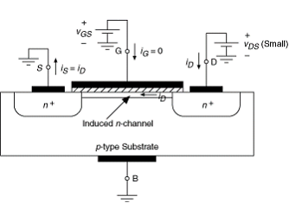
In conventional NMOS the pn junction between source and substrate, and pn junction between drain and substrate are reversed biased to reduce the leakage current [8, 9].

Slide 21
A conventional inverter
Vs.
an inverter with swapped body biasing (SBB) voltage
Vdd
Vdd
Vdd

Slide 22
Multistage buffers with variable threshold voltage
Vdd
Vdd
2
8
In
Out
Vdd
1
4

Slide 23
Average power dissipation and delay of both buffer types
for various values of supply voltages
Supply Voltage (V) | Average Power (μW) |  | Delay (nS)
 | Conventional Buffer | SBB Buffer | Conventional Buffer | Delay Per 20 tracks | SBB Buffer | Delay Per 20 tracks
0.9 | 29.58 | 93.068 | 0.6 |  | 0.2
0.8 | 19.665 | 53.161 | 0.75 |  | 0.3
0.7 | 11.668 | 30.513 | 1.0 |  | 0.4
0.6 | 5.5642 | 9.0586 | 1.6 |  | 0.9
0.5* | 1.5643 | 1.9623 | 4.2 |  | 2.5
0.45* | 0.54538 | 0.64034 | 10 |  | 4.4
0.4* | 0.1303 | 0.14963 | 27 | 540 | 11 | 220
0.35* | 0.024716 | 0.02836 | 80 | 1600 | 36 | 720

Slide 24
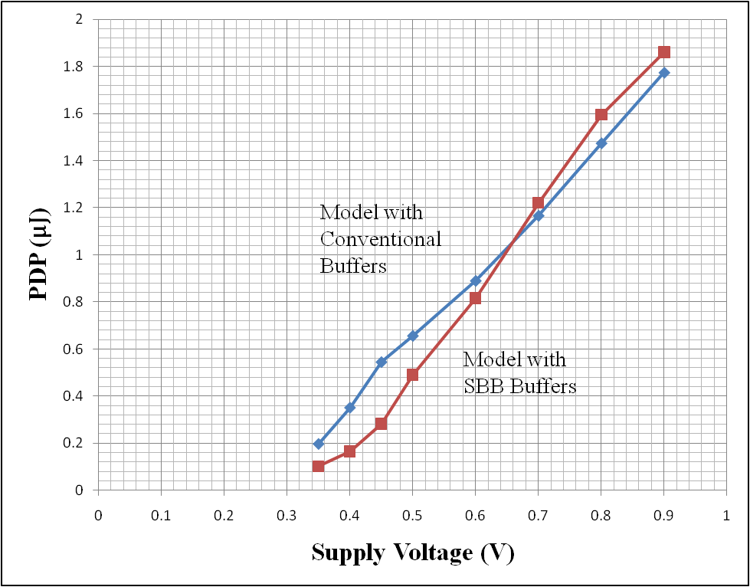
Power-Delay Product vs. Supply Voltage
for Models with SBB Buffers and Conventional Buffers

Slide 25
Conclussion:
The power requirement for implementing a computationally
intensive algorithm used for processing biosignals on FPGAs
was investigated.
FPGA routing tracks is able to operate in the subthreshold region
while still meeting the timing constraint
Using SBB buffers, it is possible to achieve power reduction by a
factor of 197.7 and power-delay product reduction by a factor of
10.78 as compared to normal operation in the saturation region
The power reduction can significantly increase in the battery life
of portable devices utilizing FPGAs for biomedical applications

Slide 26
Future Work
Subthreshold design should also be investigated
for Logic Blocks, Block RAMs, Functional Units, and
other elements that make up the architecture of
an FPGA.
Other body biasing techniques should be
investigated for the FPGA fabric.
Subthreshold design could also be investigated for
an ASIC device.

Slide 27
REFERENCES
[1]N. H. E. Weste, D. M. Harris, CMOS VLSI Design: A Circuits and Systems Perspective 4th Edition, Addison Wesley, MA, 2010.
[2]R. M. Rangayyan, Biomedical Signal Analysis: A Case-Study Approach, Wiley-IEEE Press, NY, 2001.
[3]R. M. Rangayyan, S. Krishnan, G. D. Bell, C. B. Frank, and K. O. Ladly, “Parametric Representation and Screening of Knee Joint Vibroarthrographic Signals,” IEEE Transactions on Biomedical Engineering, Vol. 44, No. 11, November 1997, pp. 1068-1074.
[4]V. Betz, J. Rose, and A. Marquardt, Architecture and CAD for Deep-Submicron FPGAs, Kluwer Academic Publishers, 1999.
[5]Available online at http://www.eas.asu.edu/~ptm
[6]Available online at http://www.eecg.utoronto.ca/vpr/architectures/
[7]S. Narendra et. al, “Ultra-Low Voltage Circuits and Processor in 180nm to 90nm Technologies with a Swapped-Body Biasing Technique,” in Proceedings of the 2004 International Solid-State Circuits Conference, San Francisco, CA, February 2004, pp. 8.4.1-8.4.3.
[8]J. Kao, S. Narendra, A. Chandrakasan, “Subthreshold Leakage Modeling and Reduction Techniques,” in Proceedings of the 2002 IEEE International Conference on Computer Aided Design, San Jose, CA, November 2002, pp. 141-148.
[9]J. Nyathi,B. Bero, "Logic Circuits Operating in Subthreshold Voltages," in Proceedings of the 2006 IEEE International Symposium on Low Power Electronics and Design, Tegernsee, Germany, August 2006, pp. 131-134.

Slide 28
?

