Slide 1
DSAI4205 Big Data Analytics
Daily Public Opinion on Israel-Palestine War
Sentiment Analysis of 3,125 Reddit Comments | 6 Models | 21 Visualizations
Member A — EDA & Visualizations Member B — Data Cleaning & Baseline Member C — Word2Vec+SVM, GloVe+XGB Member D — FastText+BiLSTM, Doc2Vec+CNN Member E — BERT + Refinement + Creativity
Semester Two, 2025/26

Slide 2
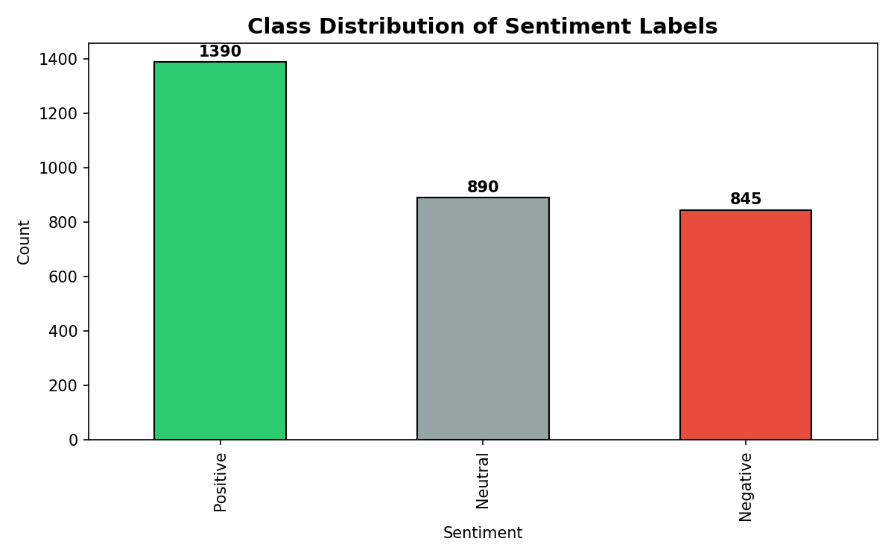
Dataset Overview & Class Distribution
Source: 3,125 Reddit comments on Israel-Palestine conflict
Labels: Positive (1,390/44.5%) | Neutral (890/28.5%) | Negative (845/27.0%)
Imbalance ratio: 1.64:1 (Positive : Negative)
Text length: Mean=235, Median=127, Max=7,973 chars
Data quality issues:
• 641 encoding artifacts (20.5%)
• 8 duplicates, 34 near-duplicates
• 277 text-length outliers (8.9%) — retained
Kruskal-Wallis: H=739.35, p<0.0001

Slide 3
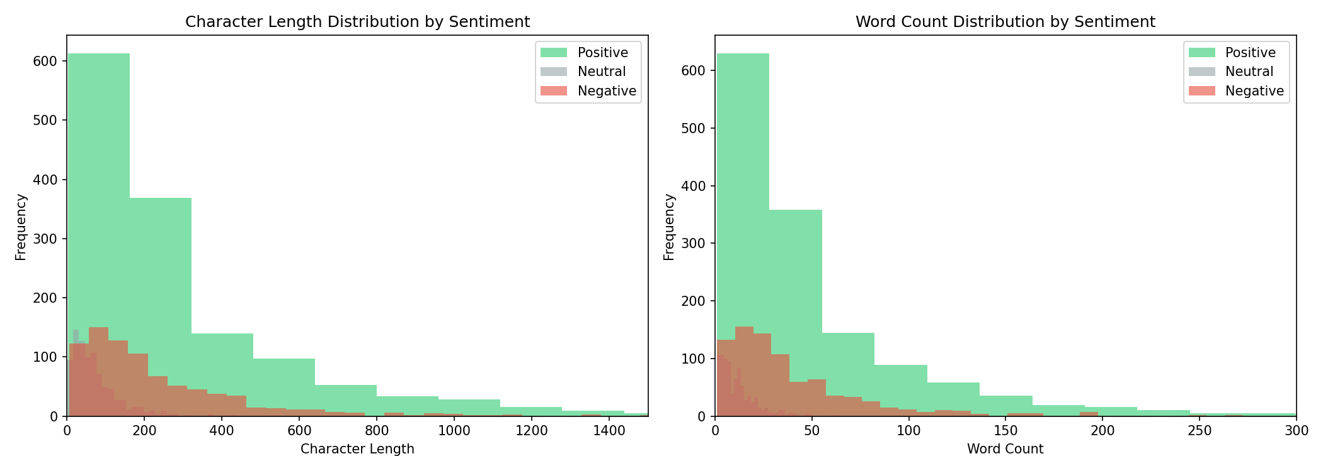
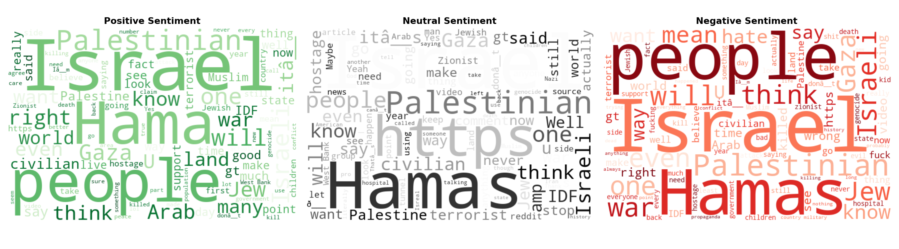
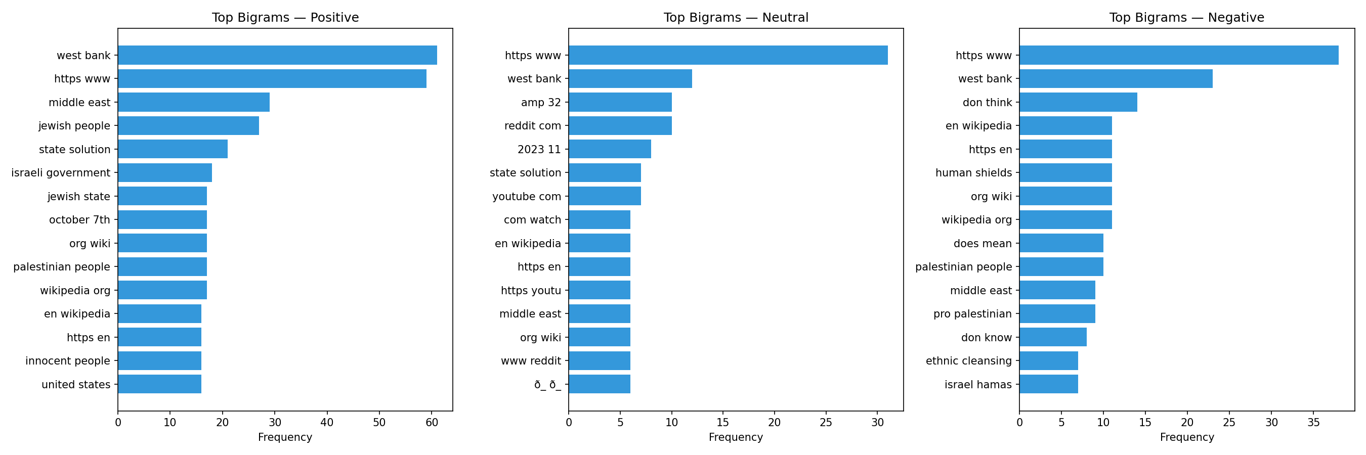
EDA: Text Distribution, Word Clouds & Bigrams
Neutral = short factual (mean 77 chars) | Positive = extended arguments (mean 327) | Negative = emotional (mean 250) Vocabulary overlap: "Israel","Palestinian" everywhere. Bigrams: "war crime" (Neg), "free palestine" (Pos)

Slide 4
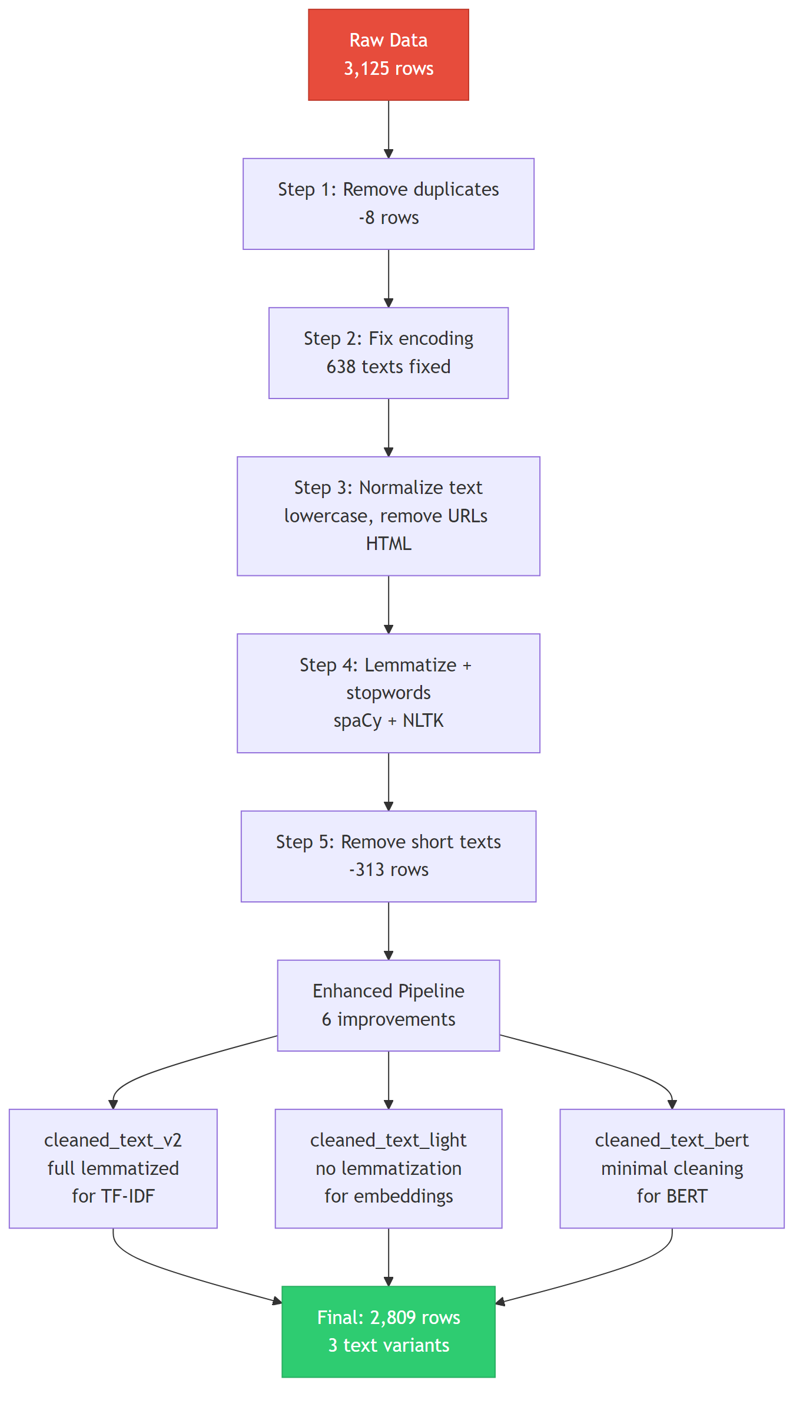
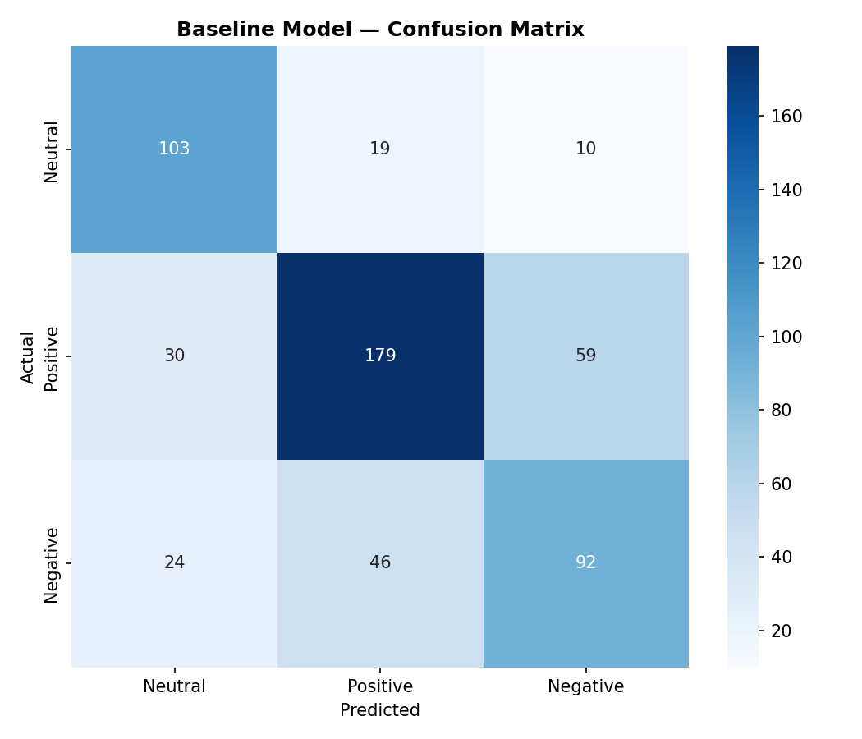
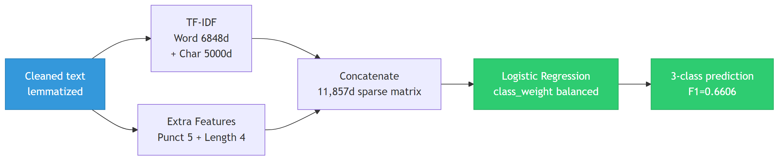
Data Cleaning & Baseline Model
Cleaning: 3,125 → 2,809 rows (6 enhancements)
• Contraction expansion, Reddit patterns, negation
• 3 text variants: lemmatized / light / BERT-preserving
Baseline: TF-IDF (11,857d) + Logistic Regression
Accuracy: 0.6655 | F1 (macro): 0.6606
Neutral F1=0.71 | Positive F1=0.70 | Negative F1=0.57
Error: 188/562 misclassified (33.5%)
Biggest confusion: Positive ↔ Negative (105 cases)

Slide 5
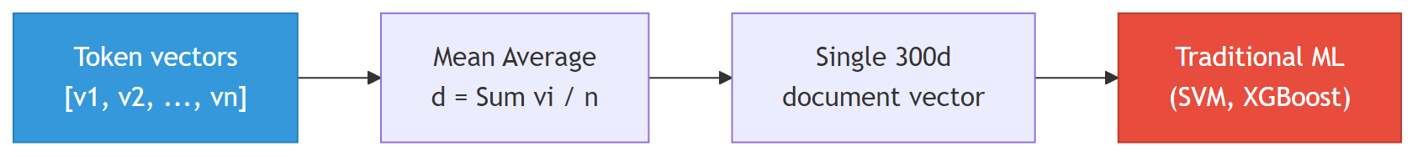
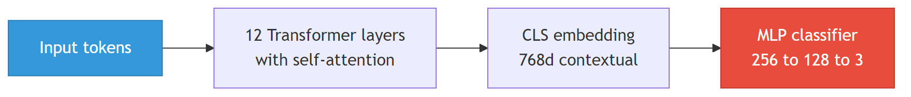
How Word Embeddings Connect to ML Classifiers
All models: Text → Tokenize → Embed → Aggregate → Classify
A. Mean Pooling (W2V+SVM, GloVe+XGB)
Simple but loses word order & dilutes signal
B. [CLS] Token (BERT+MLP)
Context-aware via self-attention
C. Sequence Input (FastText+BiLSTM)
Preserves word order, needs more data
D. Document Vector (Doc2Vec+CNN)
Holistic representation, no pooling needed

Slide 6
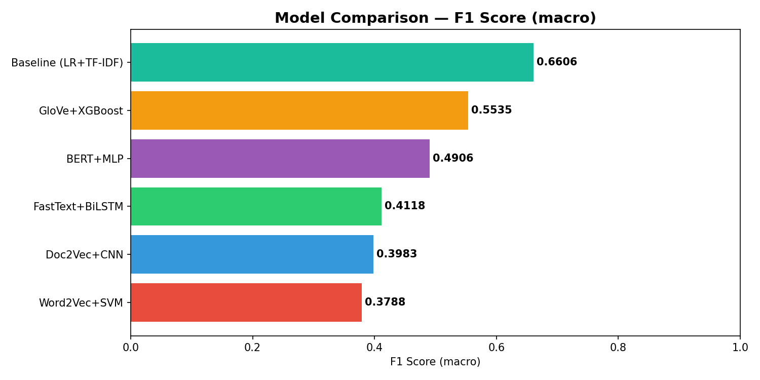
5 Advanced Models: Results
Model 1: Word2Vec (scratch) + SVM
F1=0.38 | 39% OOV → zero vectors
Model 2: GloVe (pretrained) + XGBoost
F1=0.55 | Only 7% OOV (400K vocab)
Model 3: BERT frozen + MLP / Fine-tuned
F1=0.49 / 0.59 | +0.10 from fine-tuning
Model 4: FastText (scratch) + BiLSTM
F1=0.41 | Low Negative recall
Model 5: Doc2Vec (scratch) + CNN
F1=0.40 | Noisy doc vectors
ALL underperform baseline (F1=0.66)

Slide 7
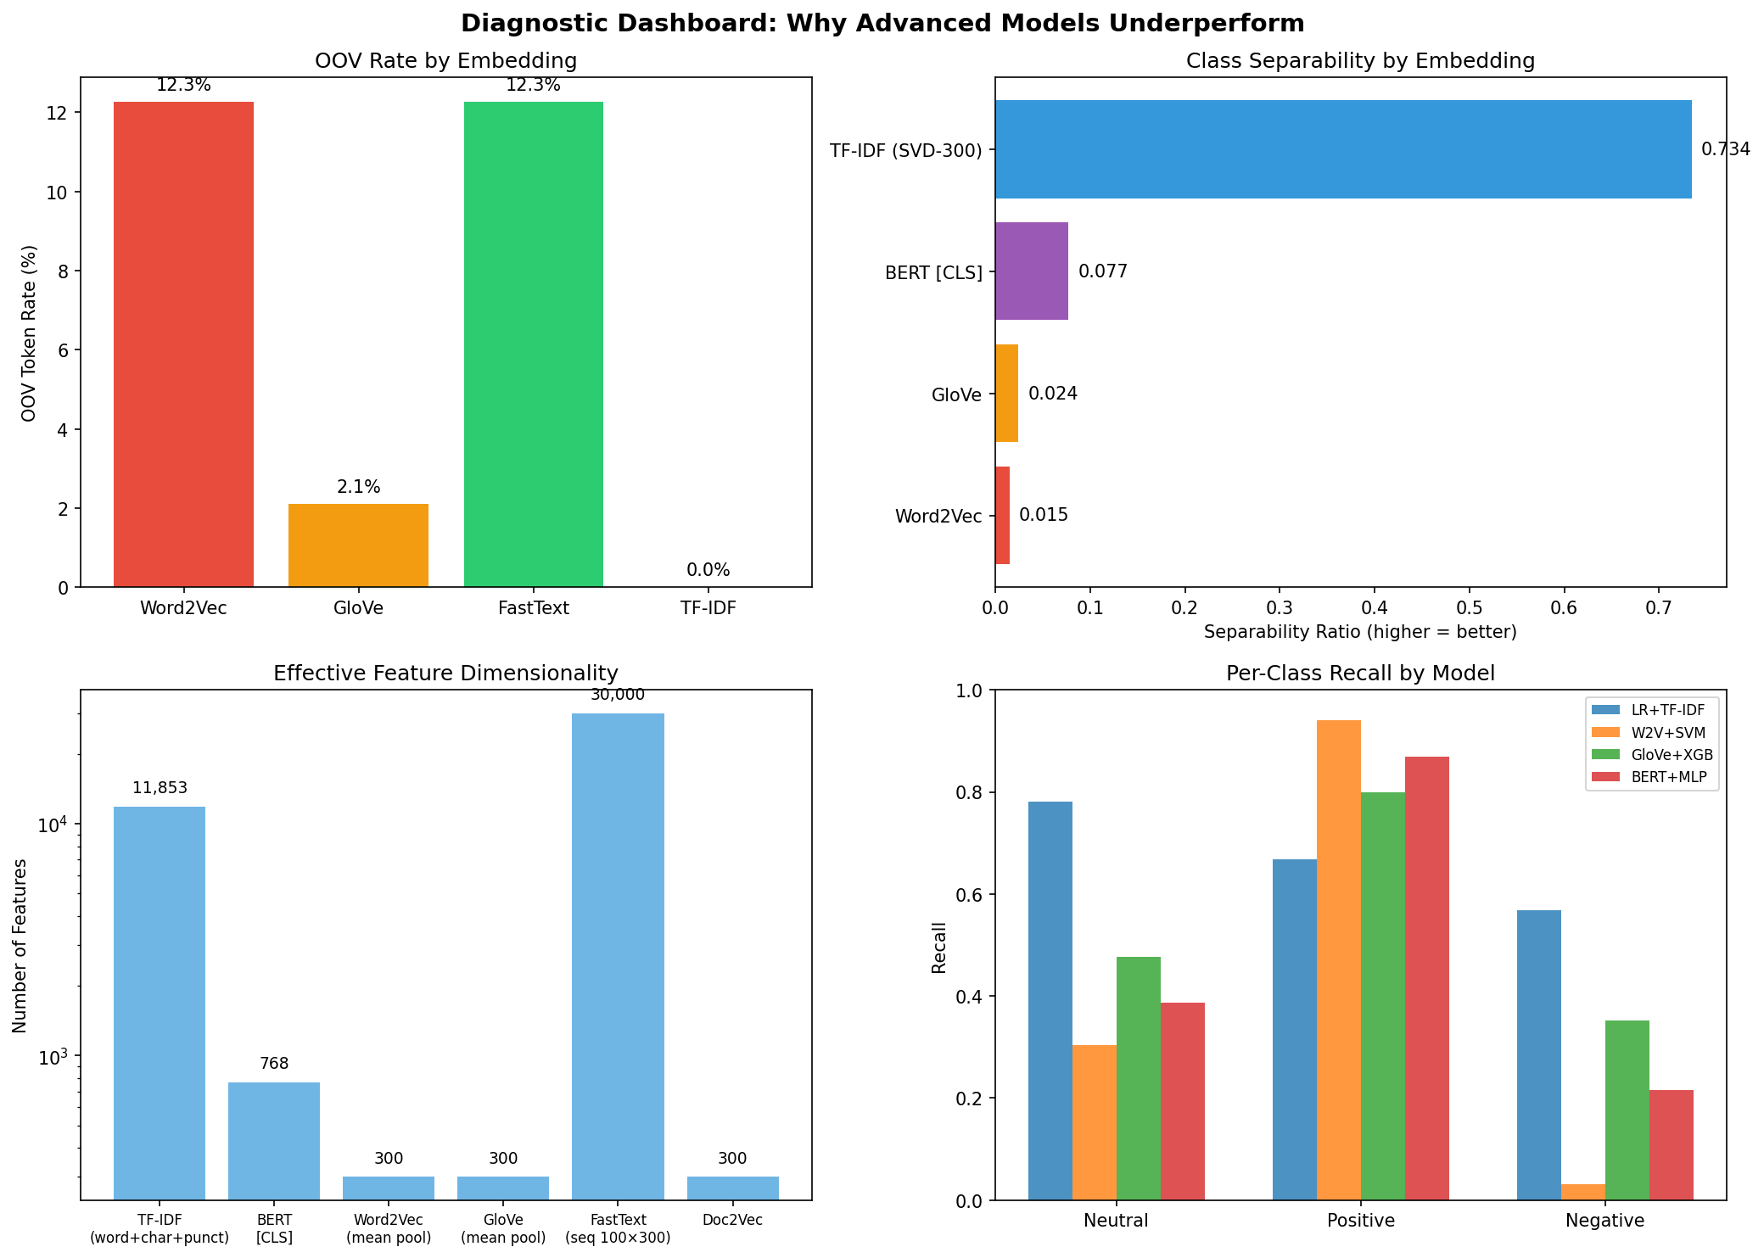
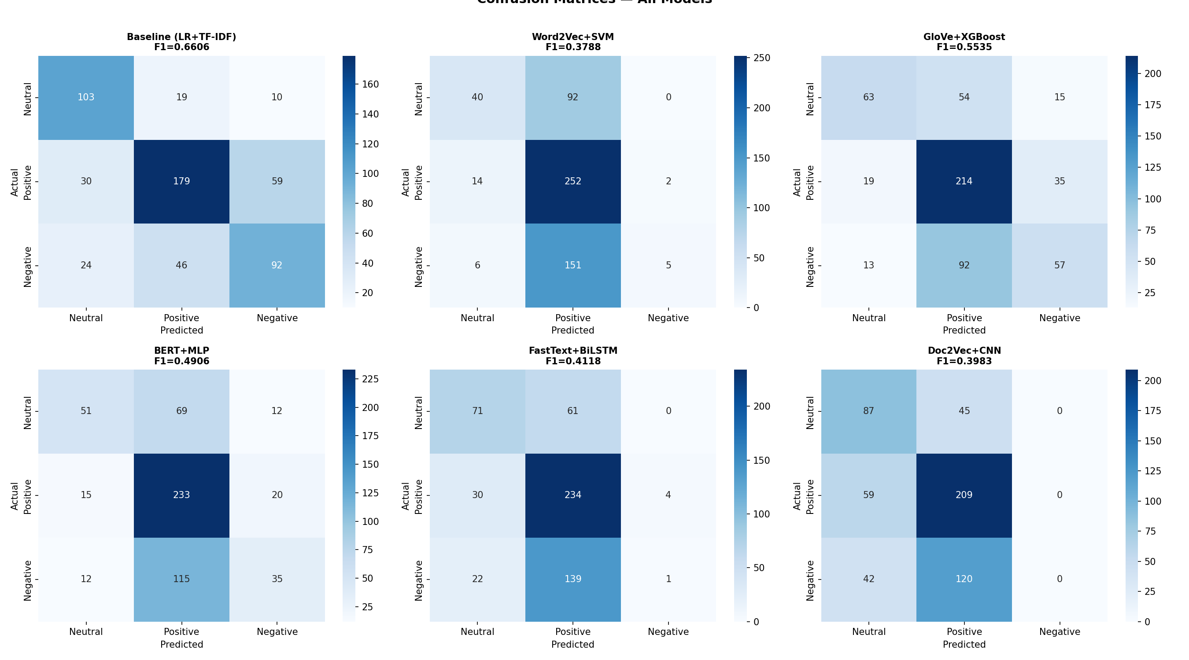
Why Advanced Models Underperform Baseline
5 root causes:
1. OOV: W2V 39.4% vs TF-IDF 0%
Missing words → zero vectors
2. Separability: TF-IDF 0.734 vs W2V 0.015
50× better class separation
3. Mean pooling destroys "genocide" signal
Averaged away with 30 other tokens
4. Dimensionality: 11,857 vs 300 features
5. Data efficiency: TF-IDF needs ~1K
BERT/BiLSTM need 10K–100K
On small data, sparse > dense

Slide 8
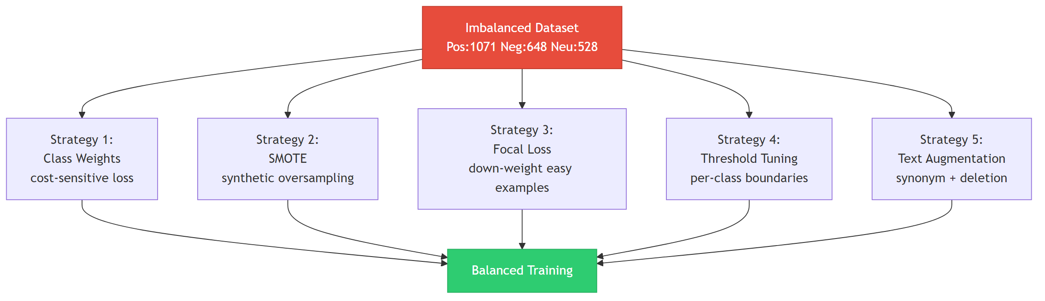
Handling Imbalanced Dataset: 8 Strategies
Best results on TF-IDF + LR:
Hybrid (Over+Under) F1=0.6692 +0.009
SMOTE on TF-IDF F1=0.6655 +0.005
ADASYN F1=0.6619 +0.001
Random Oversampling F1=0.6617 +0.001
On embedding models:
Class Weights SVM F1=0.5567 +0.178
SMOTE SVM F1=0.5245 +0.146
Focal Loss BiLSTM F1=0.4103 -0.002
Text Augmentation: Neg 648 → 1,944 samples
Key: Hybrid > SMOTE > ROS > ADASYN

Slide 9
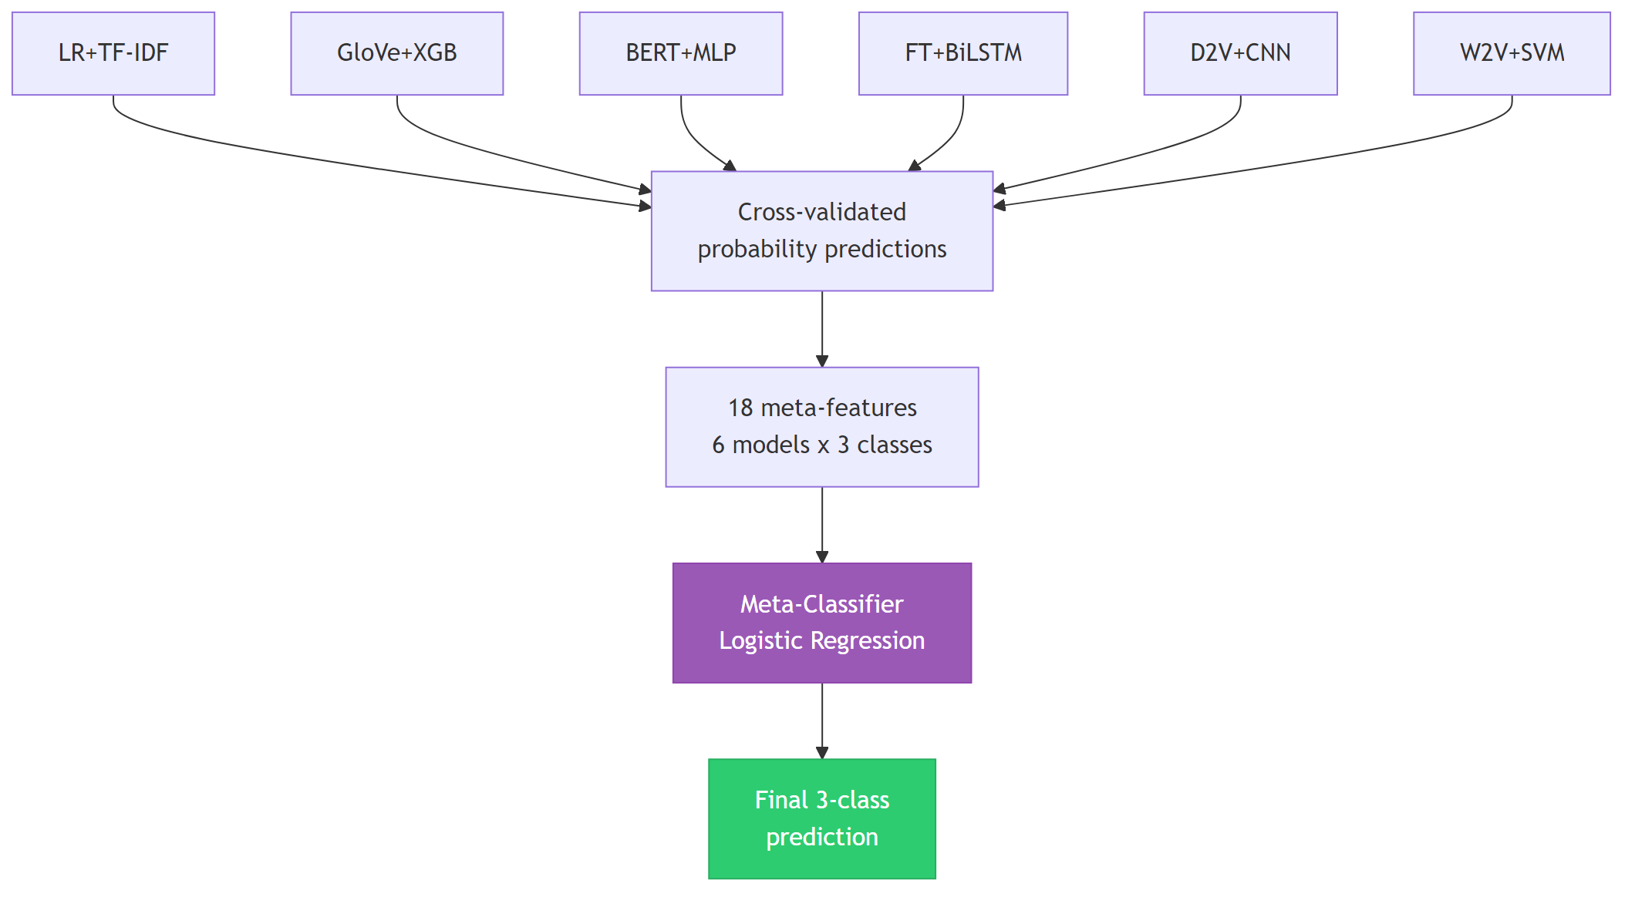
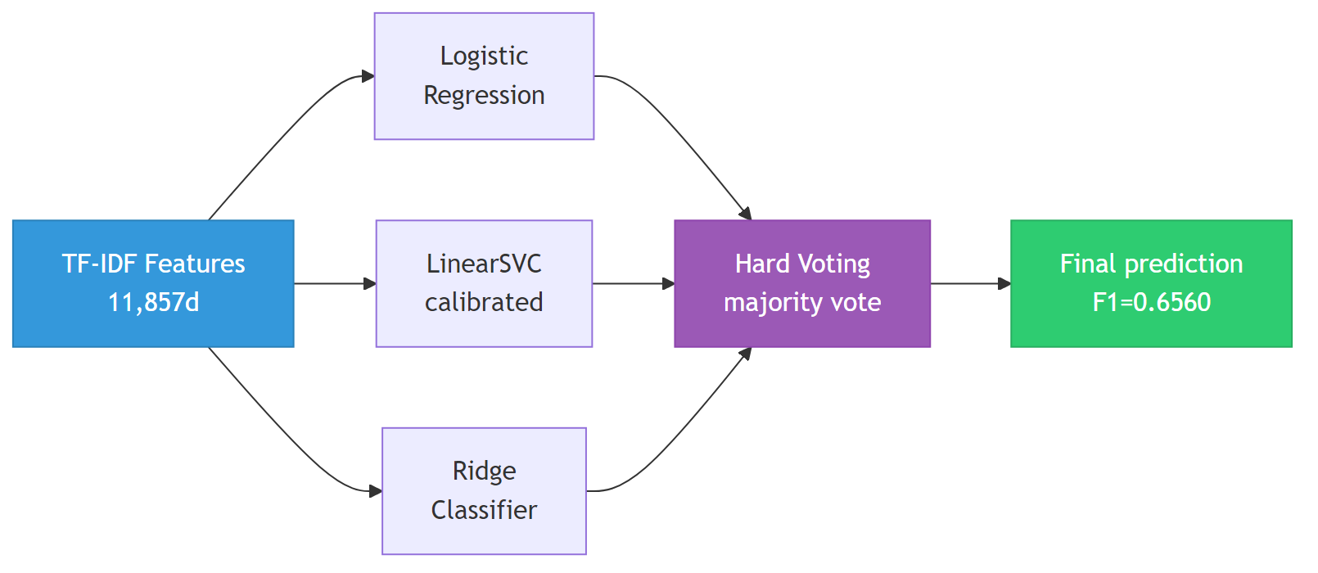
Refinement: Tuning & Ensemble Stacking
GridSearchCV:
SVM: C=10, +0.15 F1 (biggest tuning gain)
XGBoost/LR: already near-optimal
Ensemble Stacking (4 models, LR meta):
F1=0.6708 | Acc=0.6815
BEST OVERALL (+0.010 over baseline)
Uses LR, SVM, XGBoost, BERT cross-val probs
Baseline Voting (LR+LSVC+Ridge):
Soft Voting F1=0.6611
Hard Voting F1=0.6560
Ensemble v2 (6 tuned models): F1=0.6566
Correlated predictions add redundant noise

Slide 10
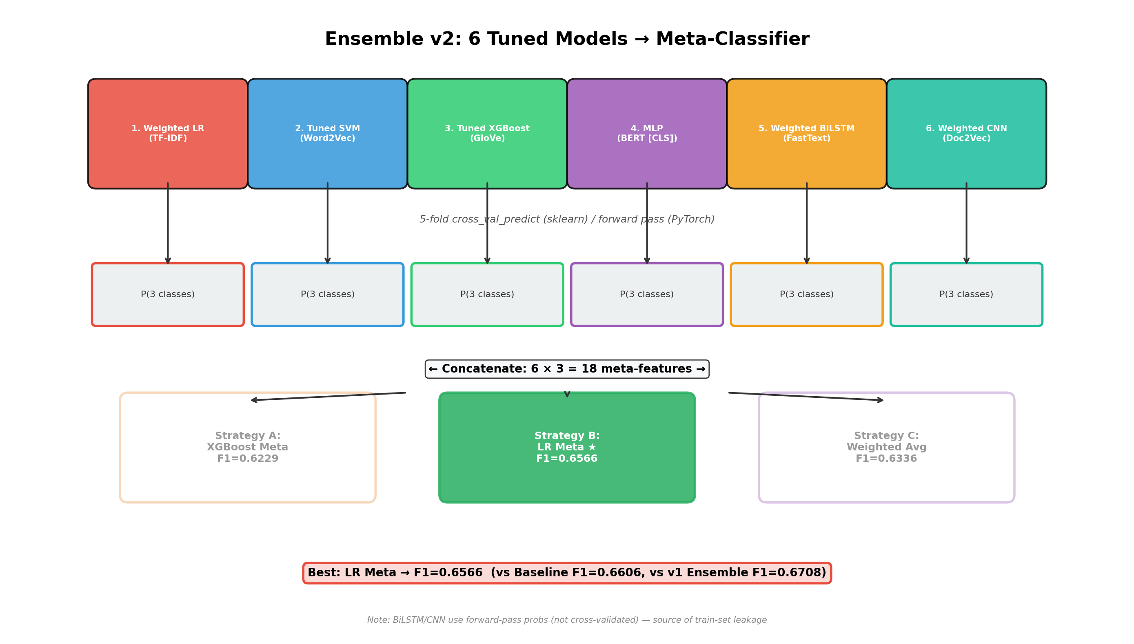
Ensemble v2: 6 Tuned Models Architecture

Slide 11
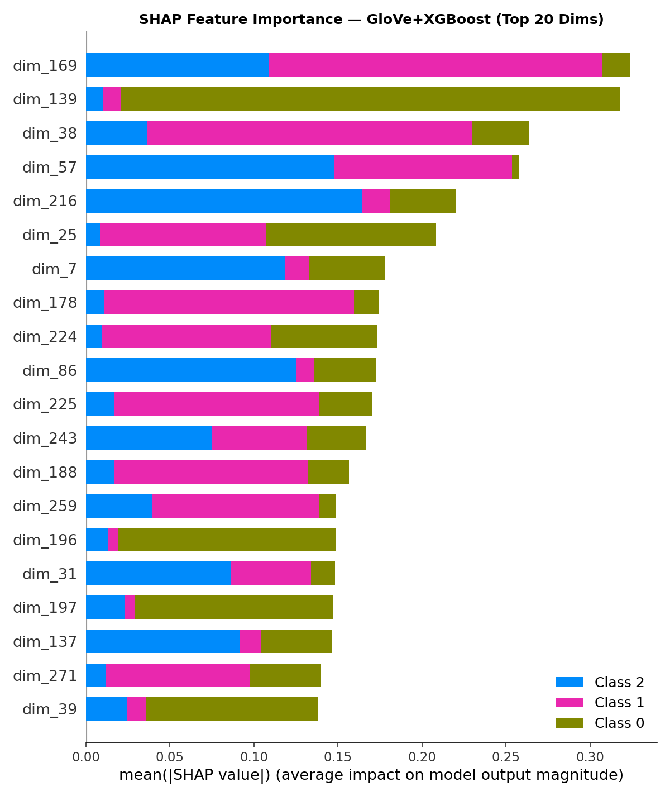
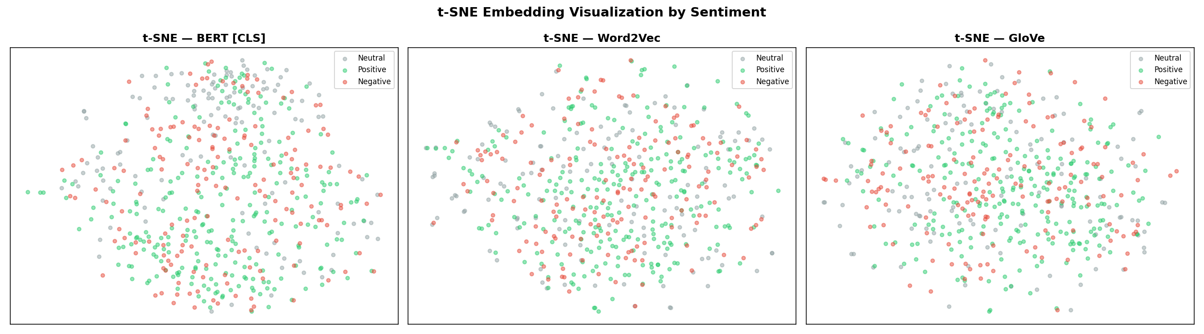
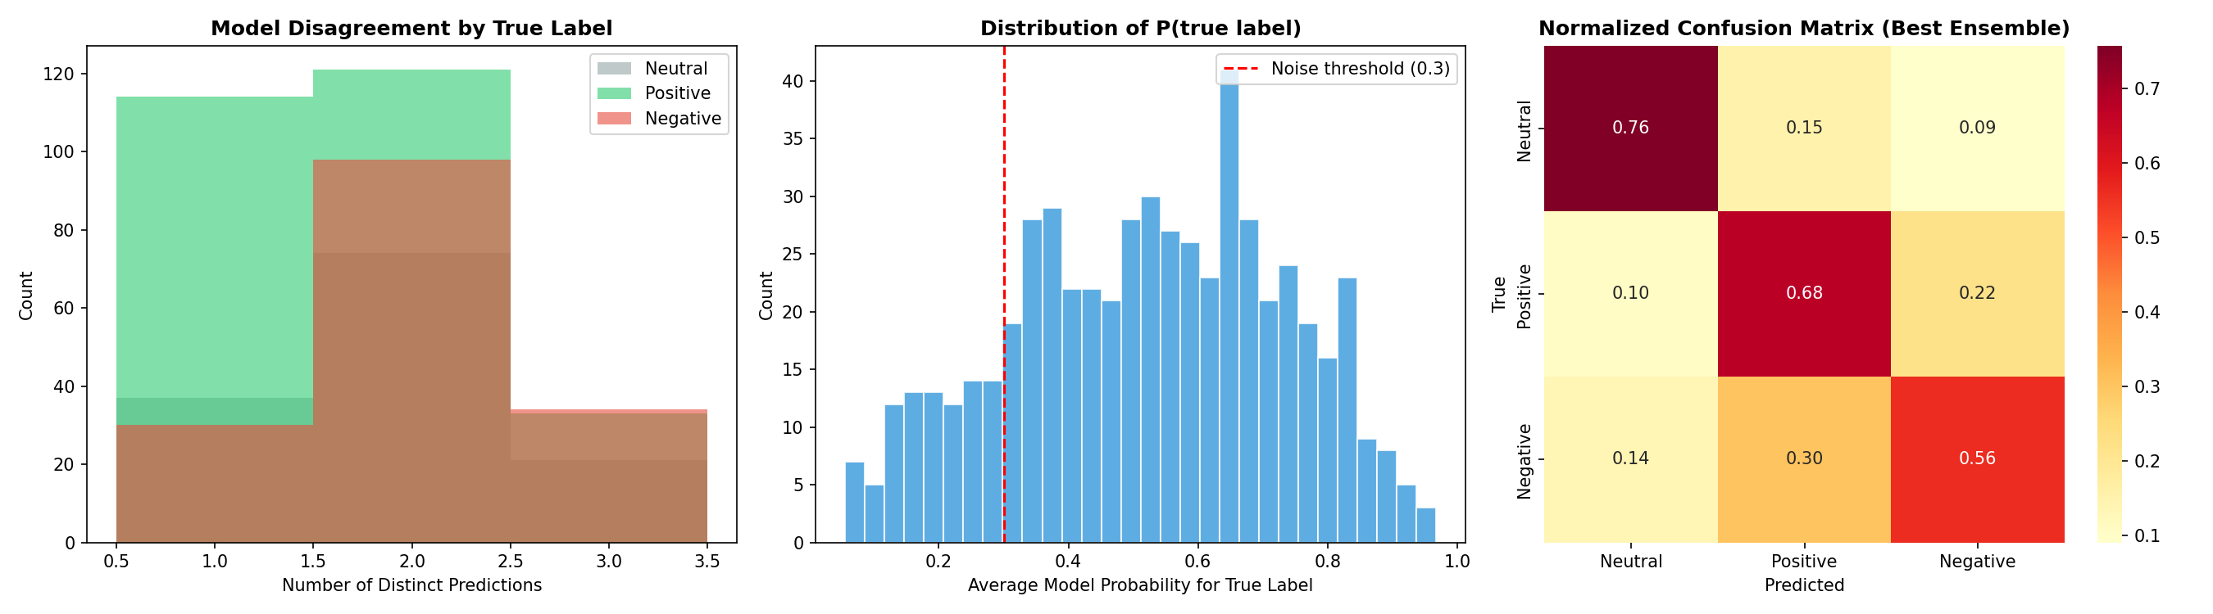
Creativity: SHAP, t-SNE/UMAP, Error Analysis
SHAP: decomposes predictions into per-feature contributions — top dimensions drive each sentiment class
t-SNE / UMAP: BERT shows best class separation; Word2Vec = amorphous blob; correlates with F1
Error Analysis: 25.4% full agreement, 16.4% high disagreement — ~16% potential label noise = performance ceiling

Slide 12
Conclusion: 5 Key Findings
1. Ensemble Stacking is the best model (F1=0.6708)
+0.010 over standalone baseline via meta-learning
2. From-scratch embeddings need far more data
~2,809 texts insufficient for 300d embeddings
3. Hybrid sampling = best imbalance fix (F1=0.6692)
Oversample minorities + undersample majority
4. Mean pooling destroys discriminative information
TF-IDF separability 0.734 vs Word2Vec 0.015
5. Political text is inherently ambiguous
~16% label noise = hard performance ceiling
Final Model Ranking:
1. Ensemble Stacking F1=0.6708
2. Hybrid + LR F1=0.6692
3. TF-IDF + LR F1=0.6606
4. Fine-tuned BERT F1=0.5927
5. GloVe + XGBoost F1=0.5535
Recommendation:
Deploy Ensemble or TF-IDF + LR
Future work:
Domain-specific transformer on 10K+ data

Slide 13
Thank You
Questions & Discussion
104 notebook cells • 21 visualizations • 15 flowcharts • 36 tables 19 experiments logged • 6 models compared • 8 imbalance strategies

