Slide 1
1111_物聯網核心網路技術 CORE NETWORK TECHNOLOGY OF INTERNET OF THINGS
IEEE INTERNET OF THINGS JOURNAL, VOL. 6, NO. 6, DECEMBER 2019
Design of oneM2M-Based Fog
Computing Architecture
Sendren Sheng-Dong Xu , Senior Member, IEEE, Chun-Huang Chen, and Teng-Chang Chang
F74082010 陳昭穎
整體架構構想、製作GUI視窗
F74082109 梁華軒
實現oneM2M system、DEMO
Q56114047 簡羽晨
簡報製作、報告

Slide 2
What is Fog Computing
Using front-end devices or serially connected terminal devices to conduct data storage, calculations, or related decentralized control management.
Why use this method
This method could provide low latency and fast response by maximizing the reduction of the overall end-to-end delay.
For example
For transmitting high-resolution image data at front-end nodes, the original oneM2M IoT architecture takes 251.2–537.2 ms, while fog computing architecture reduces the transmission time to 16.7–46.2 ms, which is a 94.1% reduction.
Fig. 1. Cloud-Fog IoT computing interface and architecture.
1

Slide 3

Our Project
In this project, we apply both fog and cloud computing architecture, simulating a sensitive pest preventing and controlling system across large agriculture lands.
Sudden outbreak of a pest may occurs in small regions.
Regional outbreak severity.
Needs
Slice farmlands into sections
Detect crop pests outbreaks and
activate the pest controlling system.
Monitor and record controlling
results, then improve the pest
controlling system periodically.
Require immediate action
Fog Computing
Methods
Require big data storage and computing resources
Cloud Computing
By applying this system, we hope to prevent pest populations spreading over vast areas and reduce the unnecessary use of pesticides.
Goals
2
Notes:
本次專案中以霧運算為基礎架構，模擬了農作物之蟲害防治的情境。由於農地面積很大，且蟲害事件發生時並不會使每個區域都產生損害，受損的程度也都不盡相同。因此本專案將農地分割成不同區塊進行管理，並期望能依照不同區域所遭遇的情況動態地進行調整。
而在蟲害防治的情境中會有兩項主要任務：
感測蟲害事件，並啟動防範裝置。
蒐集農作物損害的資訊，並調整防範裝置之強度。
由於啟動防範裝置對於即時性的要求較高，因此會交由較靠近網路邊緣的霧運算判斷是否應該啟動防範裝置；而調整防範裝置的強度所需要的運算能力較強，且對即時性的要求較低，因此會將資料送往雲端進行處理。

Slide 4
System Flow Chart
Cloud server
IN-CSE
IN
IN-AE
Node-red
MN-CSE
MN
MN-AE
Node-red
GUI
Application
Local server
3

Slide 5
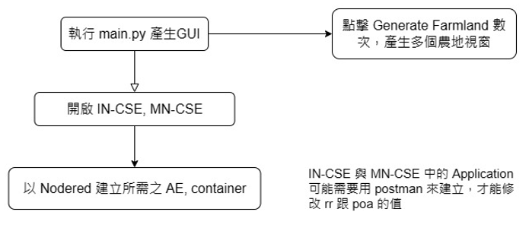
Initialize
每個農地視窗防禦能力預設為40
4

Slide 6
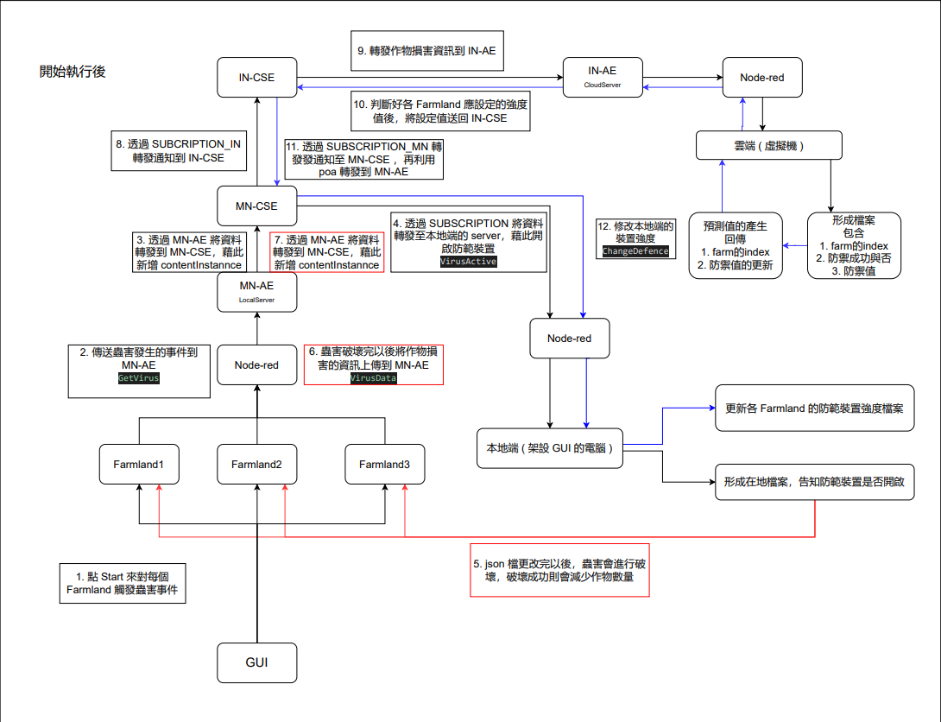
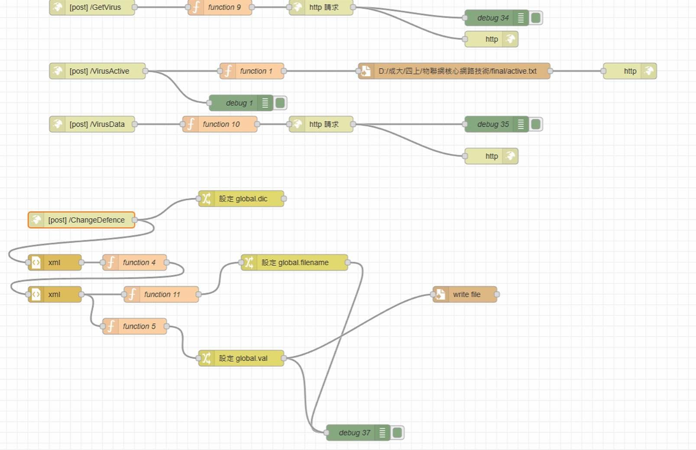





Cloud server
192.168.201.128
192.168.16.41
5
Local server

Slide 7
Cloud server
192.168.16.41
6
Local server

Slide 8
Cloud server
192.168.201.128
192.168.16.41
7
Local server

Slide 9
Local server

Slide 10
Algorithm of 'dfStrength'
Simulate the efficiency of pesticide use of crops
Default value (initial): 40
All of crops are still alive → high efficiency
reduce pesticide use in pest controlling system to 50%
(expected to reduce the unnecessary use of pesticides as well as lower costs)
Some crops are died → relative low efficiency
increase the use of pesticides by 10
Case 1
Case 2

Slide 11
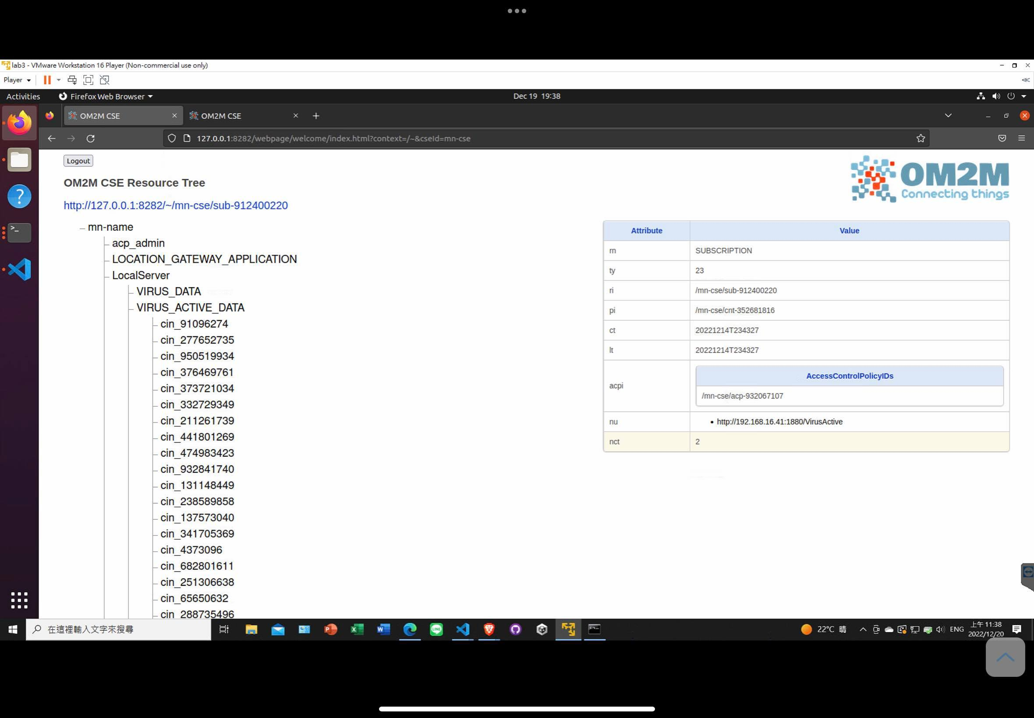
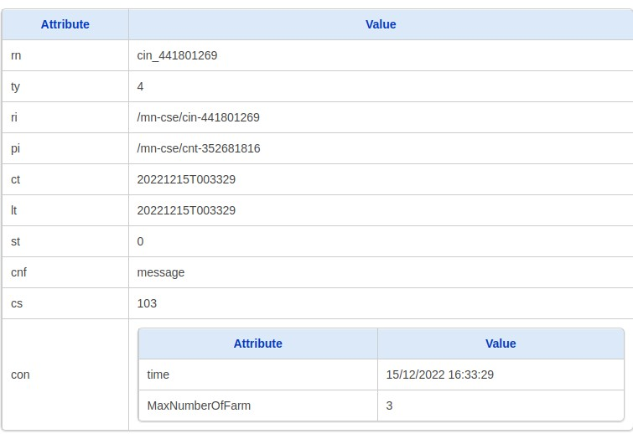
VIRUS_ACTIVE_DATA

Slide 12
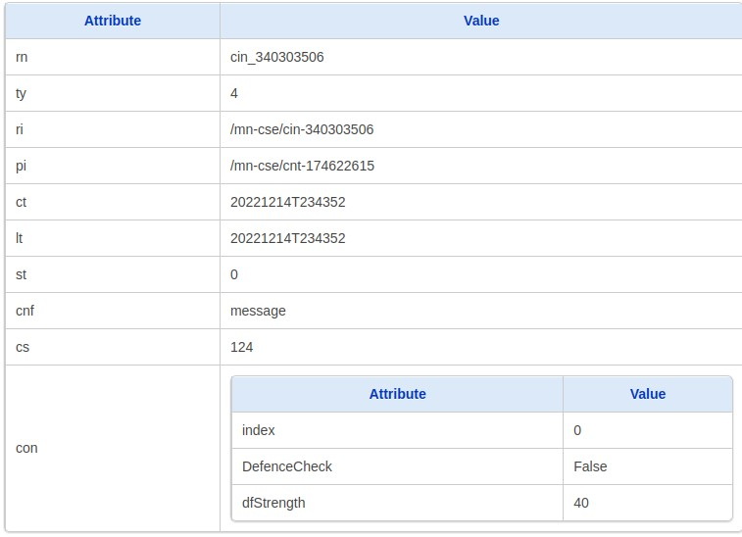
VIRUS_DATA

Slide 14


Slide 15
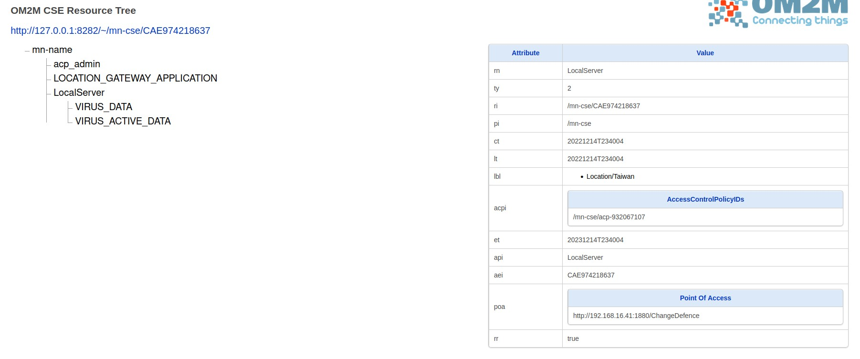

Slide 16
