Slide 1
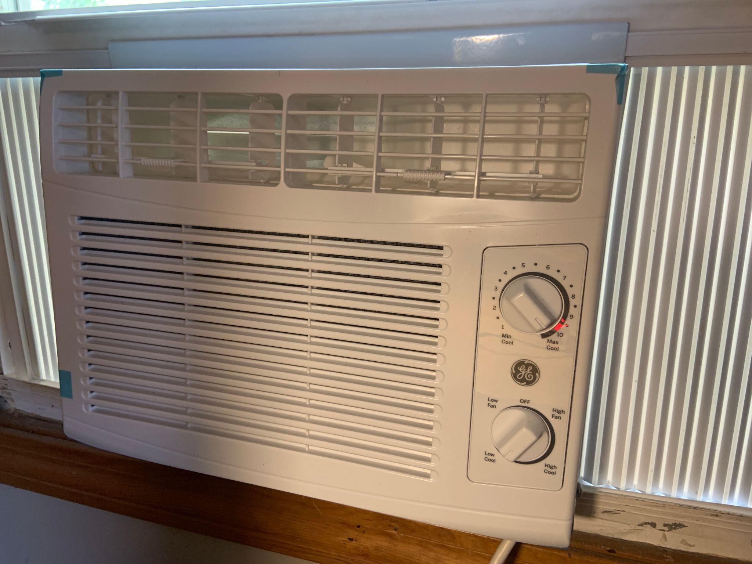
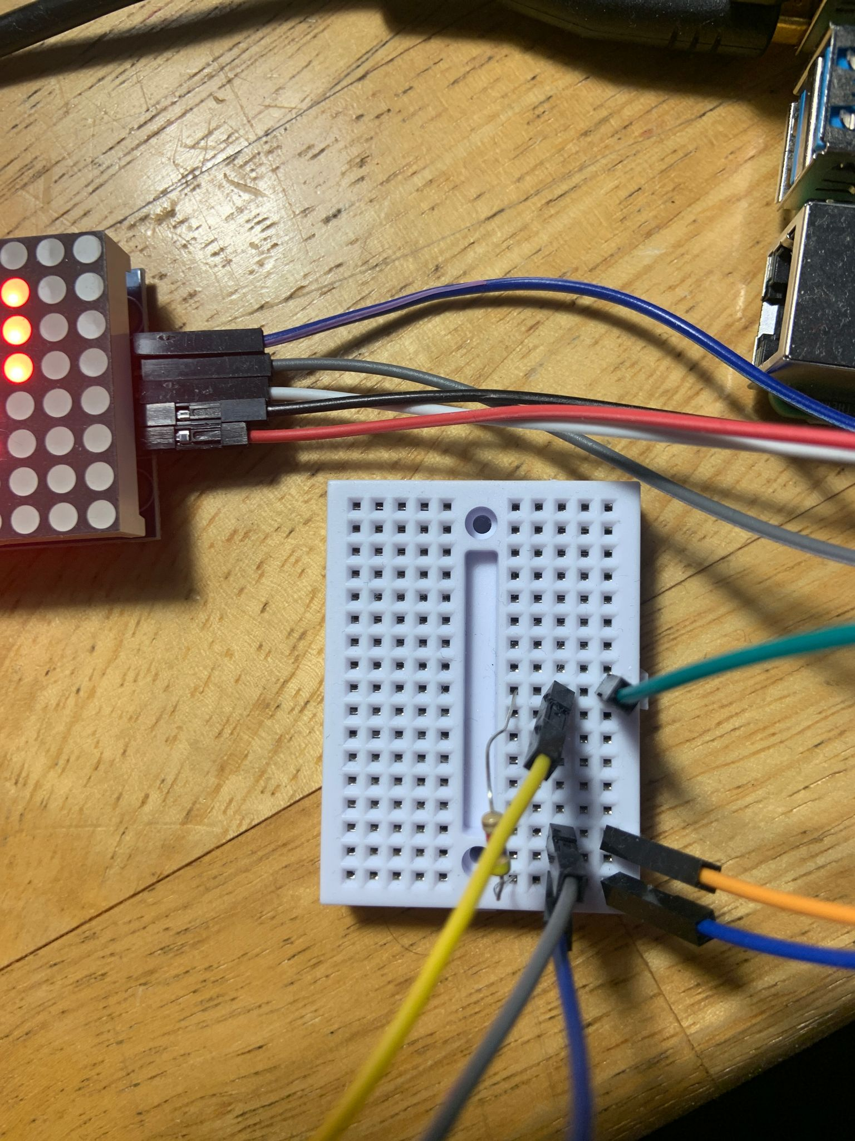
SmartTemp Control: LED‑Display Temperature Sensing with Automated AC Activation
Wilson Heath

Slide 2

Project Demonstration

Slide 3
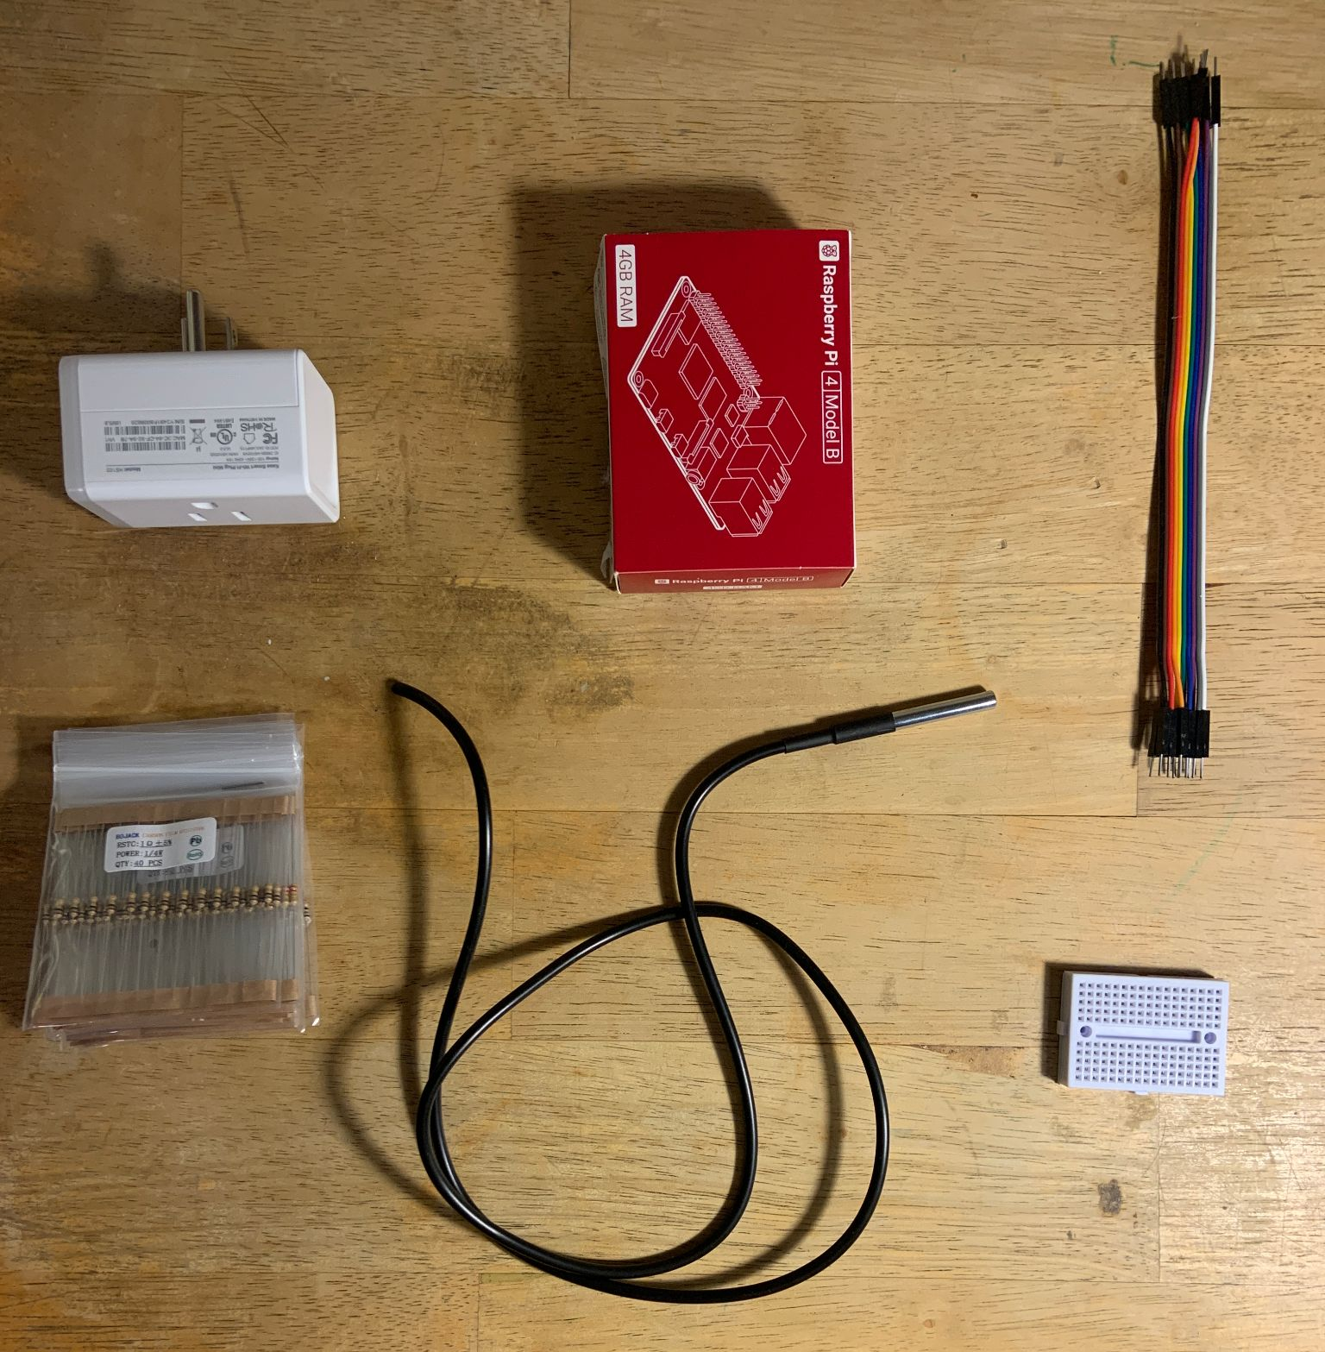
Materials
Microcontroller (Raspberry Pi4b)
Jumper wires
DS18B20 Temperature Sensor
Kasa Smart Plug
Mini breadboard
MAX7219 LED Display

Slide 4
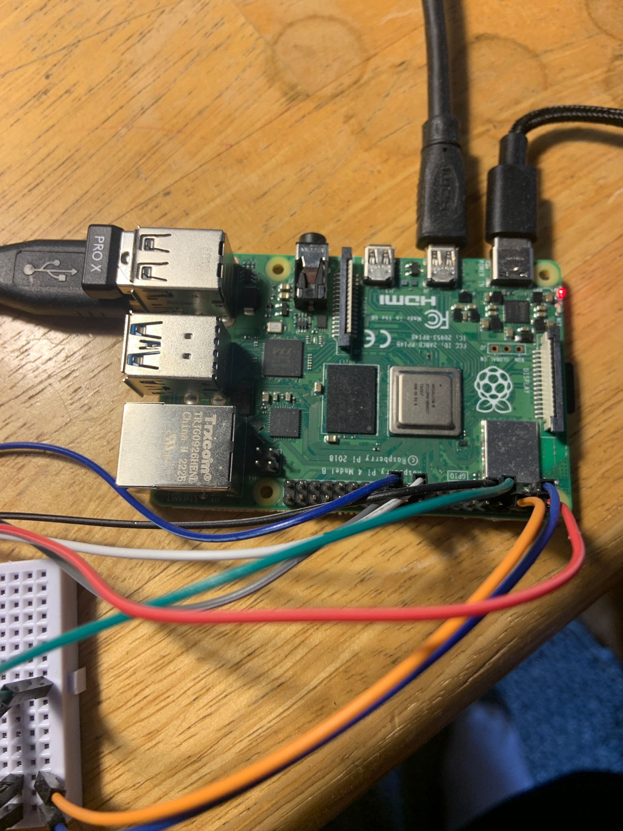
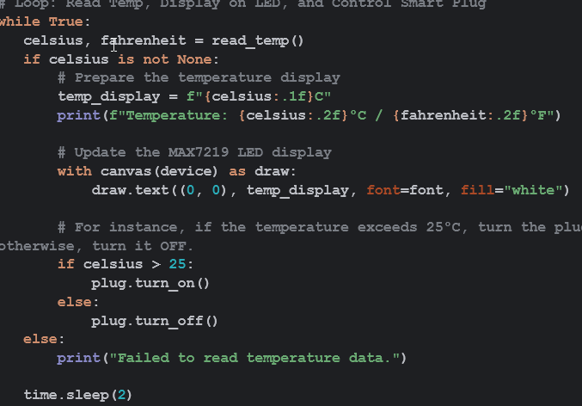
Process
Research
Circuit Design
Select Materials
Hardware Assembly
Software Development
Testing + Integration
Reflection & Improvement

Slide 5
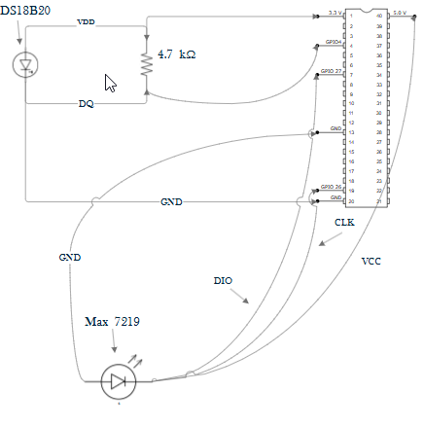
Circuit
Can not read data without 4.7k resistor in parallel with data cable and voltage source
Current flowing through the resistor is approximately 0.7 mA

Slide 6
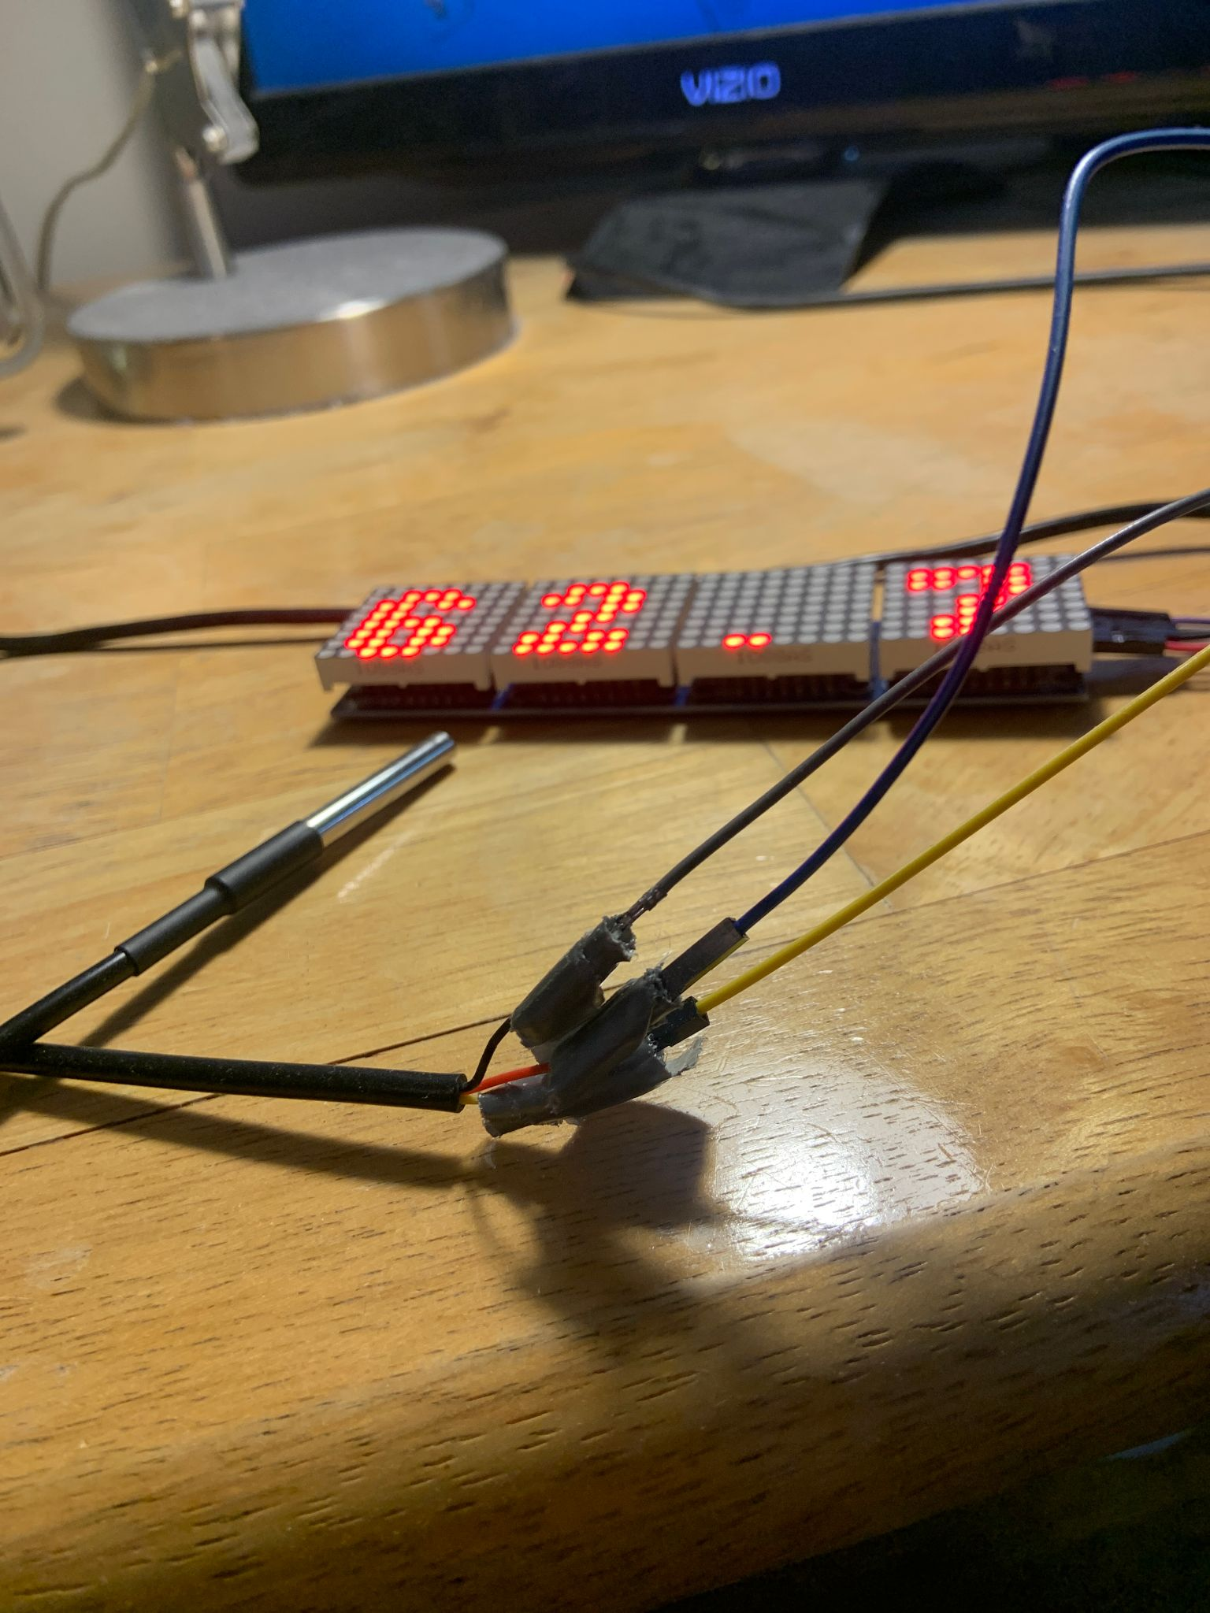
Challenges Along the Way
Connecting DS18B20 wires to jumper wires
Getting temperatures to display correctly on LED display
Troubleshooting hardware compatibility with python
Debugging code

Slide 7
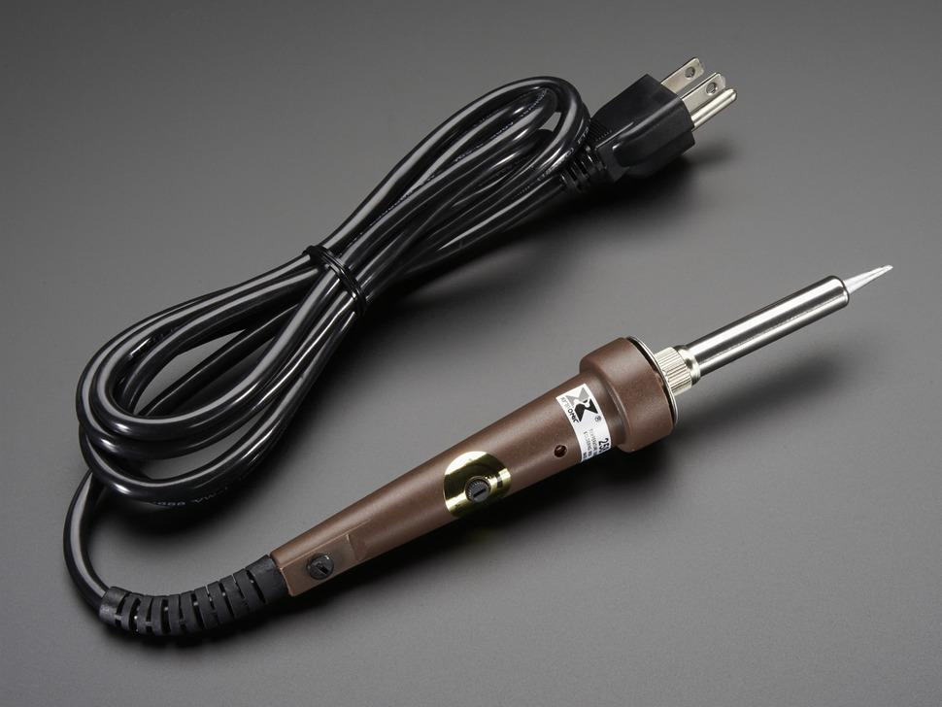
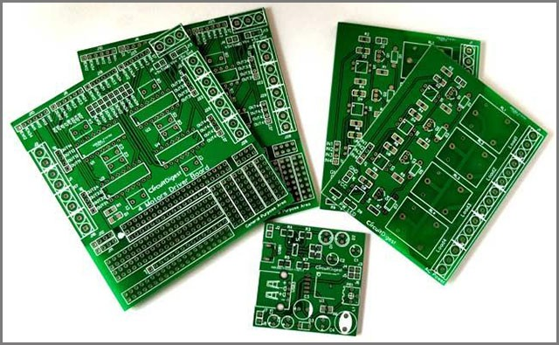
Possible Improvements
Custom PCB or solder wires
Run the python program on boot (possible switch to Arduino)
Develop a custom chassi with a CAD software

