Slide 1
Machine Learning
Shyi-Chyi Cheng (鄭錫齊)
Email:csc@mail.ntou.edu.tw
Tel: 02-24622192-6653

Slide 2
章節目錄
第一章 簡介
第二章 Tensorflow/Keras入門
第三章 貝氏定理回顧
第四章 監督式學習
第五章 神經網路與深度學習
第六章 卷積神經網路
第七章 遞迴神經網路
第八章 非監督式學習
第九章 強化學習

Slide 3
監督式學習
Supervised Learning
k-nearest neighbor classifier
Naïve Bayes
Logistic Regression
Support Vector Machines

Slide 4
NEAREST NEIGHBOR CLASSIFICATION

Slide 5
Illustrating Classification Task

Slide 6
Instance-Based Classifiers
Store the training records
Use training records to predict the class label of unseen cases

Slide 7
Instance Based Classifiers
Examples:
Rote-learner
Memorizes entire training data and performs classification only if attributes of record match one of the training examples exactly
Nearest neighbor classifier
Uses k “closest” points (nearest neighbors) for performing classification

Slide 8
Nearest Neighbor Classifiers
Basic idea:
“If it walks like a duck, quacks like a duck, then it’s probably a duck”
Compute Distance
Test Record
Training Records
Choose k of the “nearest” records

Slide 9
Nearest-Neighbor Classifiers
Requires three things
The set of stored records
Distance Metric to compute distance between records
The value of k, the number of nearest neighbors to retrieve
To classify an unknown record:
Compute distance to other training records
Identify k nearest neighbors
Use class labels of nearest neighbors to determine the class label of unknown record (e.g., by taking majority vote)

Slide 10
Definition of Nearest Neighbor
K-nearest neighbors of a record x are data points that have the k smallest distance to x

Slide 11
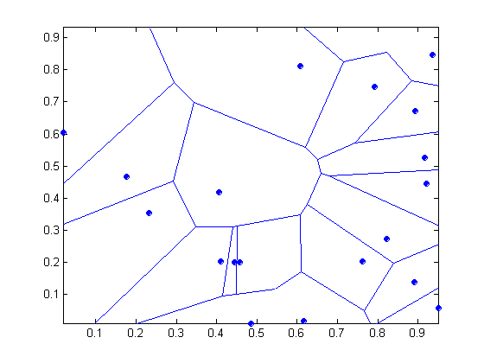
1 nearest-neighbor
Voronoi Diagram defines the classification boundary
The area takes the class of the green point

Slide 12
Nearest Neighbor Classification
Compute distance between two points:
Euclidean distance
Determine the class from nearest neighbor list
take the majority vote of class labels among the k-nearest neighbors
Weigh the vote according to distance
weight factor, w = 1/d²

Slide 13
Nearest Neighbor Classification…
Choosing the value of k:
If k is too small, sensitive to noise points
If k is too large, neighborhood may include points from other classes

Slide 14
Nearest Neighbor Classification…
Scaling issues
Attributes may have to be scaled to prevent distance measures from being dominated by one of the attributes
Example:
height of a person may vary from 1.5m to 1.8m
weight of a person may vary from 90lb to 300lb
income of a person may vary from $10K to $1M

Slide 15
Nearest Neighbor Classification…
Problem with Euclidean measure:
High dimensional data
curse of dimensionality
Can produce counter-intuitive results
1 1 1 1 1 1 1 1 1 1 1 0
1 0 0 0 0 0 0 0 0 0 0 0
vs
0 1 1 1 1 1 1 1 1 1 1 1
0 0 0 0 0 0 0 0 0 0 0 1
d = 1.4142
d = 1.4142
Solution: Normalize the vectors to unit length

Slide 16
Nearest neighbor Classification…
k-NN classifiers are lazy learners
It does not build models explicitly
Unlike eager learners such as decision trees
Classifying unknown records are relatively expensive
Naïve algorithm: O(n)
Need for structures to retrieve nearest neighbors fast.
The Nearest Neighbor Search problem.

Slide 17
Nearest Neighbor Search
Two-dimensional kd-trees
A data structure for answering nearest neighbor queries in R²
kd-tree construction algorithm
Select the x or y dimension (alternating between the two)
Partition the space into two with a line passing from the median point
Repeat recursively in the two partitions as long as there are enough points

Slide 18
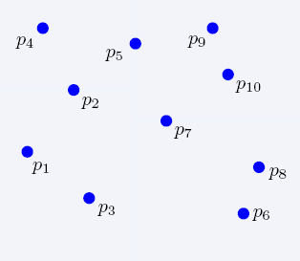
Nearest Neighbor Search
2-dimensional kd-trees

Slide 19
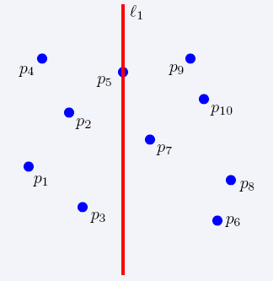
Nearest Neighbor Search
2-dimensional kd-trees

Slide 20
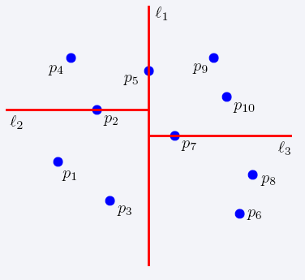
Nearest Neighbor Search
2-dimensional kd-trees

Slide 21
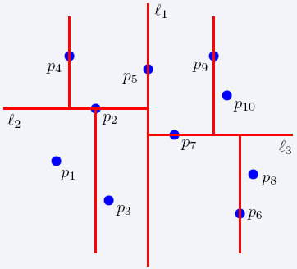
Nearest Neighbor Search
2-dimensional kd-trees

Slide 22
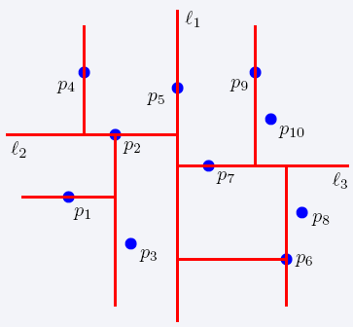
Nearest Neighbor Search
2-dimensional kd-trees

Slide 23
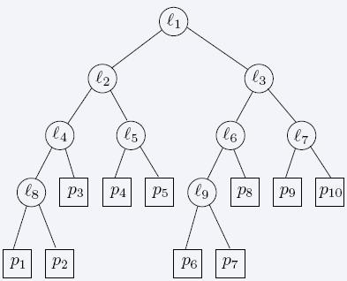
Nearest Neighbor Search
2-dimensional kd-trees

Slide 24
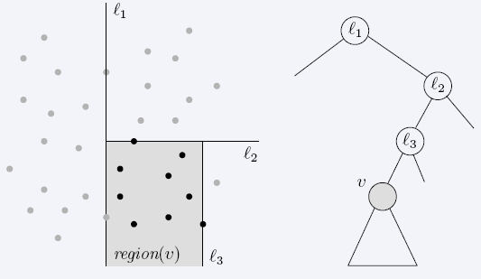
Nearest Neighbor Search
2-dimensional kd-trees
region(u) – all the black points in the subtree of u

Slide 25
Nearest Neighbor Search
2-dimensional kd-trees
A binary tree:
Size O(n)
Depth O(logn)
Construction time O(nlogn)
Query time: worst case O(n), but for many cases O(logn)
Generalizes to d dimensions
Example of Binary Space Partitioning

Slide 26
SUPPORT VECTOR MACHINES

Slide 27
Support Vector Machines
Find a linear hyperplane (decision boundary) that will separate the data

Slide 28
Support Vector Machines
One Possible Solution

Slide 29
Support Vector Machines
Another possible solution

Slide 30
Support Vector Machines
Other possible solutions

Slide 31
Support Vector Machines
Which one is better? B1 or B2?
How do you define better?

Slide 32
Support Vector Machines
Find hyperplane maximizes the margin => B1 is better than B2

Slide 33
Support Vector Machines

Slide 34
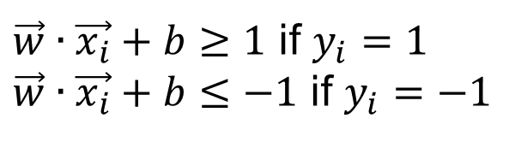
Support Vector Machines
We want to maximize:
Which is equivalent to minimizing:
But subjected to the following constraints:
This is a constrained optimization problem
Numerical approaches to solve it (e.g., quadratic programming)
$\vec{w}∙\vec{x_{i}}+b≥1$ if $y_{i}=1$
$\vec{w}∙\vec{x_{i}}+b≤−1$ if $y_{i}=−1$

Slide 35
Support Vector Machines
What if the problem is not linearly separable?

Slide 36

Support Vector Machines
What if the problem is not linearly separable?
$$\frac{ξ_{i}}{\left\|w\right\|}$$

Slide 37
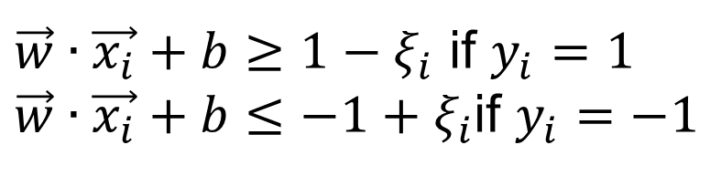
Support Vector Machines
What if the problem is not linearly separable?
Introduce slack variables
Need to minimize:
Subject to:
$\vec{w}∙\vec{x_{i}}+b≥1−ξ_{i}$ if $y_{i}=1$
$\vec{w}∙\vec{x_{i}}+b≤−1+ξ_{i}$if $y_{i}=−1$

Slide 38
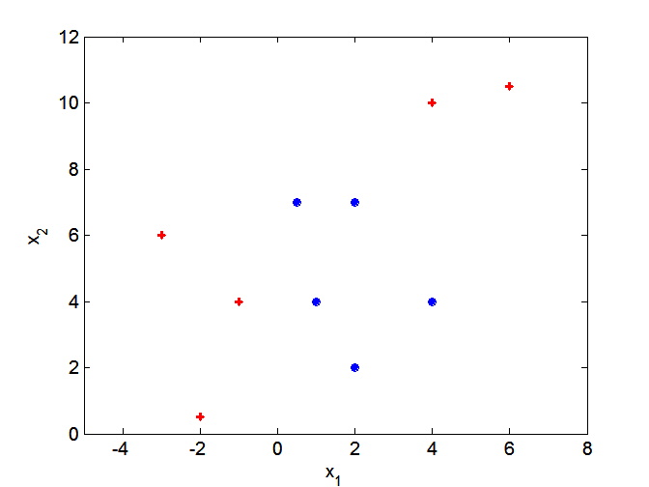
Nonlinear Support Vector Machines
What if decision boundary is not linear?

Slide 39
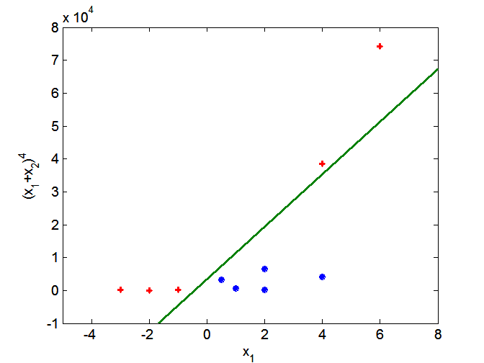
Nonlinear Support Vector Machines
Transform data into higher dimensional space
Use the Kernel Trick

Slide 40
LOGISTIC REGRESSION

Slide 41
Classification via regression
Instead of predicting the class of an record we want to predict the probability of the class given the record
The problem of predicting continuous values is called regression problem
General approach: find a continuous function that models the continuous points.

Slide 42
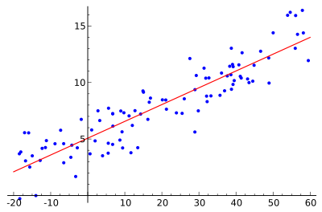
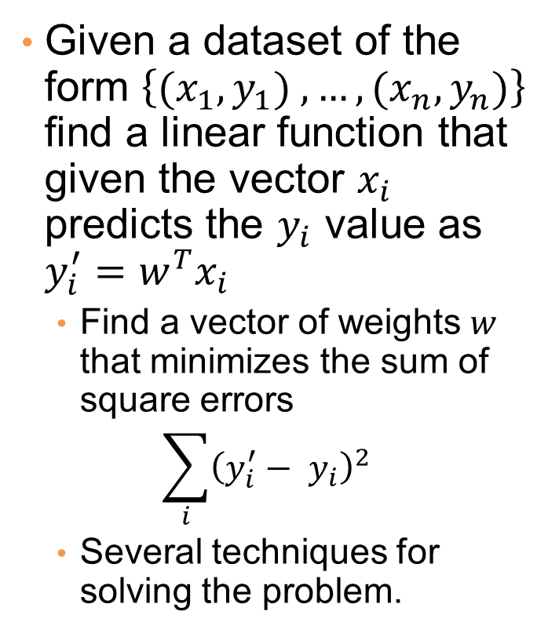
Example: Linear regression
Given a dataset of the form $\left\{{(x}_{1},y_{1}) ,…,{(x}_{n},y_{n})\right\}$ find a linear function that given the vector $x_{i}$ predicts the $y_{i}$ value as $y_{i}^{′}=w^{T}x_{i}$
Find a vector of weights $w$ that minimizes the sum of square errors
$$\sum_{i}{{\left(y_{i}^{′}− y_{i}\right)}^{2}}$$
Several techniques for solving the problem.

Slide 43





Classification via regression
Assume a linear classification boundary
$$w⋅x>0$$
For the positive class the bigger the value of $w⋅x$, the further the point is from the classification boundary, the higher our certainty for the membership to the positive class
Define $P(C_{+}|x)$ as an increasing function of $w⋅x$
$$w⋅x=0$$
For the negative class the smaller the value of $w⋅x$, the further the point is from the classification boundary, the higher our certainty for the membership to the negative class
Define $P(C_{−}|x)$ as a decreasing function of $w⋅x$
$$w⋅x<0$$

Slide 44
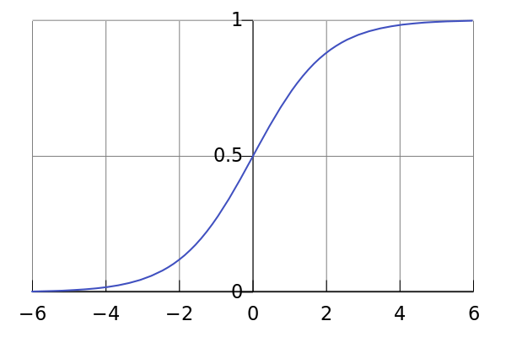
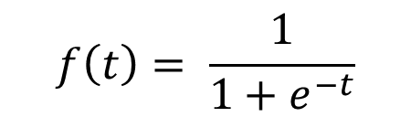
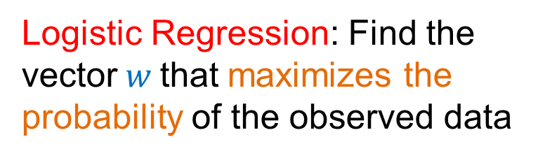
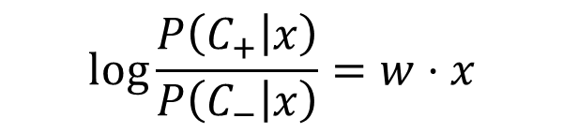
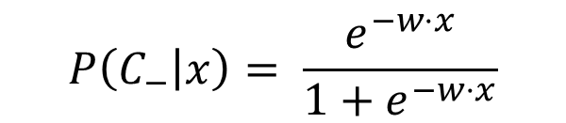
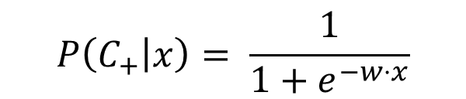
Logistic Regression
The logistic function
$$f\left(t\right)= \frac{1}{1+e^{−t}}$$
$$P\left(C_{+} | x\right)= \frac{1}{1+e^{−w⋅x}}$$
$$P\left(C_{−} | x\right)= \frac{e^{−w⋅x}}{1+e^{−w⋅x}}$$
$$\log{\frac{P\left(C_{+} | x\right)}{P\left(C_{−} | x\right)}}=w⋅x$$
Logistic Regression: Find the vector$w$that maximizes the probability of the observed data
Linear regression on the log-odds ratio

Slide 45
Logistic Regression
Produces a probability estimate for the class membership which is often very useful.
The weights can be useful for understanding the feature importance.
Works for relatively large datasets
Fast to apply.

Slide 46
NAÏVE BAYES CLASSIFIER

Slide 47
Bayes Classifier
A probabilistic framework for solving classification problems
A, C random variables
Joint probability: Pr(A=a,C=c)
Conditional probability: Pr(C=c | A=a)
Relationship between joint and conditional probability distributions
Bayes Theorem:

Slide 48
Bayesian Classifiers
Consider each attribute and class label as random variables
Evade C
Event space: {Yes, No}
P(C) = (0.3, 0.7)
Refund A₁
Event space: {Yes, No}
P(A₁) = (0.3,0.7)
Martial Status A₂
Event space: {Single, Married, Divorced}
P(A₂) = (0.4,0.4,0.2)
Taxable Income A₃
Event space: R
P(A₃) ~ Normal(μ,σ)

Slide 49
Bayesian Classifiers
Given a record X over attributes (A₁, A₂,…,A_{n})
E.g., X = (‘Yes’, ‘Single’, 125K)
The goal is to predict class C
Specifically, we want to find the value c of C that maximizes P(C=c| X)
Maximum Aposteriori Probability estimate
Can we estimate P(C| X) directly from data?
This means that we estimate the probability for all possible values of the class variable.

Slide 50
Bayesian Classifiers
Approach:
compute the posterior probability P(C | A₁, A₂, …, A_{n}) for all values of C using the Bayes theorem
Choose value of C that maximizes P(C | A₁, A₂, …, A_{n})
Equivalent to choosing value of C that maximizes P(A₁, A₂, …, A_{n}|C) P(C)
How to estimate P(A₁, A₂, …, A_{n} | C )?

Slide 51
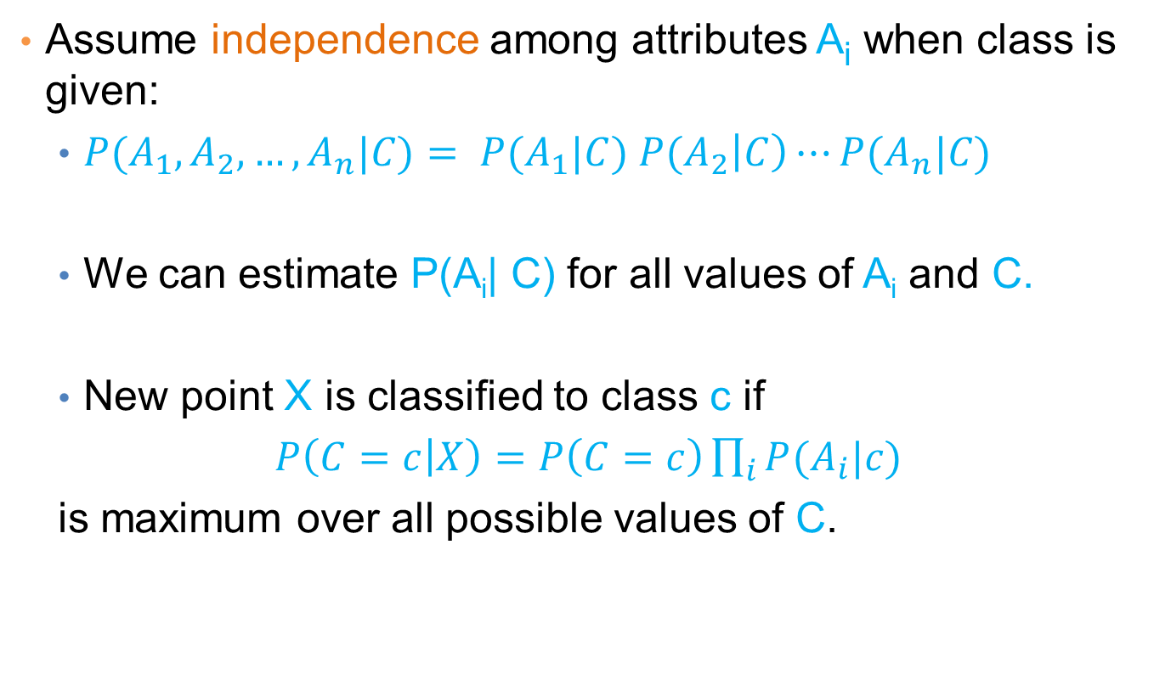
Naïve Bayes Classifier
Assume independence among attributes A_{i} when class is given:
$P(A_{1},A_{2},…,A_{n}|C)= P(A_{1}|C) P(A_{2}\left|C\right)⋯P(A_{n}|C)$
We can estimate P(A_{i}| C) for all values of A_{i} and C.
New point X is classified to class c if
$P\left(C=c | X\right)=P\left(C=c\right)\prod_{i}{P(A_{i}|c)}$
is maximum over all possible values of C.

Slide 52
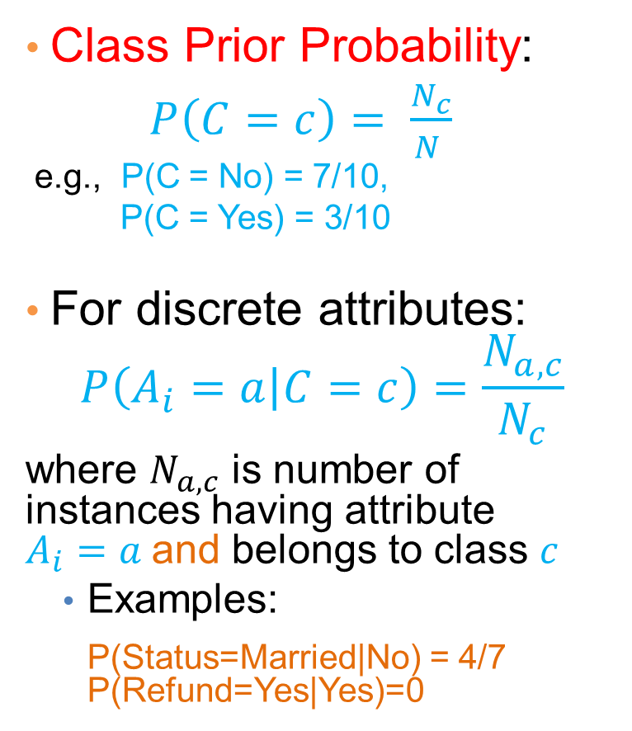
How to Estimate Probabilities from Data?
Class Prior Probability:
$P\left(C=c\right)= \frac{N_{c}}{N }$
e.g., P(C = No) = 7/10,
P(C = Yes) = 3/10
For discrete attributes:
$$P\left(A_{i}=a | C=c\right)=\frac{N_{a,c}}{N_{c}}$$
where $N_{a,c}$ is number of instances having attribute $A_{i}=a$and belongs to class $c$
Examples:
P(Status=Married|No) = 4/7 P(Refund=Yes|Yes)=0

Slide 53
How to Estimate Probabilities from Data?
For continuous attributes:
Discretize the range into bins
one ordinal attribute per bin
violates independence assumption
Two-way split: (A < v) or (A > v)
choose only one of the two splits as new attribute
Probability density estimation:
Assume attribute follows a normal distribution
Use data to estimate parameters of distribution (i.e., mean μ and standard deviation σ)
Once probability distribution is known, we can use it to estimate the conditional probability P(A_{i}|c)

Slide 54
How to Estimate Probabilities from Data?
Normal distribution:
One for each (a_{i},c_{i}) pair
For (Income, Class=No):
If Class=No
sample mean = 110
sample variance = 2975

Slide 55
Example of Naïve Bayes Classifier
Creating a Naïve Bayes Classifier, essentially means to compute counts:
Total number of records: N = 10
Class No:
Number of records: 7
Attribute Refund:
Yes: 3
No: 4
Attribute Marital Status:
Single: 2
Divorced: 1
Married: 4
Attribute Income:
mean: 110
variance: 2975
Class Yes:
Number of records: 3
Attribute Refund:
Yes: 0
No: 3
Attribute Marital Status:
Single: 2
Divorced: 1
Married: 0
Attribute Income:
mean: 90
variance: 25

Slide 56
Example of Naïve Bayes Classifier
Given a Test Record:
P(X|Class=No) = P(Refund=No|Class=No) × P(Married| Class=No) × P(Income=120K| Class=No) = 4/7 × 4/7 × 0.0072 = 0.0024
P(X|Class=Yes) = P(Refund=No| Class=Yes) × P(Married| Class=Yes) × P(Income=120K| Class=Yes) = 1 × 0 × 1.2 × 10⁻⁹ = 0
P(No) = 0.3, P(Yes) = 0.7
Since P(X|No)P(No) > P(X|Yes)P(Yes)
Therefore P(No|X) > P(Yes|X) => Class = No

Slide 57
Naïve Bayes Classifier
If one of the conditional probability is zero, then the entire expression becomes zero
Probability estimation:
N_{i}: number of attribute values for attribute A_{i}
p: prior probability
m: parameter

Slide 58
Example of Naïve Bayes Classifier
Given a Test Record:
With Laplace Smoothing
P(X|Class=No) = P(Refund=No|Class=No) × P(Married| Class=No) × P(Income=120K| Class=No) = 5/9 × 5/10 × 0.0072
P(X|Class=Yes) = P(Refund=No| Class=Yes) × P(Married| Class=Yes) × P(Income=120K| Class=Yes) = 4/5 × 1/6 × 1.2 × 10⁻⁹
P(No) = 0.7, P(Yes) = 0.3
Since P(X|No)P(No) > P(X|Yes)P(Yes)
Therefore P(No|X) > P(Yes|X) => Class = No

Slide 59
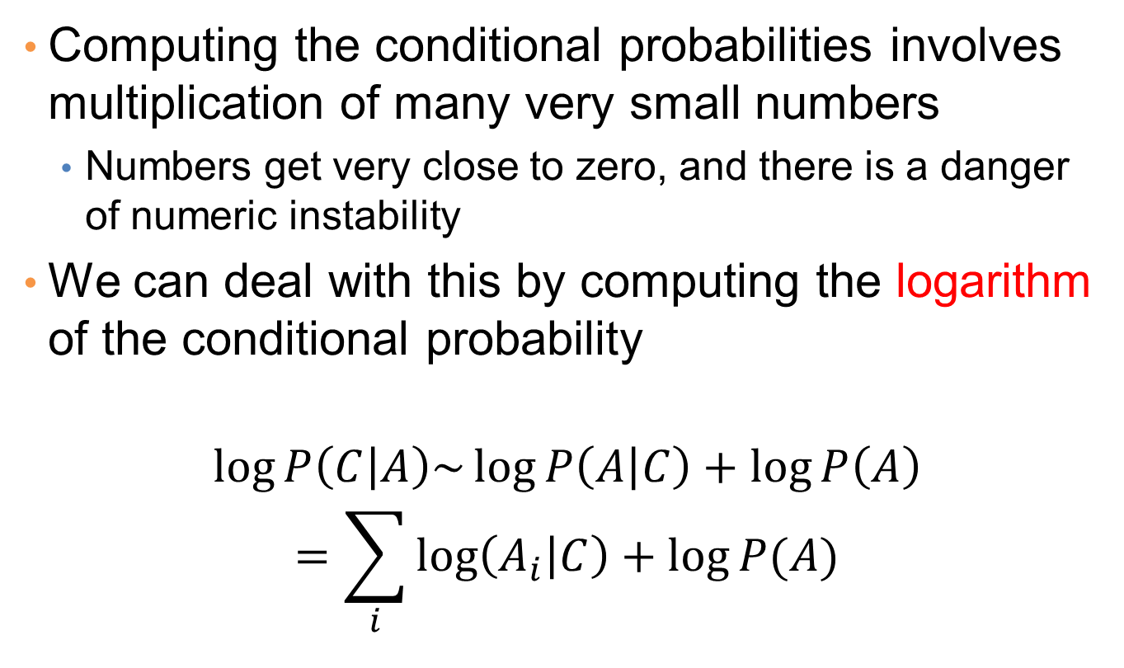
Implementation details
Computing the conditional probabilities involves multiplication of many very small numbers
Numbers get very close to zero, and there is a danger of numeric instability
We can deal with this by computing the logarithm of the conditional probability
$$\log{P\left(C | A\right)\sim \log{P\left(A | C\right)+\log{P\left(A\right)}}}$$
$$=\sum_{i}{\log\left(A_{i} | C\right)+\log{P(A)}}$$

Slide 60
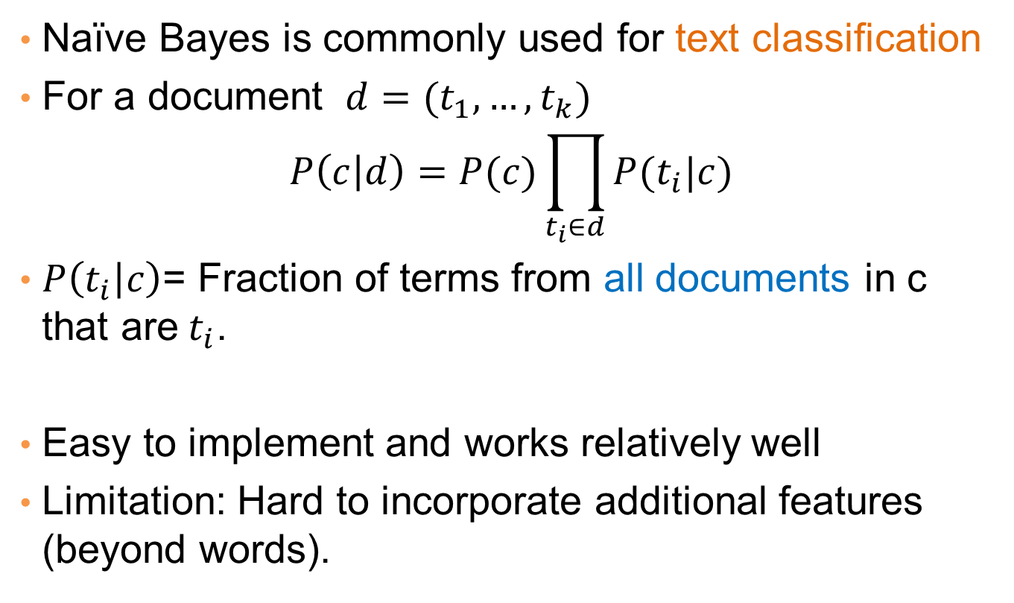
Naïve Bayes for Text Classification
Naïve Bayes is commonly used for text classification
For a document $d=(t_{1},…, t_{k})$
$$P\left(c | d\right)=P(c)\prod_{t_{i}∈d}{P(t_{i}|c)}$$
$P\left(t_{i} | c\right)$= Fraction of terms from all documents in c that are$t_{i}$.
Easy to implement and works relatively well
Limitation: Hard to incorporate additional features (beyond words).

Slide 61
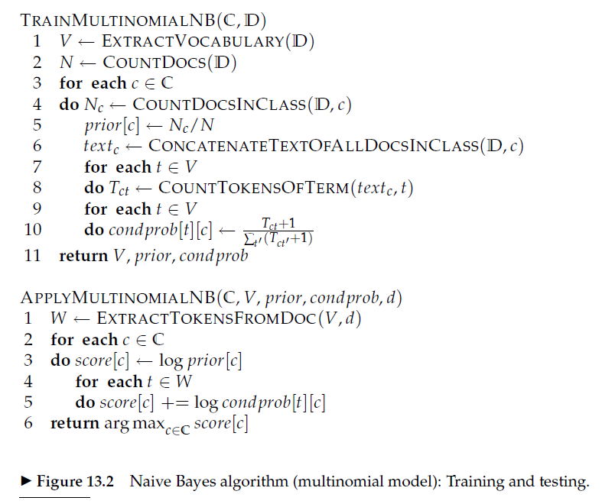

Slide 62
Naïve Bayes (Summary)
Robust to isolated noise points
Handle missing values by ignoring the instance during probability estimate calculations
Robust to irrelevant attributes
Independence assumption may not hold for some attributes
Use other techniques such as Bayesian Belief Networks (BBN)
Naïve Bayes can produce a probability estimate, but it is usually a very biased one
Logistic Regression is better for obtaining probabilities.

Slide 63



Generative vs Discriminative models
Naïve Bayes is a type of a generative model
Generative process:
First pick the category of the record
Then given the category, generate the attribute values from the distribution of the category
Conditional independence given C
We use the training data to learn the distribution of the values in a class
C
$$A_{1}$$
$$A_{2}$$
$$A_{n}$$

Slide 64
Generative vs Discriminative models
Logistic Regression and SVM are discriminative models
The goal is to find the boundary that discriminates between the two classes from the training data
In order to classify the language of a document, you can
Either learn the two languages and find which is more likely to have generated the words you see
Or learn what differentiates the two languages.

Slide 65
LAB3使用Tensorflow執行樹狀分類器
在這個實驗中，我們實作使用Google Colab，從kaggle中下載Dataset: heart-disease-uci.zip，並利用這個資料集進行以下的樹狀分類器研究:
RandomForestClassifier
DecisionTreeClassifier
BoostedTreesClassifier
樹狀分類器有許多特點
非常適合結構化資料的分類或迴歸問題。
通常也具備良好的解釋決策理由的能力。
理論上，樹狀分類器可以應付混合數值型屬性與類別型屬性的資料。
但有時候為了更有效的資料表示或是單純只是遷就演算法，會將資料屬性轉換成另一種表示方式。

Slide 66
LAB3使用Colab執行樹狀分類器
實驗步驟
建置樹狀分類器.ipynb並載入到您的Google Colab
到kaggle註冊帳號https://www.kaggle.com/
利用您的帳號取得Create New API Token，可下載kaggle.json到您的機器
研讀範例程式為例，練習樹狀分類器訓練，並利用Pandas 語法分析各種樹狀分類器的效果
撰寫實驗報告並上傳Tronclass，繳交作業

Slide 67
Any Questions?

