Slide 1
good-or-bad.m
Shaumik Ashraf, Markus Wilson, Quan Nguyen
ENGR-122-076 Final Project
March 10, 2017

Slide 2
Description
Text-interface console game
Decision driven story
Fantasy/medieval time

Slide 3
Technical Aspects
Programmed with Matlab and collaborated on Github
- Function Handles
- Random Number Generator (The Gaming RNG)
- Structs and Struct Arrays
- String handling
- Loops

Slide 4
Main Pseudo-code
Player = struct { name, energy, inventory }
Item_database = struct array [ {name1, effect1}, {name2, effect2}, ... ]
event_handle = @first_event;
while( next_event_no ~= 100 )
[next_event_no, player] = event_handle(player, item_database);
event_handle = switch-case(next_event_no);
end

Slide 5
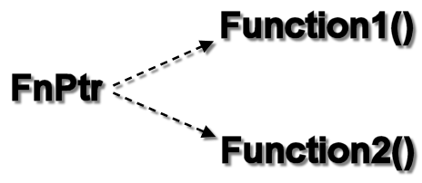
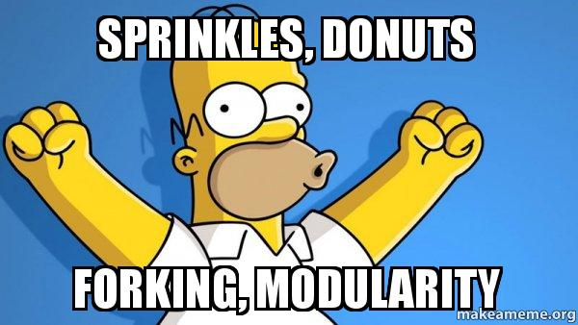
Modularity & Team Distribution
With the function handle setup, each member could design their own function and then easily incorporate it by adding one line of code to main file.

Slide 6

GitHub
File sharing and version control for programmers.
Imagine MSWord track changes, google drive, and dropbox merged into one.

Slide 7
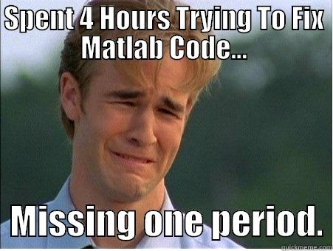
Thank you

