Slide 1

Having Fun
With windows APIs

Slide 2

About Me
Aaron Wilson
Principal Security Engineer @ TCM Security
Bachelor’s – Penn State University
Master’s – Western Governor’s University
CISSP, PNPT, eMAPT, eCPPT, eJPT, etc.
Mobile Application Penetration Tester (MAPT) Course Instructor
Other Interests:
  Chess
  Orchestra

Slide 3
Inspiration for this stream
“The crazy things I did in High School to the Teacher’s Computer”
  Using Windows Functionality (Windows APIs – Win32 APIs) to have some fun!
  Projects Today:
    Hello World – simple hello world
    Ear Destroyer – play video on repeat every 10 seconds, unmute the volume
    Mouse Mover – move the mouse around the screen
    Mini Ransomware – encrypt a file, delete the original, and ask for a ransom

Slide 4
Source Code
Source Code: https://github.com/wilsonator/TCMWindowsAPIs/tree/main (link in chat)
  All code will be written in Python
  Python is very beginner friendly
  Want to extend these skills?
    C/C++, Golang, Rust, Nim
    Windows APIs are very portable to many coding languages

Slide 5
Where to learn more about Windows APis
TCM Security – Python 201 course covers the Windows APIs and native APIs
Pavel Yosifovich – has many courses and books on the Windows APIs and Windows Internals
  Pluralsight
  Windows X Internals, where X is any version of windows ever created by man ☺
  Windows Kernel Programming
  Windows Native API Programming
Maldev Academy – Malware Development with Native and Win32 APIs
malapi.io – collection of APIs by functionality for malware development

Slide 6
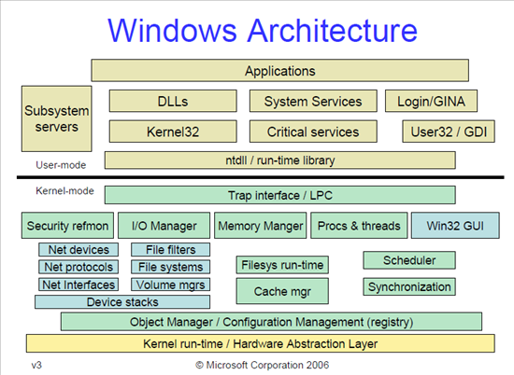
What are windows APIs?
Functionality as an interface between the user and the kernel.
Windows APIs utilize DLLs (Dynamic Link Library) to interact with the kernel
You can think of a DLL like a library of functions
  Similar to a python library like requests
Kernel mode requires privileged access while the user mode doesn’t

Slide 7

Windows APIs in modern malware development
Within the realm of “Living off the Land”
To bypass the best antivirus products, you will need to call the Native APIs and utilize other techniques as well
  What distinguishes a native API vs a Win 32 API?
  NtCreateThread (ntdll.dll) vs. CreateThread (Kernel32.dll)
Cat and Mouse Game
Undocumented APIs
All code today will bypass general Windows Defender, not Enterprise
  Our code is certainly not production-ready, we can cancel it by doing CTRL+C/CTRL+Z, ending the task, or rebooting
  It’s mischievous but not truly harmful

Slide 8

Documentation, Documentation, Documentation
Windows API Index:
https://learn.microsoft.com/en-us/windows/win32/apiindex/windows-api-list
https://learn.microsoft.com/en-us/windows/win32/api/
List of all the things you can call and control with the APIs
MessageBoxW – creates a pop up window

Slide 9
Environment setup
Download and install Python latest version
Include PIP and PATH in system environment variables
VSCode with the Python Intellisense Plugin
Git to pull down the source code repo

Slide 10
Hello World
Prompt: Open a Text Box that says Hello World!
In Python we can utilize Windows APIs to do this.
We will use the function: MessageBoxW
  https://learn.microsoft.com/en-us/windows/win32/api/winuser/nf-winuser-messageboxw
  How to read the APIs and use them

Slide 11
Ear destroyer and Mouse mover
Next we will use the Windows APIs to do the following:
  Open a video and control audio to unmute and go to 100%
  Move the mouse every second making it impossible for the user to do things

Slide 12
Final fun: mini ransomware
Here is what we are going to build:
  Prompt the user continuously to say yes to installing an antivirus program
  After they say yes, encrypt the file important.txt
  Send the original file to the trash and empty the trash, leaving only the encrypted file
  Pop up another window saying to pay the attacker100 bitcoin to a wallet address

Slide 13
Where to learn more about Windows APis
TCM Security – Python 201 course covers the Windows APIs and native APIs
Pavel Yosifovich – has many courses and books on the Windows APIs and Windows Internals
  Pluralsight
  Windows X Internals, where X is any version of windows ever created by man ☺
  Windows Kernel Programming
  Windows Native API Programming
Maldev Academy – Malware Development with Native and Win32 APIs
malapi.io – collection of APIs by functionality for malware development

Slide 14

Thank You
Questions from the audience!

