Slide 1

Razberry Pi home automation for the tinkerer and DIYer
Brian Wilson
@wilsonbnmobile
https://github.com/wilsonbn

Slide 2


Slide 3
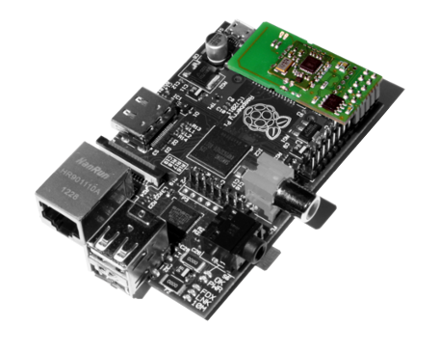
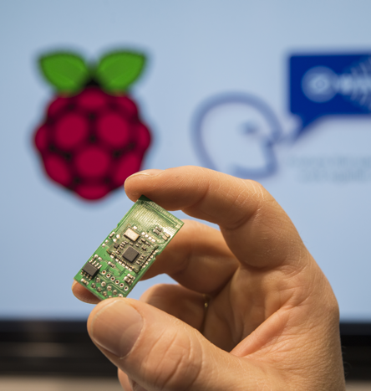
Razberry
The RaZberry is a tiny daughter card that sits on top of the Raspberry PI GPIO connector not blocking the USB boards. It is powered by the Raspberry PI board with 3.3V and communicates using TTL signals (RX/TX).

Slide 4
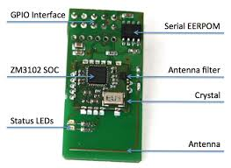
Razberry
RaZberry is compatible with old Raspberry Pi Model B as well as with new Model B+. 2 and 3. on Raspi 3 you cant use Bluetooth together with Z-Wave since both require a real hardware UART but Raspi 3 only has one.

Slide 5
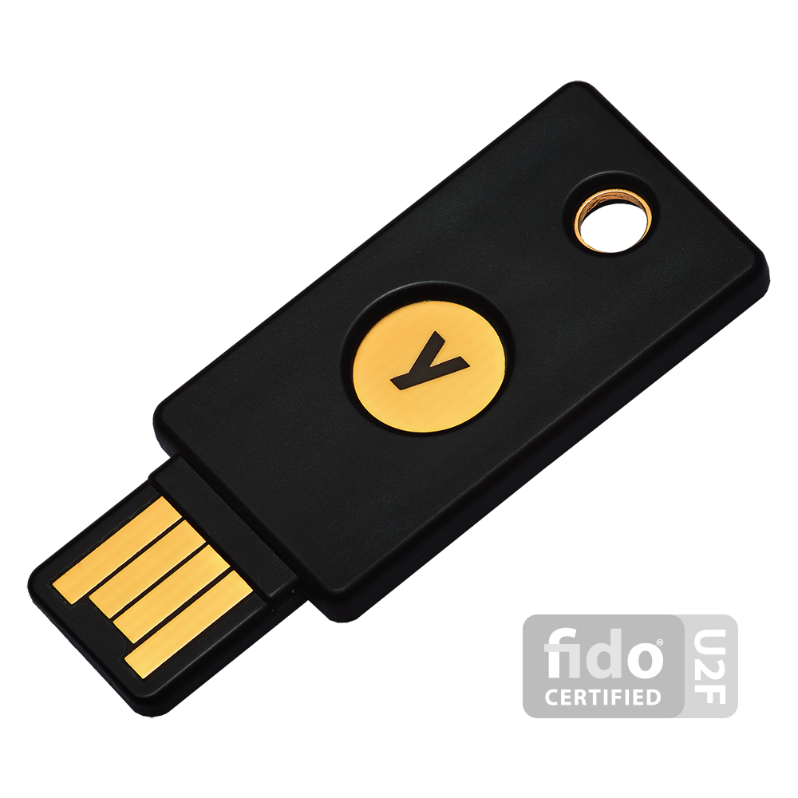
What is a YubiKey?
A YubiKey is a small hardware device that offers two-factor authentication with a simple touch of a button. YubiKeys are built strong enough for the largest enterprises, while remaining simple enough for anyone to use. The YubiKey NEO offers both contact (USB) and contactless (NFC, MIFARE) communications. YubiKeys support FIDO U2F, Yubico-OTP, OATH-OTP, OATH-HOTP, OATH-TOTP, OpenPGP, and PIV, and one security key can support an unlimited number of applications without the need for drivers, client software, or batteries.

Slide 6
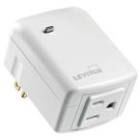


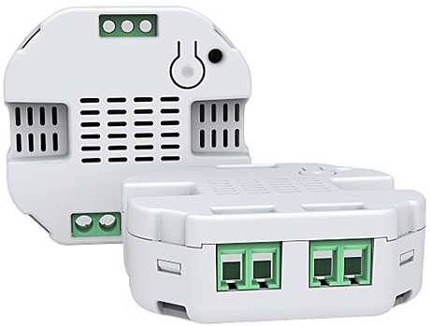
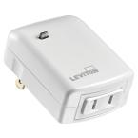
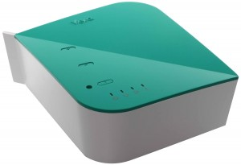

Slide 7

When you are a DIYer

Slide 8



Slide 9
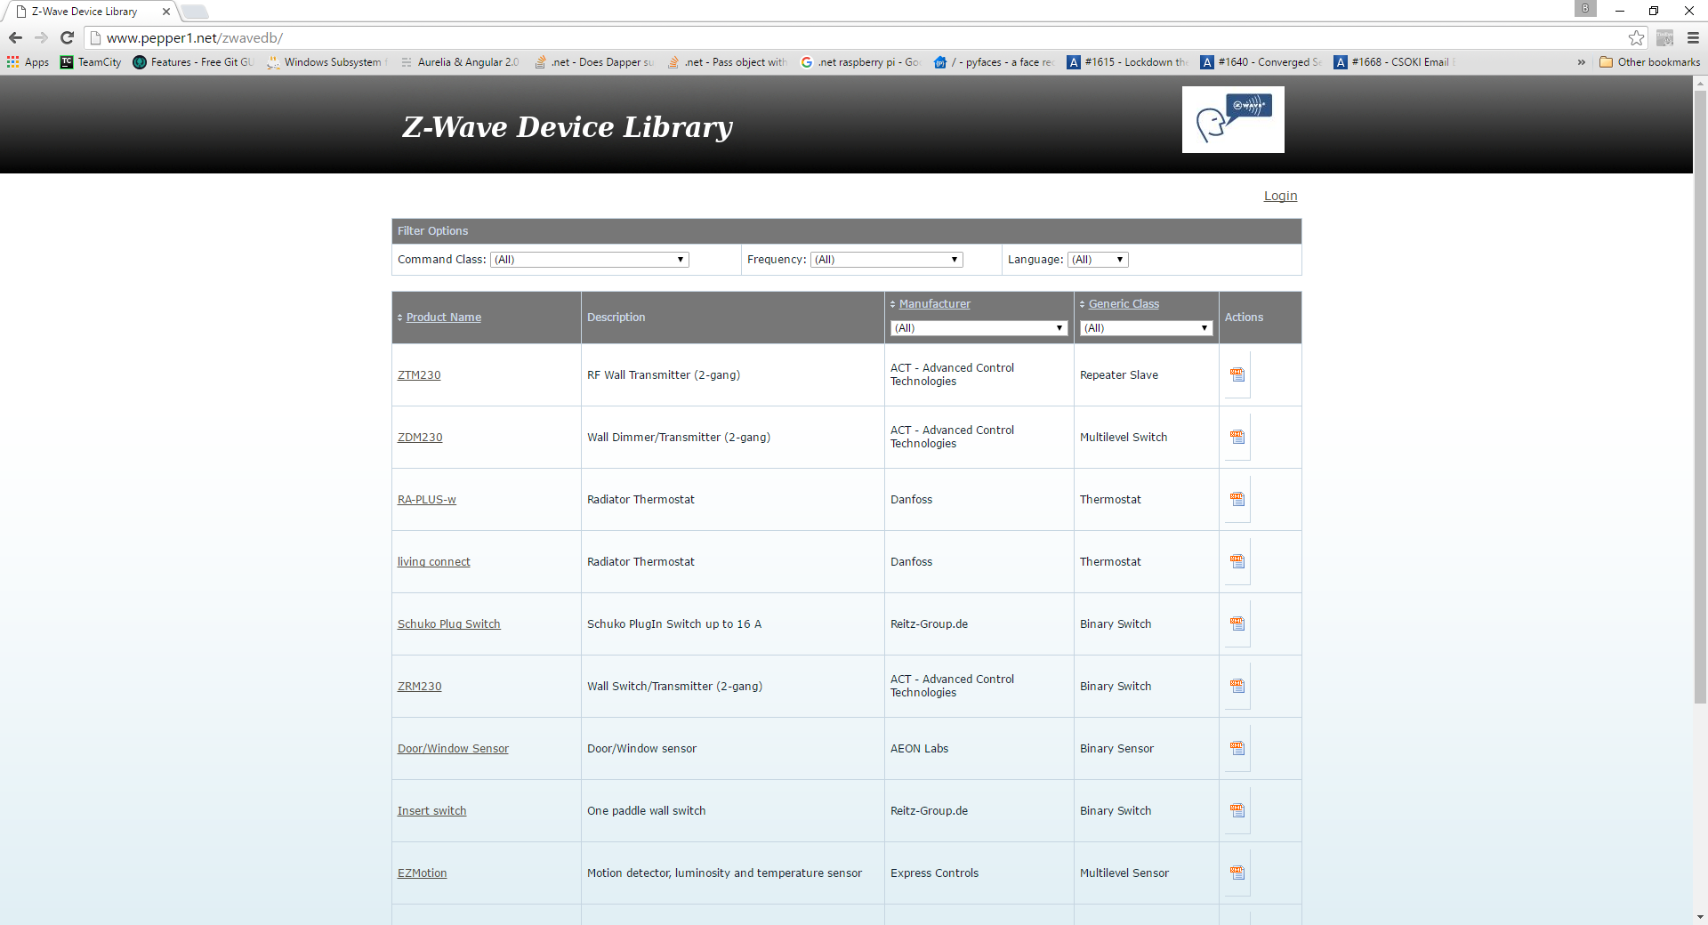
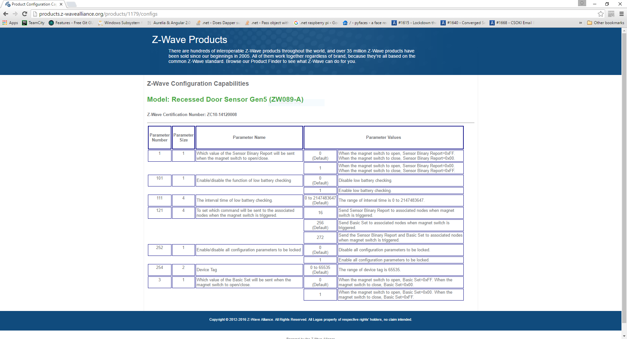
http://products.z-wavealliance.org/products/1179/configs https://razberry.z-wave.me/index.php?id=5 - Developers Documentation
http://www.pepper1.net/zwavedb/

Slide 10


Putting it all together…

Slide 11
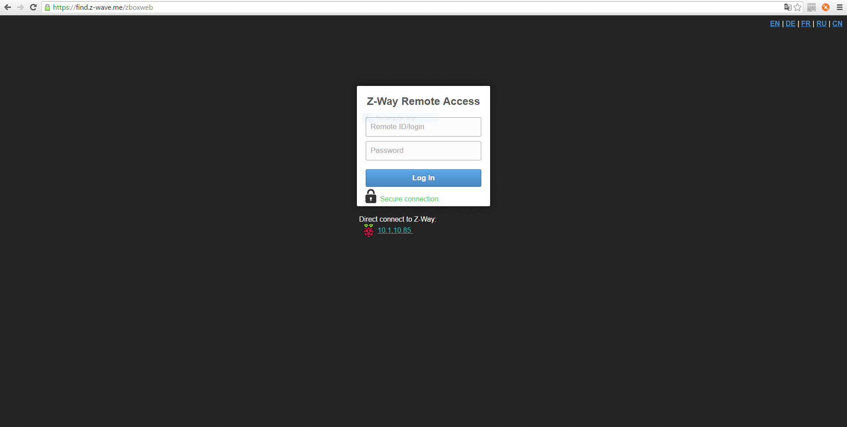
Putting it all together…

Slide 12

Parts List
Raspberry Pi: https://www.amazon.com/gp/product/B01CD5VC92
SD card: https://www.amazon.com/gp/product/B010Q57T02
Razpberry daughter card: https://www.amazon.com/gp/product/B00I8UETYC
YubiKey: https://www.amazon.com/gp/product/B018Y1Q71M

Slide 13
Razberry Pi home automation for the tinkerer and DIYer
Brian Wilson
@wilsonbnmobile
https://github.com/wilsonbn

