Slide 1
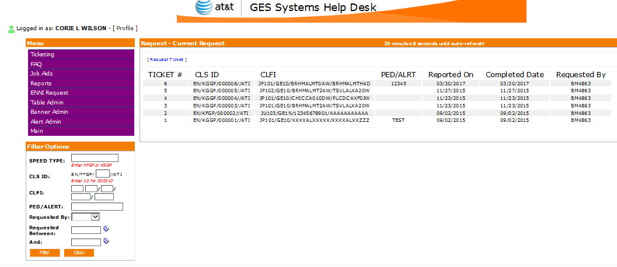
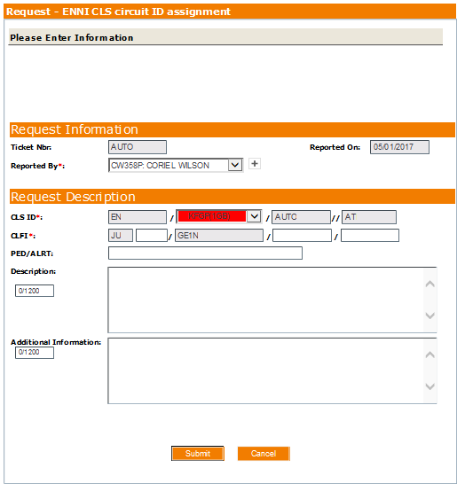
W
E
B
a
P
P
L
I
C
A
T
I
O
N
S

Slide 2
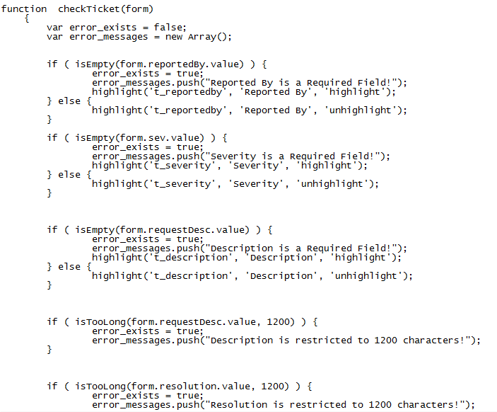
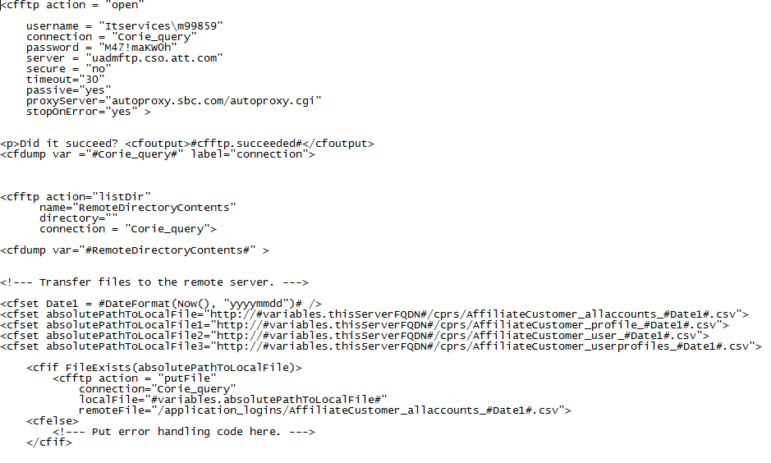
E
X
A
M
P
L
E
C
O
D
E

Slide 3
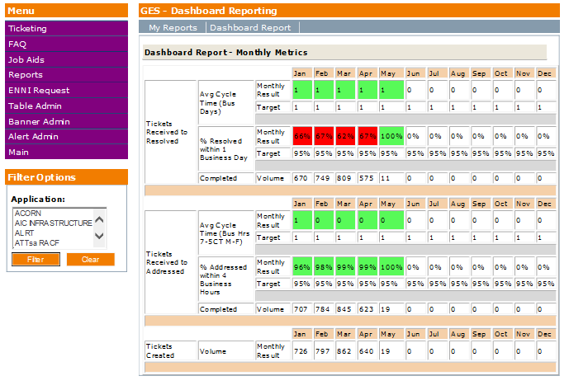
M
E
T
R
I
C
s

Slide 4
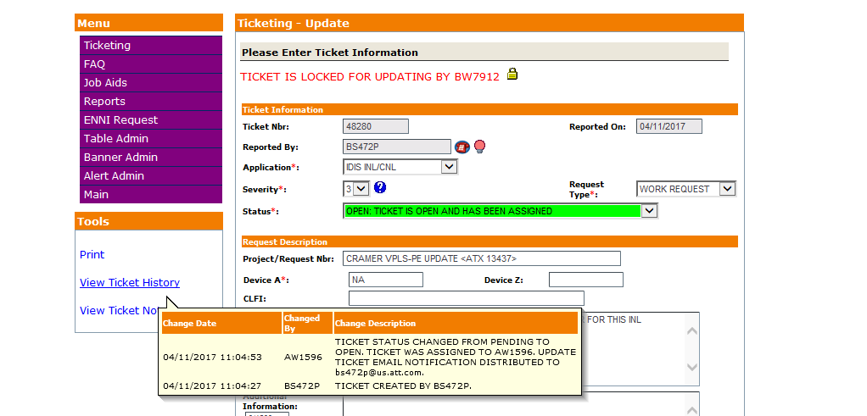
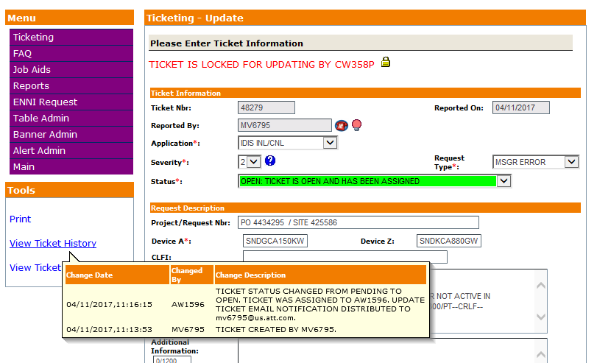
D
E
B
U
G
G
I
N
g

Slide 5
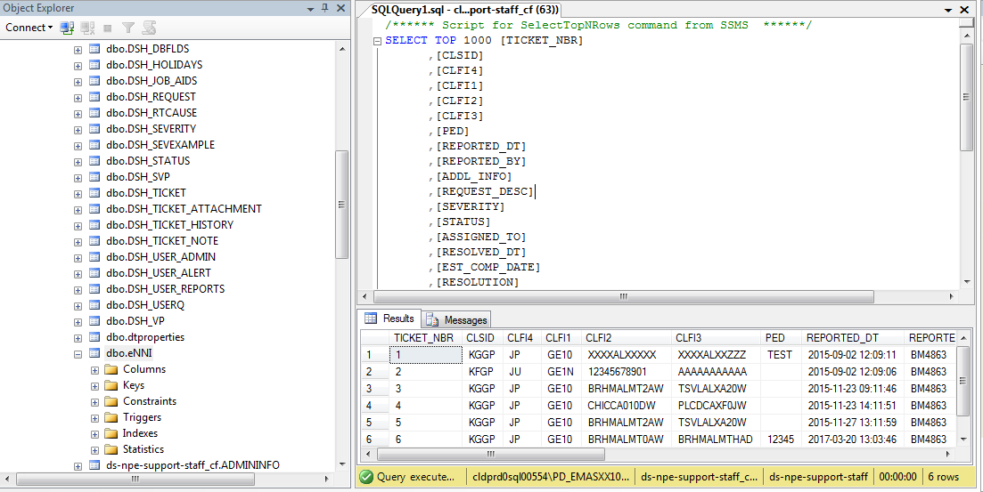
M
S
S
Q
L

Slide 6
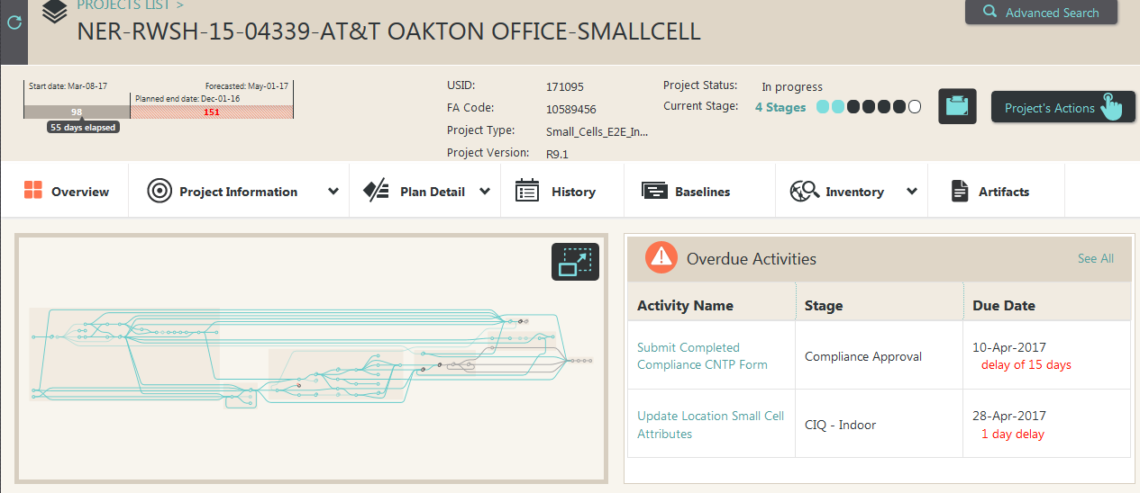
E
S
C
O
R
E
/
W
I
K
i
Tspace eScore Wiki Site

Slide 7
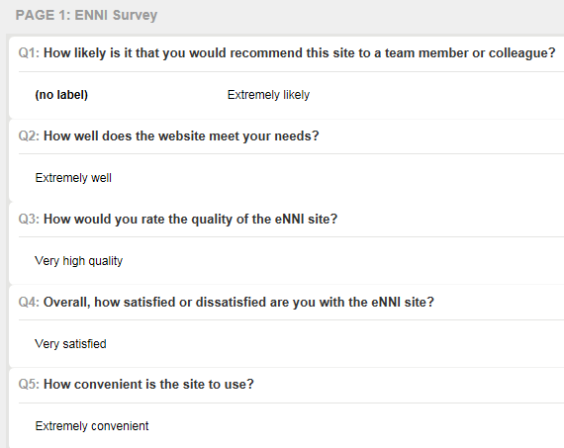
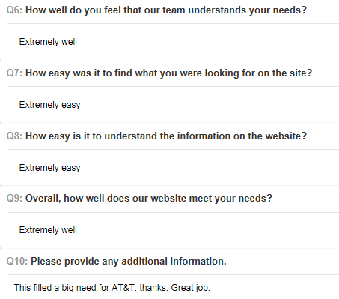

Survey completed by Bill McAllister (bm4863) - Principal-Network Design Engineer
R
E
V
I
E
W
S
Received Project Management Award from AVP Shannon Settles - NP&E Infrastructure Program Management – for decreasing the POE by 37 working days and the Current Forecast by 11 days for the Memphis VSP Card Add project.
Received an award from AVP Amy Wheelus (aw1734) – for leading community service project with AT&T and the Atlanta Community Food Bank that sorted over 40,000lbs of food and supplies, feeding over 33,000 people.

