Slide 1
MARINE AI · PREDICTIVE MAINTENANCE
Generator condition
monitoring POC
DG-01 · VESSEL-01
30 days of synthetic telemetry · 36 signals · 1-minute sampling
Predictive findings, sensor diagnostics, engineering review and an auditable workflow
Synthetic demonstration · not validated real-vessel performance

Slide 2
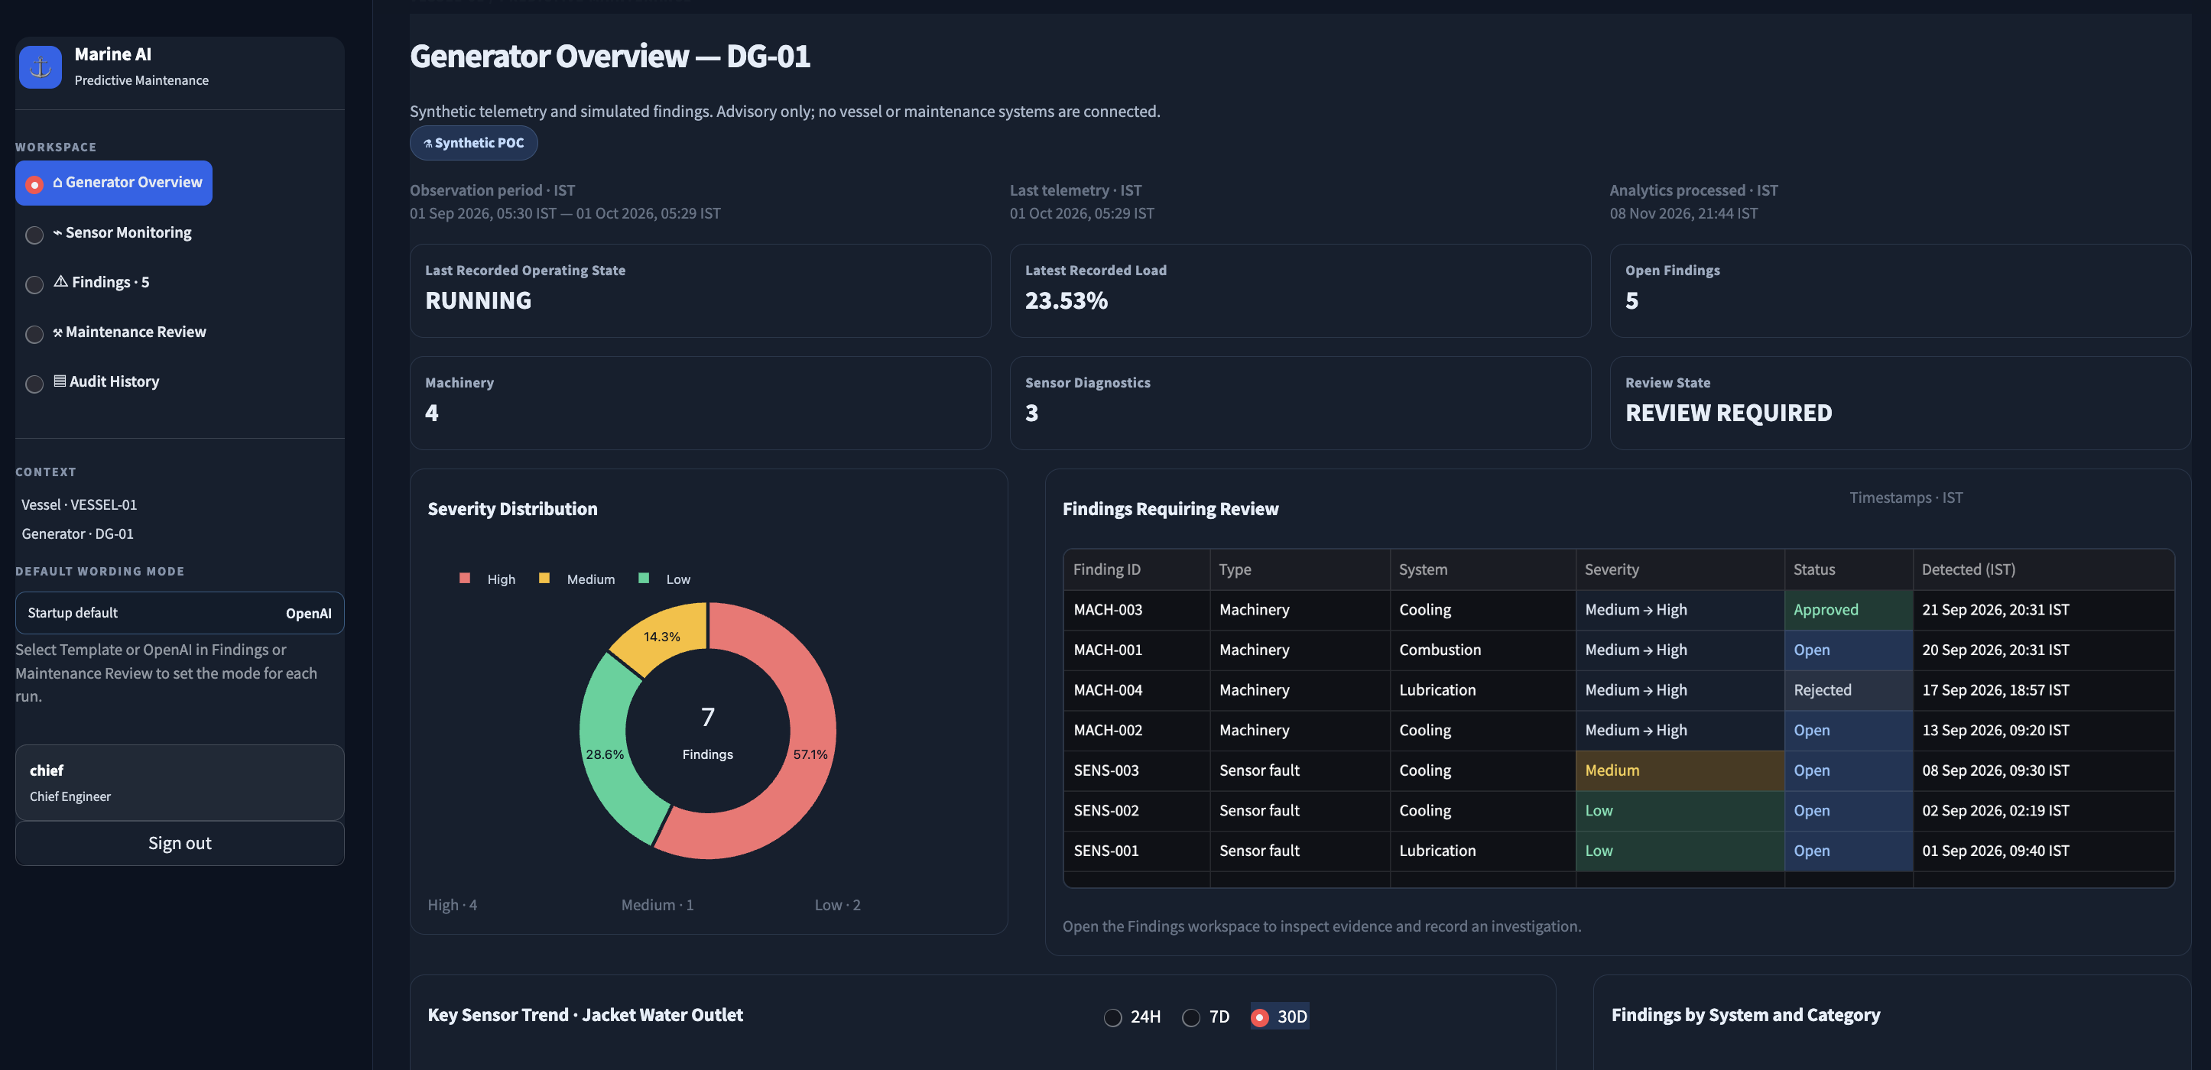
01 · OPERATING PICTURE
Generator overview
Operating context
Running state and latest recorded load sit alongside open finding and review counts.
Finding mix
Severity distribution and the review queue make the active workload visible.
Audit context
Displayed timestamps use IST. The dashboard labels this as synthetic, advisory data.
Dashboard summary for one synthetic generator asset
Synthetic POC · Advisory only · No vessel or maintenance system is connected

Slide 3
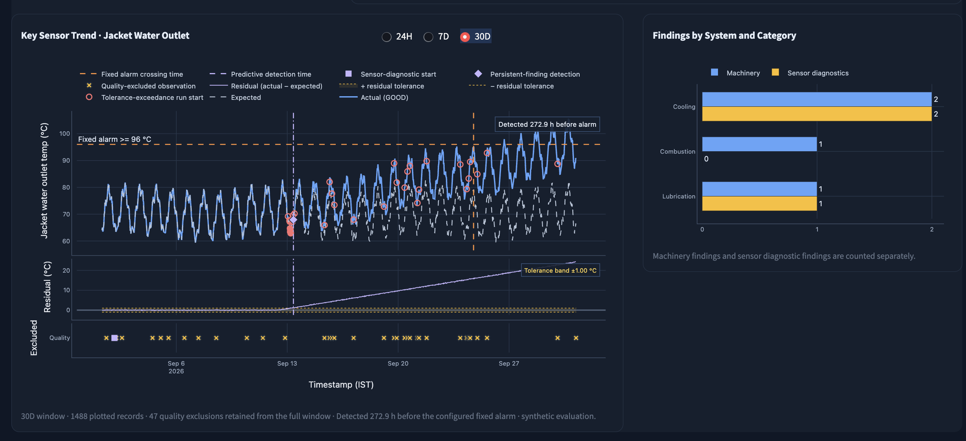
02 · COOLING TREND
Predictive signal and fixed-alarm comparison
Expected vs actual
The trend view overlays the healthy expectation and measured jacket-water outlet temperature.
Early warning
The screenshot reports detection 272.9 hours before its configured 96 °C fixed alarm.
Quality evidence
Invalid observations are shown separately; the residual panel shows deviation against tolerance.
Illustrative synthetic evaluation. Alarm settings and model assumptions require domain validation.
Synthetic POC · Advisory only · No vessel or maintenance system is connected

Slide 4
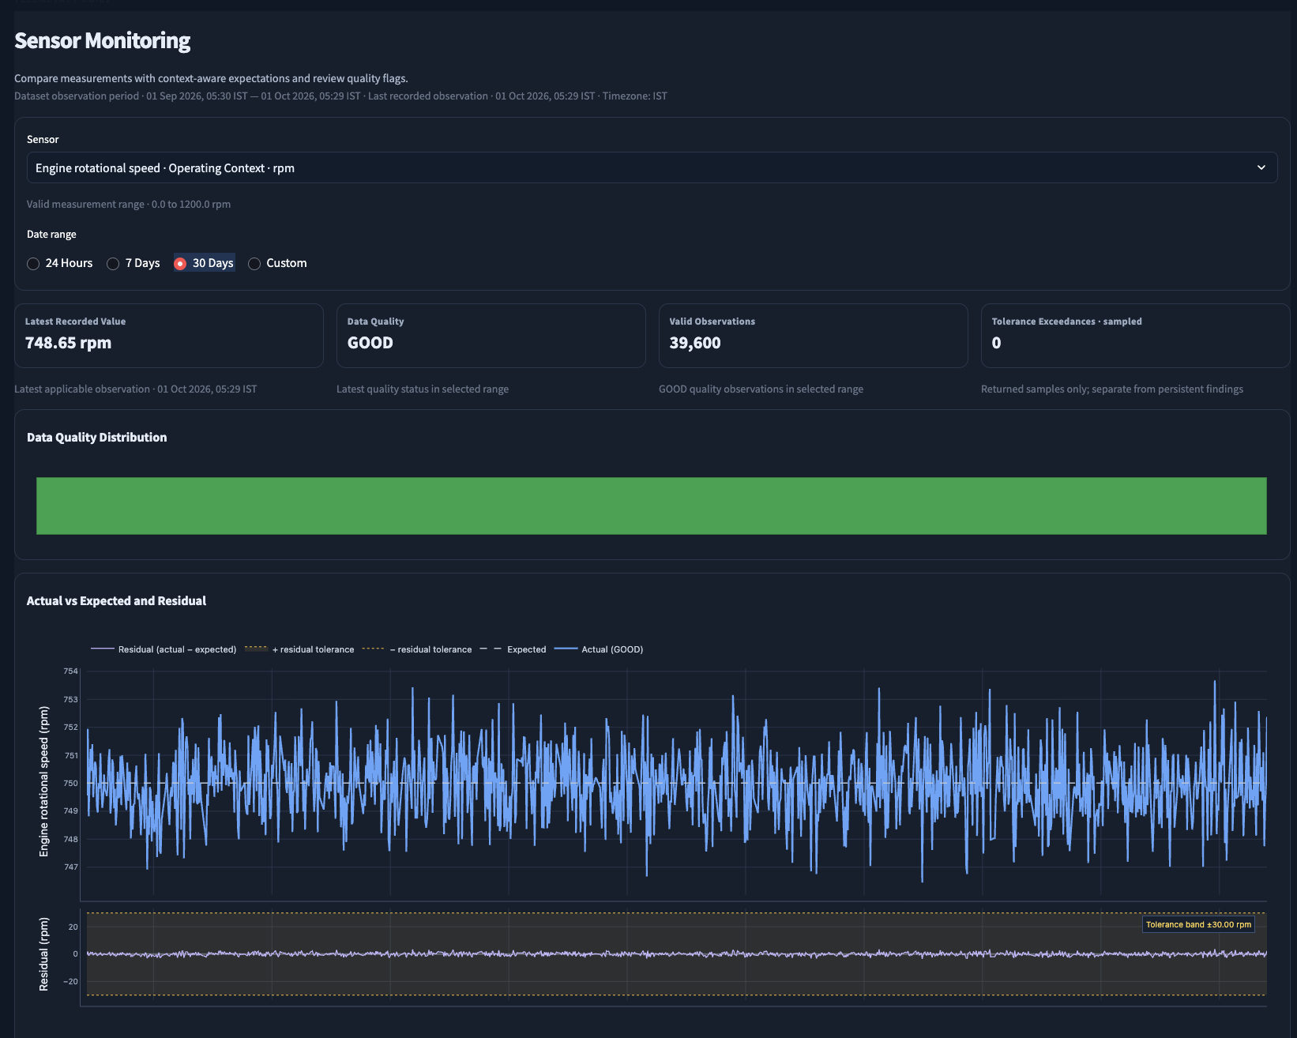
03 · SIGNAL DETAIL
Sensor monitoring
Select and inspect
Choose a signal and date range, then compare the measured value with its expected behaviour.
Check data quality
Quality distribution and valid-observation counts help reviewers interpret a trend before acting.
Review residuals
A separate residual panel makes the gap between actual and expected readings easier to assess.
Readings, quality flags and timestamps are displayed in IST.
Synthetic POC · Advisory only · No vessel or maintenance system is connected

Slide 5
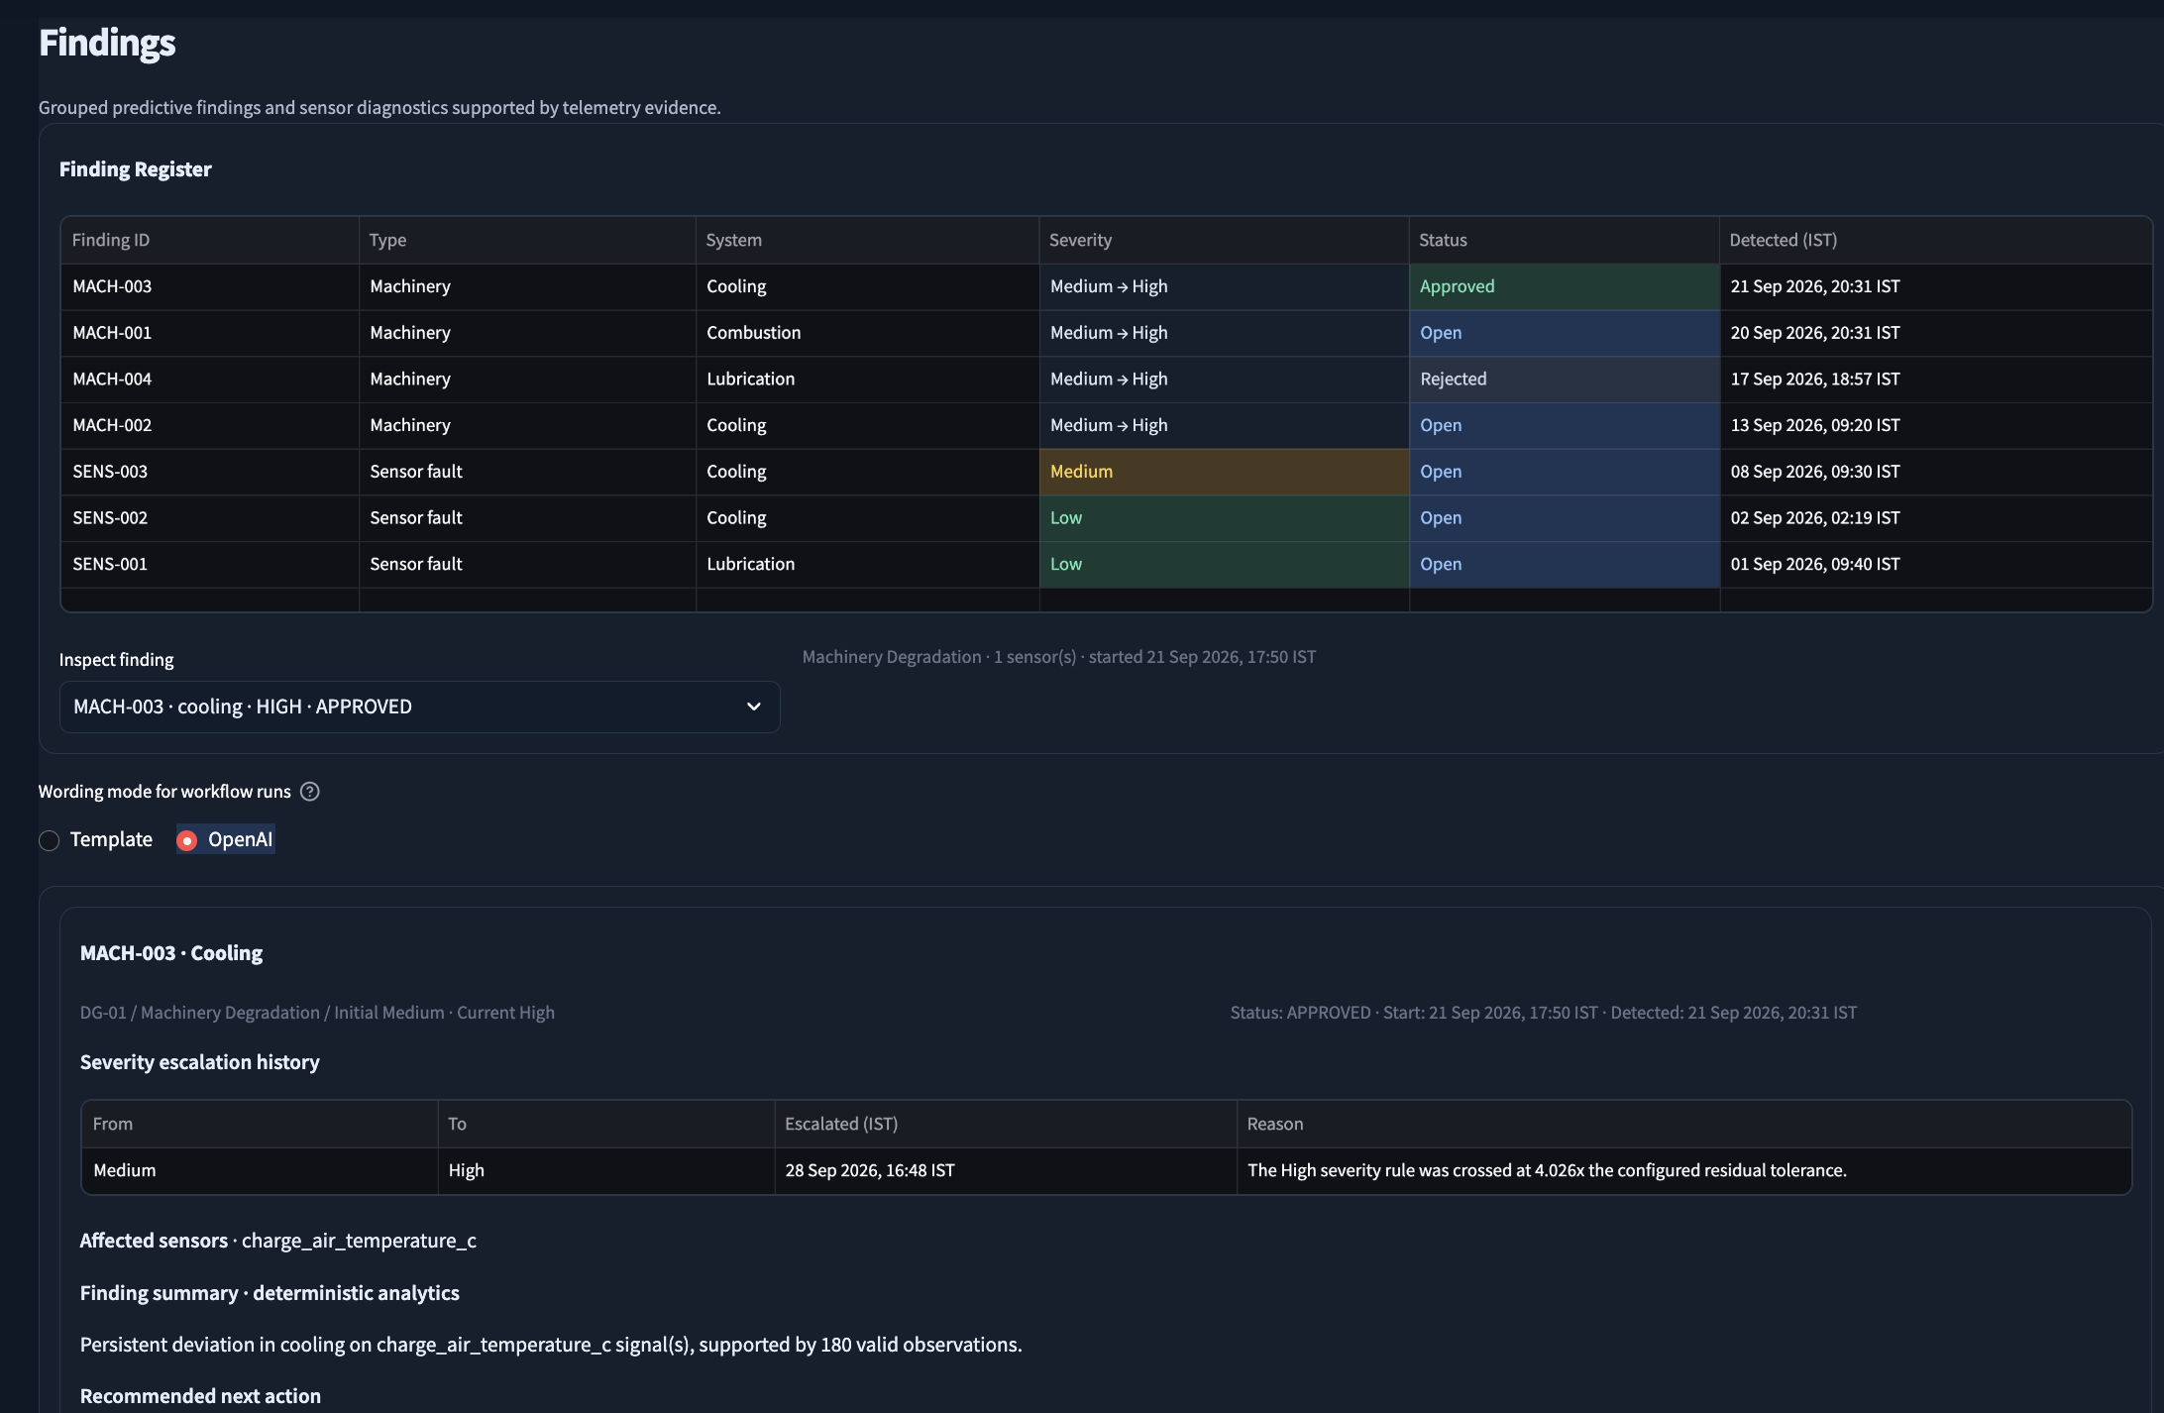
04 · REVIEW QUEUE
Findings and severity
Grouped findings
The register distinguishes machinery degradation from sensor faults and identifies the affected system.
Severity progression
Initial-to-current severity and escalation history show how a finding changed over time.
Evidence-led review
Affected signals, actual-versus-expected evidence and recommended next actions are visible in the detail view.
Human review remains required; findings do not create work orders automatically.
Synthetic POC · Advisory only · No vessel or maintenance system is connected

Slide 6
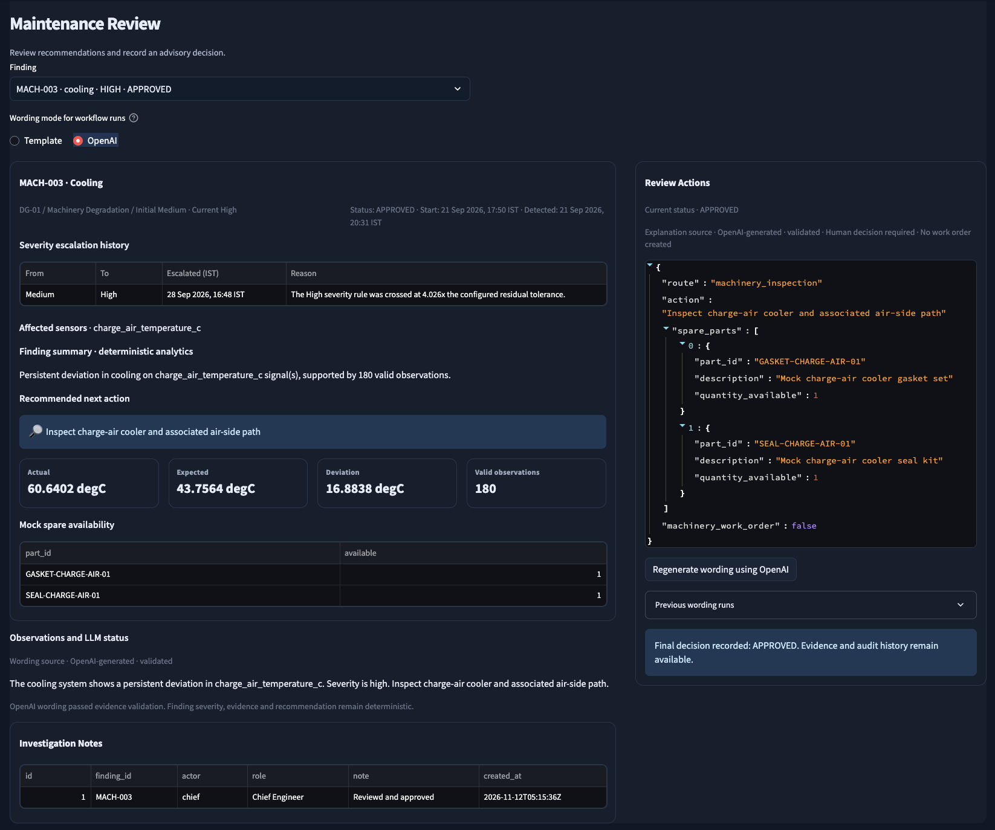
05 · HUMAN DECISION
Maintenance review and optional OpenAI wording
Deterministic decision support
Finding classification, severity, evidence and recommended action remain rule-based.
Selectable wording
Reviewer can use Template or OpenAI wording and regenerate wording for an existing run.
Safe fallback
When OpenAI is unavailable or output fails validation, template wording is used and labeled.
Approval or rejection is a separate human action with a required rationale.
Synthetic POC · Advisory only · No vessel or maintenance system is connected

Slide 7
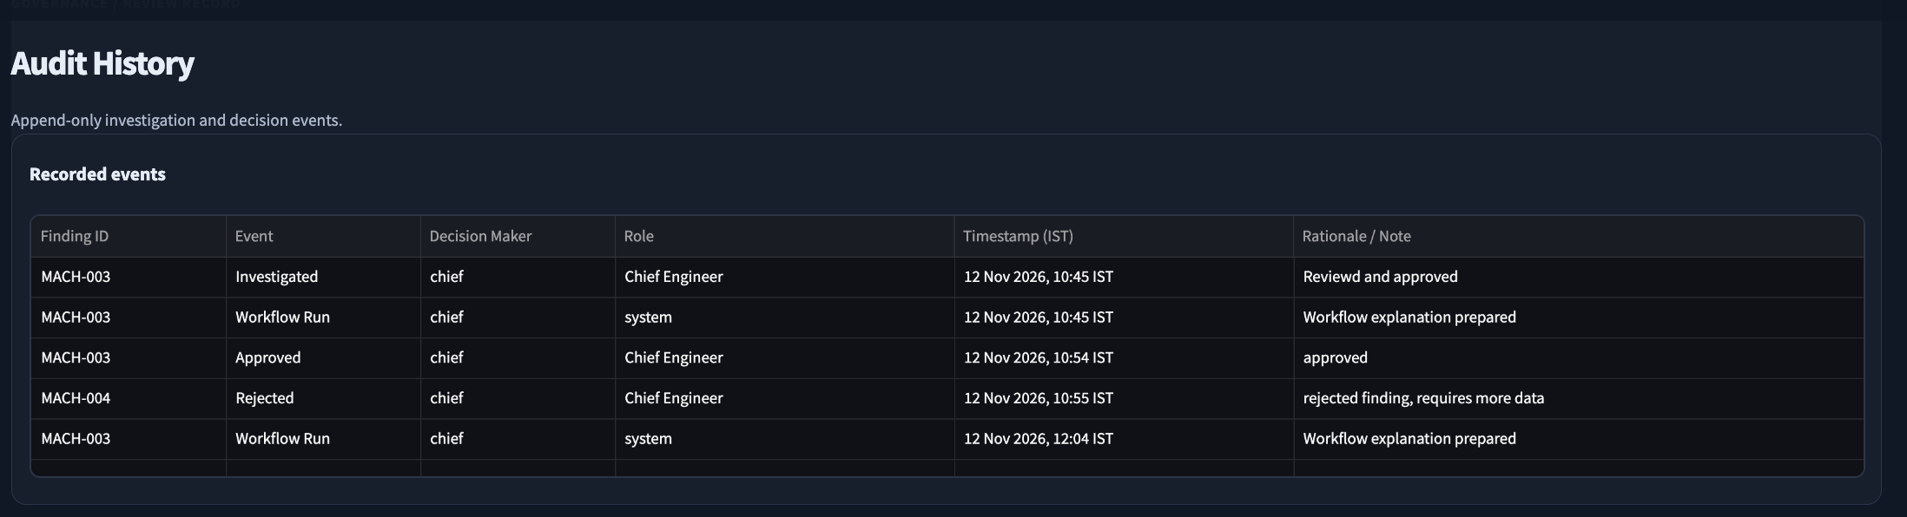
06 · GOVERNANCE
Audit history
Actor and role
Time and rationale
Append-only trail
Recorded events show who investigated or made a decision and their assigned role.
Timestamps display in IST; decisions retain the recorded rationale or note.
Workflow runs and review decisions remain available for later inspection.
Synthetic POC · Advisory only · No vessel or maintenance system is connected

