Slide 1
MARINE AI · PREDICTIVE MAINTENANCE
Generator condition
monitoring POC
DG-01 · VESSEL-01
30 days of synthetic telemetry · 36 signals · 1-minute sampling
Predictive findings, sensor diagnostics, engineering review and an auditable workflow
Synthetic demonstration · not validated real-vessel performance

Slide 2
SYSTEM DESIGN · BOUNDED AND ADVISORY
High-level architecture
Synthetic inputs
Predictive analytics
FastAPI service
Streamlit UI
Minute telemetry, tags, context, maintenance reference and separate ground truth.
→
Quality filters, running-state checks, healthy baseline, expected values, residual persistence and routing.
→
Role checks, finding and sensor endpoints, workflow requests and decision recording.
→
Engineering views for trends, findings, recommendations and human review.
↕
Persistence and wording services
SQLite stores investigations, workflow versions and decisions. LangGraph handles bounded wording; Template fallback and optional OpenAI.
Optional model use changes wording only. Detection, severity, recommendations and approval remain deterministic or human-controlled.
No live vessel, ERP or PMS connection · No automatic maintenance execution
Synthetic POC · Advisory only · No vessel or maintenance system is connected

Slide 3
IMPLEMENTATION · SMALL PYTHON APPLICATION
Technology stack
Data and analytics
API and persistence
User interface
Optional wording
Python 3.11
FastAPI
Streamlit
LangGraph bounded workflow
Standard-library predictive pipeline
SQLite
Plotly
OpenAI API optional
Context-aware expected values
Role enforcement in backend
Overview, sensor, findings and review screens
Template mode works without credentials
Quality, persistence and alarm evaluation
Investigation and decision audit records
IST display; UTC timestamps retained in data
Validated wording; deterministic fallback
All results shown in this presentation use synthetic data. The POC is advisory and does not establish real-world predictive performance.
Synthetic POC · Advisory only · No vessel or maintenance system is connected

Slide 4
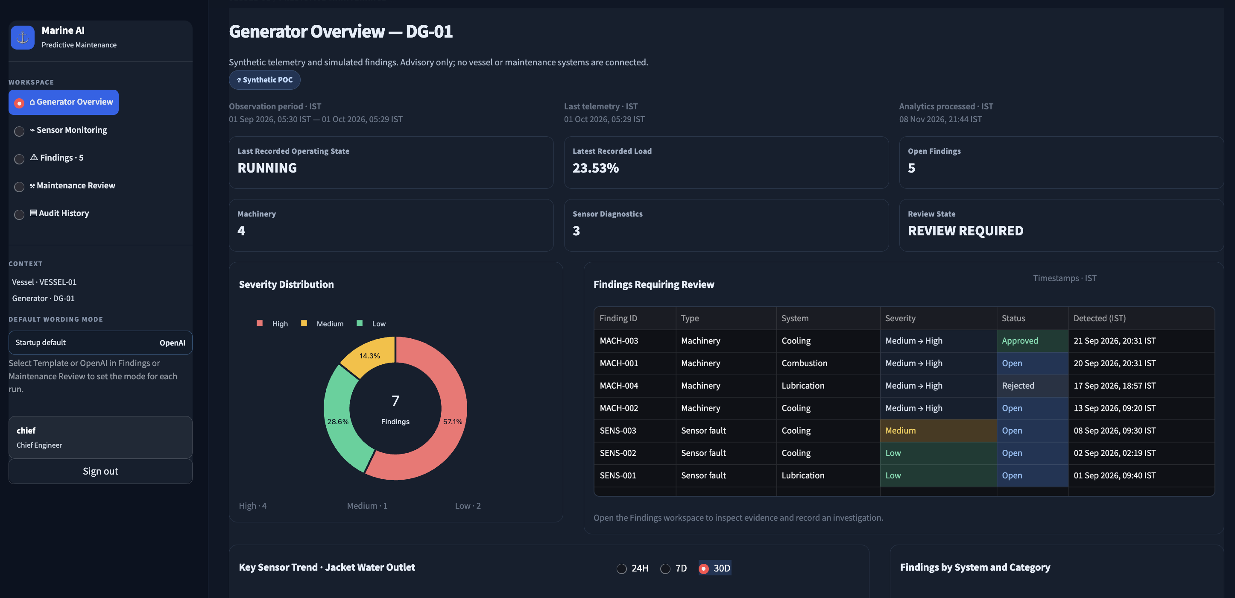
01 · OPERATING PICTURE
Generator overview
Operating context
Running state and latest recorded load sit alongside open finding and review counts.
Finding mix
Severity distribution and the review queue make the active workload visible.
Audit context
Displayed timestamps use IST. The dashboard labels this as synthetic, advisory data.
Dashboard summary for one synthetic generator asset
Synthetic POC · Advisory only · No vessel or maintenance system is connected

Slide 5
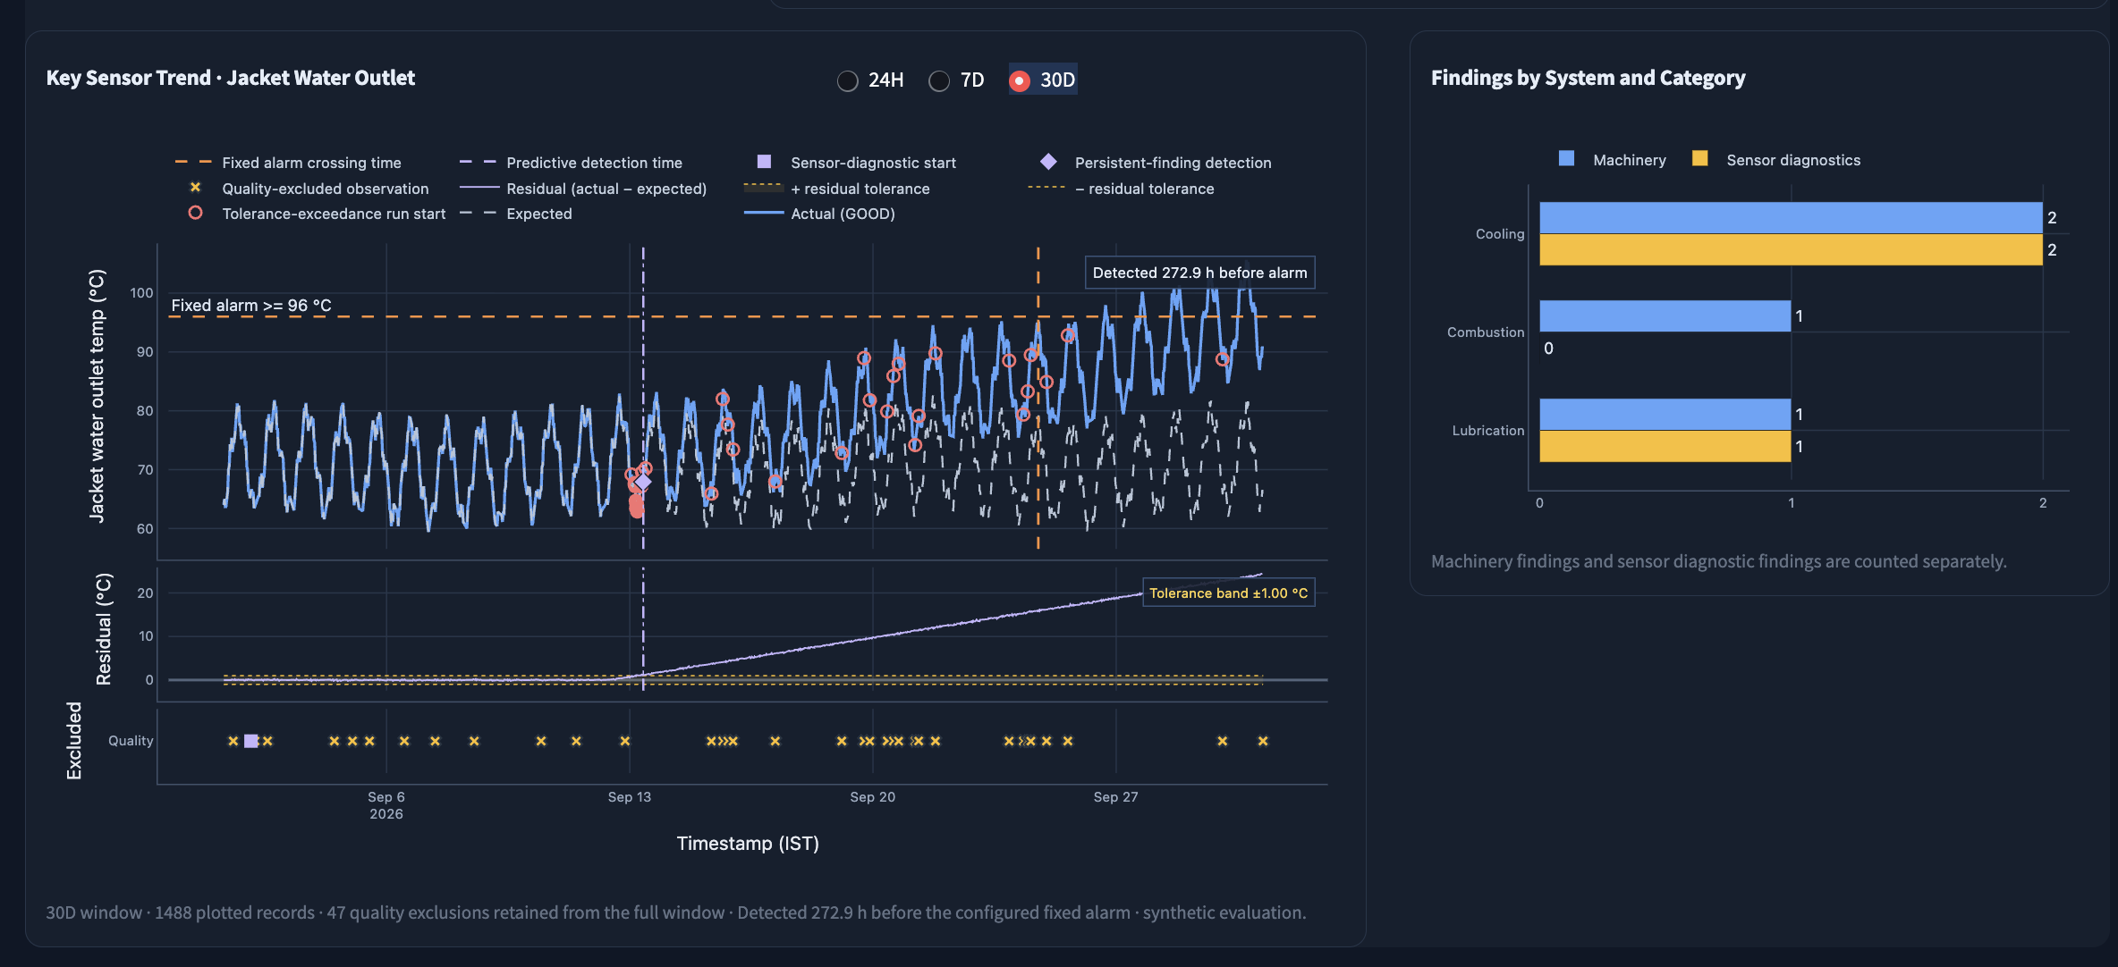
02 · COOLING TREND
Predictive signal and fixed-alarm comparison
Expected vs actual
The trend view overlays the healthy expectation and measured jacket-water outlet temperature.
Early warning
The screenshot reports detection 272.9 hours before its configured 96 °C fixed alarm.
Quality evidence
Invalid observations are shown separately; the residual panel shows deviation against tolerance.
Illustrative synthetic evaluation. Alarm settings and model assumptions require domain validation.
Synthetic POC · Advisory only · No vessel or maintenance system is connected

Slide 6
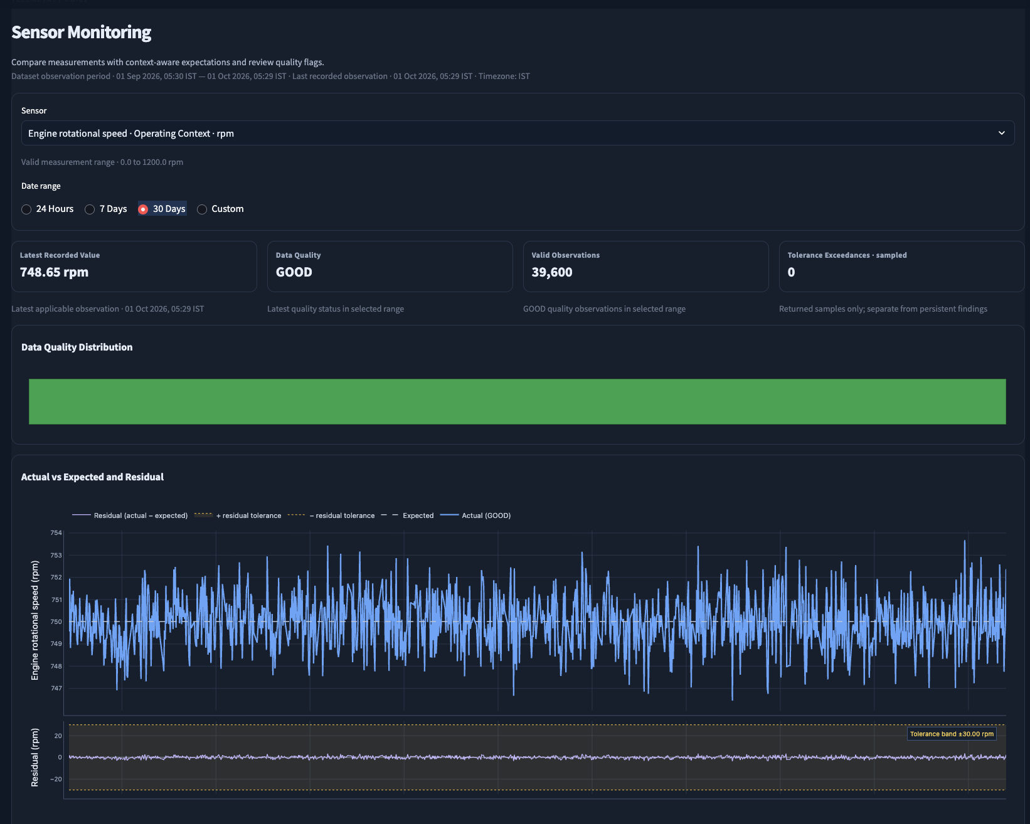
03 · SIGNAL DETAIL
Sensor monitoring
Select and inspect
Choose a signal and date range, then compare the measured value with its expected behaviour.
Check data quality
Quality distribution and valid-observation counts help reviewers interpret a trend before acting.
Review residuals
A separate residual panel makes the gap between actual and expected readings easier to assess.
Readings, quality flags and timestamps are displayed in IST.
Synthetic POC · Advisory only · No vessel or maintenance system is connected

Slide 7
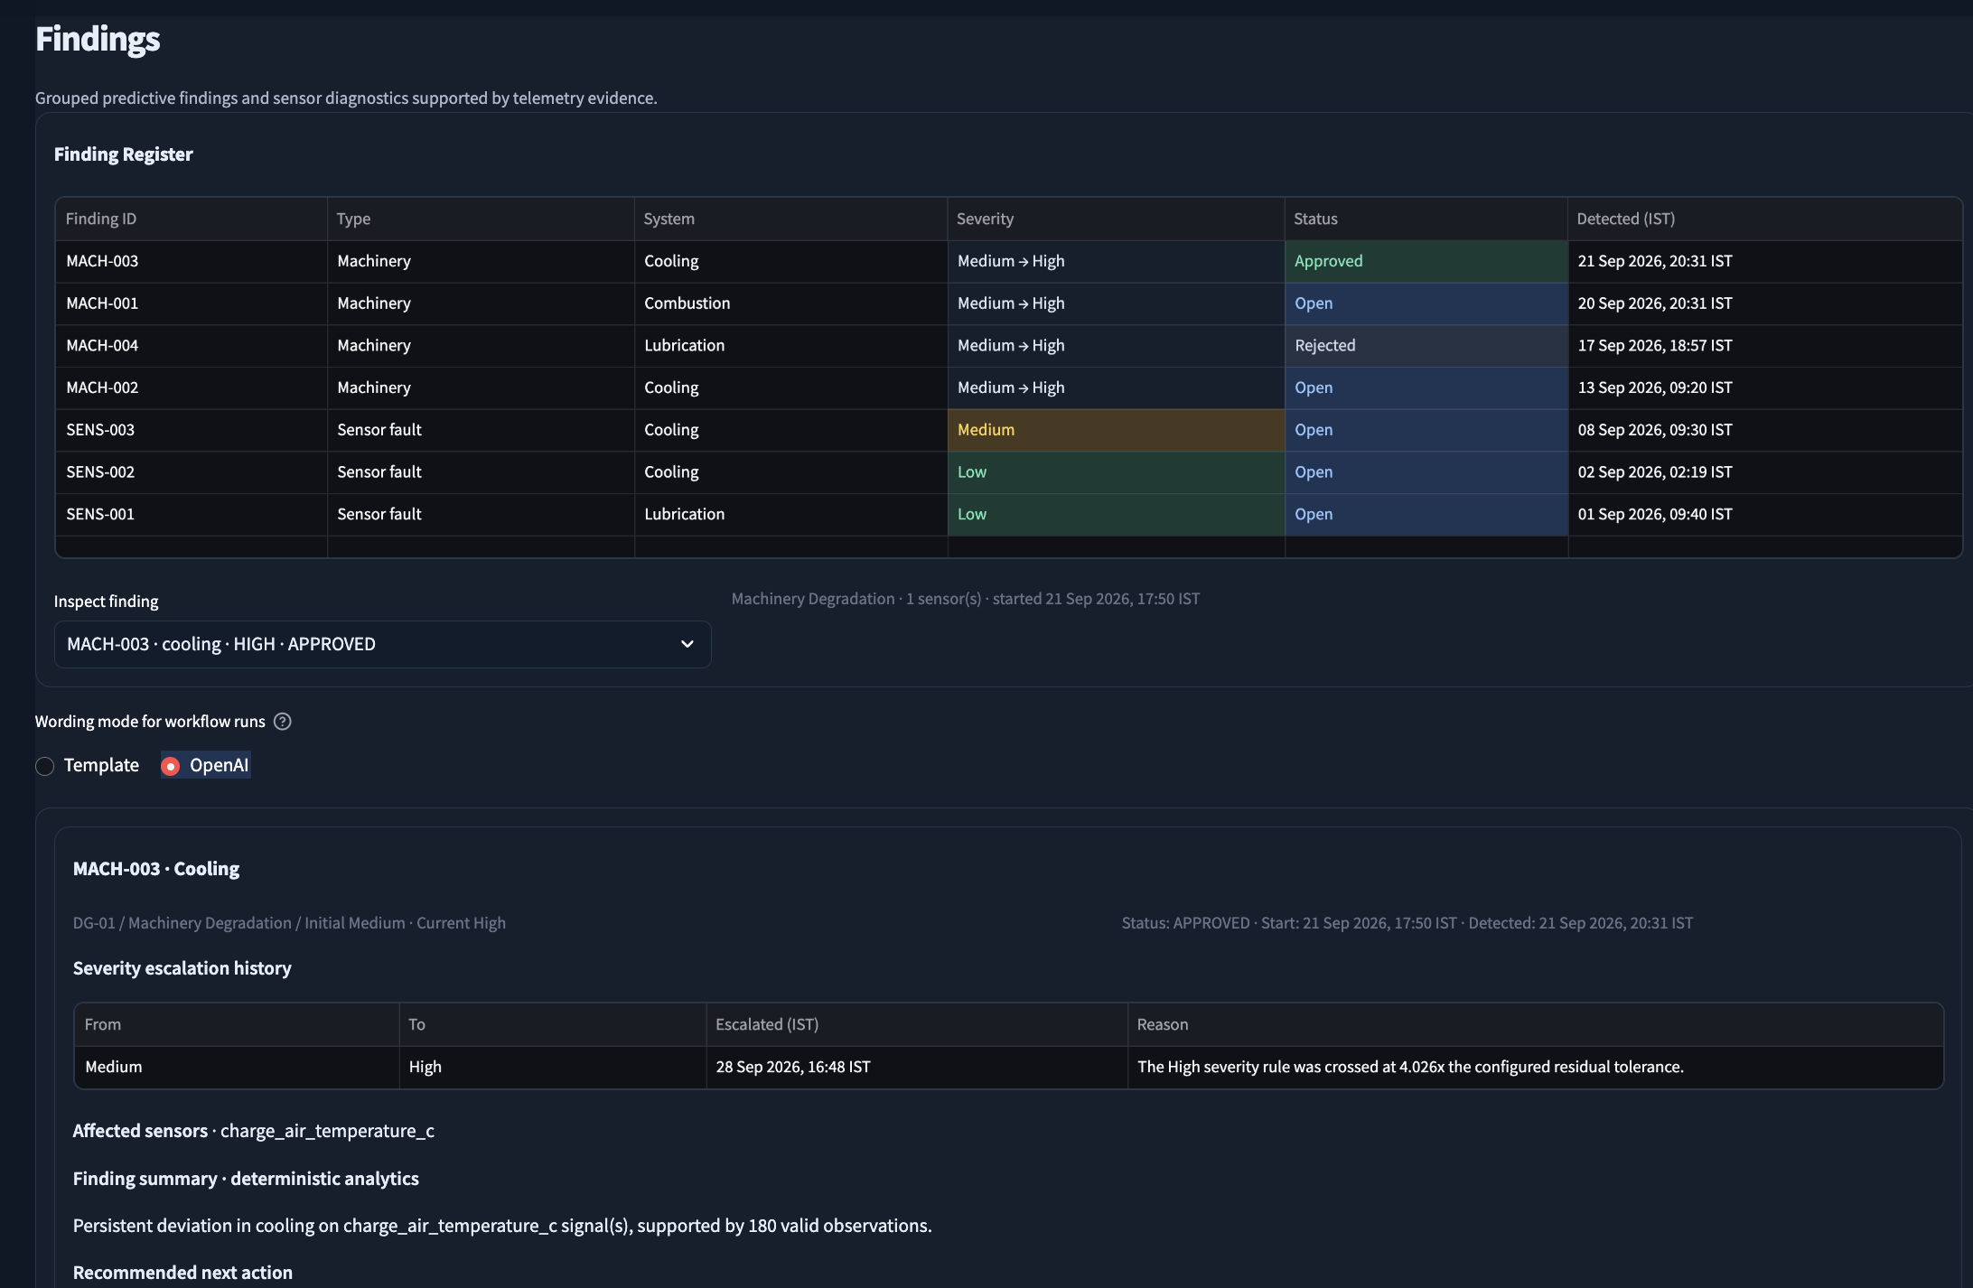
04 · REVIEW QUEUE
Findings and severity
Grouped findings
The register distinguishes machinery degradation from sensor faults and identifies the affected system.
Severity progression
Initial-to-current severity and escalation history show how a finding changed over time.
Evidence-led review
Affected signals, actual-versus-expected evidence and recommended next actions are visible in the detail view.
Human review remains required; findings do not create work orders automatically.
Synthetic POC · Advisory only · No vessel or maintenance system is connected

Slide 8
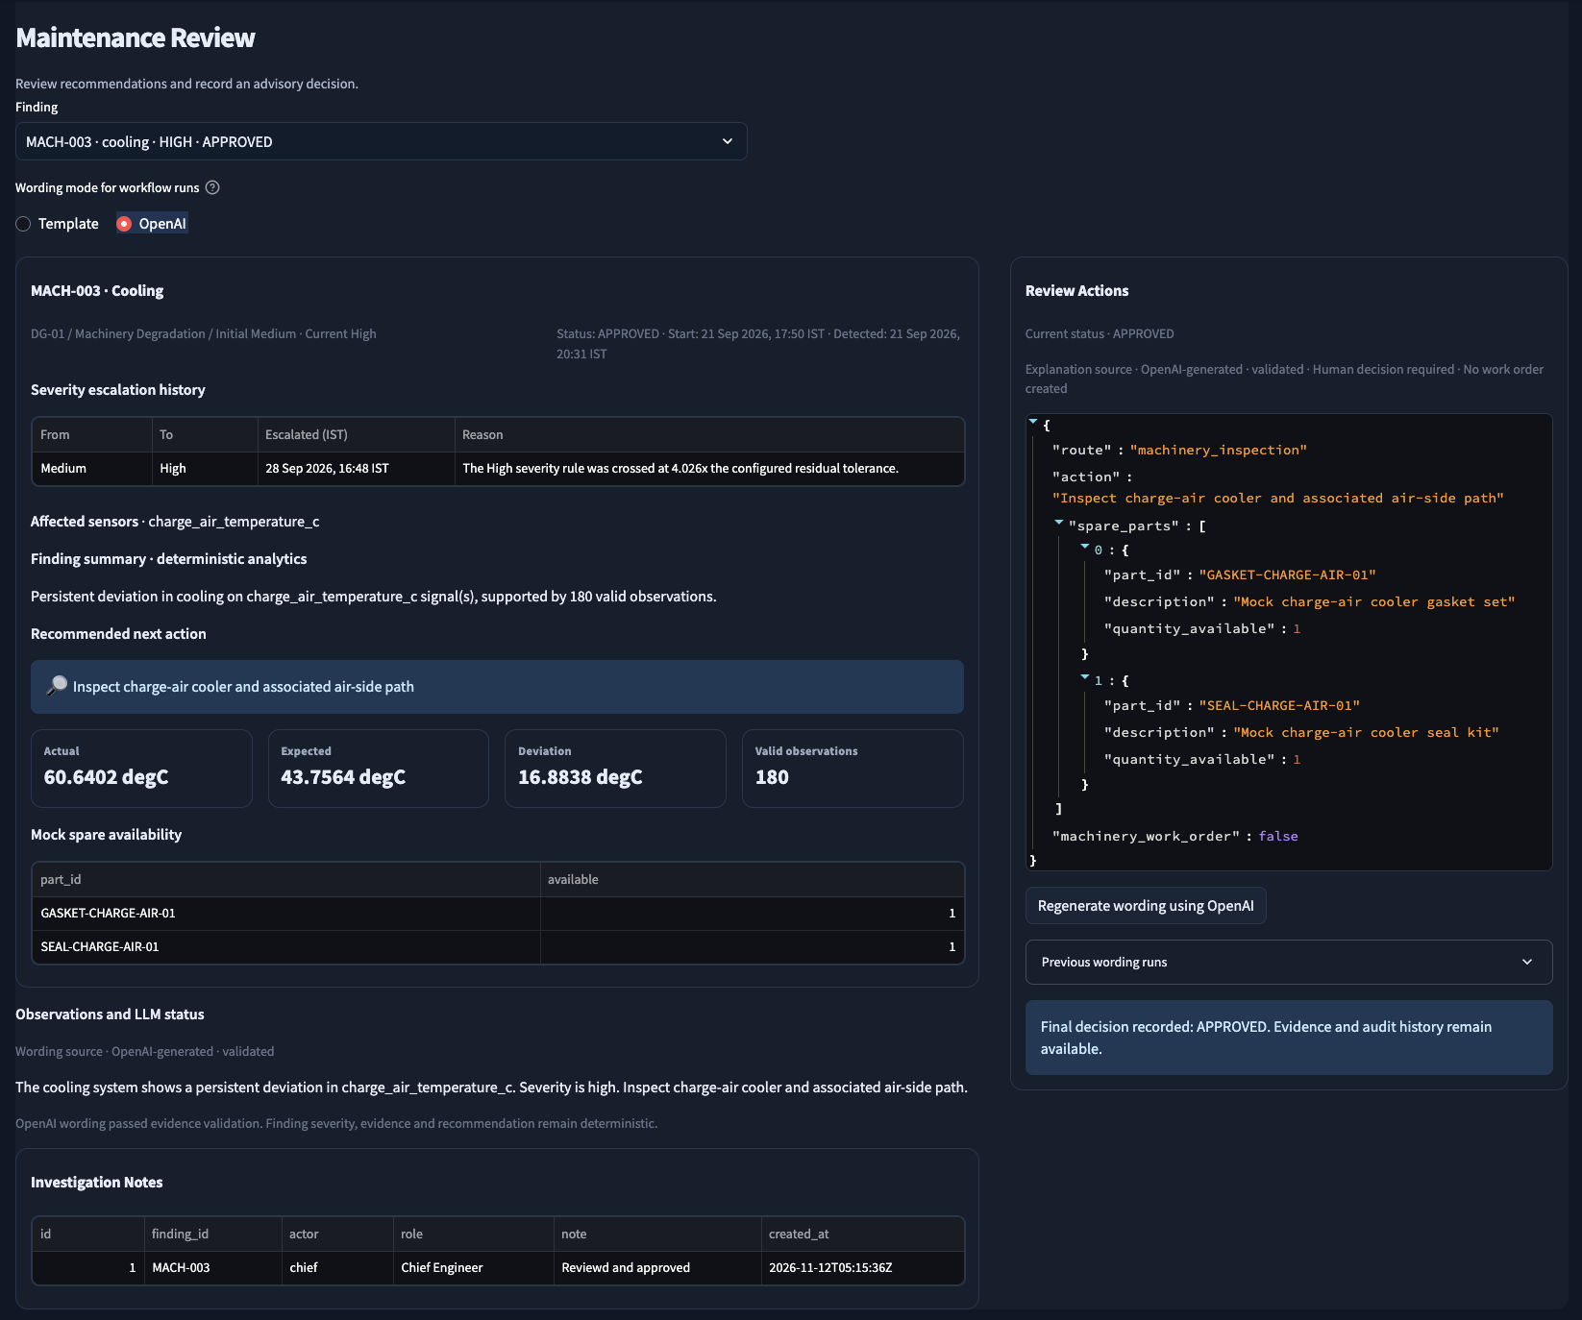
05 · HUMAN DECISION
Maintenance review and optional OpenAI wording
Deterministic decision support
Finding classification, severity, evidence and recommended action remain rule-based.
Selectable wording
Reviewer can use Template or OpenAI wording and regenerate wording for an existing run.
Safe fallback
When OpenAI is unavailable or output fails validation, template wording is used and labeled.
Approval or rejection is a separate human action with a required rationale.
Synthetic POC · Advisory only · No vessel or maintenance system is connected

Slide 9
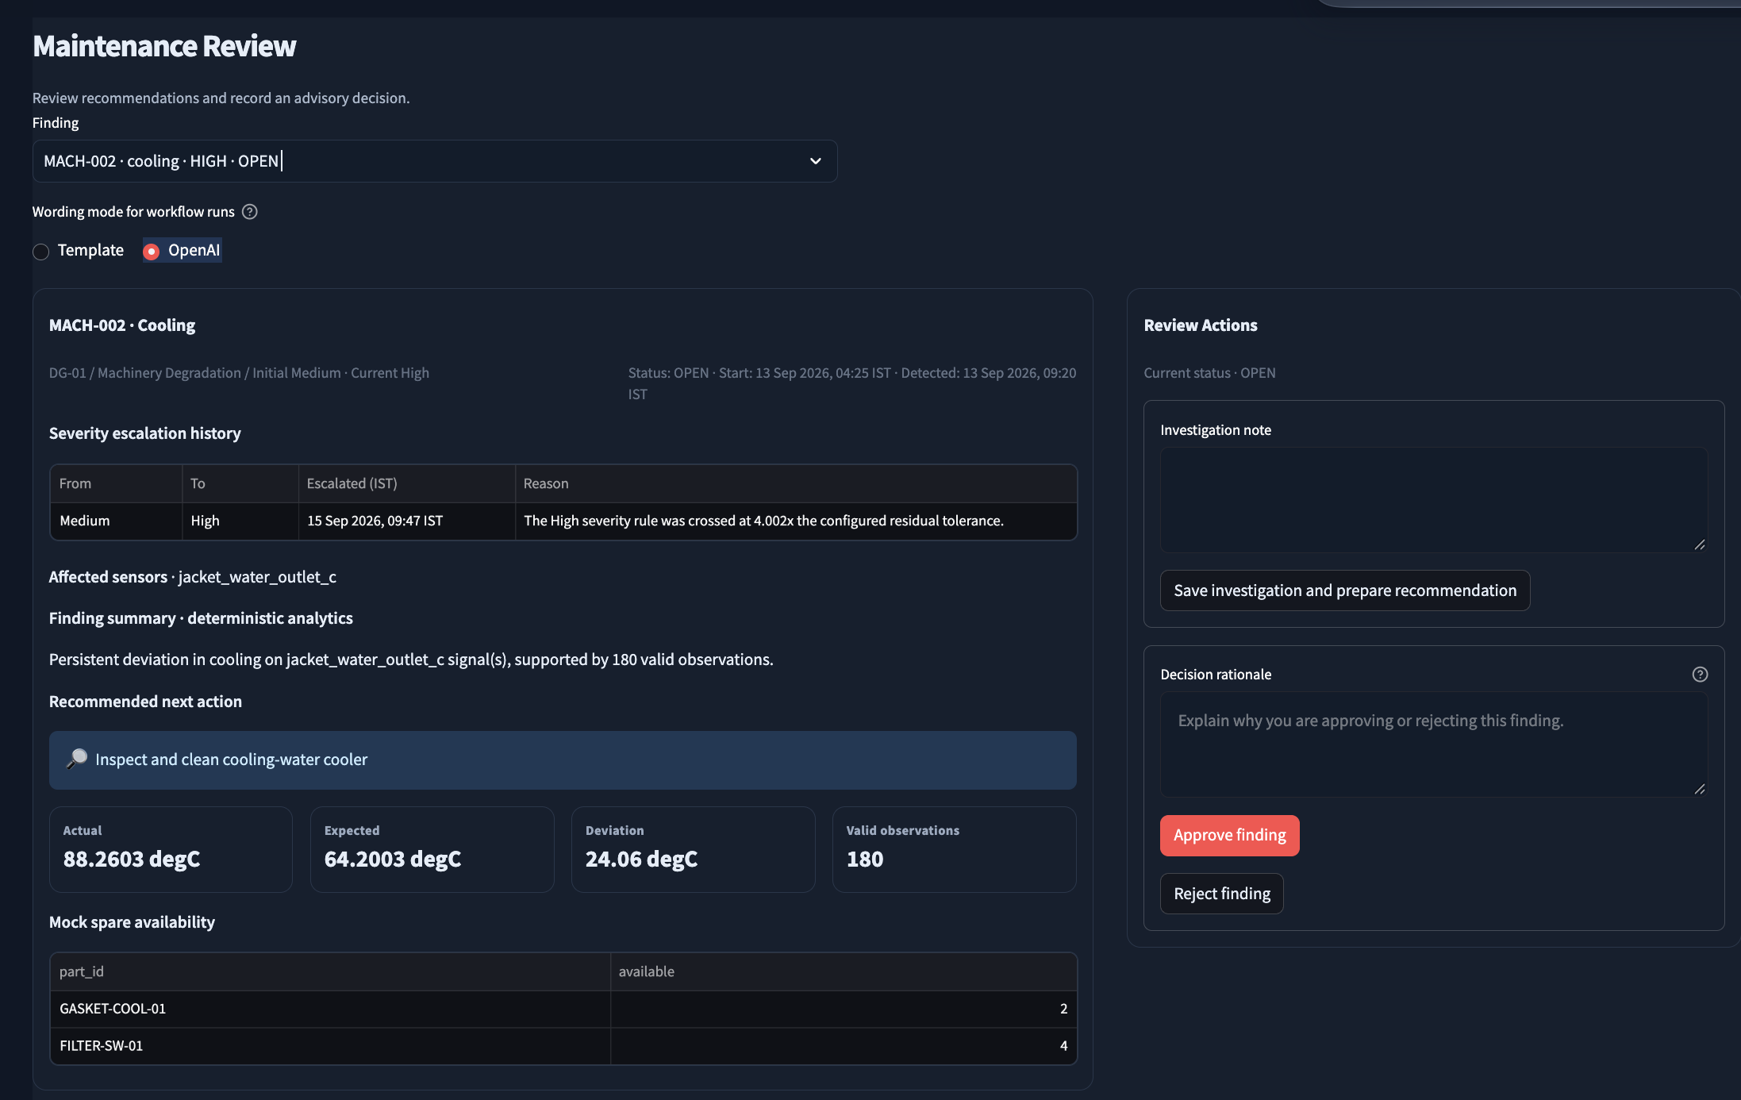
06 · HUMAN REVIEW
Maintenance investigation and decision
Investigation
Capture checks and observations before preparing a recommendation.
Decision rationale
Chief Engineer approval or rejection requires a recorded rationale.
Status in context
The screenshot shows an open machinery finding with evidence and a proposed cooling-water cooler inspection.
Approval remains a human decision; the workflow does not execute maintenance.
Synthetic POC · Advisory only · No vessel or maintenance system is connected

Slide 10
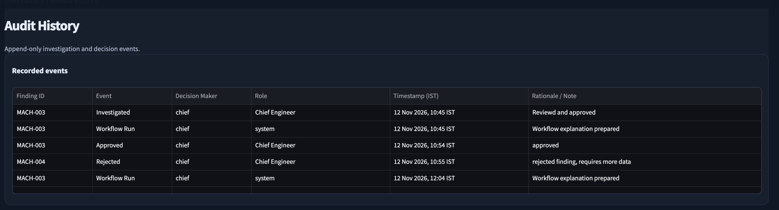
07 · GOVERNANCE
Audit history
Actor and role
Time and rationale
Append-only trail
Recorded events show who investigated or made a decision and their assigned role.
Timestamps display in IST; decisions retain the recorded rationale or note.
Workflow runs and review decisions remain available for later inspection.
Synthetic POC · Advisory only · No vessel or maintenance system is connected

