Slide 1
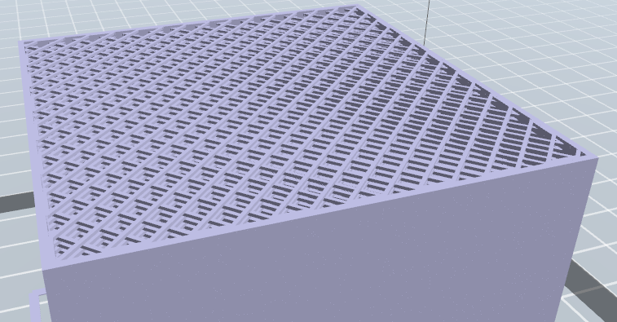
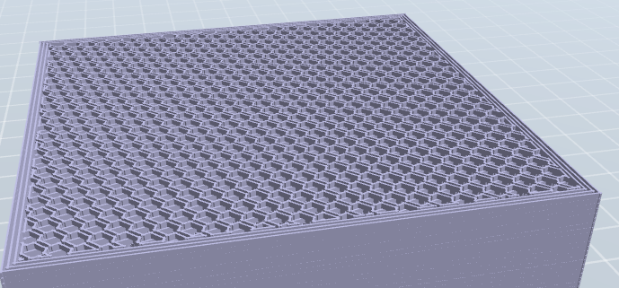
Default:
16% infill
Rectilinear
Infill every layers = 1
Layer height = 0.27 mm
Perimeters = 1
Temperature = 220
Optimal:
46% infill
honeycomb
Infill every layers = 4
Layer height = 0.47 mm
Perimeters = 5
Temperature = 270
Filament: 67.2 cm³
Strength: 10 MPa
Estimated time: 2Hrs 25mins
Filament: 111.5 cm³
Strength: 27 MPa
Estimated time: 6Hrs 16mins

