Slide 1
Computational Geometry in MEMS & Nano Design
Wilson Lam
MAE 294
UCLA

Slide 2
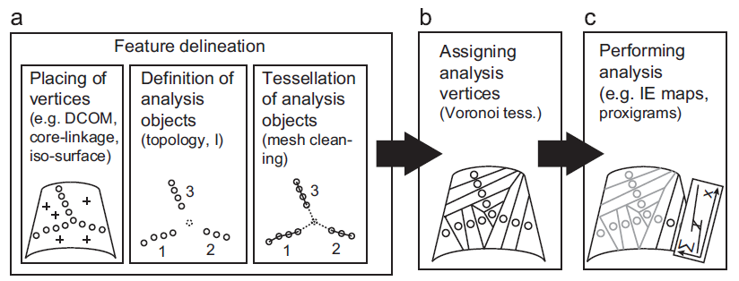
Computational Geometry & Computational Analysis
Computational geometry in MEMS and NANO normally focus on modeling, simulation, and analysis by sorting through collected data
[1]

Slide 3
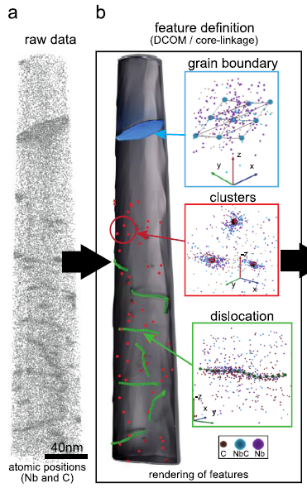
Atom Probe Tomography
Atoms imaging captured using atom probe tomography are assigned positions in space through a reconstruction algorithms using computational approaches
Data store in point cloud along with structural and chemical information
Computational approaches helps scientist analyze crystallographic structure for:
Grain boundaries
Dislocation
Clusters
[1]
Notes:
- Once computational approaches is used to analyze the structure the information are all stored in a point cloud with all the structural and chemical information.

Slide 4
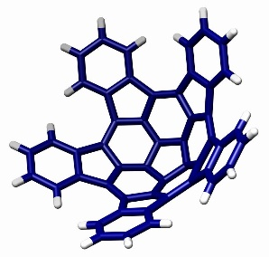
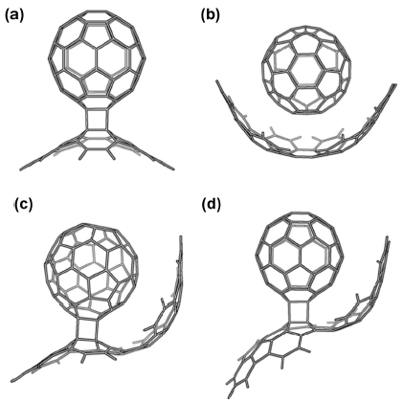
Geodesic-Arenes (Polyarenes)
[3]
[4]
Is a polycyclic aromatic hydrocarbon with curved convex or concave surfaces
Computational geometry is used here to simulate and design these polyarenes
The curvature of the planar piece change base on relative energy
both for their unique chemistry and for their technological applications in material science, electronics, and nanotechnology
[2]

Slide 5
References
Felfer, P., Ceguerra, A., Ringer, S., & Cairney, J. (2013, March 20). Applying Computational Geometry Techniques for Advanced Feature Analysis in Atom Probe Data. Ultramicroscopy. Camperdown, Australia: Elsevier. Retrieved February 18, 2014, from http://dx.doi.org/10.1016/j.ultramic.2013.03.004
Trzaskowski, B., Adamowicz, L., Beck, W., Muralidharan, K., & Deymier, P. A. (2014, January 31). Exploring structures and properties of new geodesic polyarenes. Elsevier. Tucson, Arizona, United States of America. Retrieved February 29, 2014, from http://www.sciencedirect.com/science/article/pii/S0009261414000487
Wiki. (2007, April 28). Pentaindenocorannulene JACS 2007 vol129 pp484 commons.jpg. Retrieved February 26, 2014, from http://en.wikipedia.org/wiki/File:Pentaindenocorannulene_JACS_2007_vol129_pp484_commons.jpg
Wiki. (2011, August 18). Géode V 3 1 duale.gif. Retrieved March 10, 2014, from http://en.wikipedia.org/wiki/File:G%C3%A9ode_V_3_1_duale.gif

