Slide 1
Confident Git
Contribute to open source like a pro
Notes:
Welcome to this course we call "Confident Git" so you can use Git to confidently contribute to open source using techniques and standards that top professional use.
SOUND: Git-v01-01-welcome.m4a

Slide 2
Wilson Mar
Twitter: @wilsonmar
https://wilsonmar.github.io
Notes:
I'm Wilson Mar. I began working on Git in 2010, and since 2014 have been holding live full-day hands-on tutorials at conferences held at Disneyland and Disneyworld. I improve the course each time I present.

Slide 3
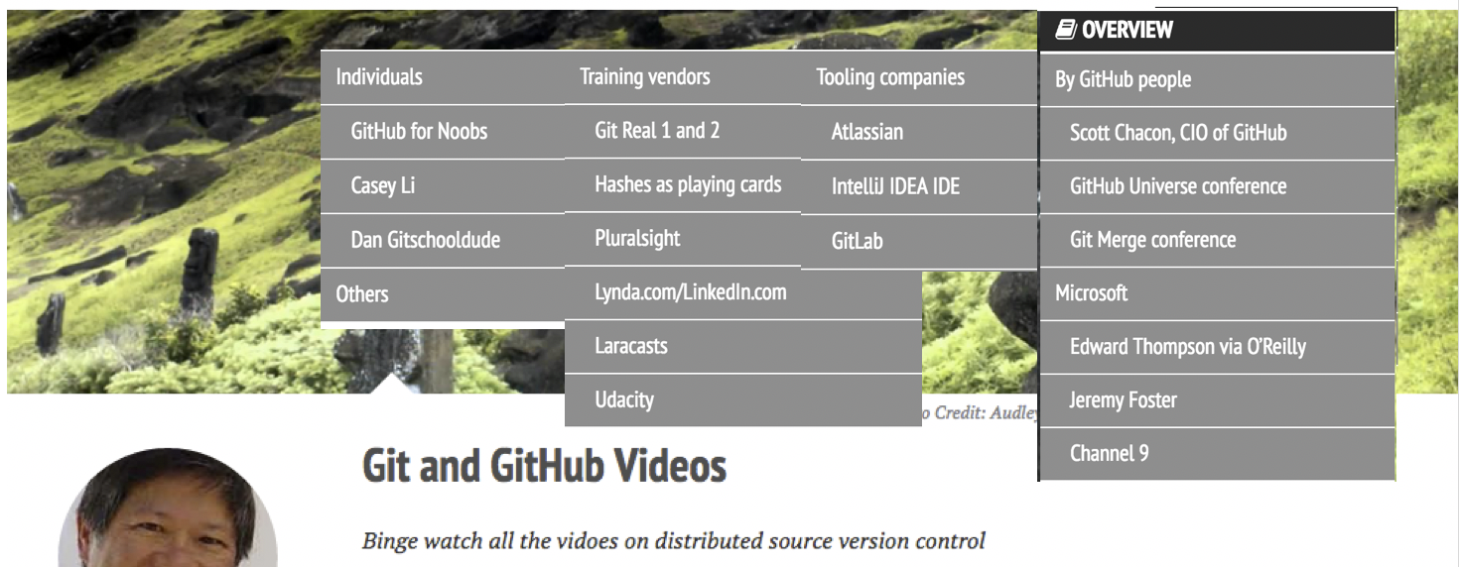
Every video, book
= git.io/v1Cow
https://wilsonmar.github.io/git-github-videos
Notes:
5/ Also, I've viewed every video and read every book I can find about Git, GitHub, GitLab, and other repositories.
6/ So, this video is about filling a need others have not filled.

Slide 4
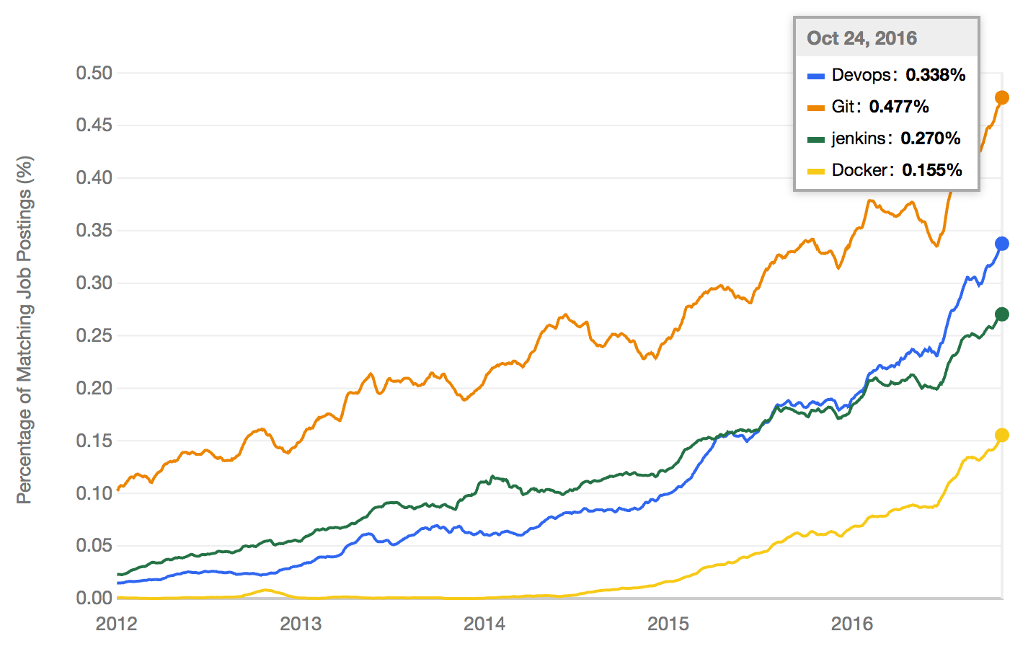
Git
Jenkins
DevOps
Docker
http://www.indeed.com/jobtrends/q-Devops-q-Git-q-jenkins-q-Docker.html
Notes:
Xxx 06a/ The need for professional training in Git is increasing because Git is becoming a prerequisite to win developer jobs.
06b/ These lines are from a website that analyzes keywords in job postings throughout the internet. The word Git, shown as the orange line at the top, is more and more frequently mentioned than the word DevOps, Jenkins, and Docker.
06c/ Skill with Git is key to achieving the "infrastructure as code" movement enterprises need today.
02a-jobs-mentions-foundational.mp3

Slide 5
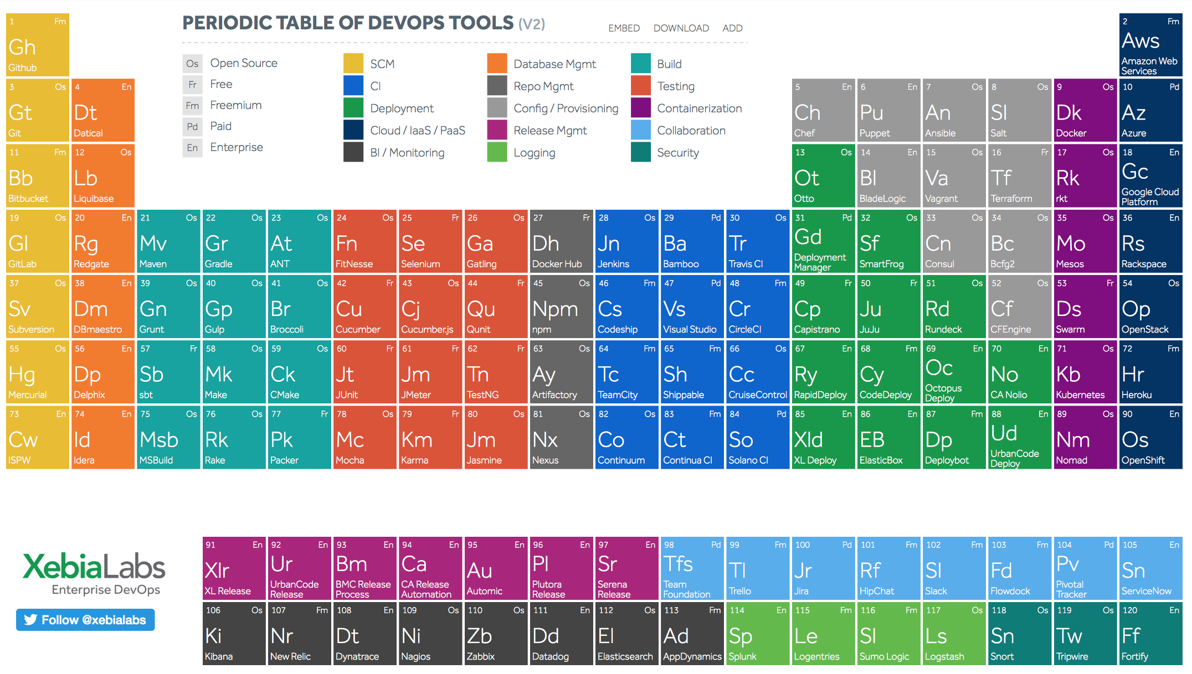
Why Git?
Quizzes
Notes:
06b/ In this "periodic table" of DevOps tools (from XebiaLabs), Git and Git repositories GitHub, BitBucket, and GitLab hold the same position as Hydrogen and Lithium in the periodic table of chemical elements.
NOTE: Alternatives to GitHub include https://osdn.net/

Slide 6
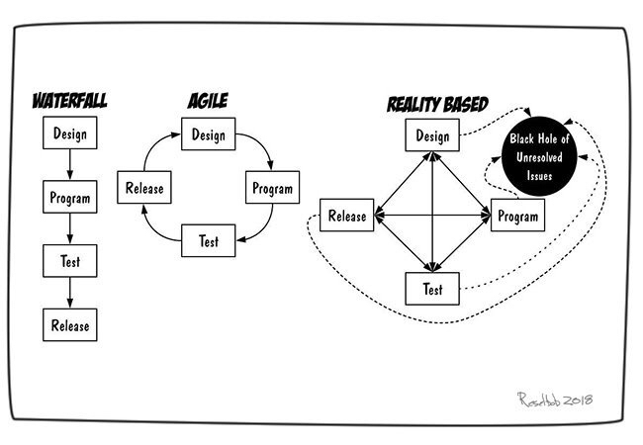
Why Git?
Notes:
The fact that you're viewing this video means that you realize how important

Slide 7
Why Git?
Prerequisite for jobs
Distributed
"Configuration as code"
Notes:
The fact that you're viewing this video means that you realize how important

Slide 8
Why this course vs. others?
Cloud
Git client
my own account's repo
have
right
Round-trip update of open source repos
Pull
Request
Merge
Merge
Fork
Other repo
no
right
upstream
Edit
Notes:
10/ The objective of this video is that you'll be able to do a round-trip update of an open-source repository you don't own. 11/ This means we work on the internet cloud where there is a repository you have no right to update. 12/ We call that an "upstream" remote. 13/ This course shows how to fork the contents of that repo (and all its history) to a repository you do have a right to update. 14/ You'll install a Git client so your can clone the whole thing onto your laptop and work with it anywhere. 15/ When you edits look good, push those changes to your repo. 16/ You can then request the owner of the upstream repo to pull your changes in. 17/ When your changes are merged into the upstream, your get listed as a contributor.
18/ Few other totorials describe how to retrieve edits made over time in those upstream repos. 19/ But here you'll learn how to fetch those changes, then keep your copy in the cloud updated. 20/ That's the round-trip I'm talking about to keep repos synced.
But that's now all.

Slide 9
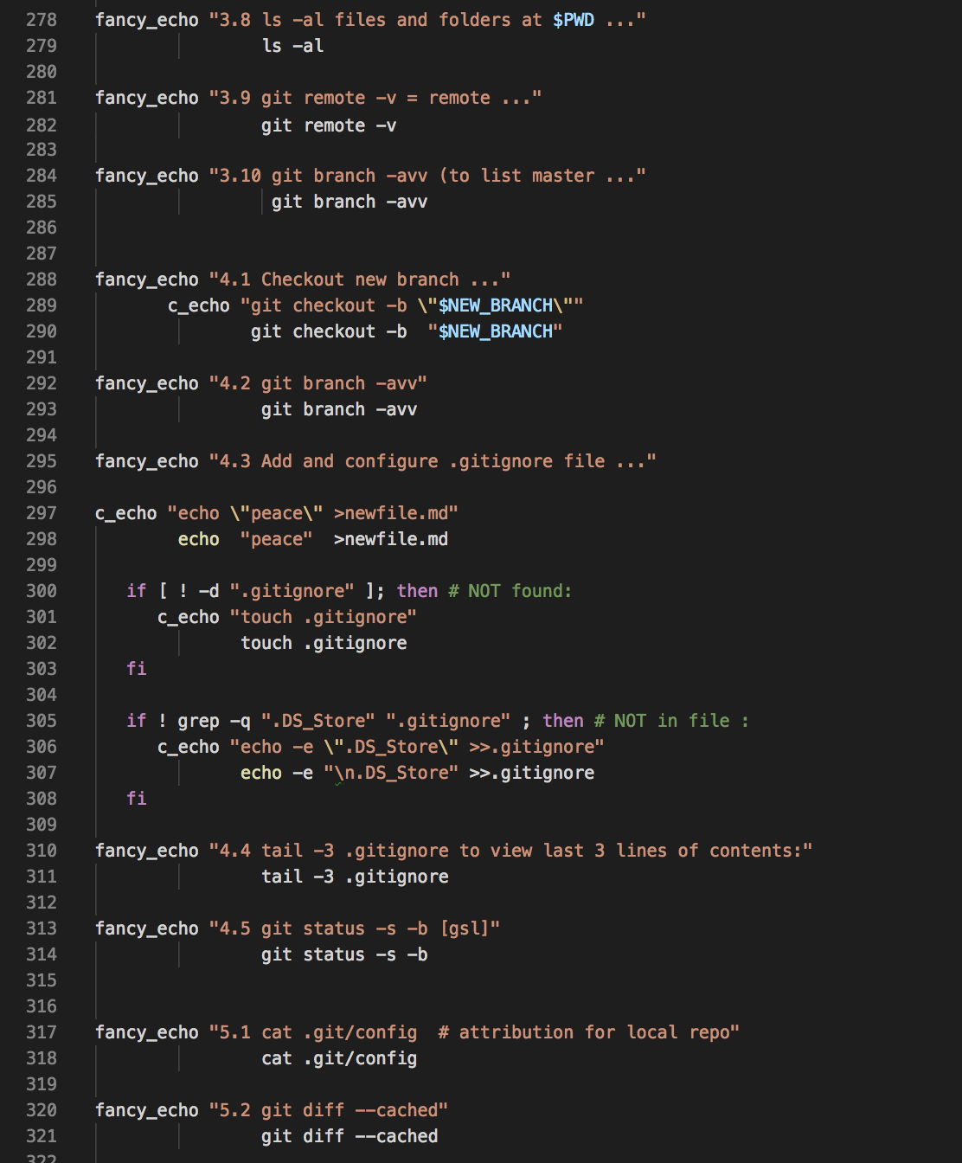
Why this course vs. others?
Round-trip update of open source repos
How to recover from mistakes
Verify status after key steps
Bash scripts doing steps
Notes:
21/ In this tutorial, we also learn how to recover from mistakes right after we try each command.
22/ This means we often use commands to verify status after key steps.
23/ Verification steps are part of bash scripts I've created so that you can tell, on your own, whether you're typed incorrectly or whether there's some issue with the system. 24/ Having a script means you can change something to see how it affects the whole workflow. 25/ The scripts are a very unique aspect that I haven't seen elsewhere.
26/ Another special aspect of this course are the keyboard shortcuts pros use to boost their efficiency.
Xxx> 27/ At the end of each segment we review key learnings to make sure you have mastered each skill.
28/ Now here's our first review: Among all these, what do you think will be the most helpful aspect of this course to you? <xxx
NEXT: Let's first learn the basic actions using a Git client.

Slide 10
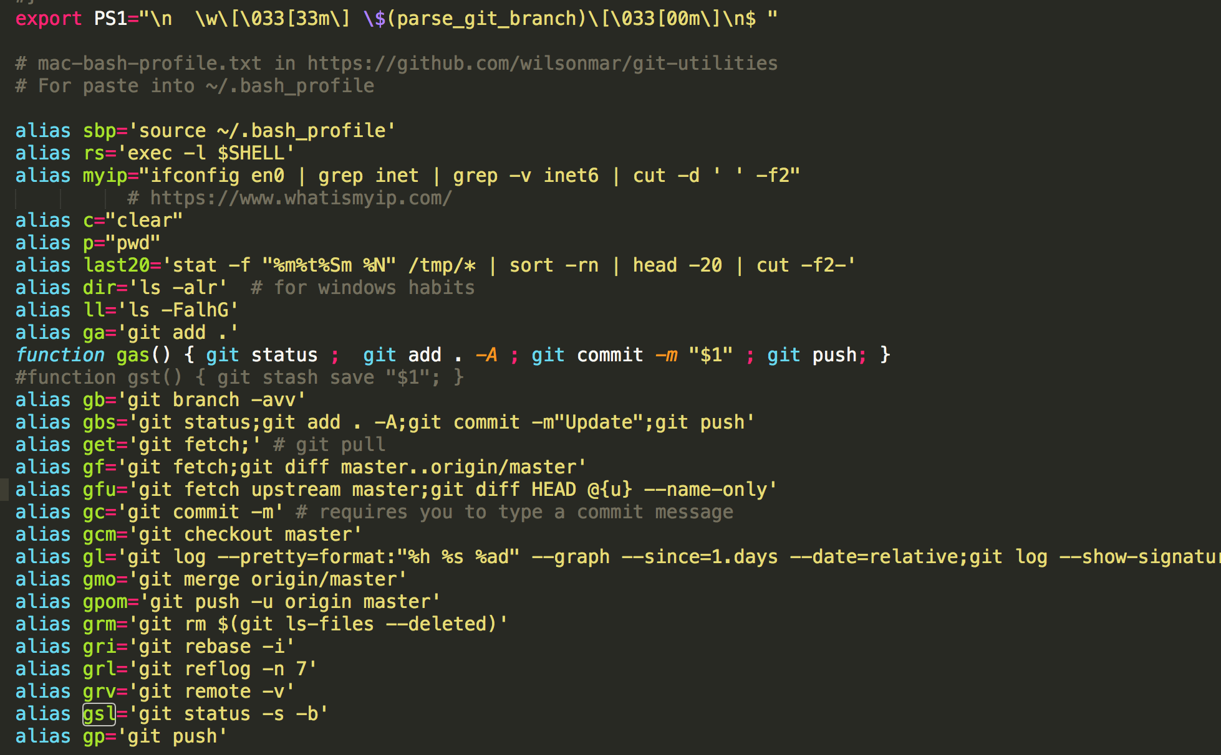
Why this course vs. others?
Round-trip update of open source repos
How to recover from mistakes
Verify status after key steps
Bash scripts doing steps
Keyboard shortcuts

Slide 11
Why this course vs. others?
Round-trip update of open source repos
How to recover from mistakes
Verify status after key steps
Bash scripts doing steps
Keyboard shortcuts
Reviews

Slide 12
Which is most helpful to you?
Round-trip update of open source repos
How to recover from mistakes
Verify status after key steps
Bash scripts doing steps
Keyboard shortcuts
Reviews

Slide 13
Part 1
Install utilities

Slide 14



Git
GitLab, Bitbucket, etc.
Used in both client and server software
web service software
SaaS (Software as a Service)
Distributed version control repository format
Designed by Linus Torvalds who also invented Linux
Open-sourced and owned by the Software Freedom Conservancy
competing tools with additional "enterprise" features
https://sfconservancy.org/projects/current/
http://octodex.github.com/
https://git-scm.com/downloads/logos
Notes:
>>> 02-git-vs-github-01-clarify.mp3
01/ Let's clarify the terms "Git" vs. GitHub, GitLab, BitBucket and other offerings, which are web service software accessed over the internet as what is called "Software as a Service" (SaaS).
02/ The term "Git" is about a distributed version control repository format designed by Linus Torvalds, who also invented Linux.
04/ The design was turned over to the non-profit Software Freedom Conservancy. This open-source approach is what makes it possible for different companies to add their own unique features.
06/ So Git technology is used in both client and server software.
07/ A choice of different GUI clients have been developed.
07a-git-vs-github.mp3
https://sfconservancy.org/projects/current/
07c-git-trademark.mp3
https://github.com/logos

Slide 15
Not in scope
Different Git clients & their configuration
Comparison of GitHub vs. GitLab vs. BitBucket, etc.
Organization accounts & profile avatar picture in GitHub
Multiple accounts, 2FA, and secure signing of commits
Create your own github.io / gitlab.io website
README.md markdown coding and readers
Intricacies of git rebase and merge, with diff/merge tools
Hooks for automatic actions
Notes:
>>> 03-notinscope-01.mp3
31/ This being a short course, we won't have time to cover
NEXT: but we can take a quick look at the GUI, without comment.

Slide 16
Text editors
IDE
Git GUI
IntelliJ WebStrom
IntelliJ IDEA (JetBrains)
Eclipse
Netbeans
etc.
SublimeText
Visual Studio Code
etc.
Git for GitHub
GitKraken
Tower
SmartGit
etc.
Notes:
04-git-tools-01-....mp3
Because the format of Git repositories is freely open-sourced and popular, there are many stand-alone Git clients available and Git functionality has been built into most IDEs today.
01/ Many use Git and GitHub capabilities built into Integrated Development Environments such as Eclipse, IntelliJ, and others.
03/
08/ You can also use Homebrew or Choco to install Git GUI clients Git Desktop, GitKraken, and others.
If prefer reaching for a mouse, install Git GUI clients Git Desktop, GitKraken, and others.

Slide 17
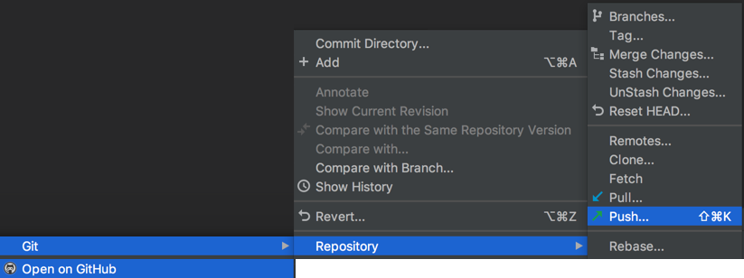
IntelliJ WebStorm IDE

Slide 18
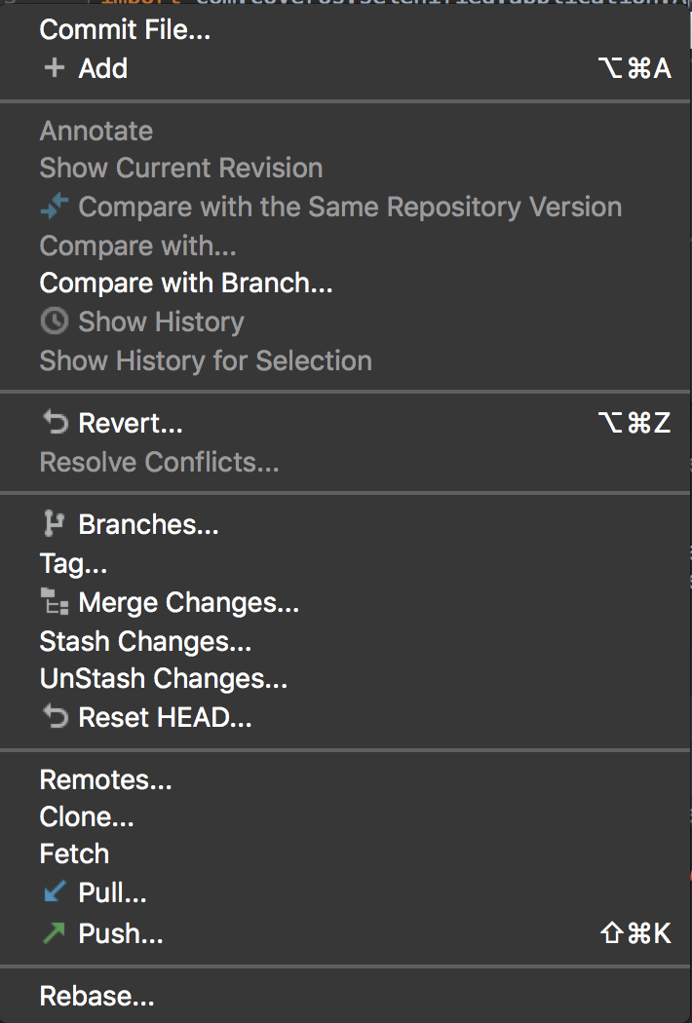
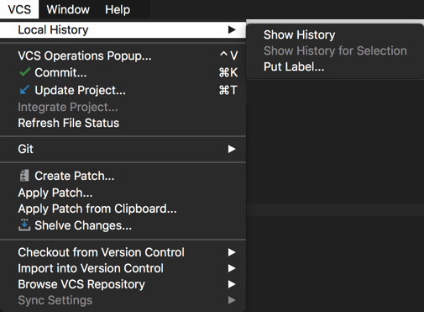

IntelliJ IDEA CE IDE
Notes:
This being a short course, we need to exclude certain topics.

Slide 19
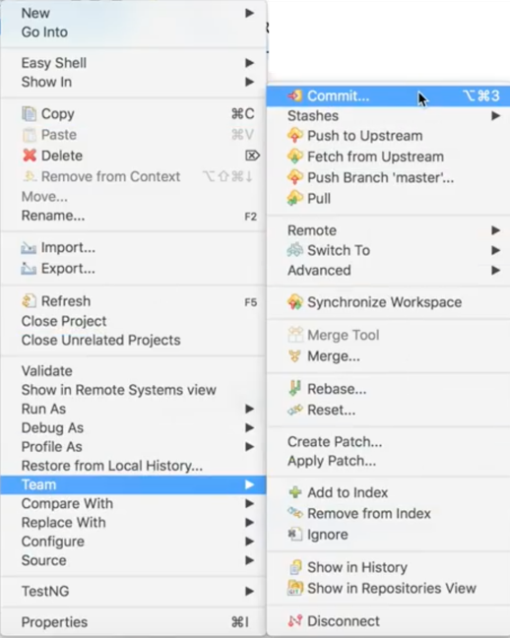
Eclipse
IDE

Slide 20
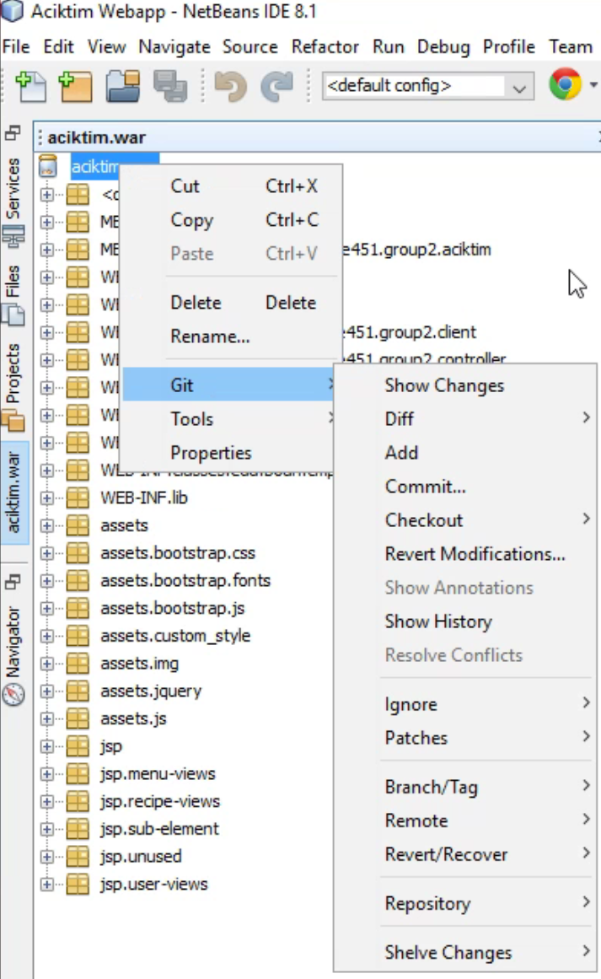
Netbeans
IDE
Notes:
This being a short course, we need to exclude certain topics.

Slide 21
Laptop Setup
Mac
Windows
CLI (Command-line Interface):
Terminal
=
Git Bash
Package install/upgrade/uninstall
Homebrew
Chocolatey
command:
brew
choco
Git CLI client installer
git
msysgit
Git GUI clients (multi-platform):
GitHub Desktop, GitKraken, etc.
Text editor (built-in):
TextEdit
Notepad
Install multi-platform text editors: SublimeText, VSCode, etc.
Internet Browsers (built-in with OS):
Safari
IE, Edge
Install:
Chrome, Firefox, Brave, etc.
Notes:
05-laptop-setup-....mp3
02/ Due to its Linux pedigree, some Git commands are designed to be typed into a Command-line Interface.
03/ On MacOS, open its Terminal program built into a Mac. On Windows, a Git Bash program can be installed on Windows machines to execute commands as if you're on a Mac or Linux machine.
04/ Git Bash installed by the msysgit package which also installs the Git CLI on Windows.
06/ There, msysgit is installed from within a standard Windows cmd program by first installing a package manager called Chocolatey. Then the choco install mysysgit command.
08/ On Macs, I recommend that you install packages with Homebrew, using the brew install command.
10/ Homebrew can also be used to install Git GUI clients and other software.
12/ Installing multiple tools is similar to the situation where even though the operating system provides defaul text editors and internet browsers, many still install multi-platform text editors, and internet browsers.
14/ Next, we explore how to obtain

Slide 22
Bash script
Types commands for you
Bash = "born again shell" terminal
Comes with Mac & Linux
On Windows, git bash is installed by Chocolatey
choco install msysgit
Notes:
This being a short course, we need to exclude certain topics.

Slide 23
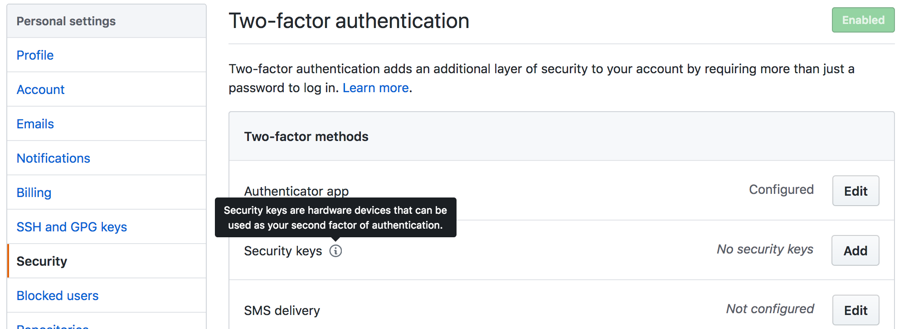
GitHub Two-Factor Authentication
https://github.com/settings/security
Notes:
20-2factor-....mp3

Slide 24
Part 2
GitHub - command script

Slide 25
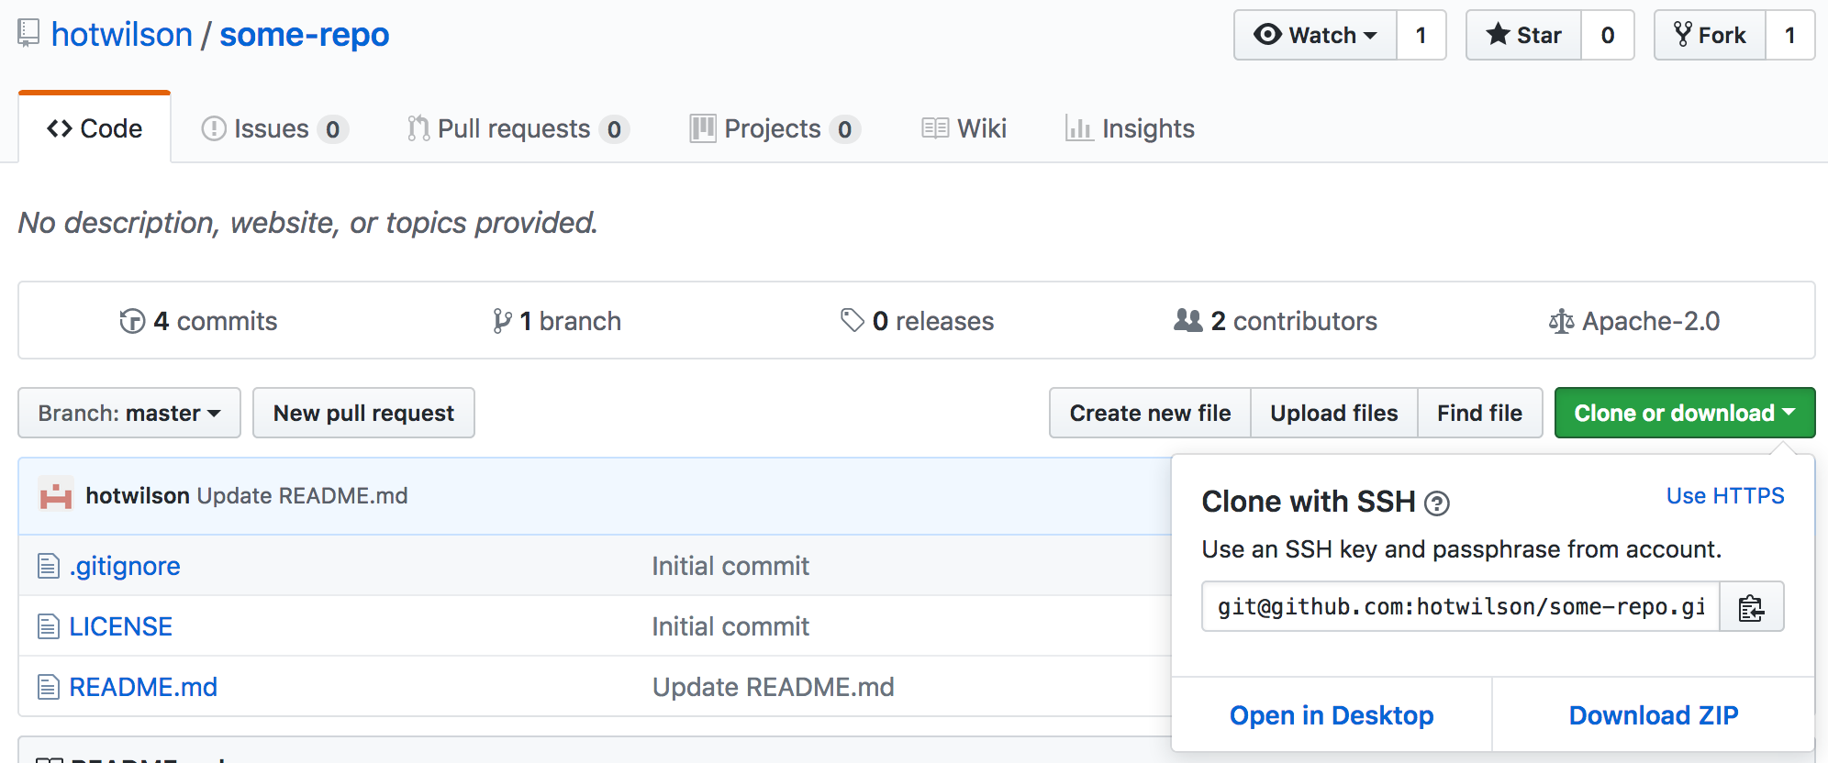
Sample repository (repo)
git clone
paste
click to copy
Notes:
06-repo-sample-....mp3
When you're in GitHub, you can click

Slide 26
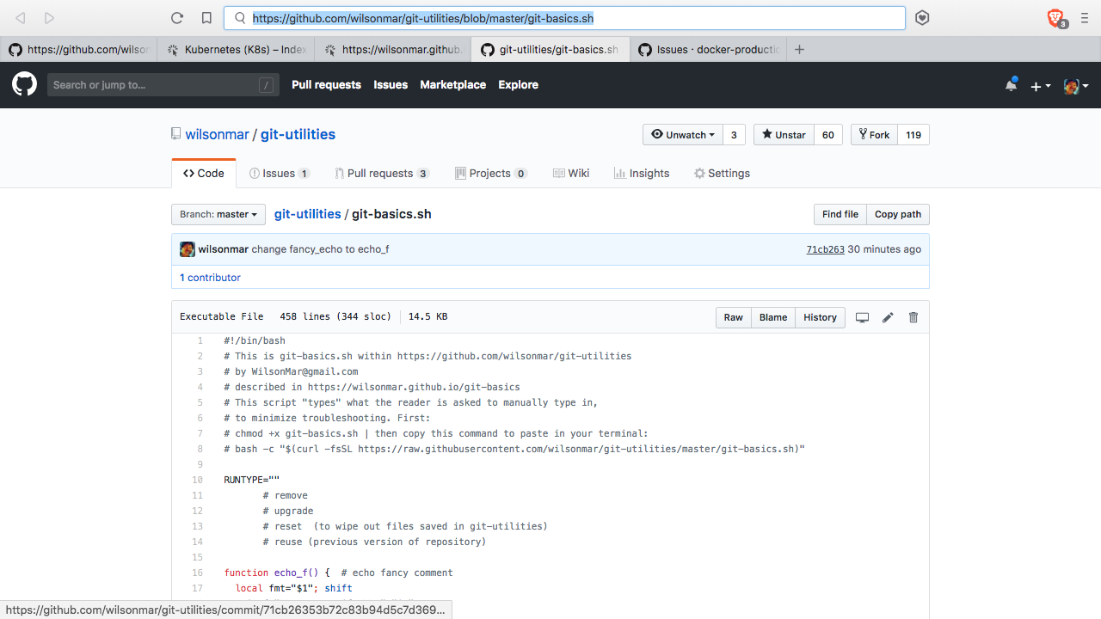
account
repository
shell script
blob:
hash
Notes:
07-cmd-script-01-....mp3
For narration, see https://wilsonmar.github.io/git-basics#

Slide 27
shell script
Notes:
07-cmd-script-01-....mp3
For narration, see https://wilsonmar.github.io/git-basics#

Slide 28
Git Bash
Terminal
git config --global core.safecrlf false
~/.ssh/
ssh-keygen
git config user.name "Wilson Mar"
cd
--global
id_rsa
$HOME
git config user.email "wilsonmar@gmail.com"
--global
pbcopy <
id_rsa.pub
puTTYgen
cd ~
mkdir ~/gits/myacct && cd myacct
container
pwd
.gitconfig
git clone https://github.com/other/some-repo
choco
msysgit
config
--depth=1
Cloud
2FA
source
~/.bash_profile
git clone git@github.com:myacct/some-repo
mkdir local-init && cd local-init
cd some-repo
Git client
public key
have
right
PATH= ...
git init
some-repo folder
export ...
echo "?">>.gitignore
hub
alias ...
(git checkout master)
myacct's repo
ls –al [ll]
(vim README.md)
git branch –avv [gb]
git checkout –b feat1
git fetch
git status –s -b [gsl]
.git
gitk master..origin/master
git-basics.env
Working directory
README.md
git merge
git-basics
stage index
git commit –m"?"
origin
git rebase –i [gri]
chmod +x
git-basics.sh
git add . –A –p
git push origin feat1
feat1
./
git reflog [grl]
master
git log [gl]
git tag –a v1.2.3 -m"?"
aliases.txt
config
git push origin –-tags
Pull
Request
git checkout master [gcm]
Merge
account
(reconcile conflicts)
git branch –d feat1
bash curl ...
git fetch upstream [gfu]
git push origin :feat1
Merge
Fork
git diff HEAD @{u} --name-only
public repo
git checkout master [gcm]
git remote add upstream
https://...
no
right
git remote –v [grv]
gitk master..upstream/master
git pull upstream master
upstream
@Copyright Wilson Mar
2015-2018
All rights reserved.`
git merge upstream/master –m"update" –-no-edit
Edit
master
git push –u origin master
https://github.com/wilsonmar/git-utilities/blob/master/aliases.txt
https://goo.gl/12C1BF
https://wilsonmar.github.io/git-basics
https://github.com/wilsonmar/git-utilities/blob/master/git-basics.sh
Notes:
For narration, see https://wilsonmar.github.io/git-basics#
10-repo-sample-....mp3

Slide 29
Git client installation
template
git diff HEAD @{u} --name-only
git checkout master [gcm]

Slide 30
Part 1
Concepts

Slide 31
ssh-keygen
–t rsa –C"user1@corp.com"
~/.ssh/
Git client
passphrase
private key
id_rsa
id_rsa.pub
PuTTYgen
pbcopy or paste
Clipboard
your repo on
GitHub .com
SSH public
key
git clone
https://github.com/user1/project.git
via port 443
git clone
git@github.com:user1/project.git
via port 80
git clone
ssh:user1@server:project.git
via port 22
git clone
git://server/project.git
via port 9418
git clone
file://myrepos/project
git clone
/myrepos/project
via hard link
~/.ssh/config
Host github.com-user1
HostName github.com
User git
IdentityFile ~/.ssh/id_rsa
git-protocols-v03.pptx
@Copyright Wilson Mar 2016.
All rights reserved.
Notes:
https://gist.github.com/grawity/4392747
NOTE: This is described in ACTIVITY 8: Copy repo from GitHub to local git, page 71
Dotted lines represent reference tlink o a file.
A local copy of a repository from github.com or private enterprise repo
can be transferred using the clone command issued from within a executable.
Settings such as the user’s name and email address are specified in configuration commands.
The target URL is typically copied from the github web page.
But the client can also process commands which handle transfers more securely use public and private keys.
The ssh-keygen generates pairs in the .ssh folder in the home folder of the current user.
The command makes pass phrase optional, but we recommend it.
The contents of the public key is pasted in the github web site for use in signing what it sends out, through typically port 443 rather than port 80.
-----
There are other options for cloning that we don’t have time for today.
But remember that one can add the name of a directory folder to create on the local drive.
See LukyBoy’s answer in http://stackoverflow.com/questions/4220416/can-i-specify-multiple-users-for-myself-in-gitconfig
https://orrsella.com/2013/08/10/git-using-different-user-emails-for-different-repositories/

Slide 32
Concept map
From https://github.com/datacamp/courses-intro-to-git
Notes:
From https://github.com/datacamp/courses-intro-to-git

Slide 33
Time travel
dddddd
Notes:
This being a short course, we need to exclude certain topics.

Slide 34
Commit message etiquette
Capitalize first letter
50 characters or less (Git's limit)
Don't add period at the end
No need to specify file name (can get from a command), but ...
Begin with file name to make subject easier to read within a list.
Use an imperative present (not past or future) tense action verb such as "Add" (new) or "Update" (an existing item)
Explain why (so that ... )
Use description to detail what and how
Notes:
This being a short course, we need to exclude certain topics.

Slide 35
Which is a good commit message? ???
Update README.md
To be or not to be :rocket:
Change
No need to specify file name (can get from a command), but ...
Begin with file name to make subject easier to read within a list.
Use an imperative present (not past or future) tense action verb such as "Add" (new) or "Update" (an existing item)
Explain why (so that ... )
Use description to detail what and how
Notes:
This being a short course, we need to exclude certain topics.

Slide 36
Merge
Rebase
* Default behavior
* Does not remove commits
* Removes commit history
* Retains previous commits
* Replaces intermediate commits
* Complex tree
* Cleaner linear tree
* Fast forward to a new commit
* New commits created for each
* Use for public branches
* Use for private branches
Notes:
git-merge-rebase-650x353-200544.jpg
https://www.youtube.com/watch?v=dO9BtPDIHJ8
https://www.youtube.com/watch?v=f1wnYdLEpgI by Modern Coder
https://www.youtube.com/watch?v=TymF3DpidJ8&t=1s
https://www.youtube.com/watch?v=a_msiOrYLgM
https://www.youtube.com/watch?v=Nftif2ynvdA
https://www.youtube.com/watch?v=g1f_luIO6Vc (heavy accent)
https://www.youtube.com/watch?v=YoByop6ccTc

Slide 37
Part 2
IDE vs. command line

Slide 38
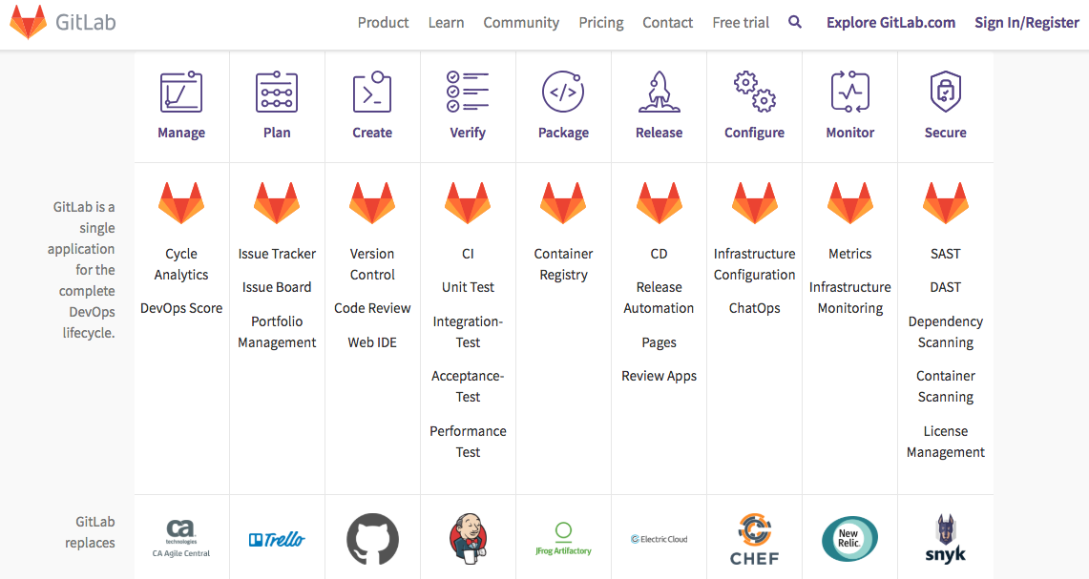
About.GitLab.com
Notes:
gitlab-about-offerings-1141x607.png

Slide 39


