Slide 1
Deploying a Go (Gin) Web Service on AWS EC2
Wilson Neira
CS 6650 – Building Scalable Distributed Systems
Week 1 – AWS Learner Lab
CS 6650 – AWS Learner Lab | Wilson Neira

Slide 2
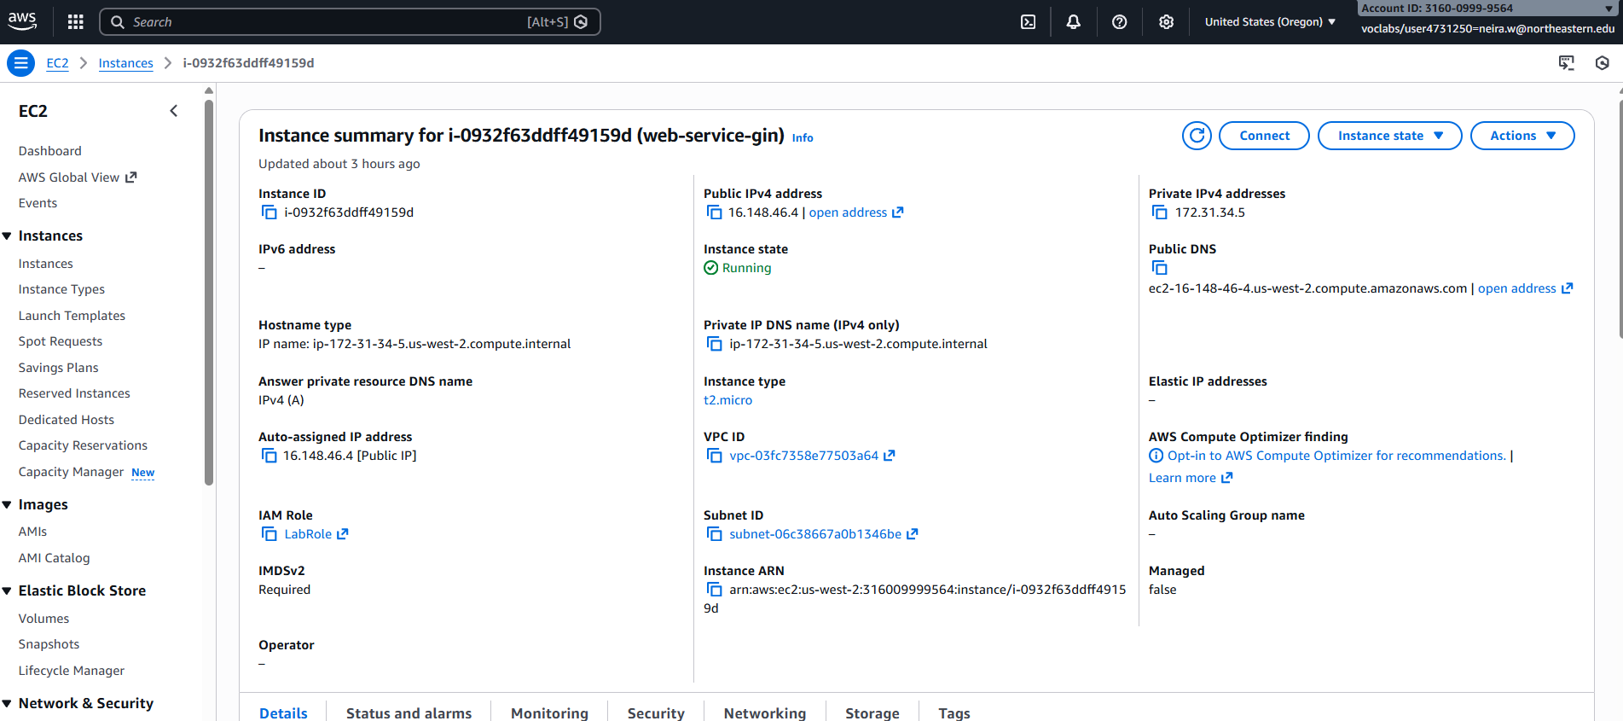
What I Built
I deployed my Homework 1a Go (Gin) web service on an AWS EC2 virtual machine
The service exposes REST endpoints for listing and adding music albums
The backend is intentionally in-memory to focus on deployment concepts
The same server code runs locally and on AWS
CS 6650 – AWS Learner Lab | Wilson Neira

Slide 3
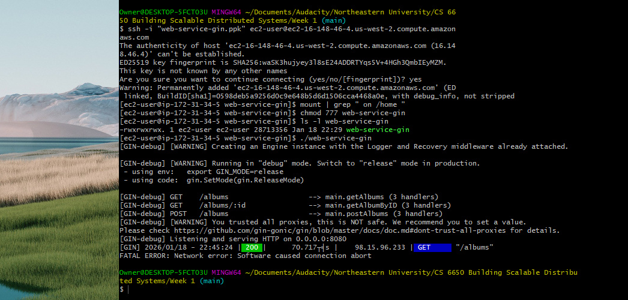
Key Learning: Server Binding (localhost vs 0.0.0.0)
Running on localhost:8080 only accepts connections from the same machine
On EC2, this blocked access from my laptop
Binding to 0.0.0.0:8080 allows traffic from outside the instance
This clarified how network interfaces affect accessibility
CS 6650 – AWS Learner Lab | Wilson Neira

Slide 4
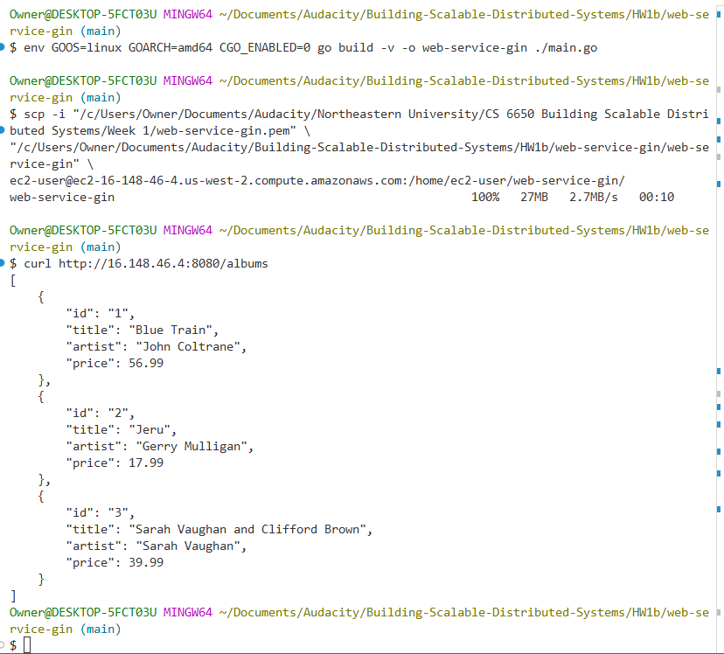
Cross-Compiling from Windows to Linux
My development machine runs Windows, while EC2 runs Amazon Linux
I cross-compiled using GOOS=linux and GOARCH=amd64
This produced a Linux ELF binary that runs directly on EC2
Linux requires executable permissions before running binaries
CS 6650 – AWS Learner Lab | Wilson Neira

Slide 5
SSH Access and Key Management
I connected to EC2 using SSH from Windows via PuTTY/Plink
PuTTY uses .ppk keys, while scp requires OpenSSH-compatible .pem keys
I converted my .ppk key to .pem to upload files
This showed how SSH tooling differs across platforms
CS 6650 – AWS Learner Lab | Wilson Neira

Slide 6
Security Groups and End-to-End Testing
AWS Security Groups act as a firewall for inbound traffic
I allowed SSH from my IP and HTTP traffic on port 8080
I tested locally with curl localhost:8080/albums
I verified remote access using the EC2 public IP from Windows
CS 6650 – AWS Learner Lab | Wilson Neira

