Slide 1

Performance of Logistic Regressions and K-nearest neighbors to predicting loan default
L&S Consultancy – Wilson Phurwo

Slide 2
Executive Summary
Logistic regression, using penalized estimations and stepwise variable selection, achieves over 99% accuracy when predicting loan default
K-nearest neighbor does not meet adequacy
The sophisticated empirical strategy by Hertzberg, Liberman, and Paravisini (2018) finds that borrowers choosing short-maturity loans when a long-term option is available for that amount are less likely to default than those with short-term with no long-term option (before Lending Club’s expansion in 2013)

Slide 3

Introduction
SUBTITLE HERE

Slide 4

Models
L&S Consultancy relies on two major frameworks to build predictive models: logistic regression and k-nearest neighbor. As the data from Lending Club initially consists of 96 predictors, many algorithms are able to choose which predictors are most significant.

Slide 5


The Major Frameworks
Logistic Regression
K-Nearest Neighbor
This parametric model assumes that the probability of default can be calculated using linear combination of the predictors.
In words, the logistic regression uses the maximum likelihood estimator to compute β using available information stored in x, and π(x) is the probability of default.
The next step is to choose what information needs to be stored into x (see next slide for penalized estimation and stepwise variable selection).
This non-parametric model learns the characteristics of defaulting borrowers then classify new borrowers according to those with the most similar traits.
The probability of default is the average of the number of defaulted cases in a set of K observations closest to x.
The drawback is choosing x has to be done manually

Slide 6


Penalized estimation & Stepwise Variable Selection
Penalized Estimation
Stepwise Variable Selection
The goal is to minimize the error, or the difference between prediction and observation, but multiplying a penalization parameter to the β coefficients
Three methods available: lasso, ridge, and elastic net regressions
Example: elastic net’s loss function is to be minimized:
Akaike Information Criterion (AIC) scores a model according to the maximum value of likelihood function and the number of parameters.
Iteratively chooses the model with the lower AIC until no possible model has smaller value of AIC

Slide 7
EdA
Exploratory Data Analysis

Slide 8
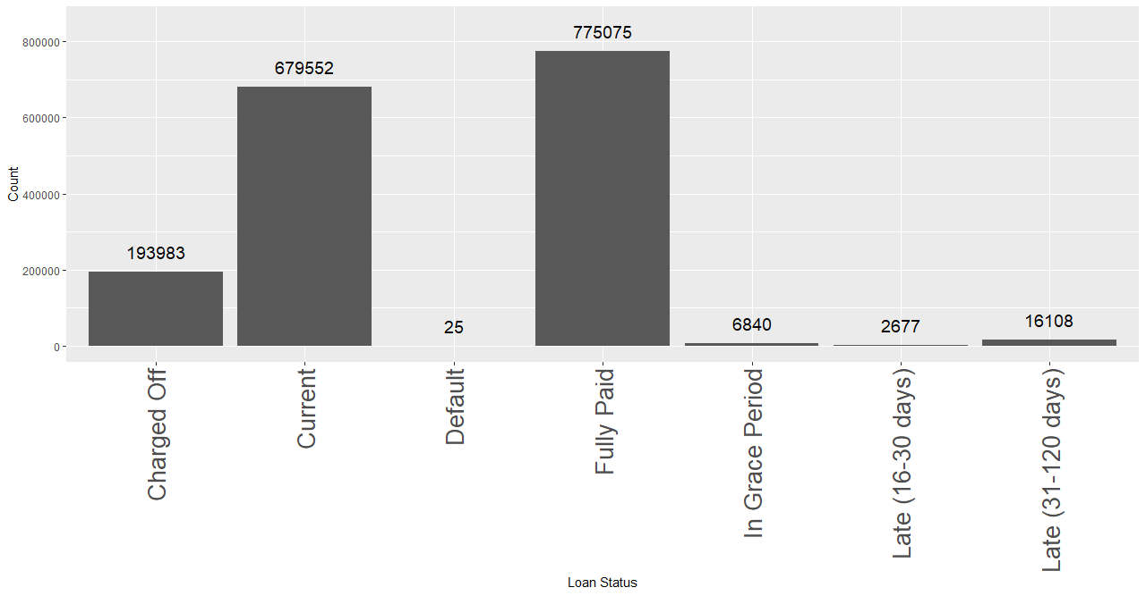
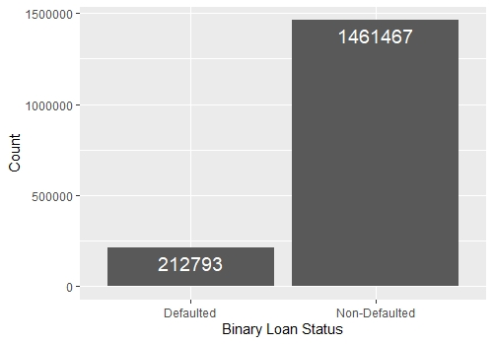
Loan Status
Loan status initially have 7 classes, but the frameworks are only suitable for binary outcomes, so they are classified to simply defaulted and non-defaulted cases. Charged off, default, and late cases are classified as defaulted. Current, fully paid, and loans in grace period are classified as non-defaulted.

Slide 9
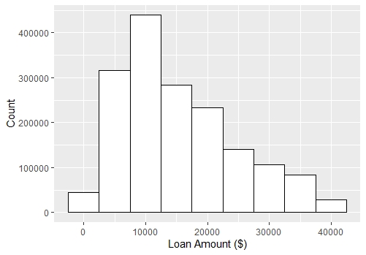
Loan Amount
The average of loan amount is $15,387 with median (50% of loans are below) of $13,650.

Slide 10
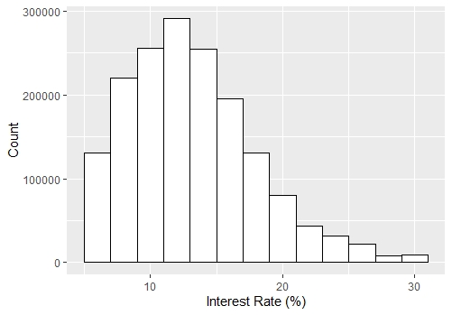
Interest Rate
The average of interest rate is 13.20% with median of12.69%.

Slide 11
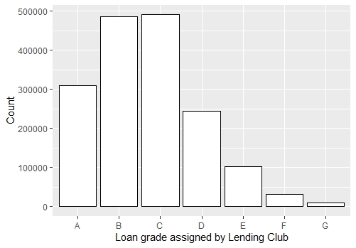
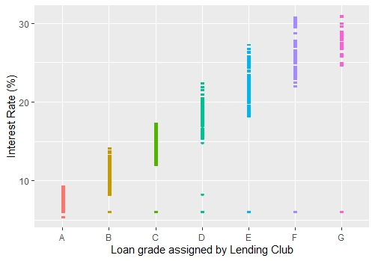
Loan Grade
Grade B and C are the majority of the loans. The worse the grade (rightward), the higher the interest rate.

Slide 12
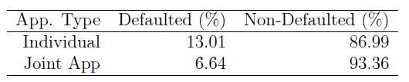
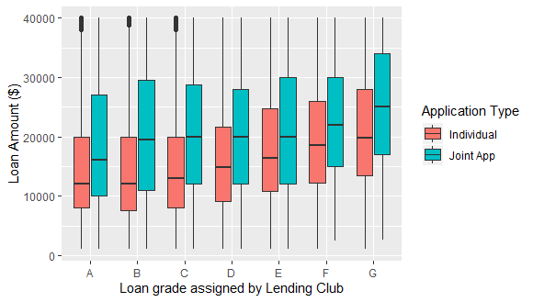
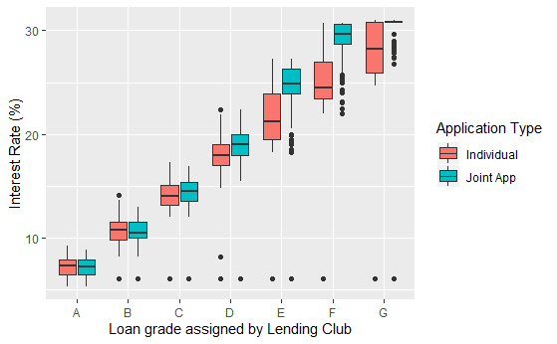
Applicant Type
Individual borrowers tend to apply for smaller amount and are charged lower interest rate than joint applicants, but have more defaulted cases percentage

Slide 13
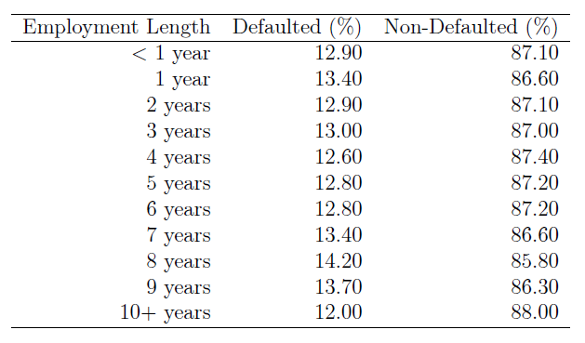
Employment Length
Employment length does not significantly change the percentage of defaulted cases

Slide 14
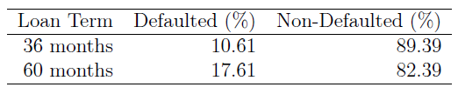
Maturity
On average, long-maturity loans have larger percentage of defaulted cases than short-maturity loans. Somehow, this may indicate that the empirical study may be inspired by this idea.

Slide 15
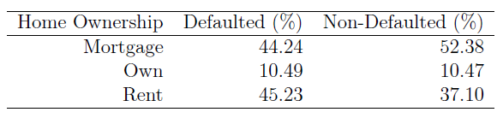
Home Ownership
The majority of borrowers who default rent their home, while borrowers who pay back their liabilities at least pay mortgage overall

Slide 16
Implementation

Slide 17
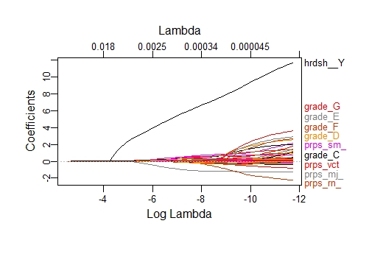
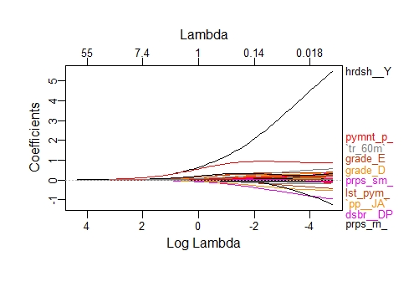
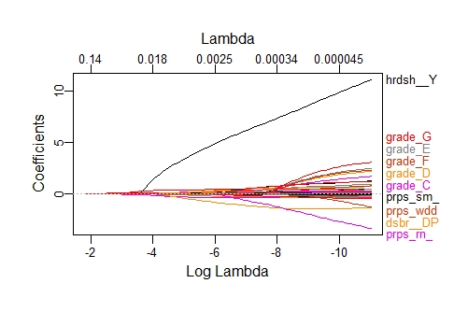
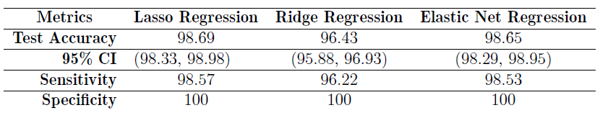
Penalized Regression
From left to right: lasso, ridge, elastic net
According to penalized regressions, hardship flag, grades, and purposes are among the most important variables. The model was trained and tested on a different set of data. The table shows the performance when tested. It is astonishing.

Slide 18
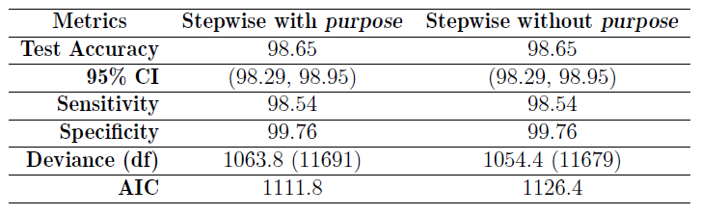
Stepwise Regression
The stepwise variable selection ends up with the dilemma of either keeping or removing the purpose variable, so it was decided to both. Again, the models were trained and tested on different set of data. The metrics in the table are achieved from testing. Both models are very similar in term of deviance and AIC. Regardless, the testing metrics (first four rows) are almost as accurate as penalized regressions.

Slide 19
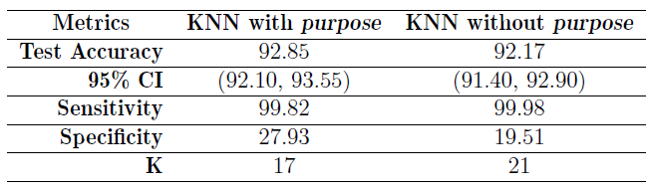
K-Nearest Neighbors
The k-nearest neighbor uses the same predictors used in stepwise regression so the comparison is not biased. The method to investigate which value of K is the best is to try a range of K values iteratively using a package in R. The result is not satisfactory when tested. Although accuracy is more than 90%, but it is most likely caused by the large number of non-defaulted cases. Specificity, by KNN, is at best 27.93%.

Slide 20
Future Direction
Choosing variables with quantitative methods yield us the previous results. Another approach to predicting the likelihood of default is to categorize variables according to their nature. The chart here illustrates this suggestion. Regressions can be done using one or more of the categories. Also, training the model with more observations using more powerful machines would provide more accurate models.
Lending Club’s information
Loan grade
Interest Rate
Borrower’s choice
Loan amount
Purpose
Maturity
Application type
Borrower’s information
Annual income
Employment length
Home ownership
Debt-to-income ratio
Borrower’s credit performance
No. of active revolving trades
No. of derogatory public records
Revolving line utilization rate
No. of inquiries in past 6 months

Slide 21
Screening on Maturity

Slide 22
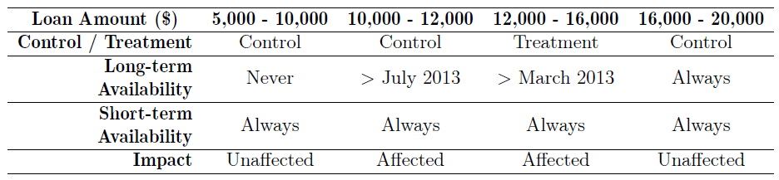
Empirical strategy
The study by Hertzberg, Liberman, and Paravisini (2018) groups short-term loans according to the above table. It uses the difference-in-differences regressions to calculate the number of short-term loans that decrease when Lending Club allows certain amounts to be lent with long-term options. They find that 14.51% short-term borrowers opt out and assumed to switch to the long-term option. Then, they perform the difference-in-differences classification to predict the probability of default. The finding is that borrowers that opt with short-term loans when long-term option is available are less likely to default by 0.8% than short-term loans when long-term option is not available.

Slide 23

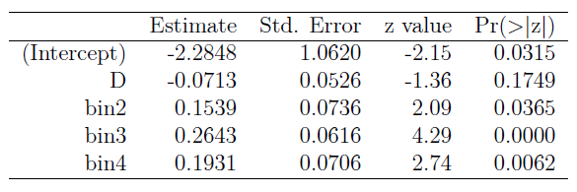
Implementing the Logistic Reg.
The logistic regression model’s formula follows similar scheme to the study’s, using dummy variable D to indicate short-term loans that were just made available after the two expansions in March 2013 (for $12,000 - $16,000) and July 2013 (for $10,000 - $12,000). Therefore, the attached β is the effect of borrowers opting for short-term loans even when long-term option is available. As the estimate is -0.0713, it means that the odds of borrowers applying for short-maturity loans when long-term option is available to default is e^{-0.0713} = 0.9312 times relative to the odds of borrowers who opt for short-term loans when there is no long-term option. The pitfall of this result is that β for D is not significant at even 15% level of significance.

Slide 24

Conclusion
At over 99% of accuracy, penalized regressions are highly recommended for default probability prediction. These models are capable of capturing all true negative (defaulted) cases.
Avoid using the k-nearest neighbor due to its poor predictive power and expensive computational resources.
Conduct the stepwise regression as an alternative to the penalized regressions. This model performs similarly as lasso, ridge, and elastic net.
Be aware of borrowers who opt with long-term loans to take advantage of the longer period to be delinquent. This may indicate the possibility of late payment or default.

