Slide 1

OpenTelemetry Integration with IBM iSeries (AS/400)
Modern Transaction Monitoring Framework for Legacy Systems

Slide 2
PROJECT OVERVIEW
Bridging Legacy AS/400 Systems with Modern Observability
Core Objective
System Context
This initiative addresses a critical challenge facing enterprises with substantial AS/400 investments: how to integrate decades-old RPG and DB2 for i applications into modern distributed tracing ecosystems without requiring costly application rewrites or system migrations. By implementing OpenTelemetry standards, we enable comprehensive transaction monitoring, distributed tracing, and performance analytics while preserving the reliability and business logic embedded in legacy systems.
1GB
250K-1M
Log Data/Hour
Records/Hour
Continuous high-volume data ingestion
Transaction throughput capacity
The solution bridges the architectural gap between EBCDIC-based physical files, DB2 for i databases, and cloud-native observability platforms, providing visibility into transaction flows that span both legacy and modern infrastructure. This approach protects existing AS/400 investments while unlocking the benefits of contemporary APM and observability tooling.
Critical Data Elements
Server ID & Program ID for service mapping
Trace ID for distributed transaction correlation
Request/Response payloads for debugging
Timing data for latency analysis
DB2 query metadata for database performance

Slide 3

ARCHITECTURE
Three-Tier Component Architecture
The integration framework consists of three specialized components working in concert to extract, transform, and transmit AS/400 telemetry data to modern observability backends. Each component is purpose-built to handle specific challenges in the legacy-to-modern data pipeline.
iSeries-Otel-Bridge
AS/400 Daemon Program
OpenTelemetry Backend
Java-based transformation engine built on IBM Toolbox for Java (JT400), providing native access to AS/400 resources. This component handles the complex data conversion from EBCDIC encodings and proprietary AS/400 formats into OpenTelemetry Protocol (OTLP) structures.
Native RPG/CL scheduled job running on the iSeries platform, responsible for collecting transaction logs from physical files and DB2 for i tables. Operates on configurable intervals to balance freshness with system load.
Cloud-native telemetry storage and analysis platform with dual deployment options. Primary recommendation is AWS X-Ray for organizations with existing AWS infrastructure; Grafana Tempo provides an open-source alternative with S3 compatibility.
Scheduled log collection via job scheduler
JT400 toolkit integration for file and database access
AWS X-Ray: Native integration, service maps, auto-instrumentation
Physical file and DB2 database polling
EBCDIC to UTF-8 character set conversion
Incremental extraction with cursor management
Grafana Tempo: Open-source, high-volume capacity, Parquet storage
OTLP LogRecord and Span generation
Batch aggregation and compression
OTLP/gRPC ingestion endpoints (port 4317)
Batch processing with configurable chunk sizes
Secure AWS S3 upload via pre-signed URLs
S3-based long-term storage with lifecycle policies
Checkpointing for exactly-once delivery semantics
Integration with CloudWatch and Grafana for visualization

Slide 4


TECHNICAL STACK
Technology Selection & Rationale
The technical stack is carefully selected to balance AS/400 compatibility, modern observability standards, cloud-native scalability, and cost efficiency. Each component was evaluated against criteria including protocol efficiency, AS/400 integration maturity, storage economics, and operational complexity.
Data Format
OTLP (Protocol Buffers)
68-90% smaller than JSON, binary efficiency for high-volume scenarios
Transport Protocol
OTLP/gRPC (Port 4317, TLS 1.3)
HTTP/2 multiplexing, bidirectional streaming, connection reuse
Integration Framework
IBM Toolbox for Java (JT400)
Mature JDBC driver, native file access, comprehensive AS/400 API coverage
Storage Layer
AWS S3 with Intelligent-Tiering
Standard → IA → Glacier lifecycle for cost optimization
Monitoring Tools
AWS CloudWatch + Grafana
Unified dashboards, alerting, and log correlation
Protocol Buffers Efficiency: At 1GB/hour ingestion rates, the 68-90% compression advantage of OTLP over JSON translates to significant bandwidth and storage cost savings—approximately $180-270/month in data transfer costs at AWS pricing, with proportional reductions in S3 storage fees.

Slide 5




DATA FORMAT
OpenTelemetry Data Format Design
The transformation from AS/400-native formats to OpenTelemetry LogRecord structures requires careful mapping of legacy system metadata into semantic conventions that enable effective distributed tracing. Our design preserves critical context while conforming to OTel standards for interoperability.
Resource Attributes
Trace Context
Top-level identifiers that describe the AS/400 system generating telemetry. These attributes enable filtering and aggregation across multiple iSeries instances in distributed environments.
W3C Trace Context propagation fields that enable correlation of AS/400 transactions with upstream/downstream systems in hybrid architectures.
service.name: RPG program or CL procedure name
trace_id: 16-byte hex identifier (generated or extracted from external headers)
host.name: AS/400 system name (from QSYSVAL)
span_id: 8-byte hex identifier for this specific operation
host.type: "ibm-iseries" or "as400"
parent_span_id: Links to parent span in distributed traces
environment: Production/staging/development partition
trace_flags: Sampling decision bit flags
service.version: Program object version from QSYS
LogRecord Body
Semantic Attributes
The payload containing AS/400-specific transaction data, timing information, and contextual metadata necessary for root cause analysis and performance optimization.
Standardized OTel attributes that classify the operation type and enable cross-platform analysis with other instrumented services.
program_id: Executing RPG/CL program name
db.system: "db2_for_i" for database operations
transaction_id: Business transaction identifier
db.name: Library/schema name
request_data: Input parameters (sanitized for PII)
db.operation: SELECT/INSERT/UPDATE/DELETE/CALL
response_data: Output results and return codes
rpc.service: RPG program name for remote calls
duration_ms: Execution time in milliseconds
rpc.method: Procedure/subroutine invoked
db2_query: SQL statements for database operations
http.status_code: Mapped from return codes for web services
Conversion Pipeline
EBCDIC Decode
Record Parse
Character set conversion from EBCDIC (CCSID 37/500) to UTF-8 using ICU4J libraries
Field extraction from fixed-format physical files or DB2 result sets via JT400 API
OTLP Build
Batch & Ship
Construction of LogRecord or Span proto messages with semantic attributes
10k-record chunks with checkpointing for exactly-once delivery guarantees

Slide 6

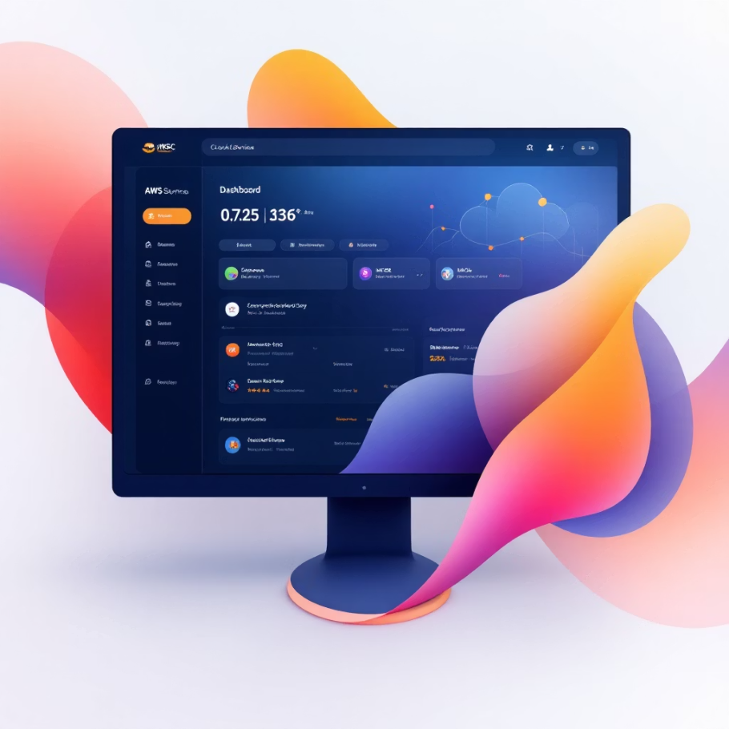
BACKEND SELECTION
OpenTelemetry Backend Evaluation
Selecting the appropriate telemetry backend requires balancing multiple factors: integration complexity, cost structure, query performance, scalability limits, and operational overhead. We evaluated both AWS-native and open-source solutions to provide deployment flexibility based on organizational constraints and existing infrastructure investments.
Primary Recommendation: AWS X-Ray
Alternative: Grafana Tempo
Open-Source Licensing
Native AWS Integration
AGPLv3 license with no vendor lock-in or per-trace pricing. Self-hosted deployment provides full control over data residency and retention policies—critical for regulated industries.
Zero-configuration integration with AWS services (Lambda, ECS, API Gateway, ALB) via X-Ray SDK and auto-instrumentation. Automatic service map generation from trace data without additional configuration.
Extreme Scale Capacity
Cost-Effective Entry Point
Proven at massive scale: Grafana Cloud ingests 27 billion spans per day across 500TB of storage. Distributed architecture supports horizontal scaling to petabyte-scale trace repositories.
AWS Free Tier includes 100,000 traces recorded and 1,000,000 traces retrieved per month—sufficient for initial deployments. Beyond free tier: $5 per million traces recorded, $0.50 per million traces retrieved.
Columnar Storage Efficiency
Apache Parquet storage format achieves 5-10% lower S3 costs compared to raw OTLP storage through columnar compression. Enables efficient analytical queries over long retention periods.
Low-Latency Query Performance
Purpose-built for sub-second query response on service maps and trace timelines. Optimized indexing on trace IDs, service names, and HTTP status codes for rapid troubleshooting workflows.
S3-Compatible Storage
Works with any S3-compatible object store (AWS S3, MinIO, Ceph, on-premises storage). No proprietary storage tier requirements—leverage existing storage infrastructure and policies.
Elastic Scalability
Serverless architecture with automatic scaling to handle traffic spikes. No infrastructure provisioning or capacity planning required—scales with AS/400 transaction volumes.
Best Fit: Organizations with Grafana expertise, multi-cloud strategies, high-volume requirements exceeding AWS X-Ray free tier economics, or strict data sovereignty requirements.
Best Fit: Organizations with existing AWS infrastructure, teams familiar with AWS console workflows, or deployments prioritizing rapid time-to-value over customization flexibility.
Decision Matrix
Criteria
AWS X-Ray
Grafana Tempo
Setup Complexity
Low (managed service)
Medium (self-hosted k8s)
Operating Cost
$500-2000/month at scale
$200-800/month (compute + storage)
Query Latency
Sub-second (optimized indexes)
1-5 seconds (object store scans)
Vendor Lock-in
AWS ecosystem only
Portable, multi-cloud
Trace Retention
30 days maximum
Unlimited (S3 lifecycle policies)

Slide 7
ARCHITECTURE LAYERS
Six-Tier System Architecture
The integration architecture follows a layered design pattern that cleanly separates concerns: data sourcing from legacy systems, collection and staging, protocol transformation, reliable transport, backend storage, and visualization. This separation enables independent scaling, testing, and maintenance of each tier.
01
02
Data Source Layer
Collection Layer
AS/400 RPG applications, CL programs, and DB2 for i databases generating transaction logs. Physical files (PF) in QSYS and user-defined libraries contain transaction records in EBCDIC format with fixed-field layouts.
Native AS/400 daemon program (RPG/CL) scheduled via job scheduler (WRKJOBSCDE) to poll physical files and execute DB2 queries at configurable intervals. Implements cursor-based pagination for incremental extraction.
03
04
Processing Layer
Transport Layer
iSeries-Otel-Bridge Java application running on JVM (OpenJDK 11+) with JT400 toolkit. Performs EBCDIC conversion, field parsing, OTLP proto message construction, and semantic attribute enrichment.
Dual-path transmission: OTLP/gRPC for real-time streaming to backend collector (4317/tcp), plus batch S3 uploads for fault tolerance and replay capability. TLS 1.3 encryption for all network traffic.
05
06
Backend Layer
Visualization Layer
AWS X-Ray or Grafana Tempo cluster with OTLP ingestion endpoints. Includes CloudWatch Logs for application logging, CloudWatch Metrics for system health, and S3 for long-term trace archive storage.
AWS X-Ray Console for service maps and trace timelines, plus Grafana dashboards for custom queries and alerting. Integration with PagerDuty or Opsgenie for incident response workflows.
Data Flow & Latency Budget
T+0s: Transaction
1
AS/400 program writes log to PF
2
T+60s: Collection
Daemon reads new records
T+90s: Processing
3
Bridge converts to OTLP
4
T+120s: Backend
Trace appears in X-Ray/Tempo
End-to-End Latency Target: 2 minutes from transaction completion to trace availability in visualization layer. This latency is acceptable for SRE debugging workflows while optimizing for batch efficiency and system load management on AS/400.
5

Slide 8

MONITORING CAPABILITIES
What Can Be Monitored with OpenTelemetry
There was an error generating this image
Transaction Tracing (Core)
Performance Metrics
Log Analysis
End-to-end transaction flow across AS/400 RPG programs
RPG program execution latency (avg/max/min)
Structured log search (filter by Server ID/Program ID/Trace ID)
Trace ID correlation for distributed transactions
DB2 query processing time
Error log aggregation & pattern detection
Log collection & conversion throughput
Transaction success/failure rates
AS/400 resource utilization
Request timestamp correlation
Request/Response payload inspection
Payload content filtering
Dependency Mapping
Error Tracking
AS/400 program-to-DB2 table relationships
Transaction failure root cause analysis
Cross-server transaction flows
Conversion errors (EBCDIC → UTF-8, DB2 → OTLP)
Bottleneck identification
S3 upload failures & retries
Service map of legacy + cloud components
AS/400 system error correlation

Slide 9
IMPLEMENTATION
Eight-Month Implementation Roadmap
The deployment follows a phased approach designed to minimize risk, validate assumptions early, and enable iterative refinement based on production feedback. Each phase includes specific deliverables, quality gates, and rollback procedures to ensure system stability.
Phase 1: Discovery & Preparation
Weeks 1-4 | Foundation Setting
AS/400 system inventory: identify source files, DB2 tables, program dependencies
Network architecture review: firewall rules, TLS certificate provisioning, egress paths
AWS account setup: VPC design, IAM roles, S3 buckets with encryption and lifecycle policies
Proof-of-concept: JT400 connectivity test, EBCDIC conversion validation
Stakeholder alignment: SLA definitions, alerting thresholds, escalation procedures
Key Deliverable: Technical design document with network diagrams, data flow specifications, and risk mitigation strategies
Phase 2: Core Development
Weeks 5-24 | Component Implementation
Weeks 5-10: AS/400 daemon program (RPG/CL) for file polling and DB2 querying, with checkpointing and error handling
Weeks 11-18: iSeries-Otel-Bridge Java application with JT400 integration, OTLP proto generation, and gRPC client
Weeks 19-22: AWS infrastructure as code (Terraform/CloudFormation): X-Ray configuration, CloudWatch dashboards, S3 lifecycle
Weeks 23-24: Grafana dashboard templates, custom queries, alerting rules, runbook documentation
Key Deliverable: Fully functional integration pipeline with unit test coverage >80% and automated CI/CD deployment to staging environment
Phase 3: Comprehensive Testing
Weeks 25-28 | Quality Assurance
Unit testing: JT400 data access layer, OTLP conversion logic, error handling paths
Integration testing: End-to-end trace propagation, S3 upload retry logic, backend ingestion verification
Performance testing: 1M records/hour sustained load, memory profiling, GC tuning, latency percentiles (p50/p95/p99)
Failure mode testing: Network partitions, AS/400 file locks, S3 outages, backend unavailability scenarios
Security review: Penetration testing, credential rotation procedures, TLS configuration audit
Key Deliverable: Test report with performance benchmarks, failure recovery validation, and security compliance sign-off
Phase 4: Pilot Deployment
Week 29 | Controlled Rollout
Deploy to non-production AS/400 partition (development or QA environment)
Monitor for 1 week with 24/7 on-call coverage
Tune batch sizes, polling intervals, and retry parameters based on observed metrics
Validate trace accuracy by manual comparison with AS/400 job logs
Conduct SRE team training sessions on dashboard usage and troubleshooting workflows
Key Deliverable: Pilot summary report with lessons learned, configuration recommendations, and production readiness approval
Phase 5: Production Rollout
Week 32 | Full Deployment
Week 32 Monday: Deploy to production AS/400 during maintenance window
Week 32 Tue-Thu: Gradual traffic ramp from 10% → 50% → 100% with canary monitoring
Week 32 Friday: Conduct retrospective, document operational runbooks, transfer knowledge to support teams
Establish ongoing maintenance schedule: weekly health checks, monthly performance reviews, quarterly capacity planning
Key Deliverable: Production launch announcement, operational handoff documentation, and post-deployment success metrics dashboard

Slide 10
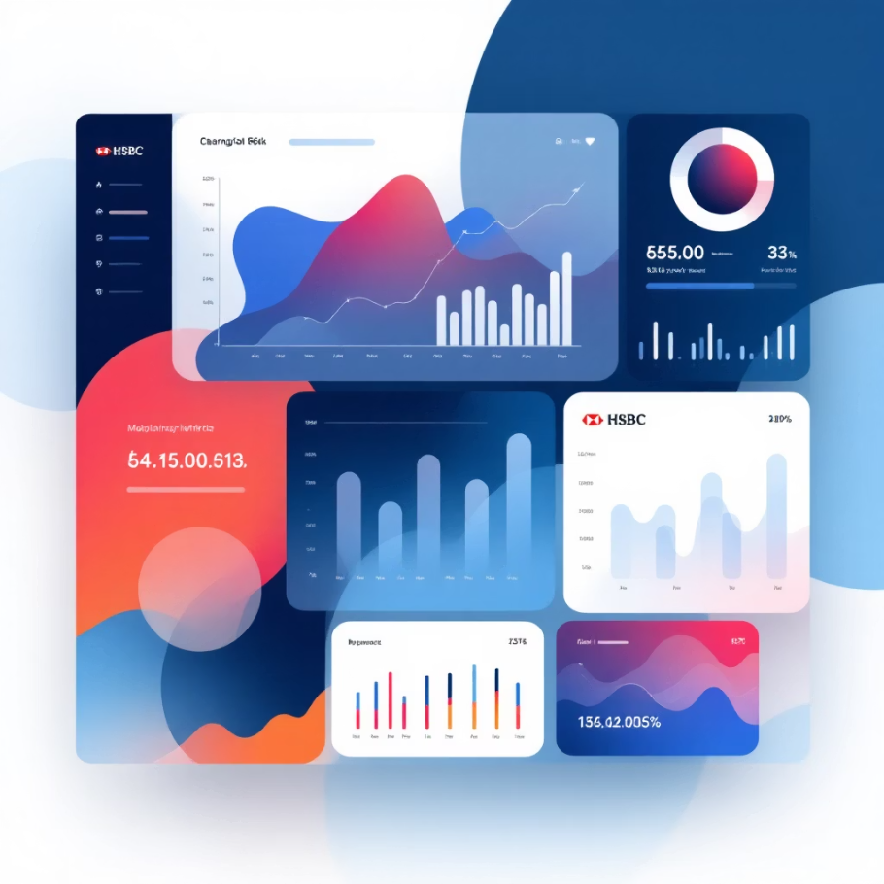



SUCCESS METRICS
Measuring Integration Effectiveness
Success criteria span technical performance, operational efficiency, and business value. These metrics provide objective indicators of system health and inform continuous improvement initiatives throughout the operational lifecycle.
Technical Performance KPIs
99.9%
Data Collection Uptime
Daemon and bridge availability excluding scheduled maintenance windows
<2min
Cost & Resource Optimization
AWS Operational Cost
$500-800/month
End-to-End Latency
S3 Storage (annual)
$1,200-1,800
Transaction completion to trace visibility (p95)
Engineering Time Savings
15-20 hours/week
ROI Timeline
6-9 months
Cost-Benefit Analysis: At average SRE loaded cost of $85/hour, 15 hours/week savings ($66,300/year) vastly exceeds infrastructure costs ($16,800/year), yielding a 294% ROI in year one.
<5%
AS/400 CPU Impact
Incremental CPU consumption from daemon polling and file access
Operational Efficiency Gains
Mean Time to Detection (MTTD): Reduce from hours to minutes through real-time trace visibility
Mean Time to Resolution (MTTR): 40-60% reduction via correlated logs and service maps
Manual Log Analysis Effort: Eliminate 80% of SSH sessions and manual DSPPFM queries
Cross-System Debugging: Enable AS/400 ↔ microservice transaction tracing previously impossible

Slide 11

CONCLUSION
Next Steps & Recommendations
Immediate Actions
1
Secure Executive Sponsorship
Present business case to IT leadership emphasizing MTTR reduction, engineer productivity gains, and regulatory compliance improvements. Obtain budget approval for AWS infrastructure and dedicated engineering resources.
2
Assemble Cross-Functional Team
Allocate 2 AS/400 specialists, 1 Java developer with OTel experience, 1 SRE for observability backend, 1 network engineer for connectivity. Establish weekly standup and shared Slack channel.
3
Initiate Discovery Phase
Schedule kickoff meeting to review technical design document, validate AS/400 system access, begin AWS account provisioning, and define detailed project timeline with milestone dependencies.
Long-Term Vision
This OpenTelemetry integration represents the foundation for a comprehensive observability strategy that spans legacy and modern infrastructure. Future enhancements may include:
AS/400 → Kubernetes trace correlation for hybrid workflows
Automated anomaly detection with machine learning on trace patterns
Business transaction monitoring with SLA tracking and alerting
Capacity planning insights from historical performance trends
"By bridging AS/400 systems with OpenTelemetry, we're not just preserving legacy investments—we're unlocking decades of business logic for modern observability and extending the operational lifespan of critical enterprise infrastructure."

