Slide 1
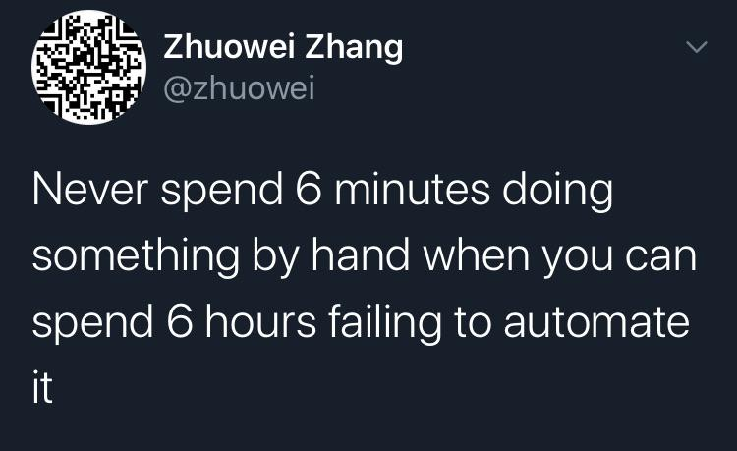
CI/CD Workshop

Slide 2
Tools
Explore CI/CD locally:
IIS
GitHub
.NET Core (3.1)
ASP.NET Core runtime (3.1)
Java Development Kit (11.*)
Jenkins (2.263.2)
Docker (3.0.4) (if your OS supports it)
Win 10 Pro with Hyper-V or
Win 10 Home/Pro with WSL 2
Explore CI/CD externally:
Azure Virtual Machines (free tier)*
GitHub
.NET Core (3.1)
ASP.NET Core runtime (3.1)
Java Development Kit (11.*)
Jenkins (2.263.2)
Docker (3.0.4)

Slide 3
Jenkins plugins
Xunit
Cobertura
Pipeline
Git
GitHub API
Workspace Cleanup
SSH Agent

Slide 4
Workshop plan
1. Prepare your workstation
2. Create basic CI job
3. Create CI job using “Pipeline”
4. Create CD job using IIS as a web server
5. Create CD job using Docker
6. Overview CD job using Docker, but implemented on the virtual machines in cloud

Slide 5
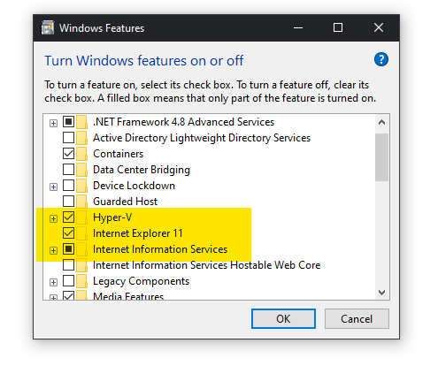
Prepare environment
Java Development Kit (11.*)
.NET Core (3.1)
ASP.NET Core runtime (3.1)
+

Slide 6
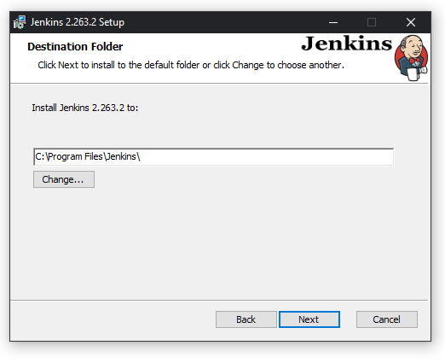
Install Jenkins

Slide 7
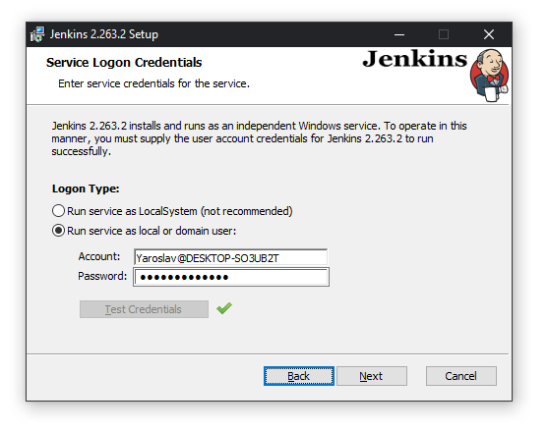
Install Jenkins

Slide 8
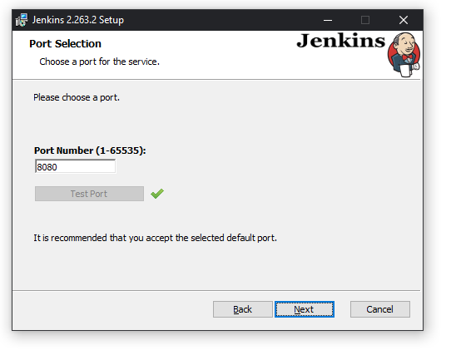
Install Jenkins

Slide 9
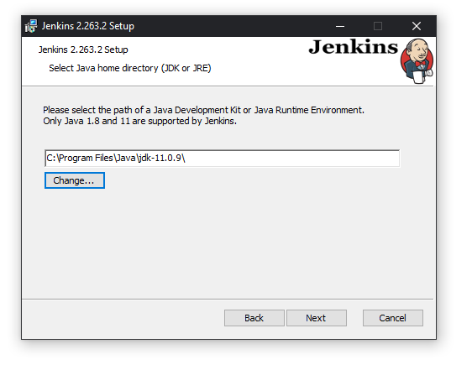
Install Jenkins

Slide 10
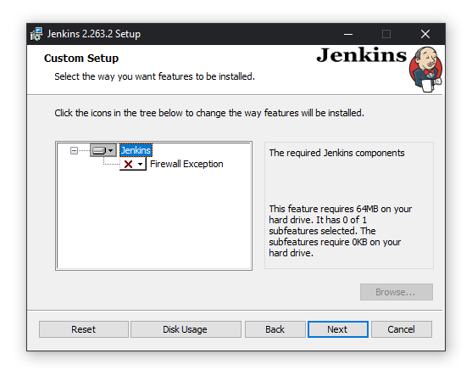
Install Jenkins

Slide 11
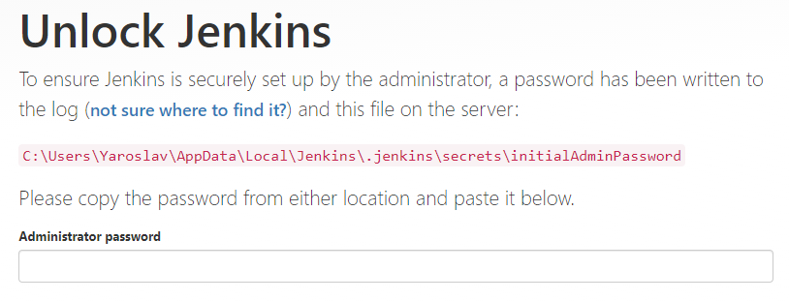
Install Jenkins, http://localhost:8080

Slide 12
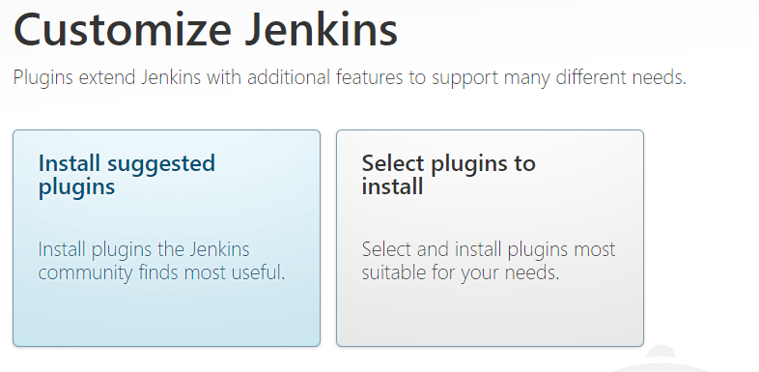
Install Jenkins, http://localhost:8080

Slide 13
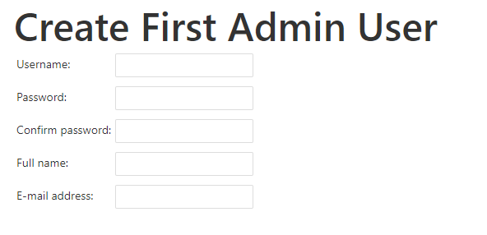
Install Jenkins, http://localhost:8080

Slide 14
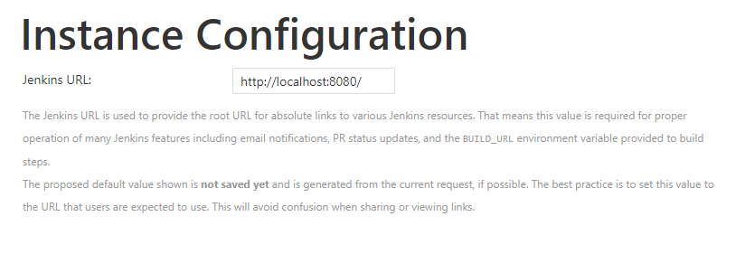
Install Jenkins, http://localhost:8080

Slide 15
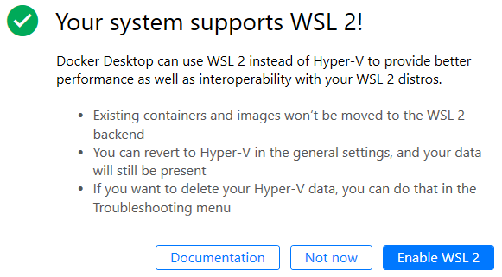
Docker

Slide 16
Source code
https://github.com/wilyoctopus/CICD
Export job: java -jar jenkins-cli.jar -s http://localhost:8080 get-job myjob > myjob.xml
Import job: java -jar jenkins-cli.jar -s http://localhost:8080 create-job mynewjob < myjob.xml
Jenkins CLI jar can be downloaded directly from your Jenkins instance: http://localhost:8080/jnlpJars/jenkins-cli.jar

