Slide 1
EECE5698
Parallel Processing for Data Analytics
Lecture 1: Introduction to Spark

Slide 2
What is Spark?
A general engine for large-scale data processing
Fast, expressive cluster computing system compatible with Apache Hadoop
Improves efficiency through:
In-memory computing primitives
General computation graphs
Improves usability through:
Rich APIs in Java, Scala, Python
Interactive shell
Up to 100× faster
Often 2-10× less code

Slide 3














Ecosystem
Growing community with more than 200 companies contributing
Details, tutorials, videos: http://spark.apache.org/

Slide 4
Why are we using it in EECE5698?
Usability: easy to go from Python to Spark
Makes parallelism easy!
Good tool to know!

Slide 5
Usability
Integrated with
Java
Scala
Python
Programmer’s point of view:
“Normal” python program, with “special” parallel data structures
Easy to write short, clear map/reduce operations
Full expressibility of java/scala/python “included”

Slide 6

Portability
Same code runs on different environments
Multi-threading on single machine
Execution over distributed cluster (e.g., NEU Discovery)
Amazon AWS
…
cpu1
cpu2
cpu40
…
Compute Node 1
Compute Node 2
Compute Node 40
…

Slide 7
Efficiency
Persistence. Results stay in memory, vs. read and write from hard disk (e.g., Hadoop).
Built-In fault tolerance: if a machine crashes and intermediate computations lost, Spark automatically recomputes it

Slide 8
Outline
Overview
Tour of Operations
Job execution
Standalone Programs

Slide 9
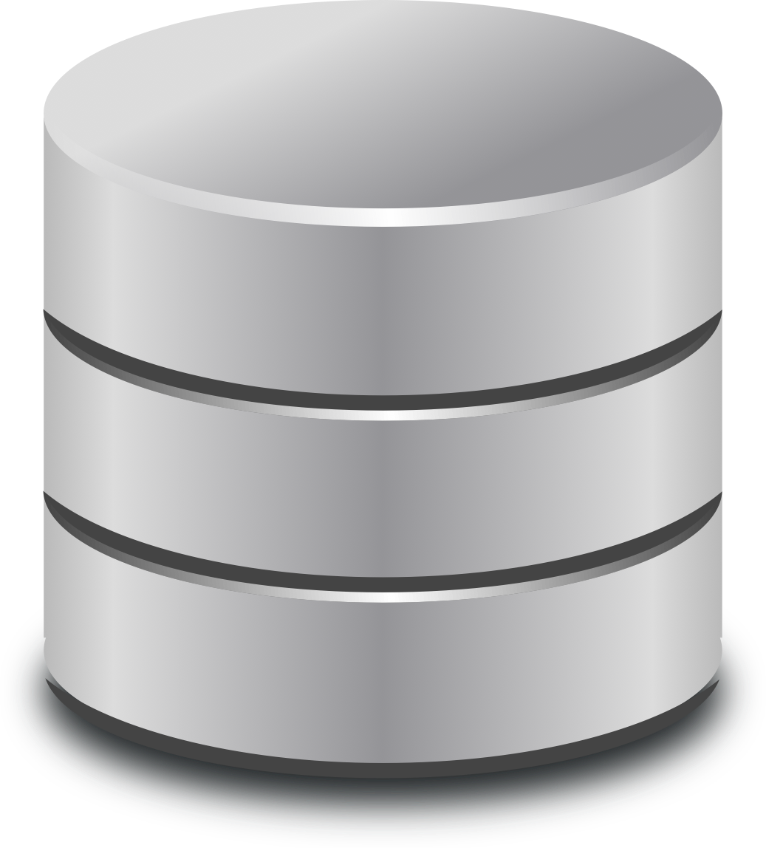
Key Idea
worker
Distributed data is just another
collection type (like, e.g. python lists or dictionaries)
Resilient Distributed Datasets (RDDs): Appear as variables in your program, but are actually stored over multiple machines.
part 1
driver
worker
rdd
part 2
…
rdd=sc.textFile(“WarAndPeace.txt”)
…
worker
Part 3

Slide 10
Resilient Distributed Datasets (RDDs)
Immutable collections of objects spread across a cluster
Built through parallel transformations (map, filter, etc)
Automatically rebuilt on failure
Controllable persistence (e.g. caching in RAM)
worker
part 1
driver
worker
rdd
part 2
worker
Part 3

Slide 11
Types of Operations
Transformations (e.g. map, filter, groupBy, join)
operations to build RDDs from other RDDs
Actions (e.g. count, collect, save)
Return a result to driver program
Write a result to hard disk

Slide 12
Outline
Overview
(Very Quick) Tour of Operations
Job execution
Standalone Programs

Slide 13
Learning Spark
Easiest Way: Spark interpreter (pyspark)
Runs in local mode with 1 thread by default, but can be controlled through master command line option
(more on this soon)
pyspark --master “local[20]”

Slide 14
SparkContext
Starting point for spark functionalities
In pyspark interpreter, automatically loaded variable:
sc
In standalone programs, you create your own

Slide 15
Creating an RDD
# Turn a local collection into an RDD
sc.parallelize([1, 2, 3])
# Load text file from local FS, HDFS sc.textFile("file.txt")
sc.textFile("directory/*.txt")
sc.textFile("hdfs://namenode:9000/path/file")

Slide 16
More on textfile
myrdd=sc.textFile(“file.txt”)
Think: myrdd is a list (sort of)
Elements in the list are lines of the file
The list is distributed over multiple machines
The list is immutable
You cannot change it,
Cannot see individual elements (e.g., 5th element)
Can only interact with it through specific ops

Slide 17
Basic Transformations
nums = sc.parallelize([1, 2, 3])
# Pass each element through a function
squares = nums.map(lambda x: x*x) # => {1, 4, 9}
# Keep elements passing a predicate
even = squares.filter(lambda x: x % 2 == 0) # => {4}
# Map each element to zero or more others
nums.flatMap(lambda x: range(0, x)) # => {0, 0, 1, 0, 1, 2}
Range function (list of numbers 0, 1, …, x-1)

Slide 18
Basic Actions
nums = sc.parallelize([1, 2, 3])
# Retrieve RDD contents as a local collection nums.collect() # => [1, 2, 3]
# Return first K elements nums.take(2) # => [1, 2]
# Count number of elements nums.count() # => 3
# Merge elements with an associative function nums.reduce(lambda x, y: x + y) # => 6
# Write elements to a text file nums.saveAsTextFile(“hdfs://file.txt”)

Slide 19
More Details
Spark supports lots of transforms and actions
Full programming guide: spark.apache.org/documentation
We will dive into map, reduce, and many more transforms and actions in upcoming lectures

Slide 20
Outline
Overview
Tour of Operations
Job execution
Standalone Programs

Slide 21
Software Components
Spark shows up as a library in your program
Runs tasks locally or on a cluster
Standalone cluster
Mesos Cluster
YARN Cluster
Your application
SparkContext
Cluster manager
Local threads
Worker
Worker
Spark executor
Spark executor
HDFS or other storage

Slide 22
Task Scheduler
Supports general task graphs
Pipelines functions where possible
Cache-aware data reuse & locality
Partitioning-aware to avoid shuffles
A:
B:
F:
Stage 1
groupBy
C:
D:
E:
join
Stage 2
map
filter
Stage 3
= RDD
= cached partition
Notes:
NOT a modified version of Hadoop

Slide 23
Hadoop Compatibility (not at NEU)
Spark can read/write to any storage system / format that has a plugin for Hadoop!
Examples: HDFS, S3, HBase, Cassandra, Avro, SequenceFile
Reuses Hadoop’s InputFormat and OutputFormat APIs

Slide 24
Outline
Overview
Tour of Operations
Job execution
Standalone Programs

Slide 25
Create a SparkContext within Standalone Program
from pyspark import SparkContext
sc = SparkContext('masterUrl', 'name'))
Cluster URL, or local / local[N]
App name
Notes:
Mention assembly JAR in Maven etc
Use the shell with your own JAR`

Slide 26
Complete App: Python
import sys
from pyspark import SparkContext
if __name__ == "__main__":
sc = SparkContext( 'local[10]', 'WordCount') lines = sc.textFile(sys.argv[1])
lines.flatMap(lambda s: s.split()) \ .map(lambda word: (word, 1)) \ .reduceByKey(lambda x, y: x + y) \
.sortBy(lambda (x,y):y, ascending=False) \
.saveAsTextFile(sys.argv[2])

Slide 27
More to Come in the Next Few Weeks
Dive in to map, reduce, joins and other operations
Partitioning & Caching
How to launch Spark Standalone Cluster on Discovery

