Slide 1
Fake News Detection
By William Minton
wim12@aber.ac.uk

Slide 2

The Project
Fake news is a prevailing issue in modern society, being spread extensively across news and social media.
Many social media platforms allow for information to be spread rapidly, without any methods of checking if the information is factually accurate, leading to a rise in deliberate misinformation, hoaxes and conspiracy theories.
Fake news detection is a project based around using trained machine learning systems to evaluate datasets and determine if the text presented is real or fake
Various different fake news classification models will be trained on a mixed dataset of fake and real news articles
This is an example of a binary classification problem
Python’s scikit-learn library is used to simplify this task, as it contains plotting information, feature extraction, and various binary classification machine learning models

Slide 3
Datasets used
Multiple open-source datasets will be used for this project. The only data that will be used is data that correlates with either the ‘fake’ or ‘real’ classes to ensure a binary classification problem is used. This is not an issue with two of the datasets, but the largest, the Fake News Corpus, requires this to filter out large amounts of certain categories, such as satire, clickbait, and politically leaning news articles.
https://s3.amazonaws.com/assets.datacamp.com/blog_assets/fake_or_real_news.csv
https://github.com/several27/FakeNewsCorpus
https://github.com/thiagorainmaker77/liar_dataset

Slide 4
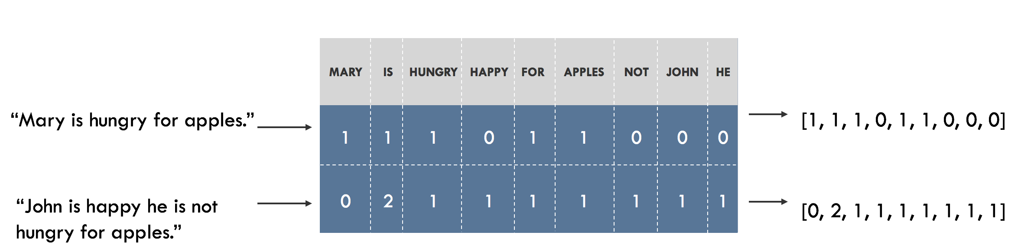
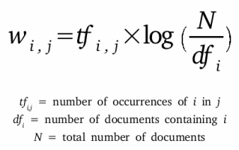
Feature extraction
Feature extraction is a method of reducing the dimensionality of the initial set of raw data. This allows for translation of the text featured in the raw data into a set of inputs necessary for the machine learning models to function.
Two methods of feature extraction will be used on the datasets, Bag-of-words and TF-IDF.
The Bag of words approach is one of the most common methods of feature extraction. Vectors are used to represent the frequency of the word in a predefined dictionary of words.
TF-IDF stands for Term frequency – Inverse document frequency. It measures the originality of words by comparing the number of times the word appears in a specific text document with the number of text documents that the word appears in. This offers a natural filtration for common words such as “the”, “of”, and “and”, penalising these common words, and serves to highlight distinct words across the documents.

Slide 5
Models Used
A number of different machine learning models will be fed with the feature-extracted training data
The models will be trained on a training set, tuned using a validation set, and tested using a test set of data, and will be evaluated against each other.
The classification models used are:
Stochastic Gradient Descent
K-Nearest Neighbours
Linear SVC (Support Vector Classification)
Multinomial Naive-Bayes
Decision Tree Classifier
Ridge Regression Classifier
Forest of Randomised Decision Trees
With more to be added if the project progresses smoothly

Slide 6
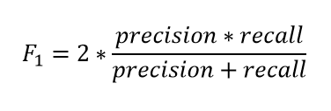
evaluating the data
Evaluation will be done using various evaluation metrics, including Accuracy, Precision, Recall, the F1 Score, and Log Loss.
Accuracy can be defined as the proportion of true results among the total number of examined cases
Precision is the number of predicted positive results that are true results
Recall is the number of actual positive results that are correctly classified
Log Loss can quantify the accuracy of the classifier by penalising false classifications
F1 Score is the harmonic mean between Precision and Recall

Slide 7
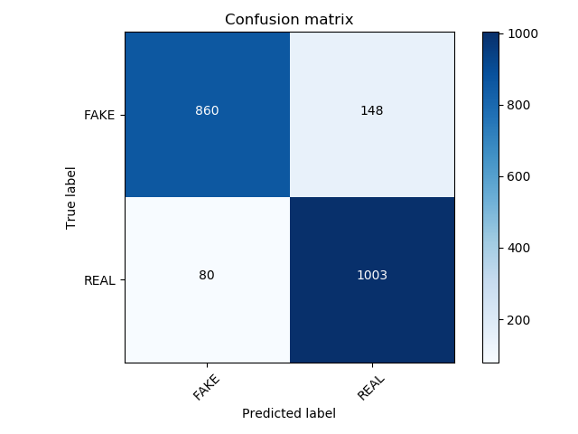
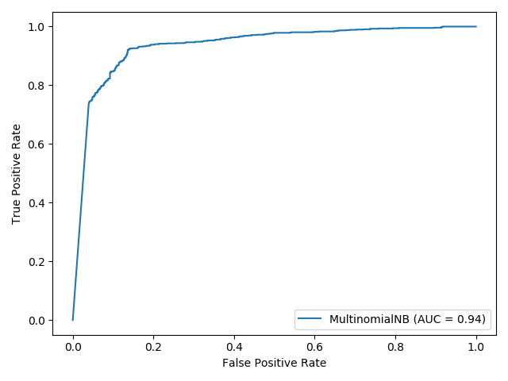
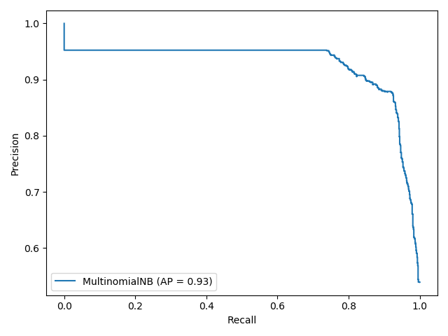
visualising the data
Three Different methods will be used to visualise the data
The Confusion matrix allows for easy identification of the confusion levels between classes, and accurately summarises the errors that are made
The ROC Curve is used to study the output of the classifiers. The true positive rate is plotted against the False positive rate at various different thresholds. It ultimately tells the amount that each model is able to distinguish between classes
The Precision-Recall curve functions similarly to the ROC Curve, although the true positive rate is plotted against the positive predictive value instead, and functions to plot the precision and recall at different thresholds

Slide 8
Progress
Steady progress has been made so far. Much of the code has been written, with 6/7 of the initial models planned in a working, testable state.
In addition, plotting and visualising the data recorded from these models is possible, although requires some fine-tuning to add AUC curves to the ROC curves, and to visualise multiple data sources within one ROC curve, such as with the K-nearest neighbours, and different numbers allocated to k.
Most of what needs to be done is in the gathering and comparison of the data, as well as the writing of the report with this information.
If enough time is available, more models will be tested, including histogram-based gradient boosting classification trees, bagging and voting classifiers, and neural network models utilising the keras library.

Slide 9
Any Questions?

