Slide 1

Network Scanning
www.readmyblog.co.uk

Slide 2
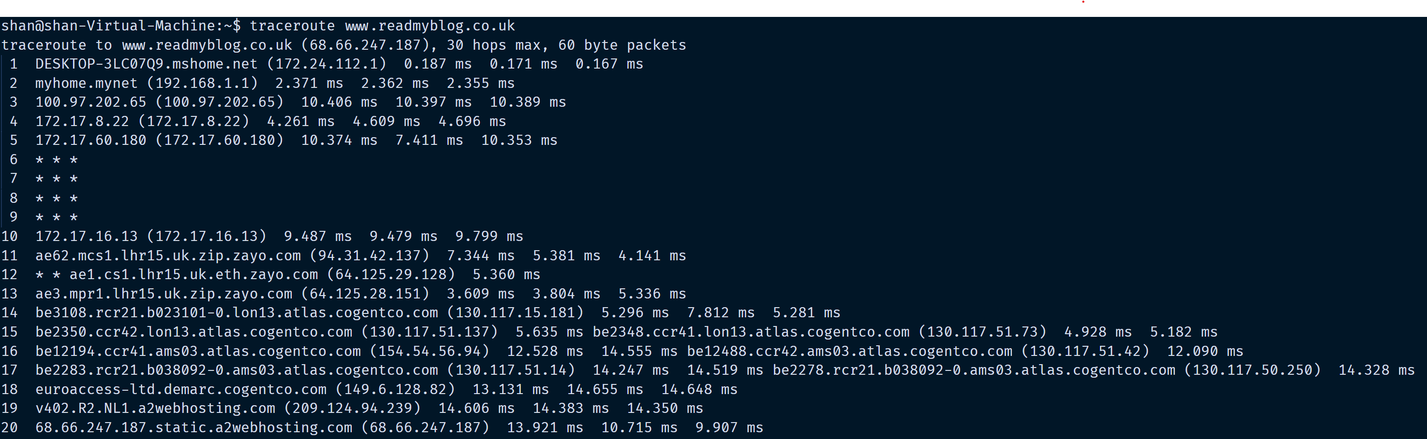
Website Analysis- traceroute

Slide 3
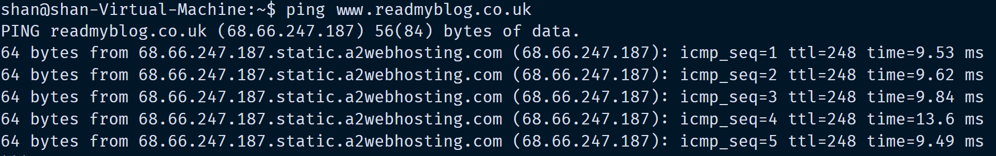
Website Analysis- ping

Slide 4
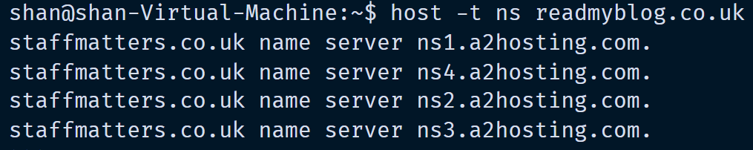
Website Analysis- host

Slide 5
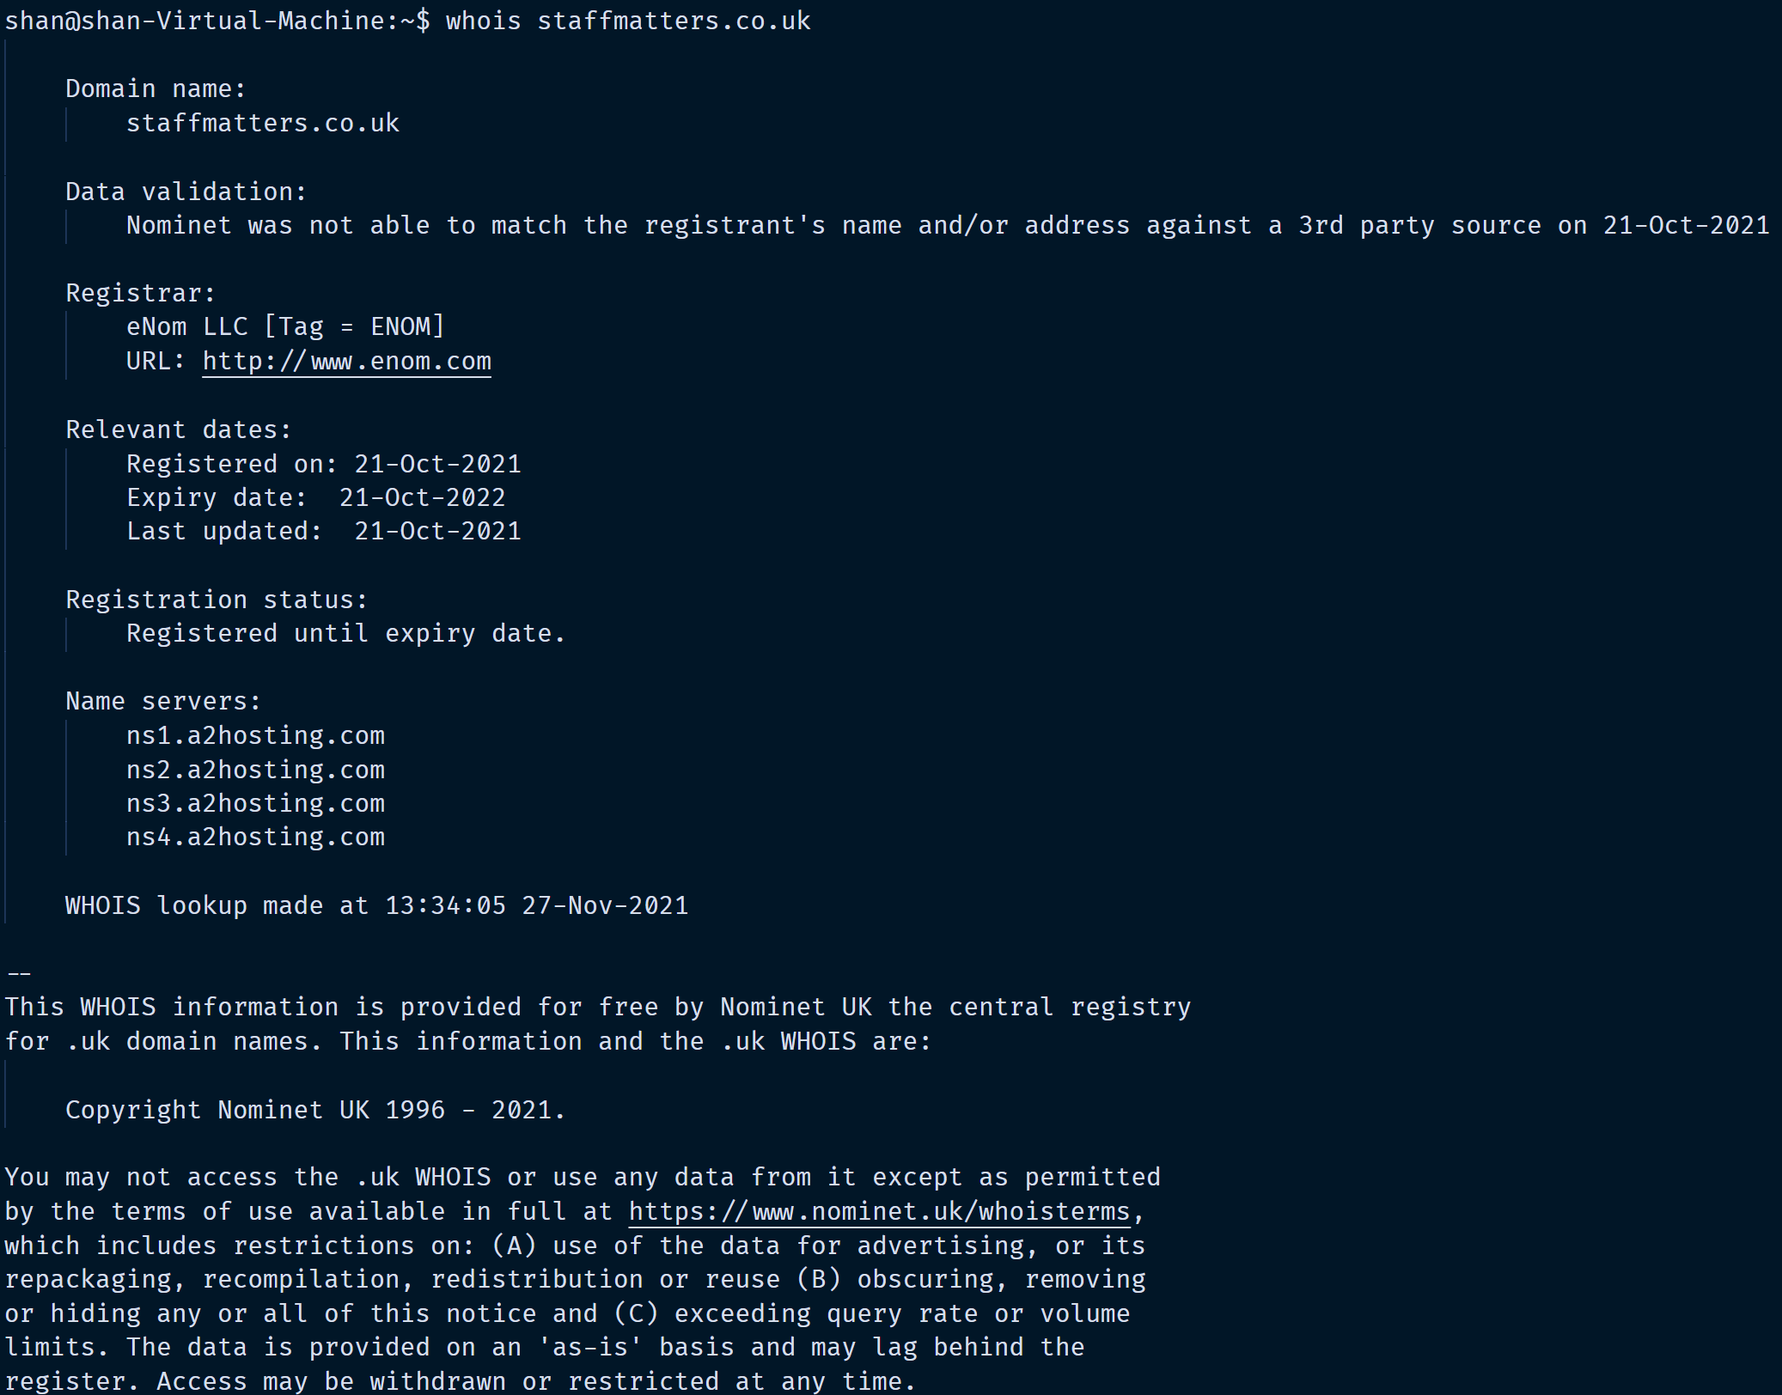
Website Analysis- WHOIS

Slide 6
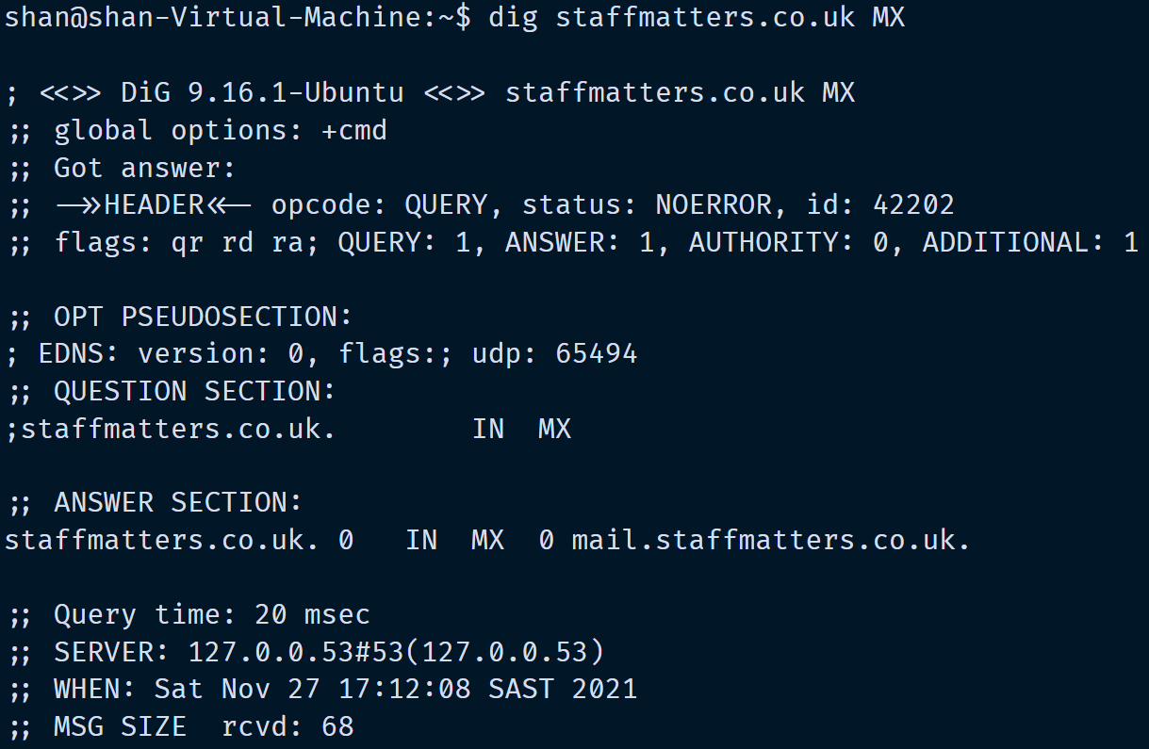
Website Analysis- MX Record

Slide 7
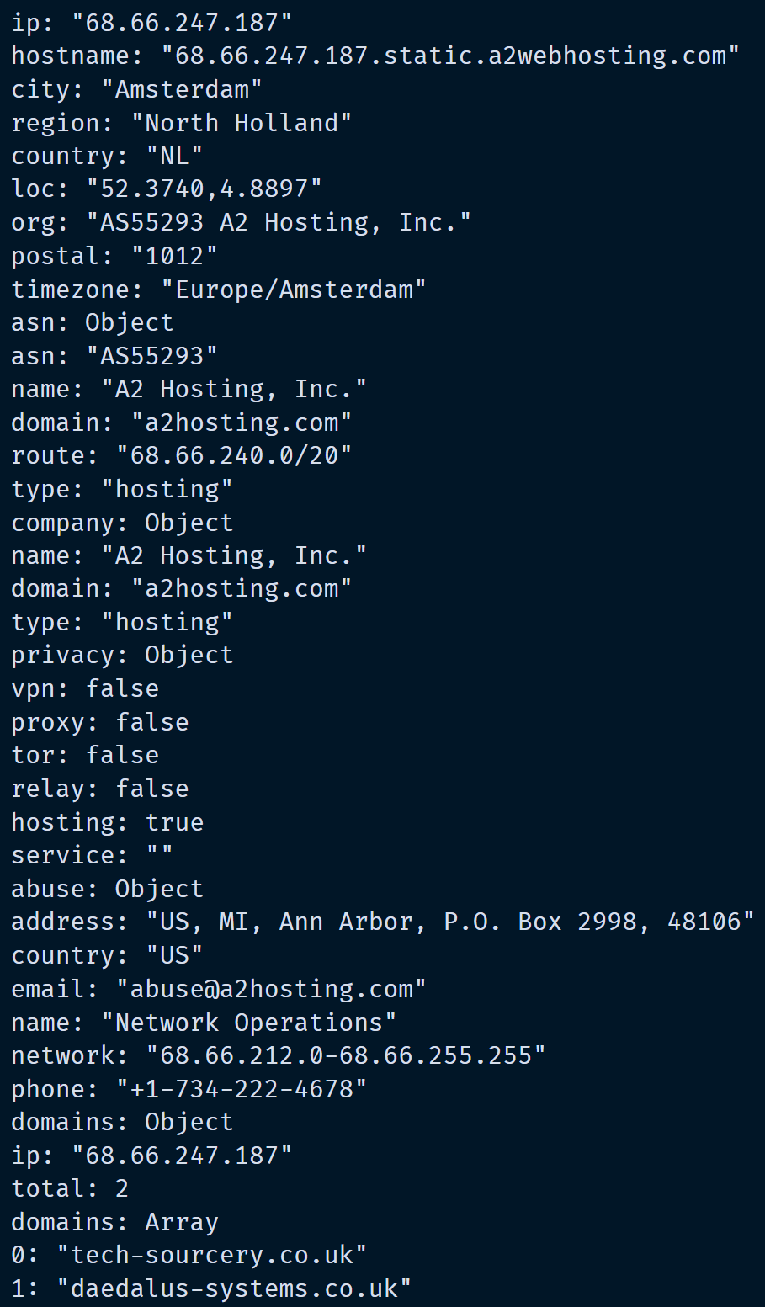
Website Analysis- host location (via ipinfo.io)

Slide 8
OSI vs TCP/IP
A key driver of the argument between the two models was politics- corporations and bodies vs engineers who wanted a working system.
Engineers favored an agile, pragmatic approach by relying on pragmatism and rough consensus.
OSI would have enabled greater flexibility due to standardization and abstraction via more layers. However, it defines no protocols.
TCP/IP is more functional in nature, inherently scalable due to client/server architecture, but is harder to modify as it’s less flexible.
In spite of this, TCP/IP can still be used long term, with some slight modifications (e.g. IPv6)

