Slide 1
Seminar 6
Team 2

Slide 2
Peer-to-peer Overlay Networks- A brief introduction
A peer-to-peer (P2P) is a network which gives all computers on that network equal responsibility, allowing all computers to share data (1)
This means that no connection to a separate server is necessary- computers communicate with each other directly.
Examples of P2P networks include the TOR network, and the BitTorrent network.
An overlay network is a network that is built on top of another network.
Existing implementations of P2P networking all leverage the internet itself, hence, they are overlay networks.
1: https://www.sciencedirect.com/topics/computer-science/peer-to-peer-networks

Slide 3
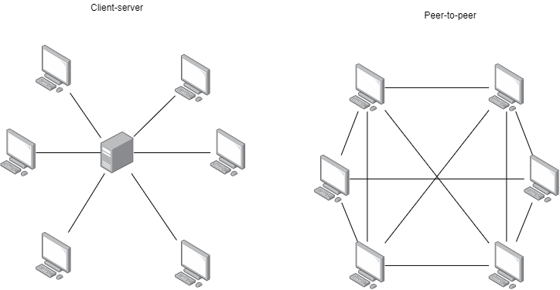
Peer-to-peer vs Client-server

Slide 4
Why P2P Overlay-based Networks are the Future
Technological drivers
Emerging fields (e.g., IoT, distributed computing, etc) all have a shared nature and require an efficient real-time data streaming architecture, both of these benefit from a flat hierarchy.
Can reduce communication for mobile devices and lower computational load on mobile networks (Saunders et al., 2016).
Political drivers
The way the Internet is currently structured is emergent, not planned. The internet has changed heavily from the way it was structured in the 90s- decentralized and modular (3), to centralised and monopolised.
This has also had political impacts- ranging from social media censorship, to government-level censorship (e.g. the “Great Firewall”).
A draft proposal to the Internet Engineering Task Force (IETF) was created this month (4) which argues that centralisation limits innovation, inhibits competition, and increases the chances of severe outages.
Solutions have been suggested in this proposal, but it is still in draft and governments/regulating bodies would be slow to change. The TCP/IP and ISO/OSI debate, along with inconsistent implementation of privacy standards (5), shows that much work is needed in terms of policy, before we can solve problems in a globally consistent and structured way.
The solution is therefore to use the existing infrastructure to power decentralised and secure networks.

Slide 5
MobilityFirst: A competitor?
MobilityFirst argues for a scalable implementation of the internet by prioritising wireless devices (6).
This is mainly done by location-independent, global name resolution, as opposed to location-bound name resolution, which is what the Internet currently uses.
It is also achieved by creating common abstractions for network entities.
MobilityFirst, however, has some challenges which it must resolve to achieve adoption (7):
The precise implementation of global resolution.
Determining the correct balance between scalability and mobility.
How to ensure communications are secure when endpoints have different NCS (name certification services). Since MobilityFirst uses a decentralised name service, this becomes hard to do.

Slide 6
References
1: https://www.sciencedirect.com/topics/computer-science/peer-to-peer-networks
2: Saunders, R. et al. (2016) ‘P2P Offloading in Mobile Networks using SDN’, SOSR '16: Proceedings of the Symposium on SDN Research. Santa Clara, California, 14-15 March. New York: Association for Computing Machinery. 1-7.
3: Tabora, V. (2018) The Evolution of the Internet, From Decentralized to Centralized. Available from: https://hackernoon.com/the-evolution-of-the-internet-from-decentralized-to-centralized-3e2fa65898f5 [Accessed 18 February 2022].
4: Nottingham, M. (2022) Centralization and Internet Standards. Available from: https://datatracker.ietf.org/doc/draft-nottingham-avoiding-internet-centralization/ [Accessed 18 February 2022].
5: Glenister, D. (2017) INTERNATIONAL DATA PRIVACY LAWS. Available from: https://cloudtweaks.com/2017/07/international-data-privacy-laws/ [Accessed 18 February 2022].
6: WINLAB. (n.d.) MobilityFirst Future Internet Architecture Project. Available from: http://winlab.rutgers.edu/projects/mfirst/Index.html [Accessed 18 February 2022].
7: W. Ding, Z. Yan and R. H. Deng, "A Survey on Future Internet Security Architectures," in IEEE Access, vol. 4, pp. 4374-4393, 2016, doi: 10.1109/ACCESS.2016.2596705.

