Slide 1
Radio sensor nodes
Ongom Daniel
+256771813487/+256757306724 ongomdaniel9@gmail.com

Slide 2
What to expect
What is Radio Sensor Node (RSN)?
Features of WIMEA-ICT RSN
RSN Firmware and download
Configuration of RSN
Recap…

Slide 3
Radio sensor node
Device equipped
Sensing
Computing
Radio transceiver, and
Power components
With sensors attached to it, the would setup is called a wireless sensor node.

Slide 4
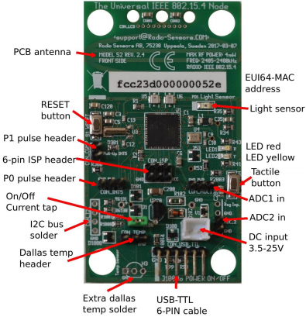
Wimea-ict rsn features
Basic & Essential Features
MCU AtMega256RFR2 integrated with IEEE 802.15.4 transceiver
Super cardioid Antenna
Unique EUI-64 address via I2C chip
Analog Inputs (ADC1 & ADC2)
USB serial connection via USB-TTL cable

Slide 5
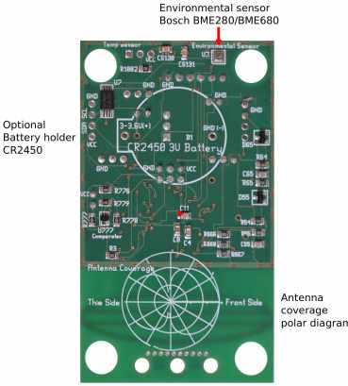
Wimea-ict rsn features cont….
Basic & Essential Features
Bosch BME280/BME680 Temperature, RH and Air Pressure sensor
Two LEDs, Red & Yellow for monitoring and debugging
On-board light sensors
Extra Temp. sensor connector

Slide 6
firmware
WIMEA-ICT application hex file
Contiki OS based
Open source
Located on WIMEA-ICT GitHub repository
Clone or download the applicating file from here
https://github.com/wimea-ict/contiki/tree/master/platform/avr-rss2/apps/wimea-ict-rss2

Slide 7
configuration
To configure the WIMEA-ICT sensor node
Download (flash) the firmware to the mote
Open Putty terminal
Use h command, to display help menu
Refer to WIMEA-ICT AWS user manual
https://github.com/wimea-ict/contiki/tree/master/platform/avr-rss2/apps/wimea-ict-rss2
User manual is found on the same link

Slide 8
Thank you…

Slide 9


