Slide 1

BIRT: The Eclipse Reporting Framework
Jason Weathersby, BIRT PMC

Slide 2

Agenda
What is BIRT?
BIRT Features and Report Gallery
Scripting BIRT
Deploying BIRT Reports
BIRT APIs
Extension Points

Slide 3
What Is BIRT?

Slide 4
What is the BIRT Project?
Business Intelligence and Reporting Tools based on Eclipse
Initially focused on embedded reporting for Java developers
Three initial components as part of BIRT project
Eclipse
Report
Designer
Custom
Report
Designer…
Report Engine
Custom
Services…
Data Transform.
Services
Charting
Services
1
3
HTML
PDF
Print
…
2
Report Design Engine
Generation
Services
Presentation
Services
XML
Report
Design
Data
Report
Document

Slide 5
BIRT What is available
birt-report-designer-all-in-one-2_0_1
  BIRT Designer and most required plug-ins
birt-report-framework- 2_0_1
  BIRT Designer Eclipse plug-in
birt-rcp-report-designer- 2_0_1
  RCP Version of the BIRT Designer
birt-runtime- 2_0_1
  BIRT web application
  report engine runtime and examples
  chart engine runtime.
birt-charts- 2_0_1
  Stand alone chart engine plug-ins.
Samples

Slide 6
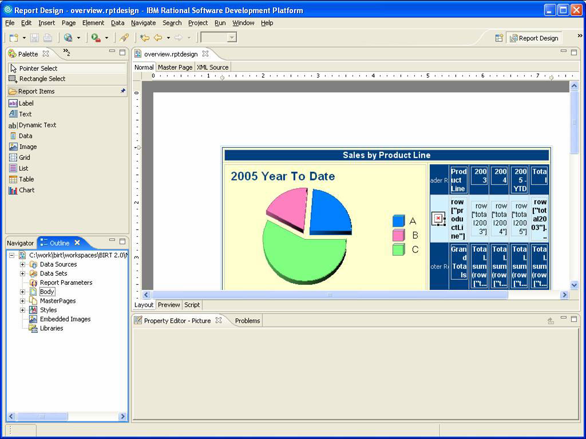
BIRT Designer
WYSIWYG
Drag and Drop

Slide 7
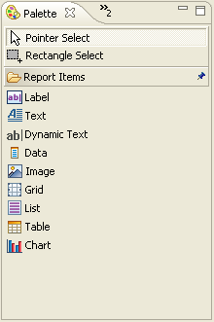
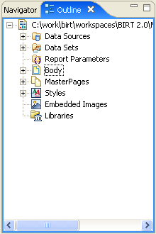
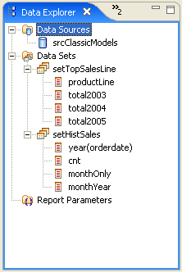
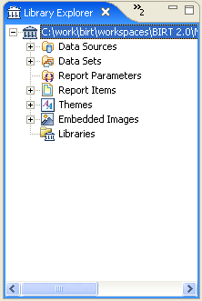
BIRT Views
Extendable Palette
Graphical outline of Report
Multiple Data Sources
Static and Dynamic parameters including cascaded
Reuse work with Libraries and Templates
Import Style sheets

Slide 8
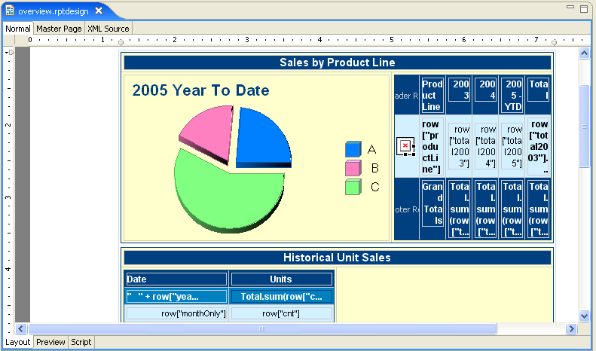
BIRT Editor
Layout and Scripting Views
Quick access to graphical components or edit XML Directly

Slide 9
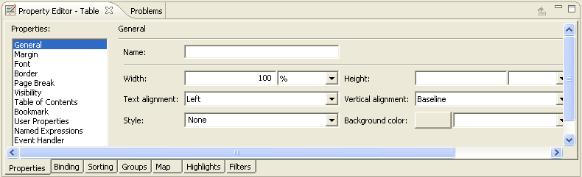
Property Editor View
Simple Property Editor
Mapping and Highlighting
Sorting and Filters

Slide 10
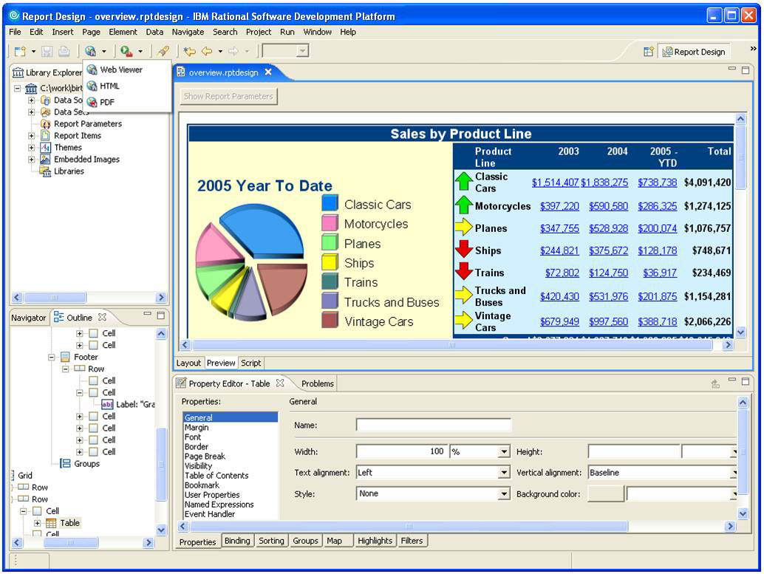
Previewing BIRT Reports
Preview Reports while building
View Data in HTML or PDF
Cached Data

Slide 11
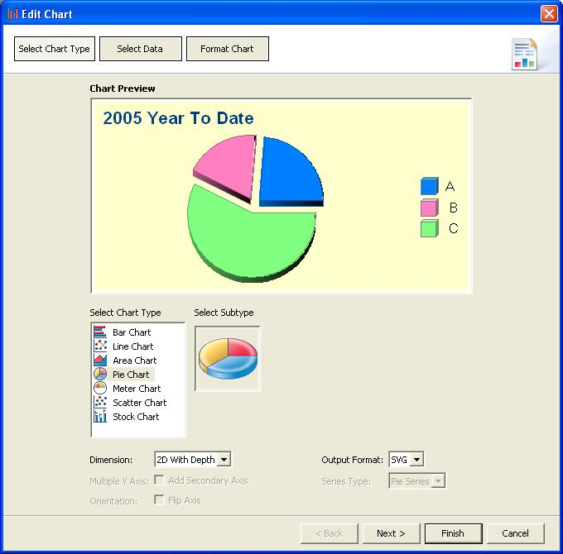
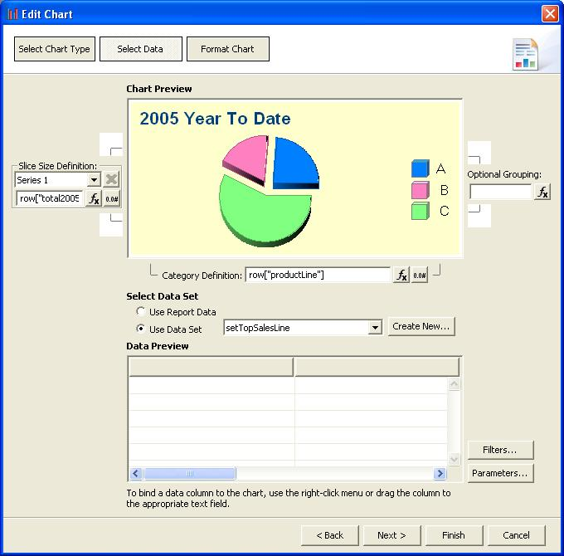
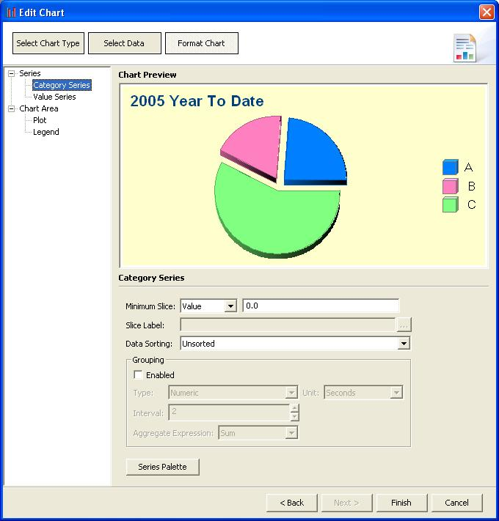
Chart Builder
Simple Wizard
Seven Chart types
Many Sub types
SVG
PNG
GIF
JPG
BMP
Filtering

Slide 12
BIRT Features and Report Gallery

Slide 13
BIRT Features
Palette of report components - Text (CLOB’s, HTML), data, images (BLOBs), tables, grids, lists, labels
Sorting, grouping, filtering, conditional highlighting, mapping
Scripting in JavaScript/Java
Cascading & dynamic report parameters
Hyperlinking, bookmarks
TOC, Paging
Direct XML source editor for report design
Multi-pass processing (top N/bottom N)
Data sources: POJO’s, JDBC, CSV, XML
WYSIWYG Editor
Integrated Chart Wizard
Report Component Libraries
Report Templates
Styles, import CSS, themes
Wizards for guided development
Report outline
Preview within report designer for iterative development
Context pass through to data source
Call stored procedure

Slide 14
BIRT Designer Demo

Slide 15
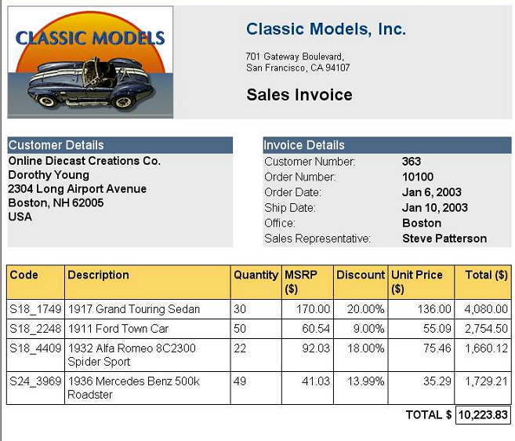
Sales Invoice Report
Embedded images (including BLOBS)
Layout flexibility
Rich formatting control
(Including conditional formatting)
Computed
column
Comprehensive aggregation functions

Slide 16
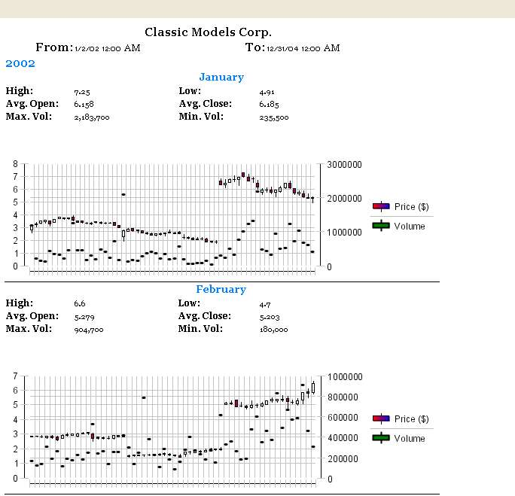
Stock Price & Volume Report
Grouping & sorting
Parent table
Integrated Charting
as a child of parent table
Notes:
This is an example of a chart integrated with a report where the chart is a child of parent aggregate information. The report is driven by a CSV file which contains daily stock price information. This has been aggregated by month and a chart displays daily price and volume information for that month.

Slide 17
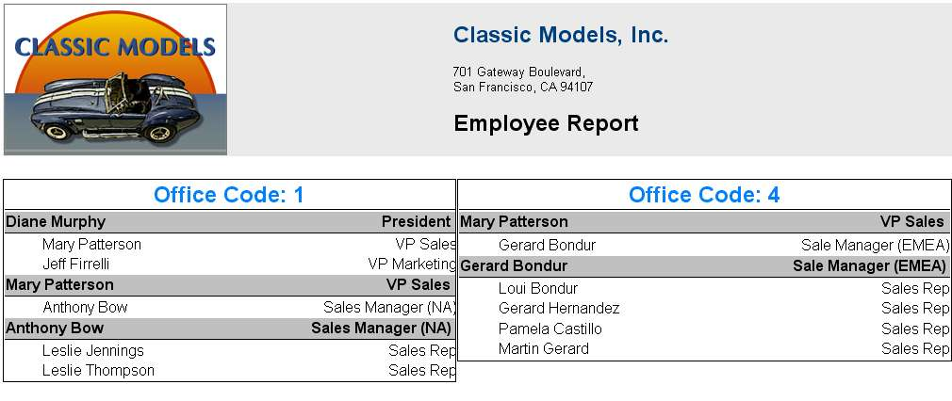
Organization Report
Table level filter for Office Code 1
Table level filter for Office Code 4
Parallel layout
Notes:
Organizational report with names and titles and direct reports listed by office location. The 2 tables use the same data set but apply different filters to limit the data by office code.

Slide 18
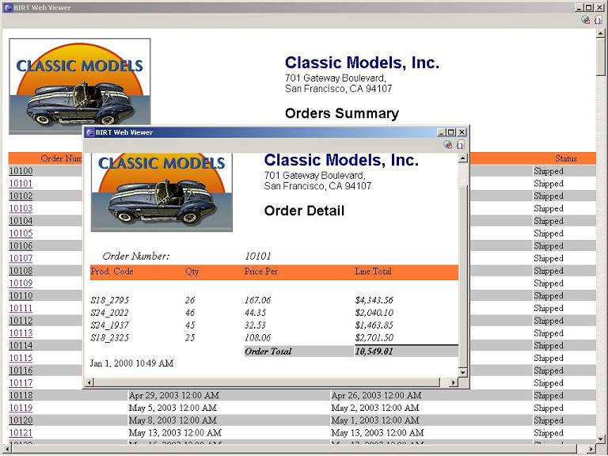
Orders Summary
Order details report for specific Order Number
Drill through from Orders Summary
Notes:
This is an example of linking reports. From the orders summary report we can drill through to an order detail report. An easy to use URL builder allows you to build this linking easily.

Slide 19
Scripting BIRT

Slide 20
BIRT Pipeline
Report
Designer
Design
Engine
Optional Java Events
JavaScript Events
RptDesign
XML
Design File
Generation Phase
Presentation Phase
Paginated HTML
PDF
CSV
Report Engine
JDBC
XML
FlatFile
Scripted
RptDocument
Report
Document
optional

Slide 21
Scripting
BIRT JavaScript
  Based on Mozilla Rhino
  - This is Server Side Scripting not Browser Based Scripting
  Two types of Scripting
    Expression Scripts - Scripts that return a data value. Available in the Expression Builder.
    Element Scripts – JavaScript methods that are called on events. Customize the behavior of the Report. Available in the Script view. Context of when the event occurs is important.

Slide 22
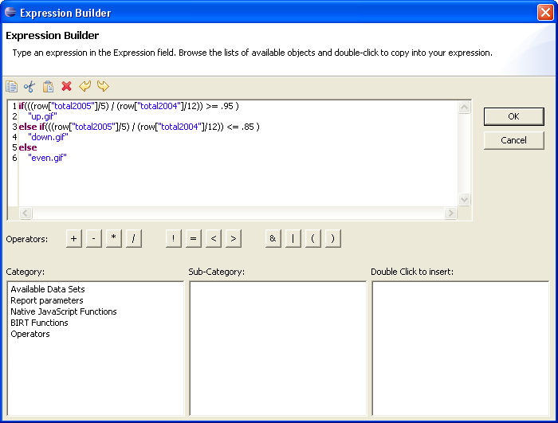
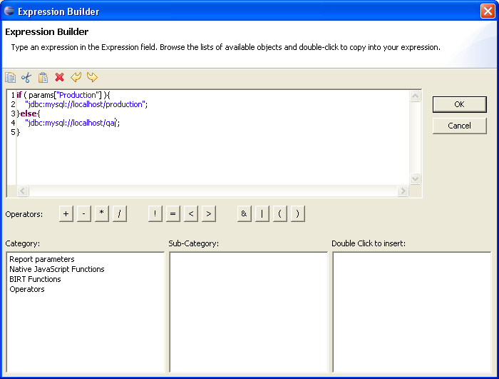
Expression Scripting

Slide 23
Expression Scripting - Locations
Creating the display value for a report item
Creating a computed field in Data Explorer
Specifying a filter condition
Specifying a data series for a chart
Specifying a map condition
Specifying a highlight condition
Specifying a group key
Specifying a hyperlink
Specifying the URI for an image
Specifying dynamic data in a text control

Slide 24
BIRT Event Model
Optional Java Event Handlers
JavaScript Event Handlers
Generation Phase
Presentation Phase
Report Level
Initialize
beforeFactory
afterFactory
Data Source/Set
beforeOpen
afterOpen
onFetch
beforeClose
afterClose
Report Level
Initialize
beforeRender
afterRender
Report Element
onRender
Report Element
onPrepare
onCreate

Slide 25
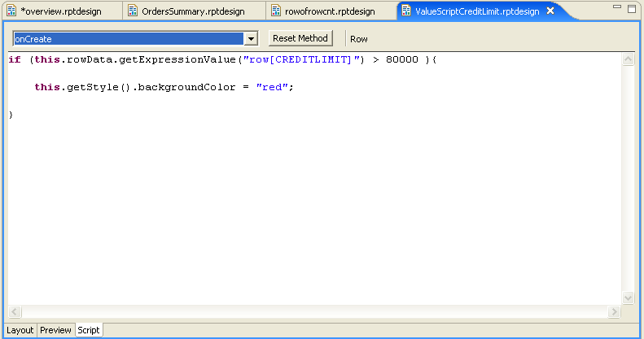
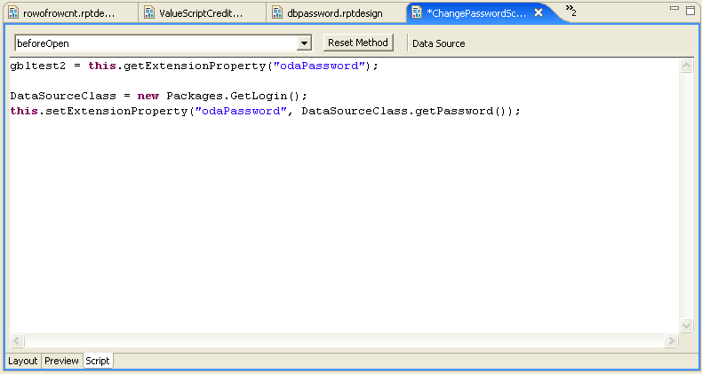
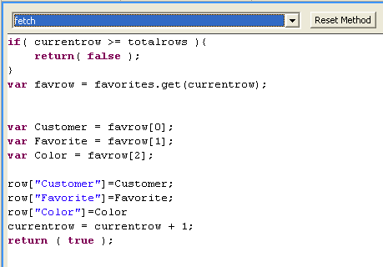
Element Scripting

Slide 26
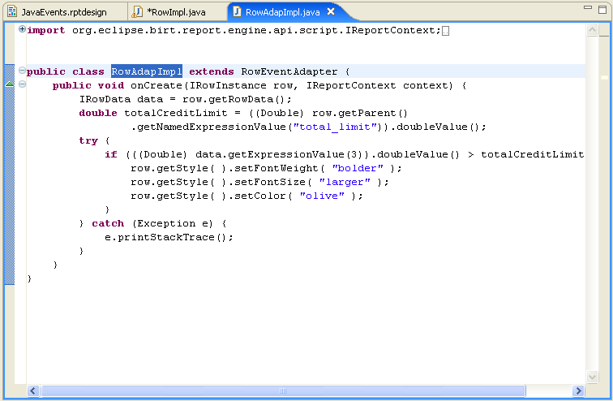
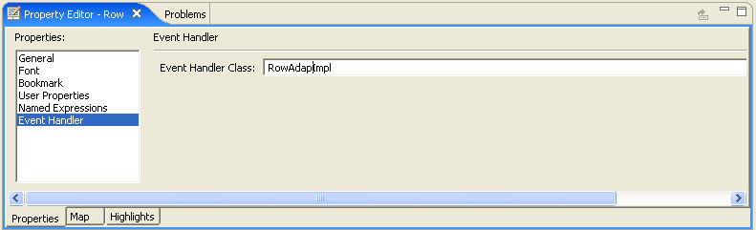
Element Event Handlers using Java
A set of Adapters are supplied that allow all event handlers to be built in Java.
The class is a property of the element.
Can be debugged with JDT using the BIRT Report Configuration.

Slide 27
BIRT Scripting Demo

Slide 28
Deploying BIRT Reports

Slide 29
Deploying Options
Deploy the Web Viewer Example
Deploy BIRT Under an RCP application
Build your own Servlet using the BIRT Engine
Use the BIRT Engine in your own Java Application (Discussed in APIs)

Slide 30
Deploying BIRT Reports
Paginated HTML, PDF, TOC, Bookmarks, CSV
Eclipse Plugin
J2EE AS
J2EE AS
Web Viewer
Web Viewer
Custom Servlet
Java Application
ReportEngine
ReportEngine
ReportEngine
ReportEngine
RptDesign
XML
Design File
RptDocument
Report
Document
RptDesign
XML
Design File
RptDocument
Report
Document
RptDesign
XML
Design File
RptDocument
Report
Document

Slide 31
BIRT Web Application
Generate report and return as PDF or HTML.
Supports Paginated HTML.
Export to CSV.
Retrieves Images and Chart Output.
Supports TOC and Bookmark Functionality.
Parameter Entry.

Slide 32
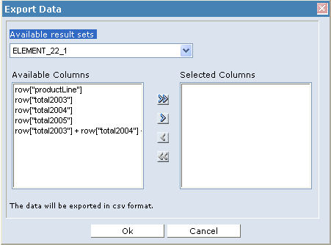
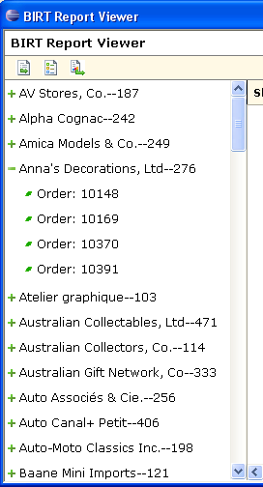
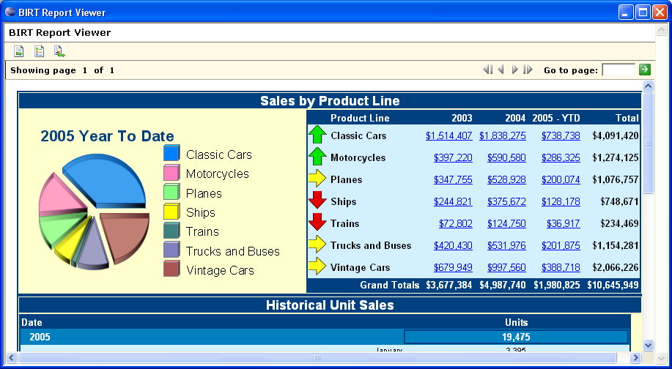
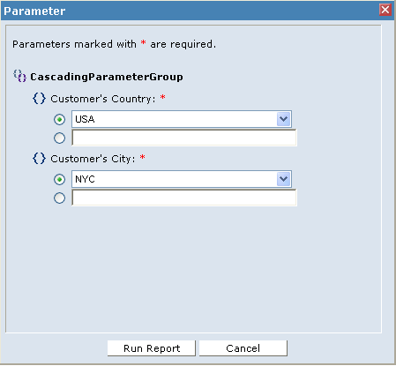
BIRT Viewer

Slide 33
BIRT Deployment Examples Demo

Slide 34
BIRT APIs

Slide 35
BIRT APIs
Report Engine API – Loads and executes design files.
Design Engine API – Creates and modifies report designs.
Charting API – Builds and renders charts.

Slide 36
Report Engine API
Used to integrate run-time portion of BIRT into your application.
Used to discover and set parameters.
Run a report and output PDF/HTML.
Combine or Split Run and Render Task
Save to Intermediate format.
Extract data.
Fetch an image or chart for a report.
2.0 Engine supports additional features for paging, cascaded and dynamic parameters, etc.
Example in the runtime download.

Slide 37
Design Engine API
Create and modify report designs.
Create and delete report elements..
Put report elements into slots.
Retrieve metadata from report elements, properties and slots
Undo/Redo.
Semantic Checks on report designs.

Slide 38
BIRT Chart Engine API
Stand Alone Chart Generator
Does not require the use of the Chart User Interface
Does not require the use of the Report Engine API
Data is provided in a static data structure
  When Charts render in Reports, Report Engine builds static structure from the specified ODA data and creates the static structure
  Charts running stand-alone require a data feed
    org.eclipse.birt.chart.datafeed-Custom User Data Set Interface
    org.eclipse.birt.chart.model.data-Interfaces defines data structure
JavaScript events support addition of custom business logic

Slide 39
Extension Points

Slide 40
BIRT Extensions Points
BIRT is not just a tool but a framework.
Predominant Extension Points.
  Emitter – Used to create additional output formats.
  ODA – DTP – Used to add customized Data Source Drivers
  Report Item – Used to extend the Palette with additional items.
  Chart Types – Used to add or extend chart types

Slide 41
BIRT API Demo

Slide 42
More on BIRT
www.eclipse.org/birt
www.eclipse.org/newsportal/thread.php?group=eclipse.birt
Source code for examples will be posted to the Eclipse site after the conference

Slide 43
Questions?

